Slide 1
PRESENTATION ON BANK ACCOUNT MANAGEMENT SYSTEM
ROLL NO: 2200290140087 Presentation-2
SUPERVISOR: DR. AMIT KUMAR
By : MANSI PANWAR

Slide 2
ABSTRACT
The Bank Account Management System is an application for maintaining a person's account in a bank. In this project I tried to show the working of a banking account system and cover the basic functionality of a Bank Account Management System. To develop a project for solving financial applications of a customer in banking environment in order to nurture the needs of an end banking user by providing various ways to perform banking tasks. Also, to enable the user’s work space to have additional functionalities which are not provided under a conventional banking project.
The Bank Account Management System undertaken as a project is based on relevant technologies. The main aim of this project is to develop software for Bank Account Management System. This project has been developed to carry out the processes easily and quickly, which is not possible with the manuals systems, which are overcome by this software. This project is developed using Java language. Creating and managing requirements is a challenge of IT, systems and product development projects or indeed for any activity where you have to manage a contractual relationship. Organization need to effectively define and manage requirements to ensure they are meeting needs of the customer, while proving compliance and staying on the schedule and within budget.
The impact of a poorly expressed requirement can bring a business out of compliance or even cause injury or death. Requirements definition and management is an activity that can deliver a high, fast return on investment. The project analyzes the system requirements and then comes up with the requirements specifications. It studies other related systems and then come up with system specifications. The system is then designed in accordance with specifications to satisfy the requirements. The system design is then implemented with Java. The system is designed as an interactive and content management system. The content management system deals with data entry, validation confirm and updating whiles the interactive system deals with system interaction with the administration and users. Thus, above features of this project will save transaction time and therefore increase the efficiency of the system

Slide 3
TABLE OF CONTENTS
1. Introduction
2. Project Objective
3. Research Methodology
4. Project Outcome
5. Proposed Time Duration
6. References

Slide 4
INTRODUCTION
The “Bank Account Management System” project is a model Internet Banking Site. This site enables the customers to perform the basic banking transactions by sitting at their office or at homes through PC or laptop. The system provides the access to the customer to create an account, deposit/withdraw the cash from his account, also to view reports of all accounts present. The customers can access the banks website for viewing their Account details and perform the transactions on account as per their requirements. With Internet Banking, the brick and mortar structure of the traditional banking gets converted into a click and portal model, thereby giving a concept of virtual banking a real shape. Thus, today's banking is no longer confined to branches. E-banking facilitates banking transactions by customers round the clock globally.
The primary aim of this “Bank Account Management System” is to provide an improved design methodology, which envisages the future expansion, and modification, which is necessary for a core sector like banking. This necessitates the design to be expandable and modifiable and so a modular approach is used in developing the application software.
Bank is the place where customers feel the sense of safety for their property. In the bank, customers deposit and withdraw their money. Transaction of money also is a part where customer takes shelter of the bank. Now to keep the belief and trust of customers, there is the positive need for management of the bank, which can handle all this with comfort and ease.
Smooth and efficient management affects the satisfaction of the customers and staff members, indirectly. And of course, it encourages management committee in taking some needed decision for future enhancement of the bank. Now a day’s, managing a bank is tedious job up to certain limit. So software that reduces the work is essential. Also, today’s world is a genuine computer world and is getting faster and faster day-by-day. Thus, considering above necessities, the software for bank management has become necessary which would be useful in managing the bank more efficiently.

Slide 5
OBJECTIVES
Account Creation and Maintenance
Transaction Processing
Balance Management
Security and Authentication
Interest and Fee Calculation
Customer Service and Support
Accessibility and Usability

Slide 6
REQUIREMENTS:
SYSTEM REQUIREMENT:
HARDWARE REQUIREMENTS:
Windows 7 or higher;
I3 processor or higher;
8GB RAM or higher;
100 ROM or higher;
SOFTWARE REQUIREMENTS:
IDE- NETBEANS;
JAVA (CONCEPTS: AWT, SWING).
MySQL

Slide 7
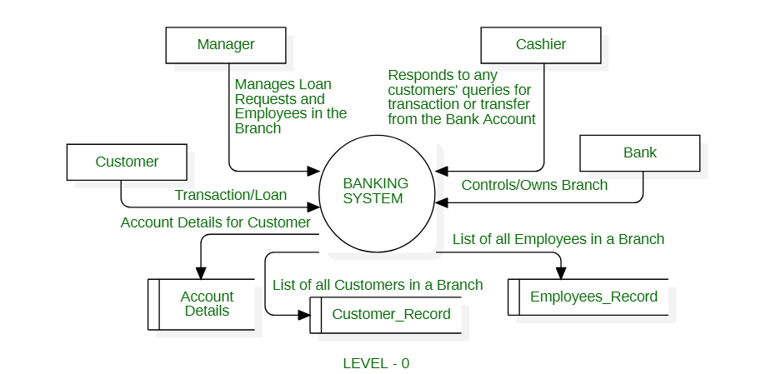
WORKING OF JAVA BRAINS

Slide 8
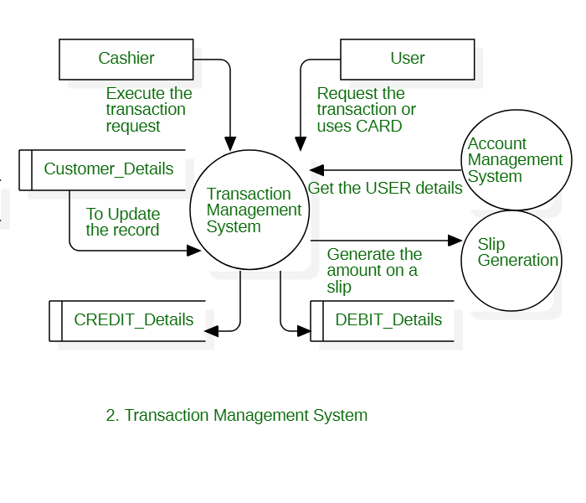

Slide 9
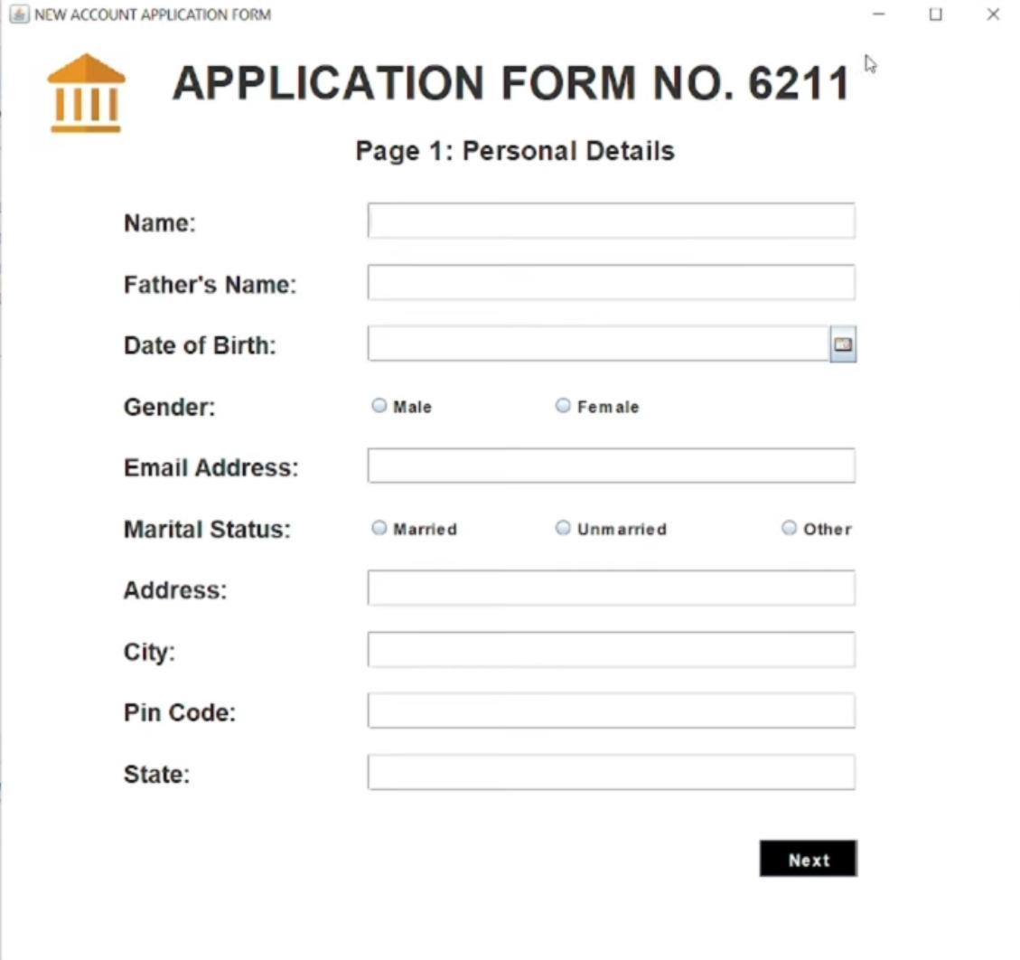
SCREENSHOTS: 1

Slide 10
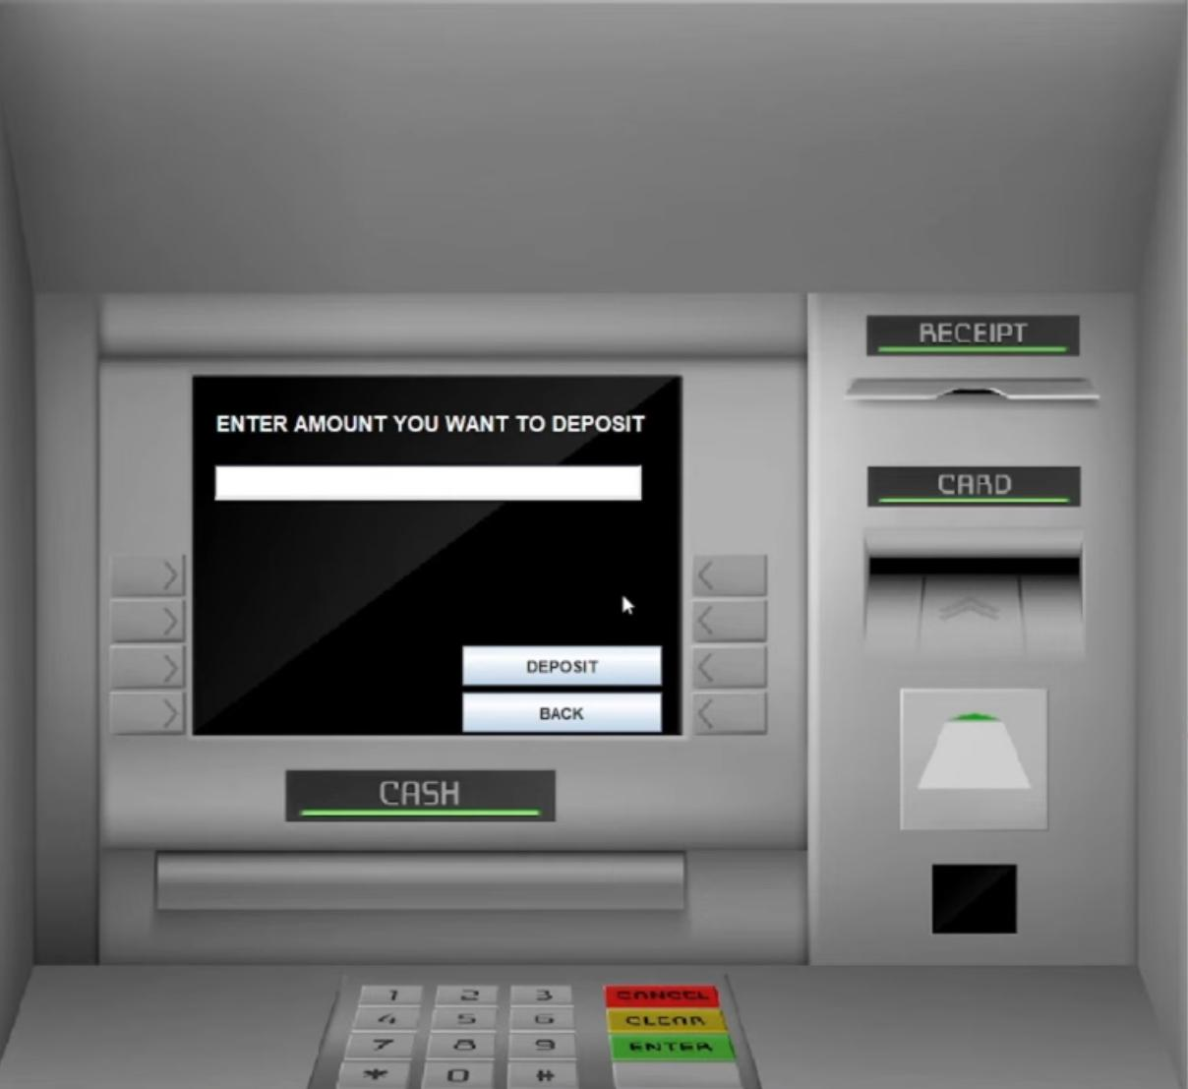
SCREENSHOTS: 2

Slide 11
PROJECT OUTCOMES
Increased Security and Fraud Prevention
Transparent and Accurate Financial Management.
Cost Savings
Improved Operational Efficiency
Enhanced Customer Experience
Scalability and Adaptability
Regulatory Compliance
Building Trust and Reputation
Integration with Digital Banking Solutions
Data-Driven Insights

Slide 12
THANK YOU!

