Slide 1
PROJECT PRESENTATION ON ELECTRICITY BILLING SYSTEM
TEAM MEMBERS
Ritik Tyagi
Shivani Sharma

Slide 2

INTRODUCTION
Electricity billing System With advanced algorithms, the system accurately calculates electricity usage based on meter readings, tariff rates, and any applicable surcharges or discounts.
Generate professional invoices and detailed billing statements effortlessly, providing customers with transparent insights into their energy consumption and charges.

Slide 3


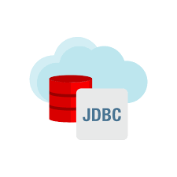
MySQL is an open-source relational database management system (RDBMS) that is widely used for building and managing databases in various applications.
Java is a versatile and robust programming language known for its platform independence and extensive ecosystem of libraries and frameworks.
JSP (JavaServer Pages) is a technology that enables the creation of dynamic web pages by embedding Java code into HTML. It simplifies the development of web applications by allowing seamless integration of Java code with HTML for generating dynamic content.

Slide 4
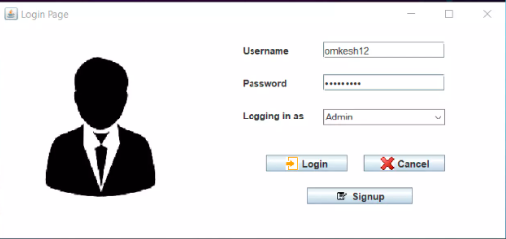
CUSTOMER LOGIN PAGE

Slide 5
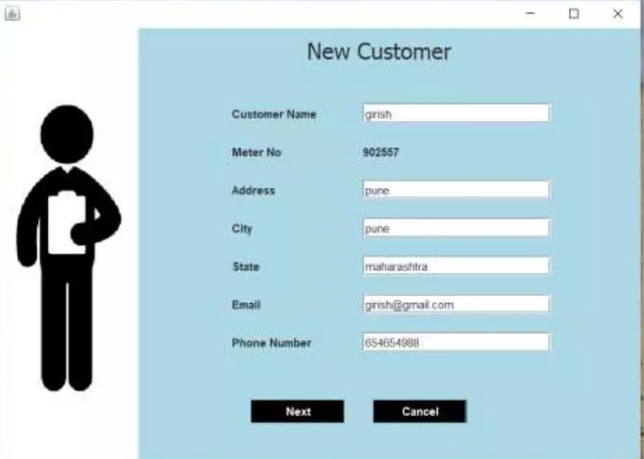
ADD NEW CUSTOMER

Slide 6
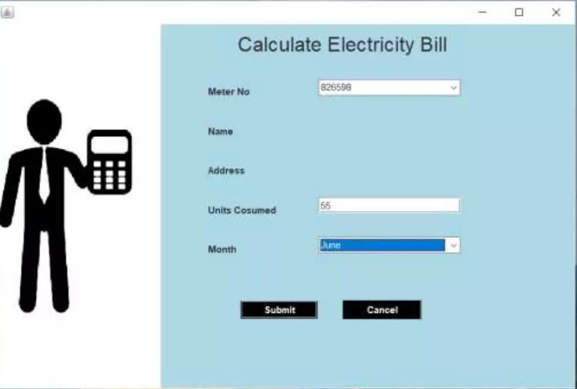
CALCULATE BILL

Slide 7
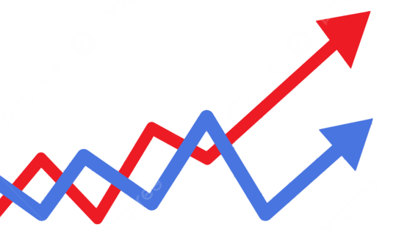
MODULES

Slide 8
PROJECT SCHEDULE

Slide 9
THANK YOU!

