Slide 1
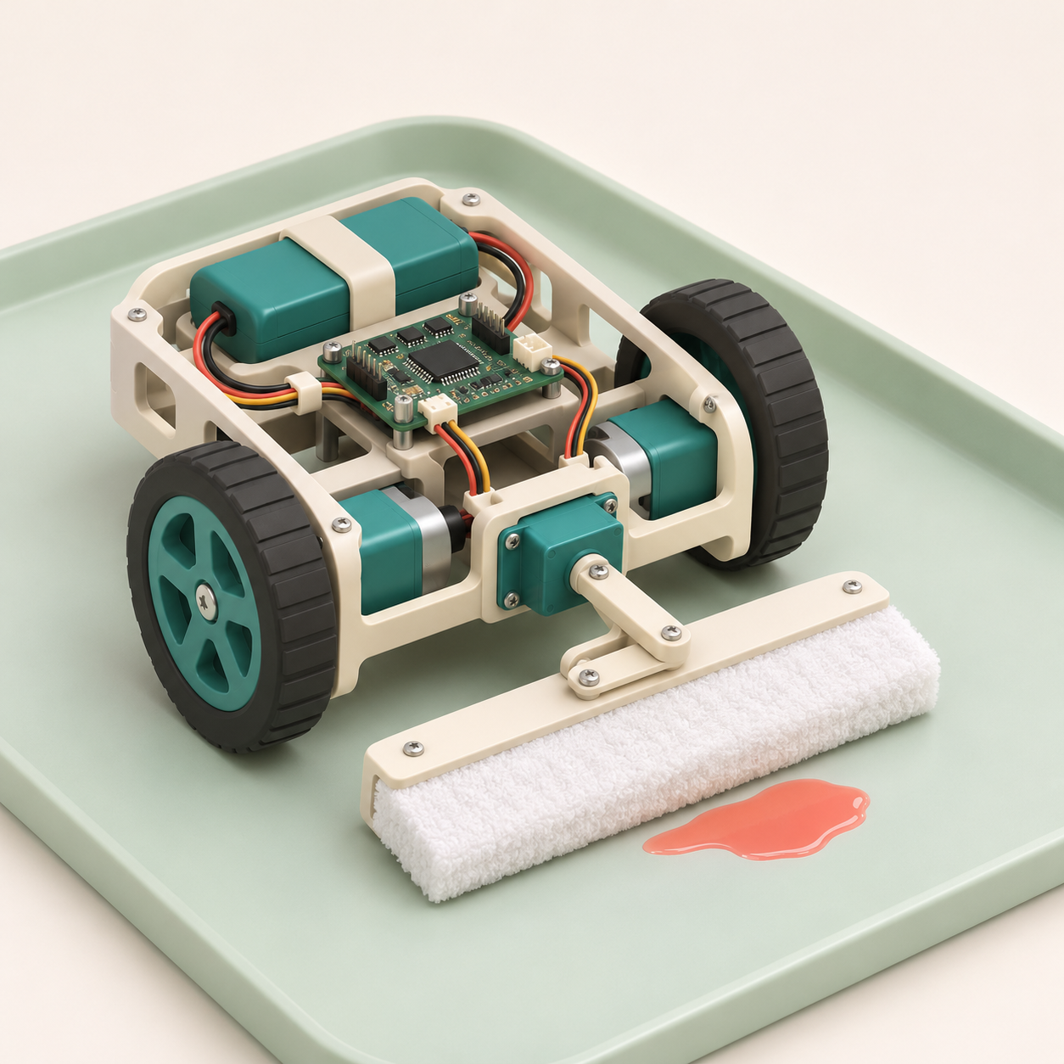
natHacks 2026
BioGuard
AI-powered cleanup for
simulated blood spills
Plan around contamination.
Clean, recheck and adapt.
Healthcare & Accessibility
Concept illustration
BioGuard
01
Notes:
TIMED PITCH: 0:00–0:15 (15 seconds).
Seven main slides target 4:25 total, leaving 35 seconds before the five-minute limit. Rehearse with a timer. Slides 8–10 are hidden Q&A appendices.
SPEAKER SCRIPT
BioGuard is an AI-powered robot concept for simulated blood-spill cleanup. We focus on preventing visible residue from spreading while the robot cleans, checks its work and returns for a fresh pad.
TECHNICAL BACKUP AND SOURCES
Pitch: BioGuard explores whether a small robot can clean a simulated spill while limiting transfer into a protected clean zone. This is a simulation-only prototype proposal. The Handbook confirms a 64-hour competition, Nov 6 at 7 PM to Nov 9 at 11 AM.
Source: user brief, November 6, 2026. Proposed concept and implementation plan. No prototype performance results supplied. Handbook verified: nh26 Hacker Handbook.pdf, supplied by the user.
Image: AI-generated BioGuard concept using the built-in image generation tool. Illustrative hardware only, not a photograph or evidence of a completed prototype.

Slide 2
The spill is only part of the problem
A contaminated pad can
carry residue into clean areas.
What can go wrong
What BioGuard changes
A coverage route crosses the spill,
then returns through a clean zone.
The planner tracks contamination
and constrains the return route.
BioGuard
02
Notes:
TIMED PITCH: 0:15–0:40 (25 seconds).
Seven main slides target 4:25 total, leaving 35 seconds before the five-minute limit. Rehearse with a timer. Slides 8–10 are hidden Q&A appendices.
SPEAKER SCRIPT
Cleaning can create a second problem: a contaminated pad or wheel can carry residue into a clean area. A normal coverage route does not account for that change. BioGuard adds contamination state to the planning problem, so the route depends on what the robot has touched.
TECHNICAL BACKUP AND SOURCES
This slide describes an engineering risk scenario, not a validated claim about a deployed product. The hackathon demonstration uses a nonhazardous colored liquid on a contained test surface. We compare route behavior and visible transfer.
Source: user brief, November 6, 2026. Proposed concept and implementation plan. No prototype performance results supplied. Handbook verified: nh26 Hacker Handbook.pdf, supplied by the user.

Slide 3
A route that accounts for contamination
Simulated spill
Protected
clean zone
Track the contact state
Mark the spill and protected zones.
Keep wheels outside the spill where possible.
Route the dirty pad to a service point.
Cleaning edge
Dirty return corridor
Pad-change point
No feasible route? Pause.
Conceptual route constraint
BioGuard
03
Notes:
TIMED PITCH: 0:40–1:20 (40 seconds).
Seven main slides target 4:25 total, leaving 35 seconds before the five-minute limit. Rehearse with a timer. Slides 8–10 are hidden Q&A appendices.
SPEAKER SCRIPT
We map the spill and mark protected clean zones. The planner accounts for the robot footprint and keeps wheels outside the spill wherever possible. Once the pad contacts the spill, its state changes to dirty. The return route must stay within a designated corridor to the pad-change point. If that route is blocked or uncertain, the robot pauses for intervention. This diagram shows the constraint we want to demonstrate.
TECHNICAL BACKUP AND SOURCES
Planner design: maintain a grid with clean, spill, cleaned-but-unverified and forbidden states. Inflate masks by robot footprint and localization uncertainty. Use A* for transit with hard protected-zone exclusions and a coverage sweep for the active patch. Track pad state as clean or dirty. A pad that contacted the spill cannot traverse protected clean zones. The cleaning head should reach the spill while wheels remain outside whenever possible. A contaminated wheel requires an operator reset rather than an unverified software workaround.
Source: user brief, November 6, 2026. Proposed concept and implementation plan. No prototype performance results supplied. Handbook verified: nh26 Hacker Handbook.pdf, supplied by the user.
The editable diagram is a conceptual spatial constraint, not a measured route or a scale drawing. The cleaning edge marks where the pad contacts the spill while the wheel footprint remains outside where feasible. Protected area remains excluded from dirty-pad transit.

Slide 4
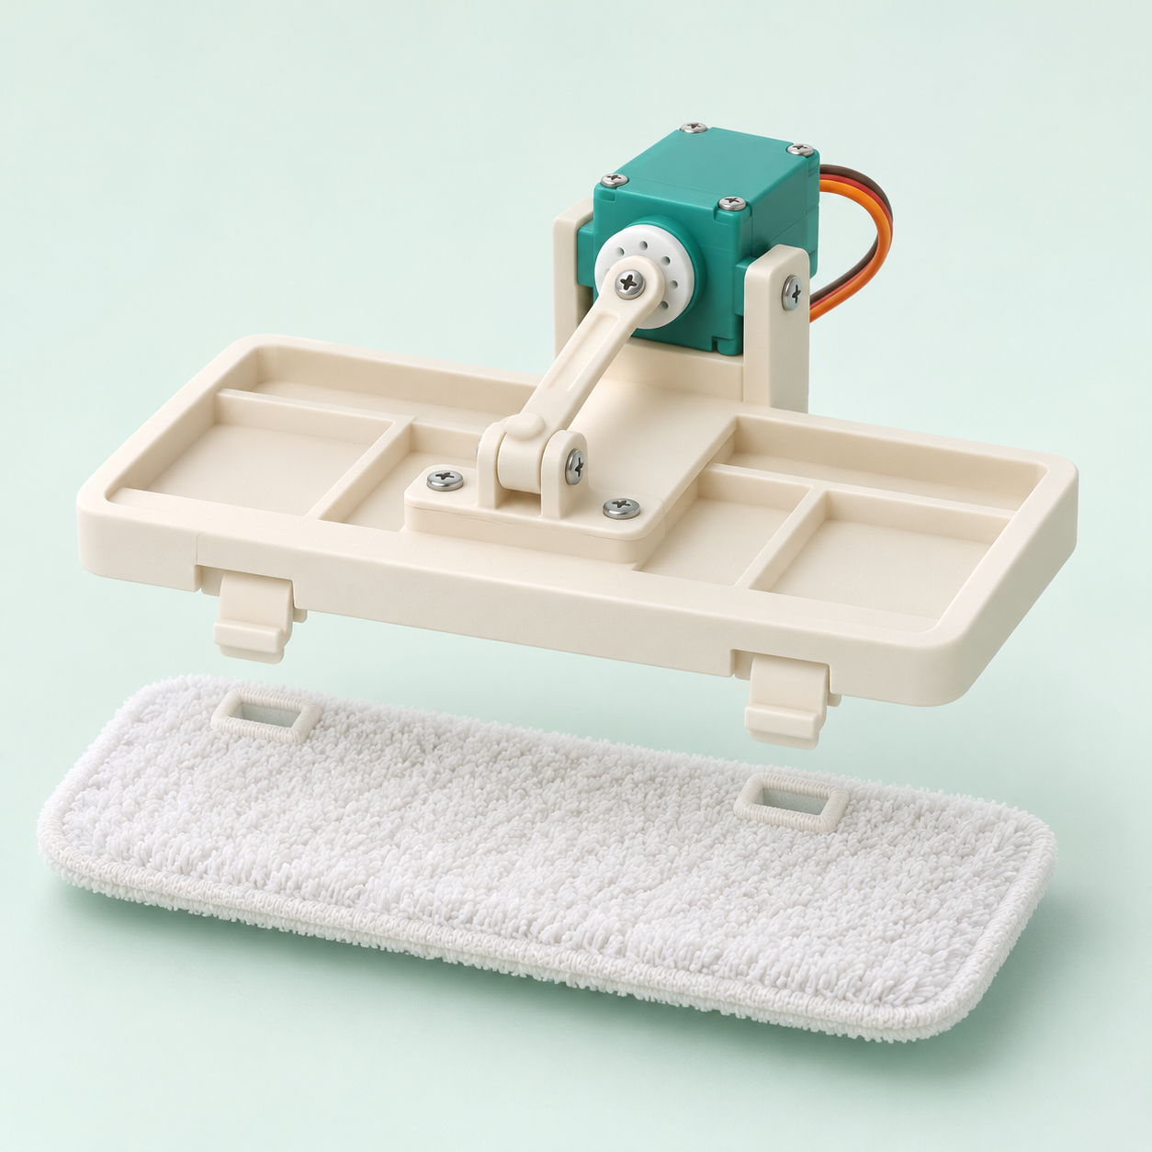
Adaptive cleaning with a replaceable pad
Clean, recheck, adapt
A servo lifts the pad for a new image.
Repeat or slow down if residue remains.
Pad swaps and motor control
Manual pad swap for the MVP.
Encoder PID, a watchdog and a physical
stop control motion.
Cleaning-head concept illustration
BioGuard
04
Notes:
TIMED PITCH: 1:20–2:05 (45 seconds).
Seven main slides target 4:25 total, leaving 35 seconds before the five-minute limit. Rehearse with a timer. Slides 8–10 are hidden Q&A appendices.
SPEAKER SCRIPT
The cleaning loop uses short passes. A servo lifts the pad so the camera can inspect the surface again. If visible residue remains, the controller can slow down or repeat, with a retry limit. The MVP uses a clip-in pad that an operator replaces. Encoders support motor-speed control, while a watchdog and physical stop halt motion. These images are design concepts. Our demonstration uses colored water, and visual verification measures residue removal, not sterility.
TECHNICAL BACKUP AND SOURCES
Proposed hardware: existing differential-drive chassis, motor driver, encoder-equipped DC motors, ESP32 or Arduino, low-voltage battery and servo-operated pad lift. Host sends bounded linear and angular velocity commands over serial. The microcontroller enforces a watchdog and speed limits. The MVP uses manual pad replacement so the team can focus on planning and closed-loop cleaning. Operators reset any wheel contamination in the simulation.
Source: user brief, November 6, 2026. Proposed concept and implementation plan. No prototype performance results supplied. Handbook verified: nh26 Hacker Handbook.pdf, supplied by the user.
Image: AI-generated cleaning-head concept using the built-in image generation tool. Mechanical details illustrate the proposal and require prototyping. Automatic exchange remains outside the MVP.
Technical backup from the cleaning loop slide:
Use a fixed overhead camera with controlled lighting and fiducials for calibration. OpenCV produces a baseline color mask. If time and labeled images permit, add a small segmentation model. Compare remaining mask area in the same region before and after cleaning. Tune speed and pass count, with a strict maximum number of retries. Visual disappearance cannot establish disinfection, biological safety or clinical readiness.
Source: user brief, November 6, 2026. Proposed concept and implementation plan. No prototype performance results supplied. Handbook verified: nh26 Hacker Handbook.pdf, supplied by the user.

Slide 5
One perception-to-motion loop
Camera
Frames + calibration
Python + OpenCV
Spill mask + robot pose
Planner + state machine
A* transit + coverage
Robot + cleaning head
Encoders + servo lift
ESP32 / Arduino
Speed PID + watchdog
Serial commands
Velocity + pad state
A new camera frame checks the result after each pass.
BioGuard
05
Notes:
TIMED PITCH: 2:05–2:40 (35 seconds).
Seven main slides target 4:25 total, leaving 35 seconds before the five-minute limit. Rehearse with a timer. Slides 8–10 are hidden Q&A appendices.
SPEAKER SCRIPT
An overhead camera sends frames to Python and OpenCV for spill segmentation and robot tracking. A state machine combines A-star transit planning with cleaning coverage. Serial commands go to an ESP32 or Arduino, which handles motor PID, the pad servo and the watchdog. A new frame checks each pass. A learned segmentation model is an optional extension after the baseline works.
TECHNICAL BACKUP AND SOURCES
All architecture objects are editable. Data flow goes left to right across the top, down to serial communication, then right to left across the bottom. Camera frames feed the next perception cycle. Python hosts perception, grid planning, finite-state control and CSV experiment logs. OpenCV and NumPy are sufficient for the baseline. An optional compact learned segmentation model must earn its place through a same-scene comparison. Git records changes. A local status view can show masks, paths and pass counts without requiring a separate frontend.
Source: user brief, November 6, 2026. Proposed concept and implementation plan. No prototype performance results supplied. Handbook verified: nh26 Hacker Handbook.pdf, supplied by the user.
AI scope: baseline perception uses OpenCV segmentation, with search-based planning and adaptive control. A compact learned segmentation model is an optional extension, contingent on data and measurable benefit. Do not imply an implemented trained model.

Slide 6
A 64-hour MVP with a narrow scope
Nov 6, 7 PM to Nov 9, 11 AM
00–08 h
Calibrate
Camera, chassis and stop
08–24 h
Integrate
Perception and motion
24–40 h
Constrain
Coverage path and pad state
40–54 h
Test
Paired trials and visual verification
54–64 h
Submit
Freeze, document and rehearse
MVP: one arena, one surface, one spill surrogate. Manual pad changes.
BioGuard
06
Notes:
TIMED PITCH: 2:40–3:15 (35 seconds).
Seven main slides target 4:25 total, leaving 35 seconds before the five-minute limit. Rehearse with a timer. Slides 8–10 are hidden Q&A appendices.
SPEAKER SCRIPT
Our 64-hour MVP is deliberately narrow: one arena, one surface and one spill surrogate. We first calibrate, then integrate motion and perception, add contamination rules, and run paired trials. The final ten hours cover documentation, submission and rehearsal. Manual pad changes keep the build achievable. After the hackathon, we would test more surfaces and develop automatic pad exchange.
TECHNICAL BACKUP AND SOURCES
Source: nh26 Hacker Handbook.pdf, physical PDF pages 4, 8 and 13 (printed pages 2, 6 and 11). Official 64-hour competition: Nov 6, 7 PM to Nov 9, 11 AM. Submission due Nov 9 at 11 AM. Presentation and judging noon to 3 PM, break 3–4 PM, finalist showcase and closing 4–6 PM. Relative work phases are BioGuard’s proposed engineering plan. The handbook labels certain deadlines MDT despite Edmonton observing standard time on these dates. Slide uses the published clock times without converting them. Confirm timezone wording with organizers. All coding and prototyping must occur during natHacks. Pre-event planning is allowed.
Scope backup:
Scope assumes a small team with access to a working chassis, camera, controller and cleaning-head materials at kickoff. If hardware integration slips, keep the planning comparison in simulation and demonstrate low-level motor control separately. Disclose that fallback explicitly to judges. Do not claim end-to-end autonomy unless the complete physical loop runs.
Source: user brief, November 6, 2026. Proposed concept and implementation plan. No prototype performance results supplied. Handbook verified: nh26 Hacker Handbook.pdf, supplied by the user.

Slide 7
The demo measures visible transfer
Same spill. Two routes.
Run a naive coverage baseline and BioGuard
on reset copies of the same scene.
Show the evidence
Proposed success targets
Path overlay and pad state
Before/after images
Time, retries and interventions
≥90% visible spill-area reduction
No detected transfer into
the protected zone
BioGuard
07
Notes:
TIMED PITCH: 3:15–4:25 (70 seconds). Includes 45 seconds for the live demo or backup clip. If the demo stalls, stop it at 45 seconds and close. State only actual observed results.
Seven main slides target 4:25 total, leaving 35 seconds before the five-minute limit. Rehearse with a timer. Slides 8–10 are hidden Q&A appendices.
SPEAKER SCRIPT
Our demo compares a baseline route with BioGuard on the same reset scene. Watch the protected boundary, pad state and before-and-after image. [RUN THE 45-SECOND DEMO.] Our proposed targets are at least ninety percent visible-area reduction and no detected transfer into the protected zone. BioGuard makes contamination part of the route, then checks the outcome.
TECHNICAL BACKUP AND SOURCES
Targets are proposed acceptance criteria, not measured results. Compute reduction as 1 minus final spill-mask area divided by initial area, under fixed camera and lighting conditions. Quantify visible transfer in a marked protected zone using the same segmentation approach. Report the detection threshold and image noise floor. Use at least three paired trials if time permits, reset the surface and pad each time, and show all trial outcomes rather than selecting a best run. Route time must include retries.
Source: user brief, November 6, 2026. Proposed concept and implementation plan. No prototype performance results supplied. Handbook verified: nh26 Hacker Handbook.pdf, supplied by the user.
Closing line: BioGuard makes contamination state part of the route, then checks the visible outcome.

Slide 8
A controlled simulation-only demonstration
Colored water on a contained test surface
Operator safeguards
Evidence boundaries
Low speed and a physical stop
Pause on tracking loss or blocked routes
Reset pads and surface between trials
No blood or biological samples
No hazardous cleaning agents
Visual checks cannot certify sanitation
BioGuard / Q&A appendix
08
Notes:
Q&A APPENDIX: hidden from the main slide show. Open only during questions.
Demonstration boundary: nonhazardous surrogate only, on a contained surface away from electronics and public walkways. Use a physical stop and low speed. No clinical, infection-control or sterilization claims. These are BioGuard demonstration design choices, not verified quotations from the hackathon handbook. The Handbook prohibits unsafe behavior and property damage. Ask organizers about the specific demo setup.
Source: user brief, November 6, 2026. Proposed concept and implementation plan. No prototype performance results supplied. Handbook verified: nh26 Hacker Handbook.pdf, supplied by the user.
Appendix for Q&A. Handbook source: physical PDF page 7 (printed page 5), Conduct & Safety. Simulation-only choices on this slide are BioGuard design choices, not specific Handbook requirements.

Slide 9
Official rubric and planned evidence
CATEGORY
MAX
BIOGUARD EVIDENCE
Technical Execution & Problem-Solving
09
Perception, planning and motor integration
Prototype Functionality & Usability
09
Repeatable loop and clear operator controls
Creativity & Innovation
09
Pad-state constraints and return routing
Impact & Real-World Relevance
09
Visible transfer measured in simulation
Feasibility & Continuation Potential
09
Scoped MVP and a validation roadmap
Pitch & Demonstration
09
Clear demo and transparent results
Written Summary
5
Problem, approach and actual outcomes
Division-Specific Bonus
3
Team composition (SD) or reports (PPD)
68 points maximum, including up to 3 division-specific bonus points
BioGuard / Q&A appendix
09
Notes:
Q&A APPENDIX: hidden from the main slide show. Open only during questions.
Appendix for Q&A. Source: nh26 Hacker Handbook.pdf, physical PDF page 14 (printed page 12), Evaluation. Category names and maxima match the supplied Handbook. Sum: six categories at 10 points, written summary 5, division-specific bonus 3, maximum 68. Evidence descriptions are BioGuard’s planned evidence, not achieved results. SD means Standard Division. PPD means Problem Provider Division. The handbook links a full rubric, but the detailed scoring descriptors in that linked document were not supplied.

Slide 10
Submission and judging essentials
Five-minute pitch + demo
Required submission
Five minutes of Q&A follow.
Video must fit within the pitch time.
All team members attend unless excused.
Summary: up to 250 words
Project story: up to 600 words
Repository + README with run steps,
supporting materials and credits
Pre-event planning is allowed. Coding and prototyping happen during natHacks.
BioGuard / Q&A appendix
10
Notes:
Q&A APPENDIX: hidden from the main slide show. Open only during questions.
Appendix for team preparation and Q&A. Source: nh26 Hacker Handbook.pdf, physical PDF pages 5, 7, 12 and 13 (printed pages 3, 5, 10 and 11). Submit via the form shared on Discord by Nov 9 at 11 AM. Late submissions are not accepted. Code must be developed during the 64-hour event. Do not submit pre-event prototype work. This deck is planning material and must describe implementation status honestly. Only the team leader signs out borrowed hardware. Return all hardware in original condition by Nov 9 at 7 PM and report issues to the Hardware Desk. Standard Division teams have 4–6 members. The 3-point bonus is subject to division-specific rubric conditions and is not automatic.

