Slide 1

Music Store Management System

Slide 2

About Us :
P.Manohar :- Completed B.Tech in AI&DS
Linked in :- linkedin.com/in/manoharpagadala
2. K B V.Mani Kanta :- Completed B.Tech in CSE
Linked in :- Kurivella Bala Venkata Mani Kanta | LinkedIn
3. B.Santhosh :- Completed B.Tech in CSE
Linked in :- Santhosh Bonagiri | LinkedIn

Slide 3
Agenda:
Business Problem
Objective of the Project
Schema Diagram
Key Analysis Questions
Business Insights
Conclusion
Challenges Faced
Questions & Answers (Q&A)

Slide 4
Introduction:
The Music Store Management System is a SQL-based project that analyzes music store data to understand customer purchasing behavior and sales performance. Using SQL queries, the project identifies valuable insights such as top customers, popular music genres, and high-revenue locations. These insights help the business make better decisions and improve overall performance.

Slide 5
Objective of the Project:
Analyze the Music Store database using SQL.
Use SQL concepts like JOIN, GROUP BY, Aggregate Functions, CTEs, and Window Functions.
Convert raw data into meaningful business insights.
Understand customer behavior and sales trends.
Support better business decisions and growth.

Slide 6
Business Problem :
Large amount of sales data.
Difficult to identify top customers and trends.
Need to find high-revenue locations.
Need better business insights using SQL.

Slide 7
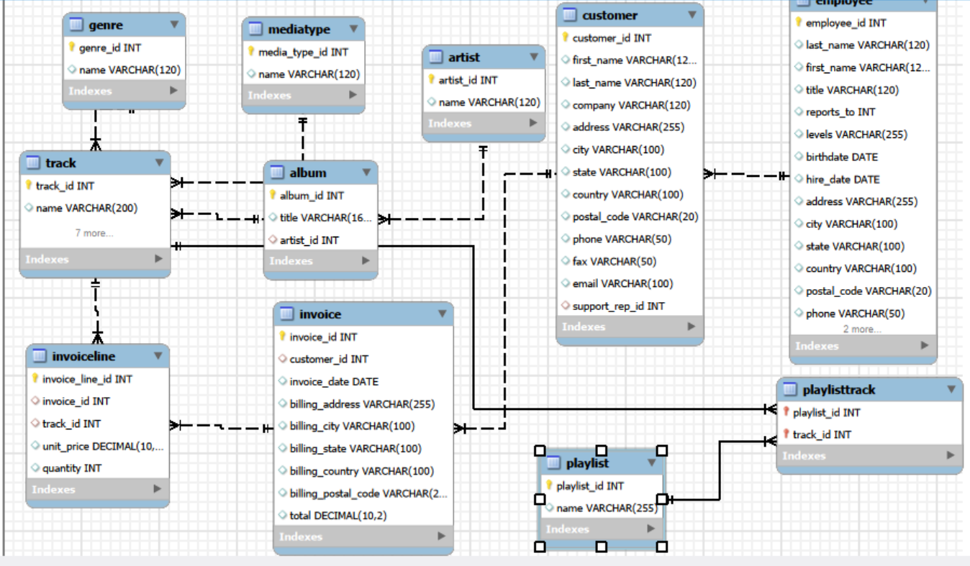
Schema Diagram :

Slide 8
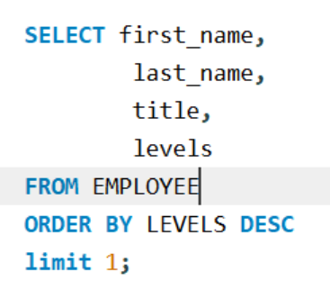

1. Who is the senior most employee based on job title?
Query :
Output :
Key Insight :-
Andrew Adams is the senior-most employee in the company, holding the position of General Manager (L6), which is the highest level in the organization.

Slide 9
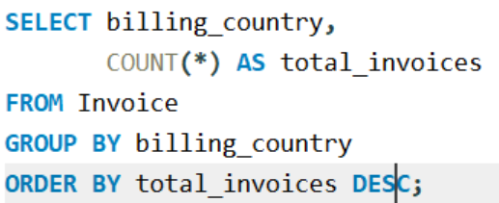
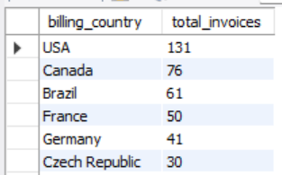
2. Which countries have the most Invoices?
Query :
Output :
Key Insight :-
The USA has the highest number of invoices (131), followed by Canada (76) and Brazil (61). This indicates that customers from these countries contribute the most transactions, making them the strongest markets for the music store.

Slide 10
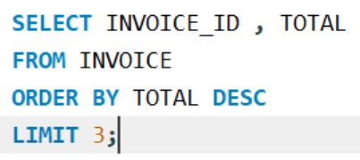
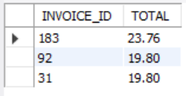
3. What are the top 3 values of total invoice?
Query :
Output :
Key Insight :-
The highest invoice value recorded is 23.76, followed by 19.80. This shows that a few customers made larger purchases compared to the average transaction, contributing more revenue to the music store.

Slide 11
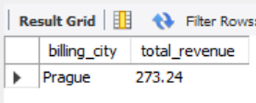
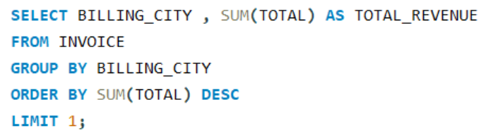
4. Which city has the best customers? - We would like to throw a promotional Music Festival in the city we made the most money. Write a query that returns one city that has the highest sum of invoice totals. Return both the city name & sum of all invoice totals
Query :
Output :
Key Insight :-
Prague generated the highest revenue with a total invoice value of 273.24. This indicates that customers in Prague contributed the most to the store's sales, making it a suitable location for promotional events such as a music festival.

Slide 12
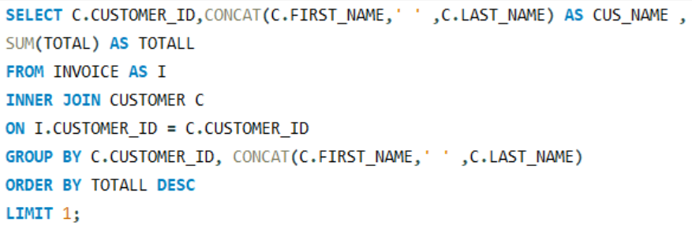

5. Who is the best customer? - The customer who has spent the most money will be declared the best customer. Write a query that returns the person who has spent the most money
Query :
Output :
Key Insight :-
František Wichterlová is the highest-spending customer, with a total purchase amount of 144.54. This indicates strong customer loyalty and a high level of engagement with the music store's products.

Slide 13
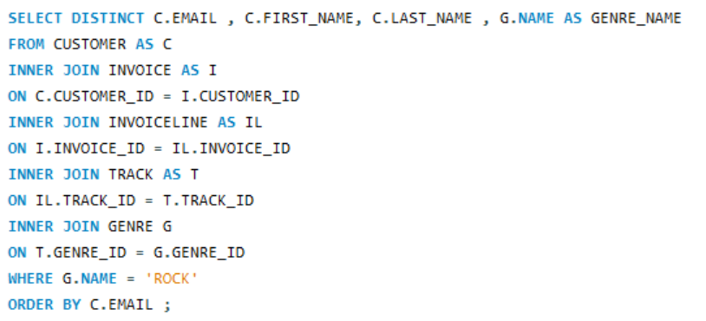
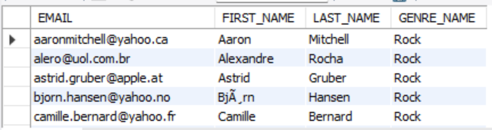
6. Write a query to return the email, first name, last name, & Genre of all Rock Music listeners. Return your list ordered alphabetically by email starting with A
Query :
Output :
Key Insight :-
The results show that customers from different countries have purchased Rock music, making Rock one of the most popular genres in the music store. This indicates a broad and diverse audience for Rock music across the customer base

Slide 14
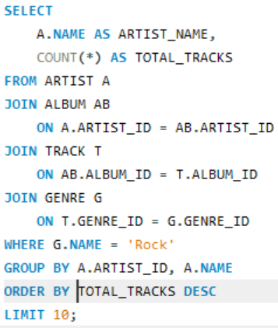
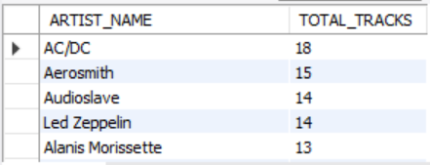
7. Let's invite the artists who have written the most rock music in our dataset. Write a query that returns the Artist name and total track count of the top 10 rock bands
Query :
Output :
Key Insight :-
AC/DC has the highest number of Rock tracks (18), followed by Aerosmith (15) and Audioslave and Led Zeppelin (14 each). This shows that these artists have a strong presence in the Rock genre and are among the most significant contributors to the music store's Rock music collection.

Slide 15
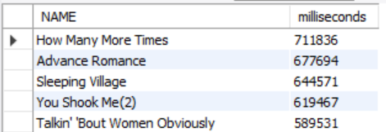
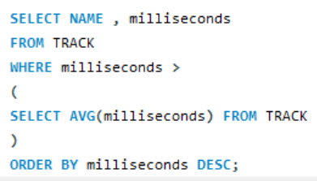
8. Return all the track names that have a song length longer than the average song length.- Return the Name and Milliseconds for each track. Order by the song length, with the longest songs listed first
Query :
Output :
Key Insight :-
Several tracks in the music store are significantly longer than the average song length. The longest track is "How Many More Times" with a duration of 711,836 milliseconds, indicating that the collection includes extended versions and long-form musical compositions preferred by certain listeners.

Slide 16
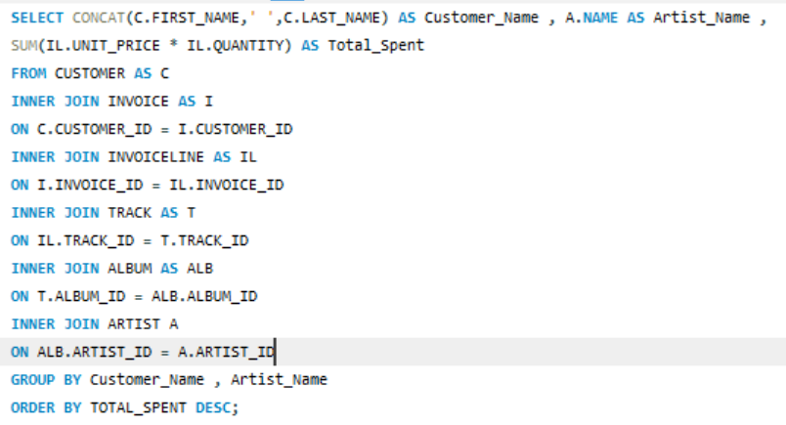
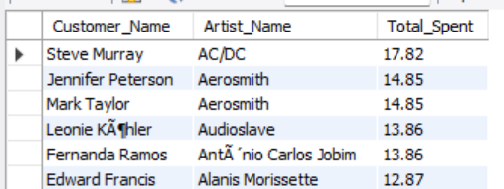
9. Find how much amount is spent by each customer on artists? Write a query to return customer name, artist name and total spent
Query :
Output :
Key Insight :-
The analysis shows that some customers have strong preferences for specific artists. Steve Murray spent the highest amount (17.82) on AC/DC, while several other customers also spent significantly on artists such as Aerosmith, Audioslave, and Alanis Morissette. This helps identify artist popularity and customer listening preferences

Slide 17
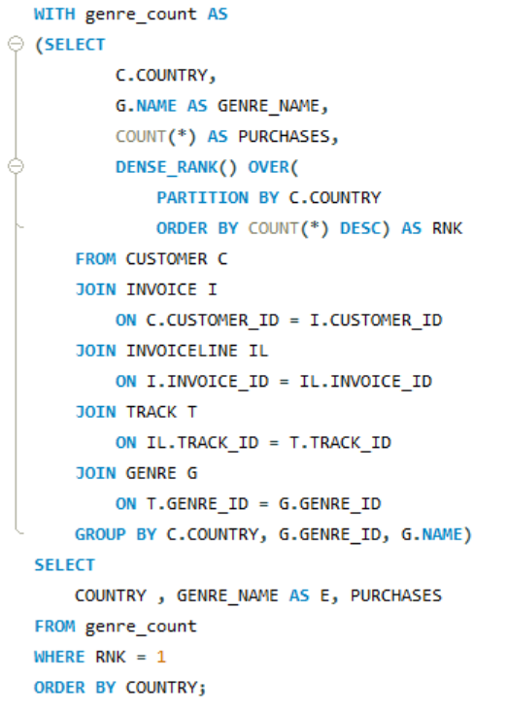
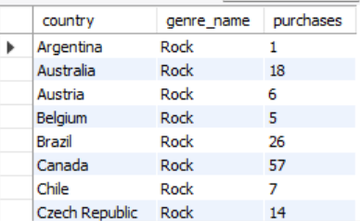
10. We want to find out the most popular music Genre for each country. We determine the most popular genre as the genre with the highest amount of purchases. Write a query that returns each country along with the top Genre. For countries where the maximum number of purchases is shared, return all Genres
Query :
Output :
Key Insight :-
The analysis shows that Rock is the most purchased genre in the majority of countries. Understanding genre preferences by country helps the company design region-specific marketing campaigns and improve customer engagement.

Slide 18
Business Insights:
Identified the top customers.
Found the most popular music genre.
Identified high-revenue countries and cities.
Analyzed customer purchasing behavior.
Generated insights for better business decisions

Slide 19
Conclusion:
Successfully analyzed the Music Store database using SQL.
Identified customer behavior and sales trends.
Found top customers, popular genres, and high-revenue locations.
Generated meaningful business insights.
Supported better business decisions and business growth.

Slide 20
Our Experience / Challenges Working
Improved our SQL query writing skills.
Learned to use JOINs, GROUP BY, CTEs, and Window Functions.
Faced challenges in writing complex SQL queries.
Debugged errors and optimized queries.
Gained practical experience in solving real-world business problems.

Slide 21

THANK YOU

