Slide 1

ENGINEERING BRIEF
Advanced Prompt Engineering
Building reliable, production-grade LLM systems through rigorous specification, context architecture, and automated evaluation.
Contract
Context
Tools
Eval Loop
Technical Architecture Series · Production AI Systems
Notes:
Welcome. Today we transition from viewing prompt engineering as creative wordsmithing to treating it as rigorous software system design. Across nine modules, we will examine task contracts, context partitioning, structured schemas, tool grounding, and systematic regression testing.

Slide 2
CORE ARCHITECTURE
Prompting is system design, not clever wording
Reliable prompts design the task, context, constraints, tools, and feedback loop together—optimizing behavior across varied inputs, not one impressive answer.
THE FRAGILE INTENT MODEL
SYSTEM DESIGN PARADIGM
Intuitive "Clever" Phrasing
Engineered Component Stack
Focuses on finding magic keywords, polite cajoling, or monolithic prompt blobs that work on one specific seed input but collapse across edge distributions.
Decouples execution into task definitions, ranked context, runtime constraints, tool interfaces, and automated post-generation validators.
❌ High variance across model revisions
Deterministic Schemas: Strict JSON outputs
❌ Latent failure modes hidden by single tests
Bounded Grounding: Isolated tools with strict fallback
❌ Unmaintainable prose with intertwined concerns
Distributional Testing: Benchmark sweeps across splits
Notes:
Clever phrasing creates brittle systems. Production reliability demands that we design the task, context, constraints, tools, and feedback loop together as an integrated system, optimizing for consistency across all inputs rather than a single impressive demo.

Slide 3
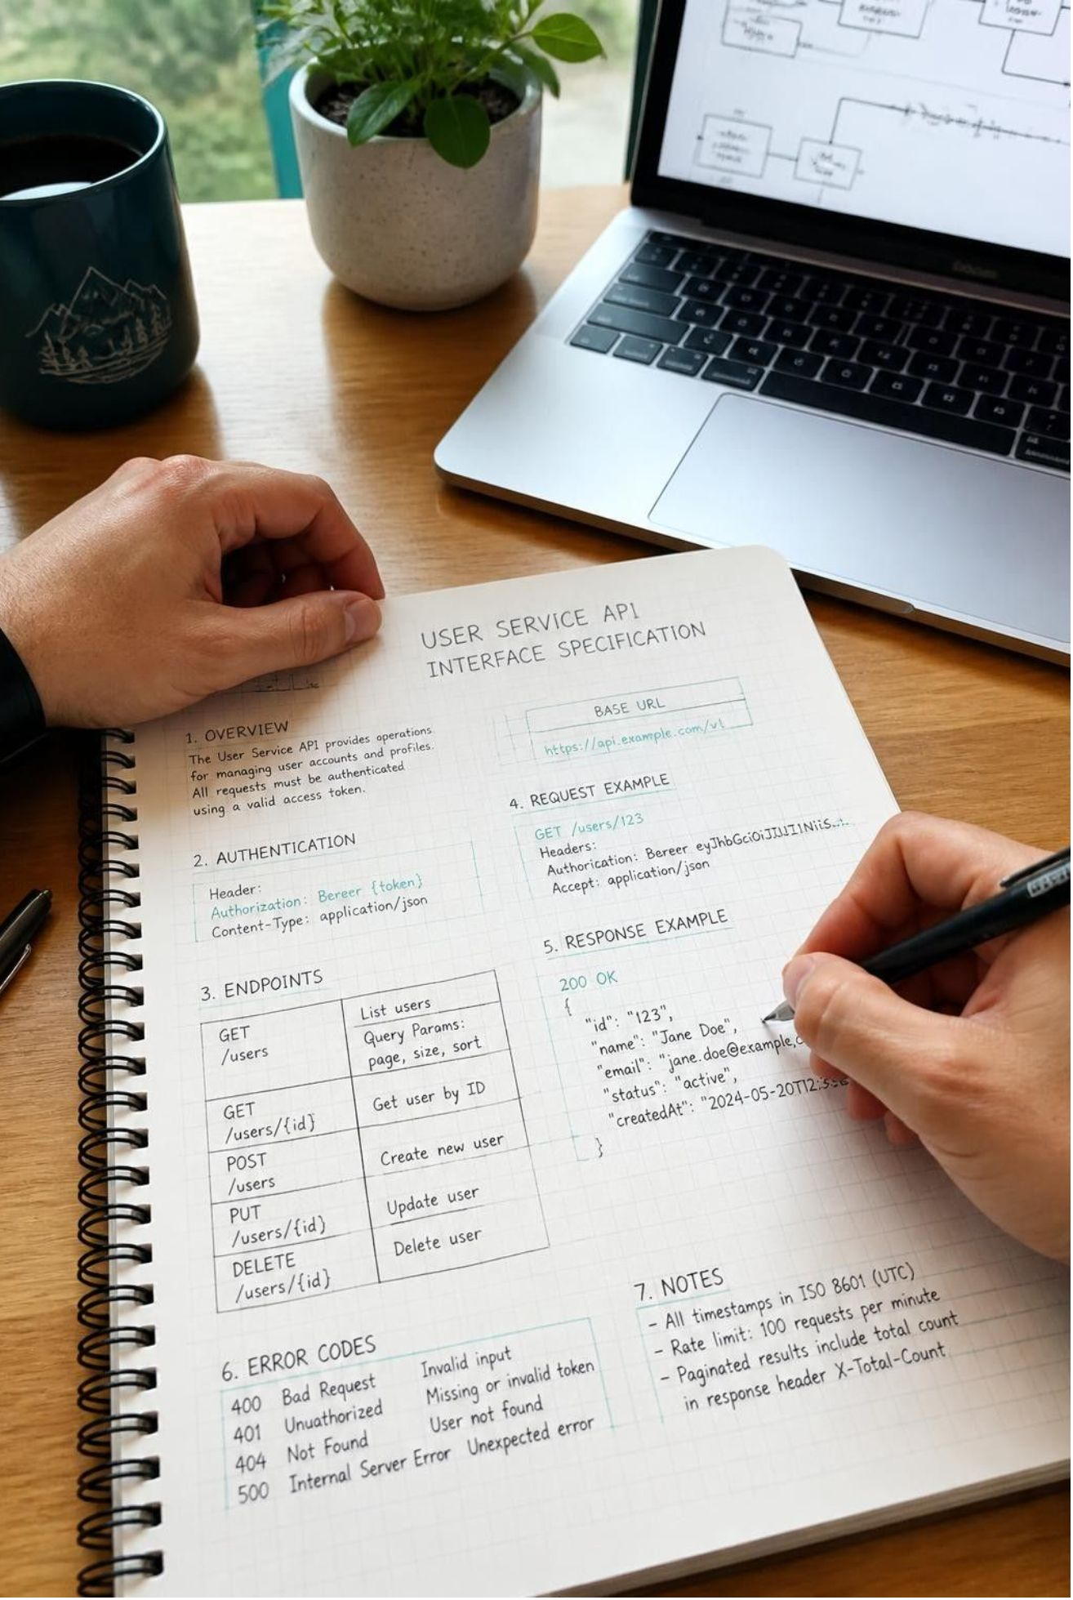
CONTRACT SPECIFICATION
Start with a precise task contract
Like API contracts, precise prompts define ambiguity; otherwise models guess probabilistically, causing silent regressions.
Explicit Objective
Before task material, define target transformation, intended consumer (human reviewer vs. parser), and acceptance gates.
Boundary Constraints
List negative constraints and hard failure conditions (e.g., forbidden keys, word bounds, required fallback formats).
Visible Ambiguity
If data is incomplete, require a typed diagnostic or uncertainty flag instead of hallucination.
Contract rule: Isolate system directives, reference context, few-shot examples, and output schemas in separate channels.
Notes:
A rigorous task contract establishes unambiguous expectations. Rather than letting the model guess during edge cases, we explicitly specify output requirements and force uncertainty to surface through structured diagnostic flags.

Slide 4
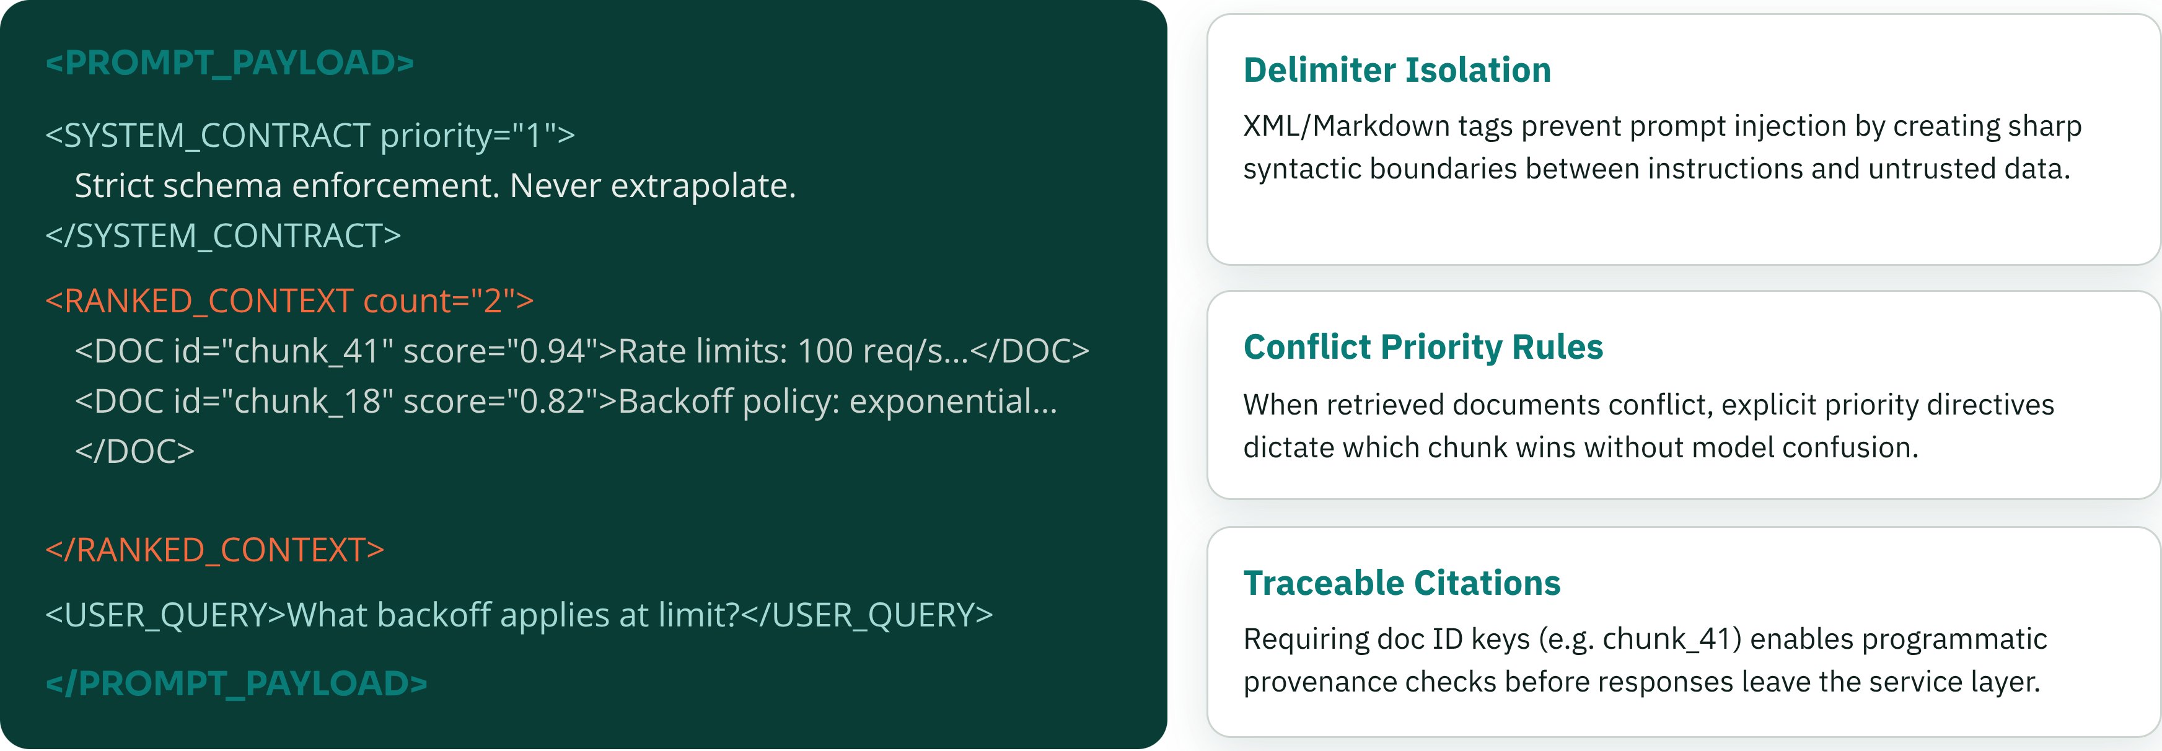
CONTEXT ARCHITECTURE
Use structured context to control complexity
Long contexts degrade model attention when presented as unstructured text. Structure incoming tokens with explicit tags, priority hierarchy, and citation keys.
Notes:
Structured delimiters such as XML tags isolate variables and context blocks from system directives. By ranking retrieval by relevance score and forcing chunk-level citations, we suppress context poisoning and hallucinated derivations.

Slide 5




COGNITIVE PATTERNS
Choose the right reasoning pattern
Single-turn inference often fails on high-depth problems. Select reasoning architectures based on latency budgets and validation requirements.
Plan-then-Execute
Critique & Revise
Branch & Vote
Decomposed Pipelines
Generate an ordered dependency tree before invoking any tools or writing answers.
A generator pass drafts the solution; a separate critic agent validates against constraints.
Sample multiple reasoning trajectories concurrently and select through consensus or scoring.
Break massive tasks into distinct, isolated prompts linked by programmatic validation hooks.
Best for: Multi-step migration, multi-table queries, deterministic sequences.
Best for: Code synthesis, regulatory compliance, zero-defect drafting.
Best for: Ambiguous entity linking, algorithmic problems, high-variance domains.
Best for: Production pipelines requiring sub-task error isolation.
Notes:
Reasoning isn't one-size-fits-all. Match the pattern to the workload: plan-then-execute for complex workflows, critique-and-revise when quality trumps speed, and branching self-consistency when dealing with high-uncertainty problem spaces.

Slide 6
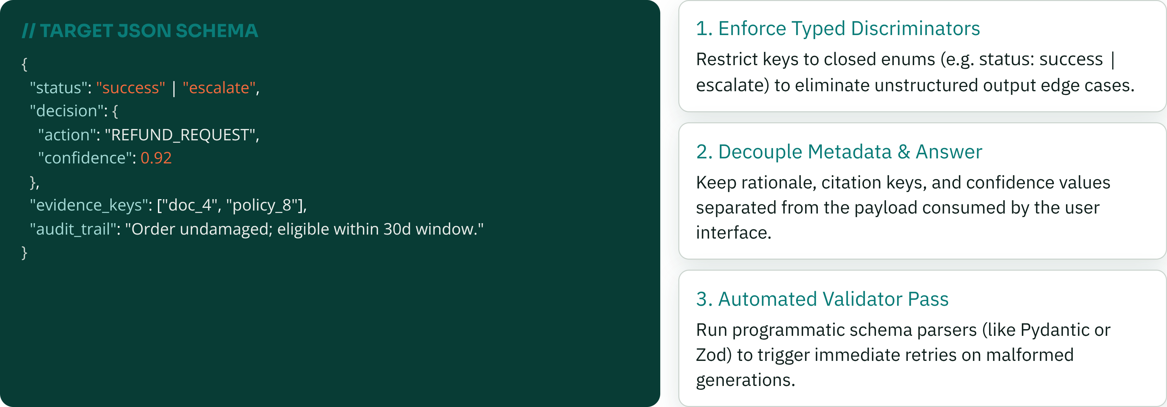
CONTRACT VALIDATION
Make outputs machine-checkable
Never parse open prose in downstream services. Require strict schema validation to catch malformed payloads before they reach user applications.
Notes:
Machine-checkable outputs turn unpredictable text into robust software interfaces. Validating outputs with tools like Pydantic or Zod before they enter databases or downstream APIs ensures that hallucinated structures trigger retries rather than production crashes.

Slide 7
AGENTIC INTEGRATION
Ground the model with tools and evidence
Use tools for dynamic facts and arithmetic; define clear invocation, evidence, and fallback rules.
Decide
Run safely
Synthesize
Search, calculate, retrieve, or ask for clarification when needed.
Pass tool results back with provenance and clear boundaries.
Refuse or escalate when evidence is missing.
PROTOCOL 01
PROTOCOL 02
PROTOCOL 03
Explicit invocation
Bounded results
Refusal gates
Specify when to invoke a tool and when to answer from prompt context.
Return verified provenance and clear boundaries; use token budgets to prevent context blowup.
Escalate or refuse when tool results lack necessary facts.
Notes:
Grounded models operate through strict protocols. Providing structured tool definitions, validating sandbox outputs, and defining explicit paths for refusal prevents confident hallucinations when external knowledge is missing.

Slide 8
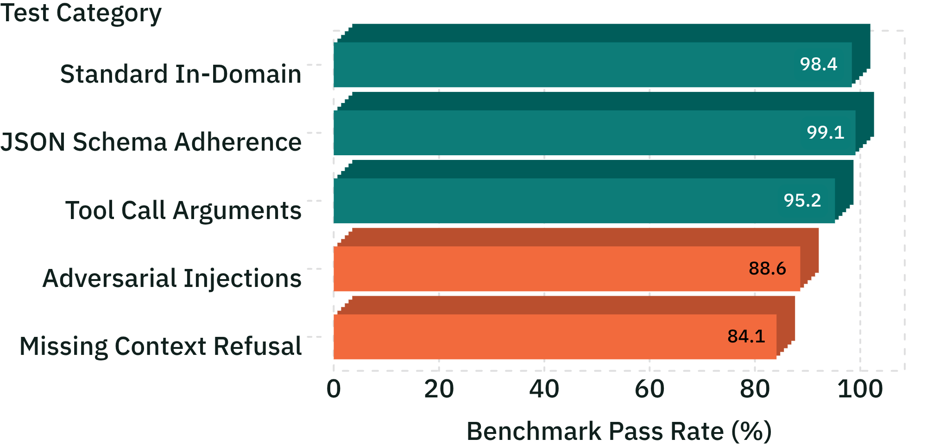
CONTINUOUS INTEGRATION
Evaluate prompts like production software
Prompt changes must be governed by test suites, cost tracking, and regression assertions. Never push a prompt revision without testing across edge cases.
99.1%
Schema adherence in CI pipeline
−42%
Latency through concise directives
84.1%
Synthetic and curated regression split (n=850 test cases, Prompt v2.4 build).
Refusal rate on incomplete evidence
Focus Area
Notes:
Treat prompt updates like software commits. Build representative test sets featuring both standard tasks and adversarial injections, comparing pass rates, token costs, and latency before shipping to production.

Slide 9
THE OPERATING CADENCE
The advanced loop: specify, test, inspect, improve
Production excellence is an ongoing iteration cycle. Build the prompt harness around structured telemetry and root-cause classification.
01
02
03
04
PHASE 01
PHASE 02
PHASE 03
PHASE 04
Specify Minimal Contract
Stress Test Hard Cases
Inspect Categorically
System-Level Refinement
Author the most concise instruction set that encodes the task boundaries and required output schema.
Execute the test suite against ambiguous inputs, adversarial injections, and zero-context edge scenarios.
Group failures by root cause—ambiguous directives, retrieval gaps, or validation issues—never by anecdote.
Fix errors by tuning chunking, tooling constraints, or prompt architecture, then lock in new regression tests.
Production Takeaway: Reliable prompts are engineered through tight feedback loops, rigorous contracts, and automated test harnesses.
Notes:
To conclude: start with the minimal viable contract, benchmark against difficult cases, cluster failures into actionable categories, and refine the whole system rather than tweaking words in isolation. This loop is what powers reliable production AI.

