Slide 1

ADAPTIVE TECHNOLOGY FOR AUTISM SUPPORT
by
PRANEESHA V
Roll No. 224G1A0573
RAJESHWARI K
Roll No. 224G1A0579
VENKATA VENU K
Roll No. 224G1A05C3
Under the guidance of
Mr. G.Ganesh M.Tech. Assistant Professor
Department of Computer Science and Engineering
Srinivasa Ramanujan Institute of Technology
Autonomous
Rotarypuram Village, B K Samudram Mandal, Ananthapuramu – 515701.
2025-2026

Slide 2
Contents
ADAPTIVE TECHNOLOGY FOR AUTISM SUPPORT
Title Justification
Abstract
Problem statement
Objectives of Project
Literature survey for objectives
Proposed Work -(Methods to be followed for proposed system)
References
GitHub Link
Queries
Srinivasa Ramanujan Institute of Technology

Slide 3
Title Justification
ADAPTIVE TECHNOLOGY FOR AUTISM SUPPORT NETWORKSADA
“ADAPTIVE TECHNOLOGY FOR AUTISM SUPPORT” reflects the core objectives of the project:
Adaptive intelligence → Using AI-based techniques to adjust content and feedback according to emotional state and attention level.
Target audience & purpose → Supporting children aged 6–12 years with Autism Spectrum Disorder through personalized and sensory-friendly assistance.
Practical impact → Enhancing emotional regulation, engagement, and social interaction while enabling caregivers and educators to monitor progress effectively.
Srinivasa Ramanujan Institute of Technology

Slide 4
Abstract
ADAPTIVE TECHNOLOGY FOR AUTISM SUPPORT
Adaptive Technology for Autism Support is an AI-assisted, cross-platform application developed to support children aged 6–12 years with Autism Spectrum Disorder (ASD). The system aims to provide a personalized and sensory-friendly learning environment by adapting to a child’s emotional state and attention level. Basic emotion recognition techniques using facial expressions, eye-focus patterns, and speech-related cues are employed to estimate engagement. Based on this analysis, the application provides supportive feedback through a virtual avatar to encourage emotional regulation and sustained focus. Interactive game-based activities are included to enhance cognitive, emotional, and social skills in a low-stress environment. The system also offers progress tracking and caregiver support features to help parents and educators monitor development. Built using Flutter, the application ensures a calming, intuitive interface across multiple platforms. The project focuses on ethical design and practical feasibility to create a secure and adaptive support tool for children with ASD.
Srinivasa Ramanujan Institute of Technology

Slide 5
Problem Statement
ADAPTIVE TECHNOLOGY FORAUTISM SUPPORT
Children with Autism Spectrum Disorder (ASD) face difficulties in emotional regulation, social interaction, and sustained attention.
Existing assistive and learning tools are mostly static and lack personalization.
Emotional states and sensory sensitivities are often not considered during learning.
Caregivers and educators have limited real-time visibility into a child’s engagement and progress.
There is a need for an adaptive, sensory-friendly technology that personalizes support and improves engagement.
Srinivasa Ramanujan Institute of Technology

Slide 6
Objectives of Project
ADAPTIVE TECHNOLOGY FOR AUTISM SUPPORT
To develop an adaptive, AI-assisted application to support children with Autism Spectrum Disorder (ASD).
To personalize learning and interaction based on emotional state and attention level.
To create a sensory-friendly and low-stress environment using interactive activities.
To improve emotional regulation, engagement, and basic social skills.
To provide progress tracking tools for caregivers and educators.
Srinivasa Ramanujan Institute of Technology

Slide 7
ADAPTIVE TECHNOLOGY FOR AUTISM SUPPORT
Literature survey for objectives
S.NO | AUTHOR’S NAME | BASE PAPER | Key Contribution | Limitations Identified
1 | Holmgaard et al. | Animation: Children, Autism and New Possibilities for Learning | Demonstrated that animated visual content improves engagement and learning interest | Lacks personalization and real-time emotional adaptability
2. | Landowska et al. | Automatic Emotion Recognition in Children with Autism: A Systematic Literature Review | Reviewed facial, speech, and multimodal emotion recognition methods | Limited real-time implementation and privacy considerations
3. | Elhaddadi et al. | Serious Games to Teach Emotion Recognition to Children with Autism Spectrum Disorders | Showed improved emotional awareness and motivation through serious games | No integration of attention tracking or adaptive feedback
Srinivasa Ramanujan Institute of Technology

Slide 8
Proposed System
ADAPTIVE TECHNOLOGY FOR AUTISM SUPPORT
An AI-assisted, cross-platform application to support children (6–12 years) with Autism Spectrum Disorder (ASD).
Uses real-time facial emotion recognition, eye tracking, and speech-based emotion cues to estimate emotional state and attention.
Provides adaptive feedback through a virtual avatar to support emotional regulation and engagement.
Includes therapeutic games and a collaborative canvas to improve cognitive, emotional, and social skills in a low-stress environment.
Offers progress tracking, session reports, and alerts for parents and therapists.
Built using Flutter with a Firebase backend, ensuring cross-platform accessibility, scalability, and secure data handling.
Designed with a privacy-first and ethical approach, where all sensitive processing is performed on-device.
Srinivasa Ramanujan Institute of Technology

Slide 9
References
ADAPTIVE TECHNOLOGY FOR AUTISM SUPPORT
[1]A. Holmgaard, H. Pedersen, and C. Abbott, “Animation: Children, Autism and New Possibilities for Learning,” PsykologCentret, Viborg, Denmark; VIA University, Denmark; King’s College London, UK, 2012.
[2] M. Elhaddadi, H. Maazouz, N. Alami, M. M. Drissi, C. S. Mènon, M. Latifi, and A. O. T. Ahami, “Serious Games to Teach Emotion Recognition to Children with Autism Spectrum Disorders (ASD),” International Journal of Computer Applications in Technology, 2019.
[3] A. Landowska, A. Karpus, T. Zawadzka, B. Robins, D. E. Barkana, H. Kose, T. Zorcec, and N. Cummins, “Automatic Emotion Recognition in Children with Autism: A Systematic Literature Review,” IEEE Transactions on Affective Computing, 2021.
Srinivasa Ramanujan Institute of Technology

Slide 10
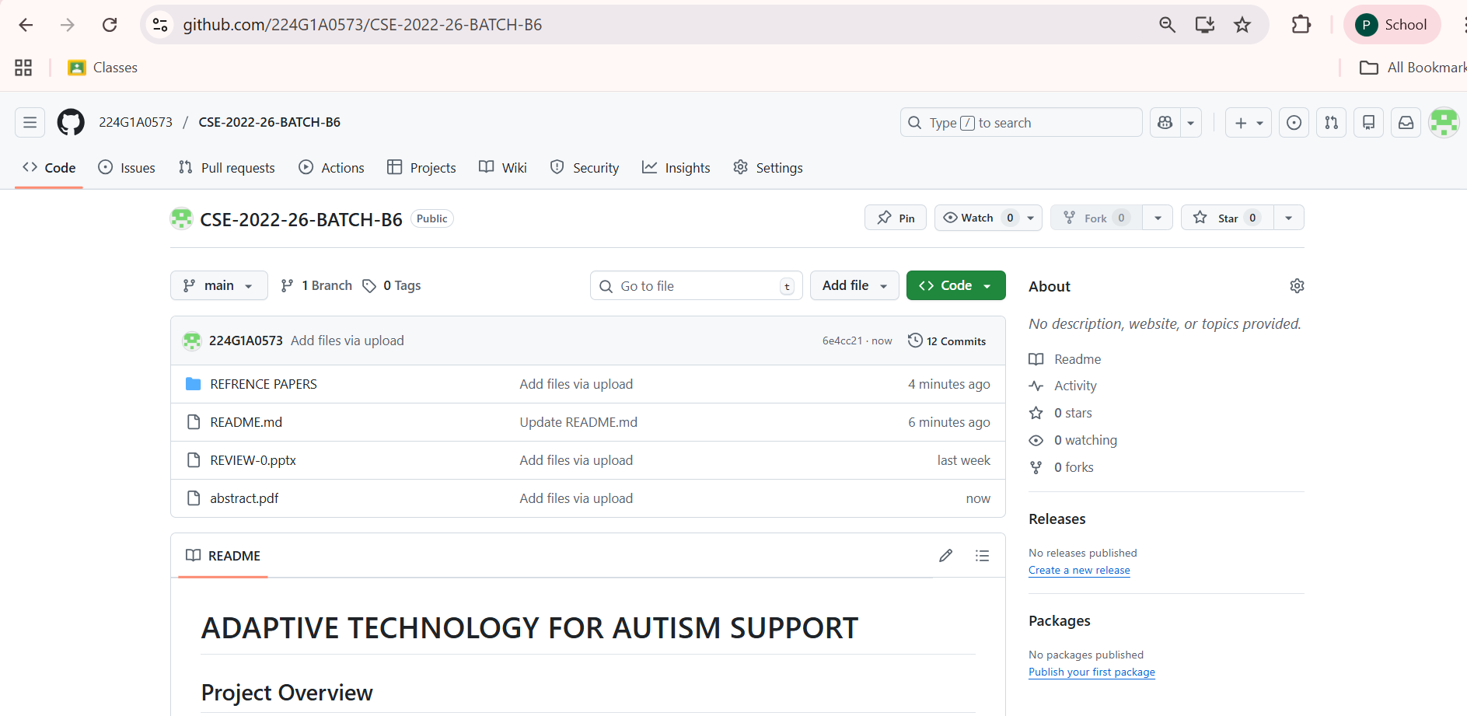
Git Hub Dashboards of each student
ADAPTIVE TECHNOLOGY FOR AUTISM SUPPORT
https://github.com/224G1A0573/CSE-2022-26-BATCH-B6
Srinivasa Ramanujan Institute of Technology

Slide 11
Any Queries?
ADAPTIVE TECHNOLOGY FOR AUTISM SUPPORT
Srinivasa Ramanujan Institute of Technology

