Slide 1
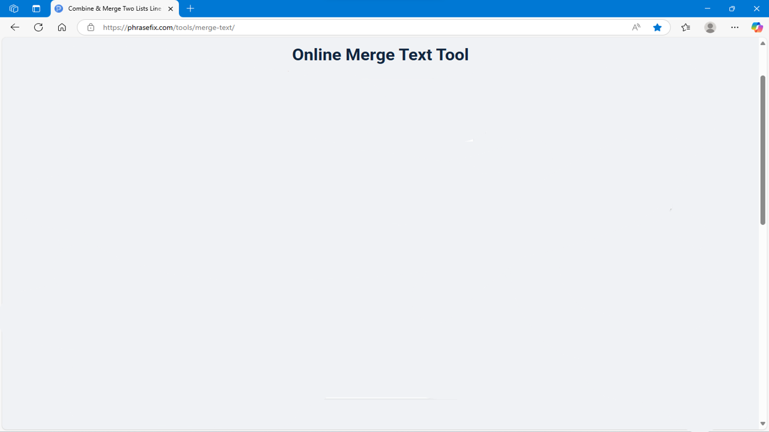



Word limit:
5000
Set
Result
Combine
Add
Next

Slide 2
Range:
2000
List 1
Segment
Text
Back

Slide 3
