Slide 1

Team Nine Final project
Hao Wu, Jun Xiang, Hui Huang
Notes:
Good afternoon, everyone!

Slide 2
Problem Statement
Unorganized drivers are unable to get in touch with customers.
Unorganized drivers cannot get decent pay without an approach to receive enough drive requests.
There should be a platform to connect unorganized drivers and customers together.
Notes:
Our team designed a communication ecosystem solve a multi-party problem that there’s some trouble for customers to find an appropriate vehicle and driver to help them transport some cargos or send people to some place. At the same time, unorganized drivers are unable to get in touch with customers. What‘s more, …Unorganized drivers cannot get decent pay without an approach to receive enough drive requests.
Therefore, there should be a platform to connect unorganized drivers and customers together.

Slide 3
Approach
Customers, Drivers, Cargo Delivery Agencies, Pickup Service Agencies and System Administrators will share the same platform.
Customer will send order request directly to Cargo Delivery Agencies / Pickup Service Agencies.
Cargo Delivery Agencies / Pickup Service Agencies select driver and send drive request to it.
Notes:
The approach of this application as follows.

Slide 4
Use cases
All Users
• Login
• View/Modify personal information
• Change password
Customer
• Registration
• View cargo delivery agencies/pickup service agencies details under selected city
• Place order
• View order history
• Write/View reviews
• Rate cargo delivery agencies/pickup service agencies
Notes:
Next, let’s talk about the use cases.
All users can login in the platform by using their accounts, and view or modify personal information, and change password
For customers ,they can register a new account…

Slide 5
Use cases
Cargo Delivery Agencies / Pickup Service Agencies Manager
• View/ Edit cargo delivery agencies/pickup service agencies information
• View/Confirm/Cancel order
• View all employees
• View/Add/Remove car type
• View/Select available drivers
• View rate & reviews
Notes:
For cargo Delivery Agencies or Pickup Service Agencies Manager, they can view their company information.

Slide 6
Use cases
Driver
• View/Edit personal information
• View/Confirm/Cancel order
• Update order status
• View/Cancel drive request

Slide 7
Use cases
System Administrator
• View/Add/Update/Remove network
• View/Add/Update/Remove cargo delivery agencies/pickup service agencies .
• View/Add/Update/Remove customer account

Slide 8
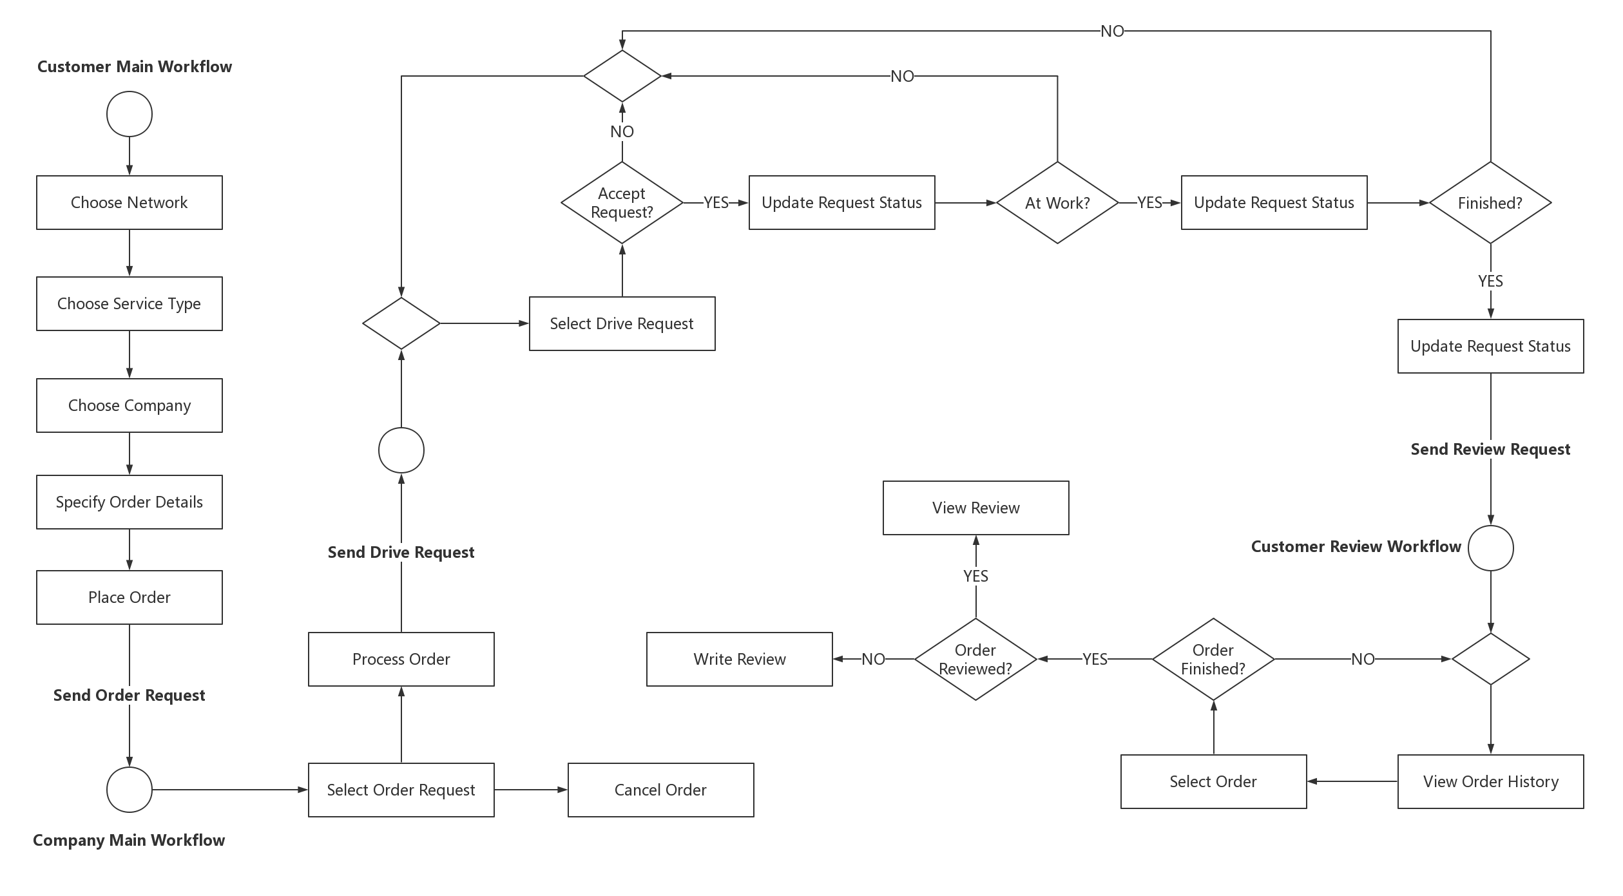
Workflow
Notes:
For each customer, after login, you should choose network and service type first.
There are two service types – cargo delivery and pick up service.
After that, when choosing a company, customers can see the detailed information and reviews of each company.
After selecting a company, customers would be asked to specify their order details, and then provide contact information to place an order.
Once an order is placed, an order request would be sent to the company.
The company manager can either process or cancel an order.
When the manager choose to process an order, the order would be assigned to an available driver.
If the order status becomes ‘Processing’, a drive request would be sent to the designated driver.
For each driver, after login, you will see a drive request table, you can change the status of each order to ‘Accept Request’, ‘At Work’ or ‘Finished’.
Every time the order status becomes ‘Finished’, a review request would be sent to the customer.
Each customer can score and comment the company in the OrderHistory panel.

Slide 9
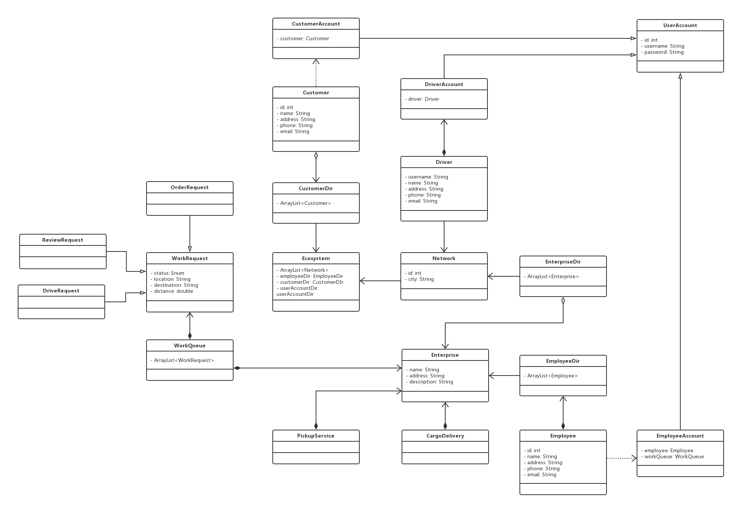
UML

