Slide 1
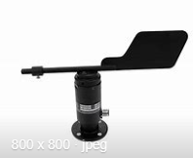
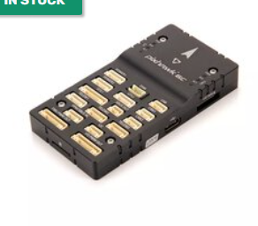
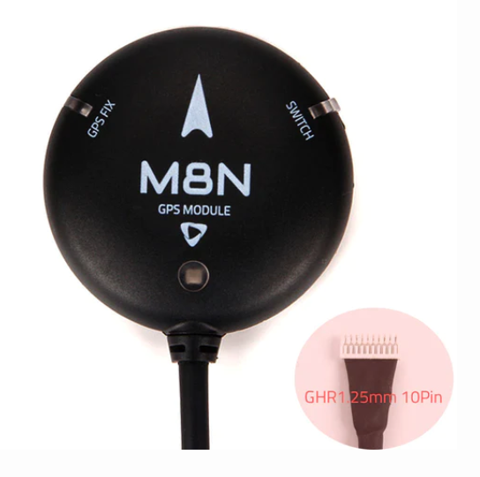


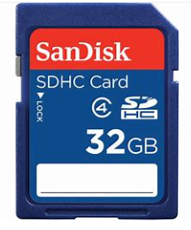
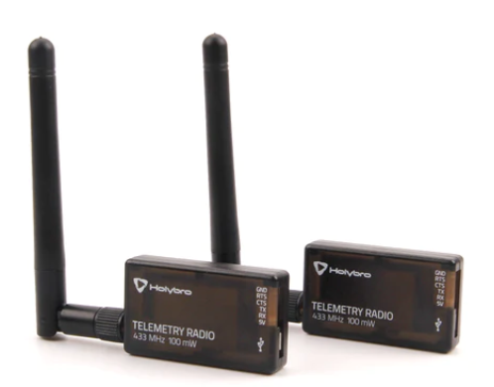
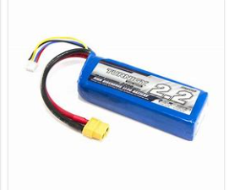
Wind Sensor
Accel/Gyro
Accel/Gyro
Magnetometer
Barometer
PIXHAWK
Wind Speed and Direction
GPS/compass
Rudder and Sail Angle
GPS and Compass
Rudder and Sail Servo
Data/Commands
Data
Base Station PC
SD Card
Data/Commands
Telemetry Radio
Battery

