Slide 2
Content
Introduction
Overview
Sailboat Simulation
Motion Control System
Future Work

Slide 3
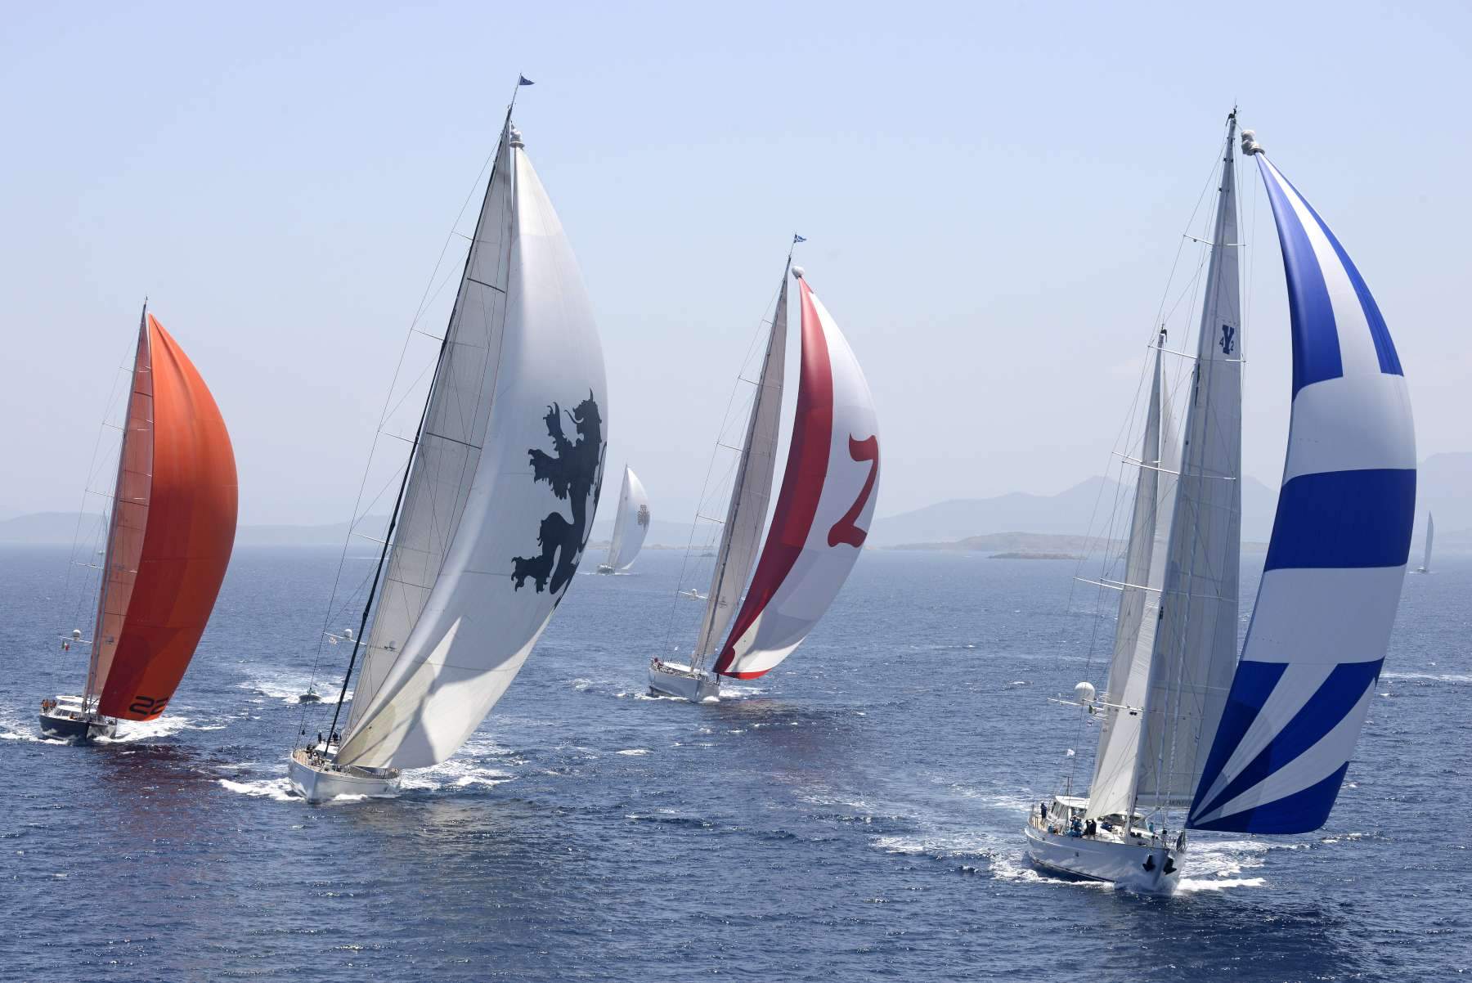
Introduction
Unmanned wind-powered autonomous surface vehicle (ASV)
Oceanographic research
Low-power Consumption
Introduction
Overview
Sailboat Simulation
Motion Control
Future Work

Slide 4
Overview
Development and Control of an Autonomous Racing Sailboat
Introduction
Overview
Sailboat Simulation
Motion Control
Future Work

Slide 5
Overview
Development and Control of an Autonomous Racing Sailboat
Introduction
Overview
Sailboat Simulation
Motion Control
Future Work
Hardware Development

Slide 6
Overview
Development and Control of an Autonomous Racing Sailboat
Introduction
Overview
Sailboat Simulation
Motion Control
Future Work
Hardware Development
Firmware Development

Slide 7
Overview
Development and Control of an Autonomous Racing Sailboat
Introduction
Overview
Sailboat Simulation
Motion Control
Future Work
Hardware Development
Firmware Development
Simulation Development

Slide 8
Overview
Development and Control of an Autonomous Racing Sailboat
Introduction
Overview
Sailboat Simulation
Motion Control
Future Work
Research Control Systems

Slide 9
Overview
Development and Control of an Autonomous Racing Sailboat
Introduction
Overview
Sailboat Simulation
Motion Control
Future Work
Research Control Systems
Design Control Systems

Slide 10
Overview
Development and Control of an Autonomous Racing Sailboat
Introduction
Overview
Sailboat Simulation
Motion Control
Future Work
Research Control Systems
Design Control Systems
Implement Control Systems

Slide 11
Overview
Development and Control of an Autonomous Racing Sailboat
Introduction
Overview
Sailboat Simulation
Motion Control
Future Work
Test Navigation

Slide 12
Overview
Development and Control of an Autonomous Racing Sailboat
Introduction
Overview
Sailboat Simulation
Motion Control
Future Work
Test Navigation
Control Objective

Slide 13
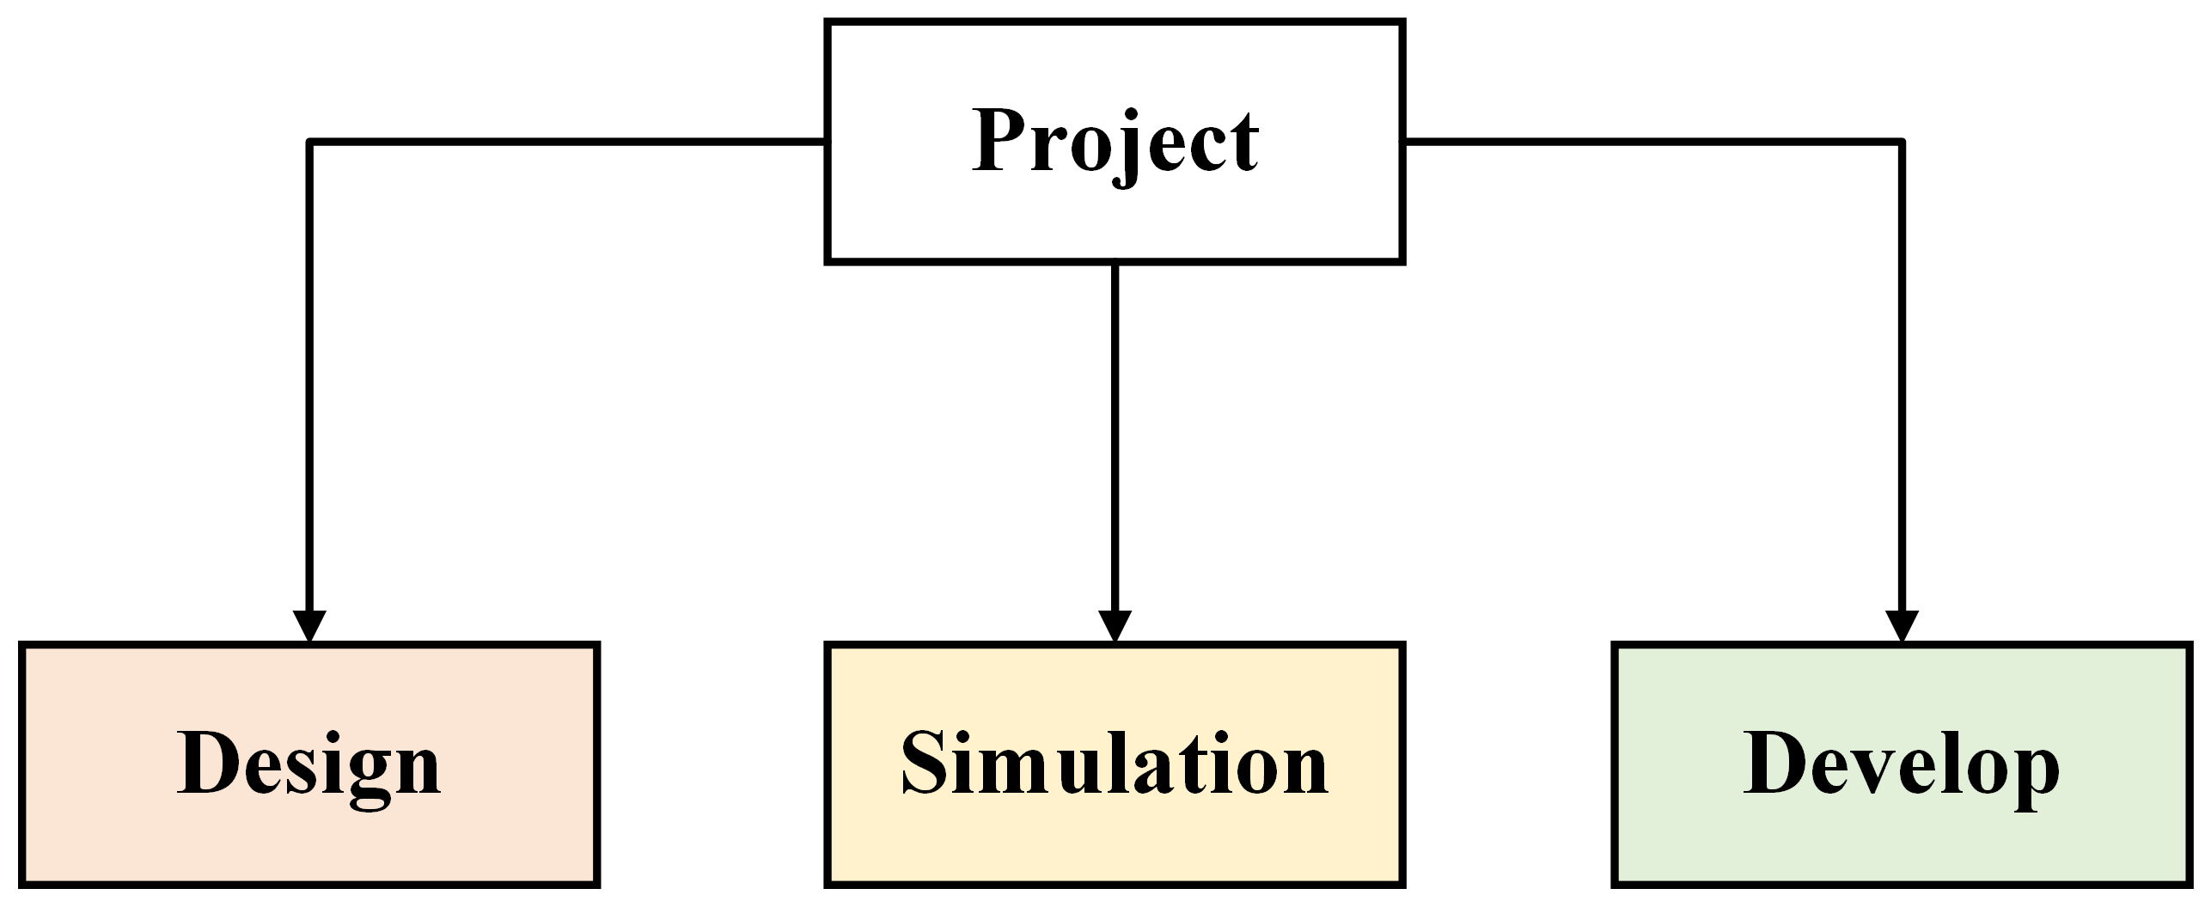
Overview
Research Goal: Develop a sailboat control system capable of sailing a predefined sail course
Project Scope can be separated into three groups
Design: Research and design sailboat control strategies
Simulation: Build a physics simulator to test designed control strategies
Develop: Develop and implement a platform capable of testing the control strategies in real environment
Introduction
Overview
Sailboat Simulation
Motion Control
Future Work

Slide 14
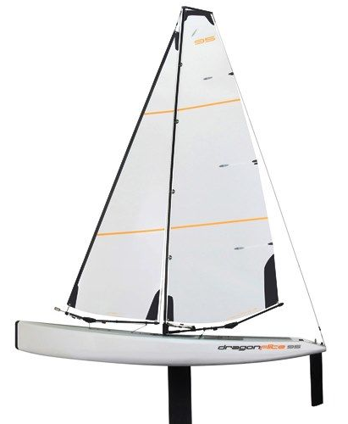
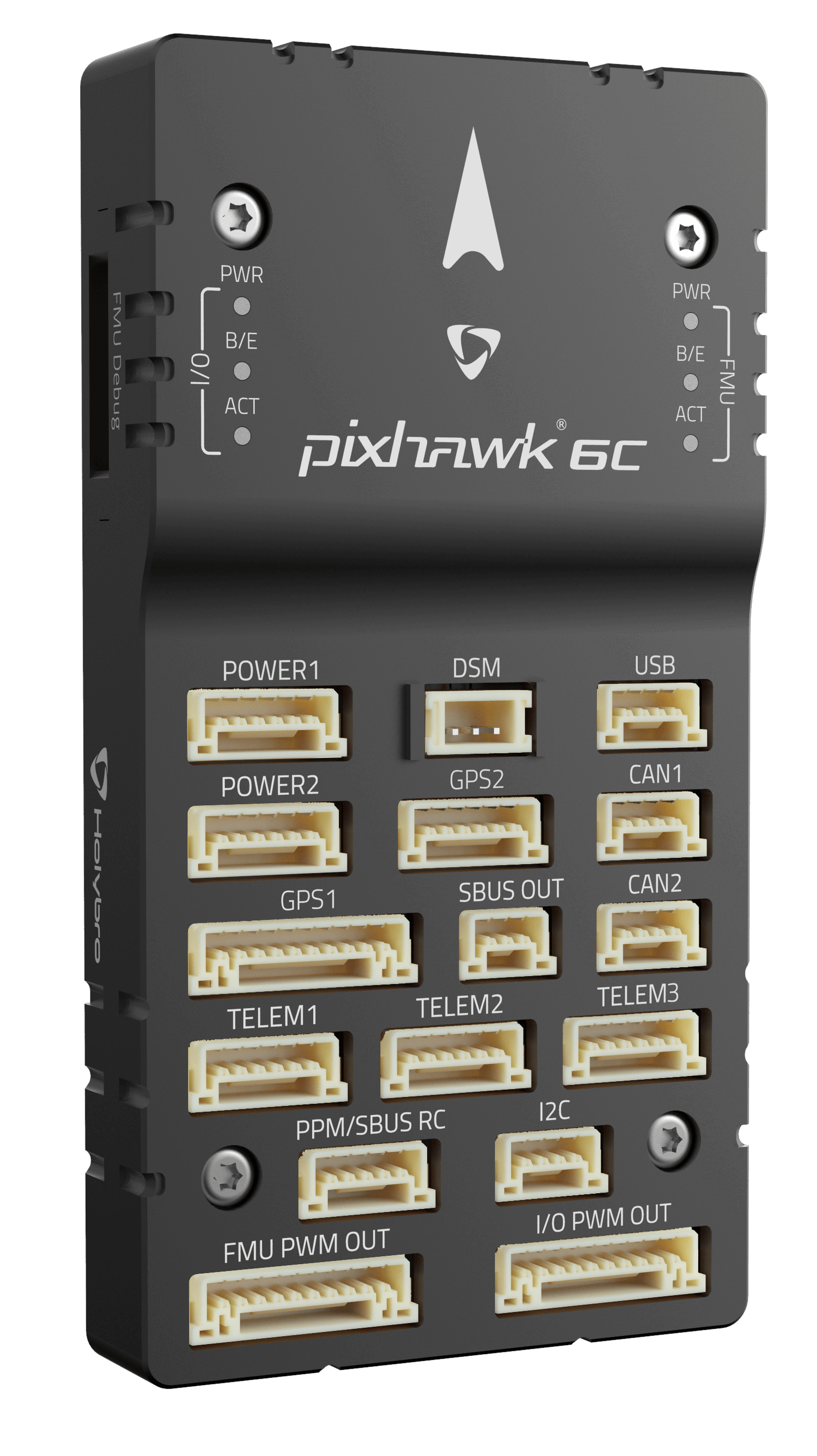

Overview: Platform
Dragonflite 95 Sailboat, 1m long RC Sailboat
Very popular racing sailboat (International Comp)
Lightweight and Durable hull
Two actuators (rudder & sail)
Pixhawk flight controller
Ardupilot Software Architecture
Introduction
Overview
Sailboat Simulation
Motion Control
Future Work

Slide 15
Overview
Racecourse
Introduction
Overview
Sailboat Simulation
Motion Control
Future Work
Start Line
Sailboat
Upwind Waypoint
Downwind Gate
Wind Direction

Slide 16
Sailboat Simulation
Assumptions
The sailboat is assumed to be rigid with 4-DOF: surge, sway, roll and yaw motions
The sails are combined into one effective sail area
The sail, keel and rudder is modelled as rigid foils and computed independently
Friction forces are considered as linear damping elements
Added mass and Coriolis coefficients are modelled as constants
Environmental forces are modelled
Servo motor delays for the sail and rudder is modelled
Environmental Forces
Waves
Wind
Ocean Currents
Introduction
Overview
Sailboat Simulation
Motion Control
Future Work
[Modeling and Nonlinear Heading Control for Sailing Yachts, L. Xiao and J. Jouffroy]

Slide 17
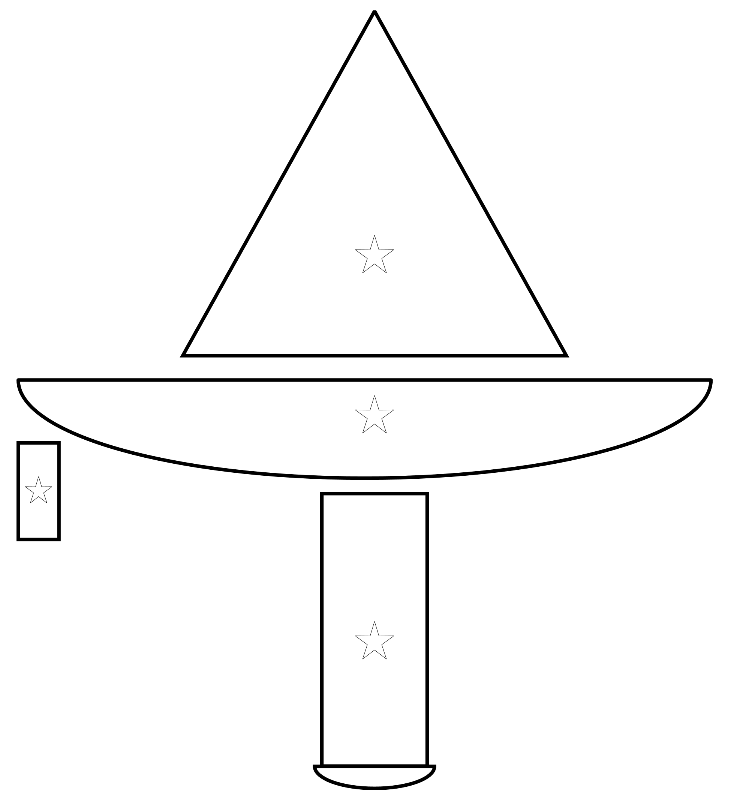
Sailboat Simulation
Introduction
Overview
Sailboat Simulation
Motion Control
Future Work
Sail
Hull
Rudder
Keel

Slide 18
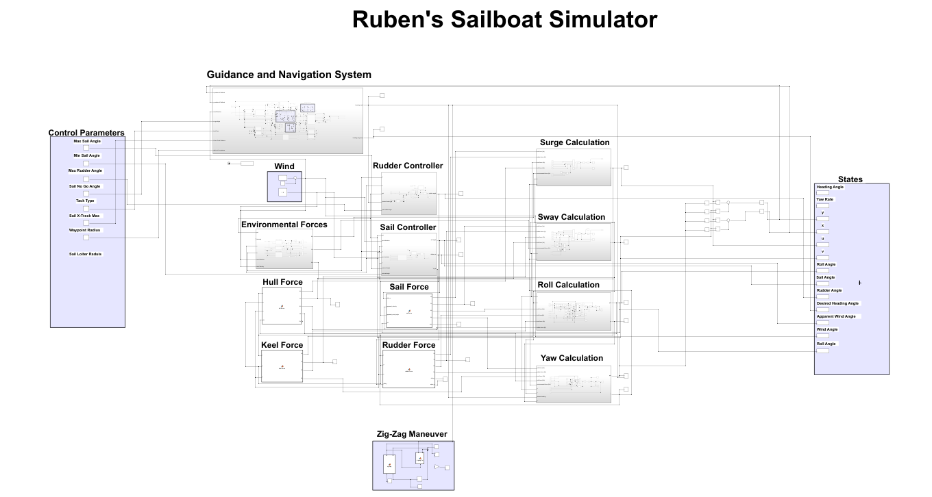
Sailboat Simulation
Introduction
Overview
Sailboat Simulation
Motion Control
Future Work

Slide 19
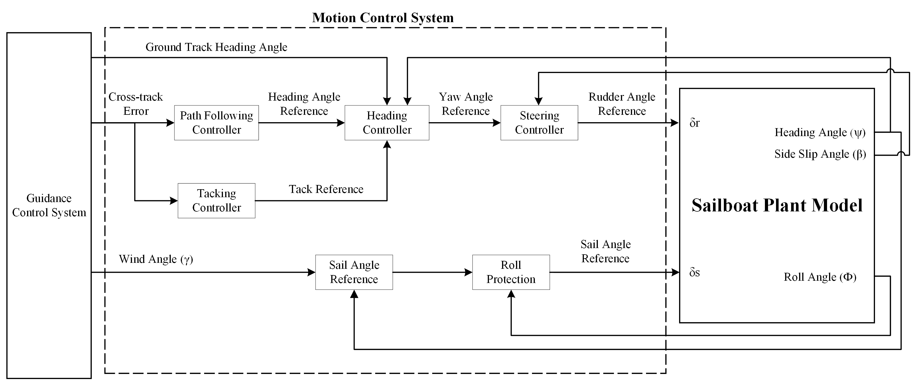
Motion Control System
Introduction
Overview
Sailboat Simulation
Motion Control
Future Work

Slide 20
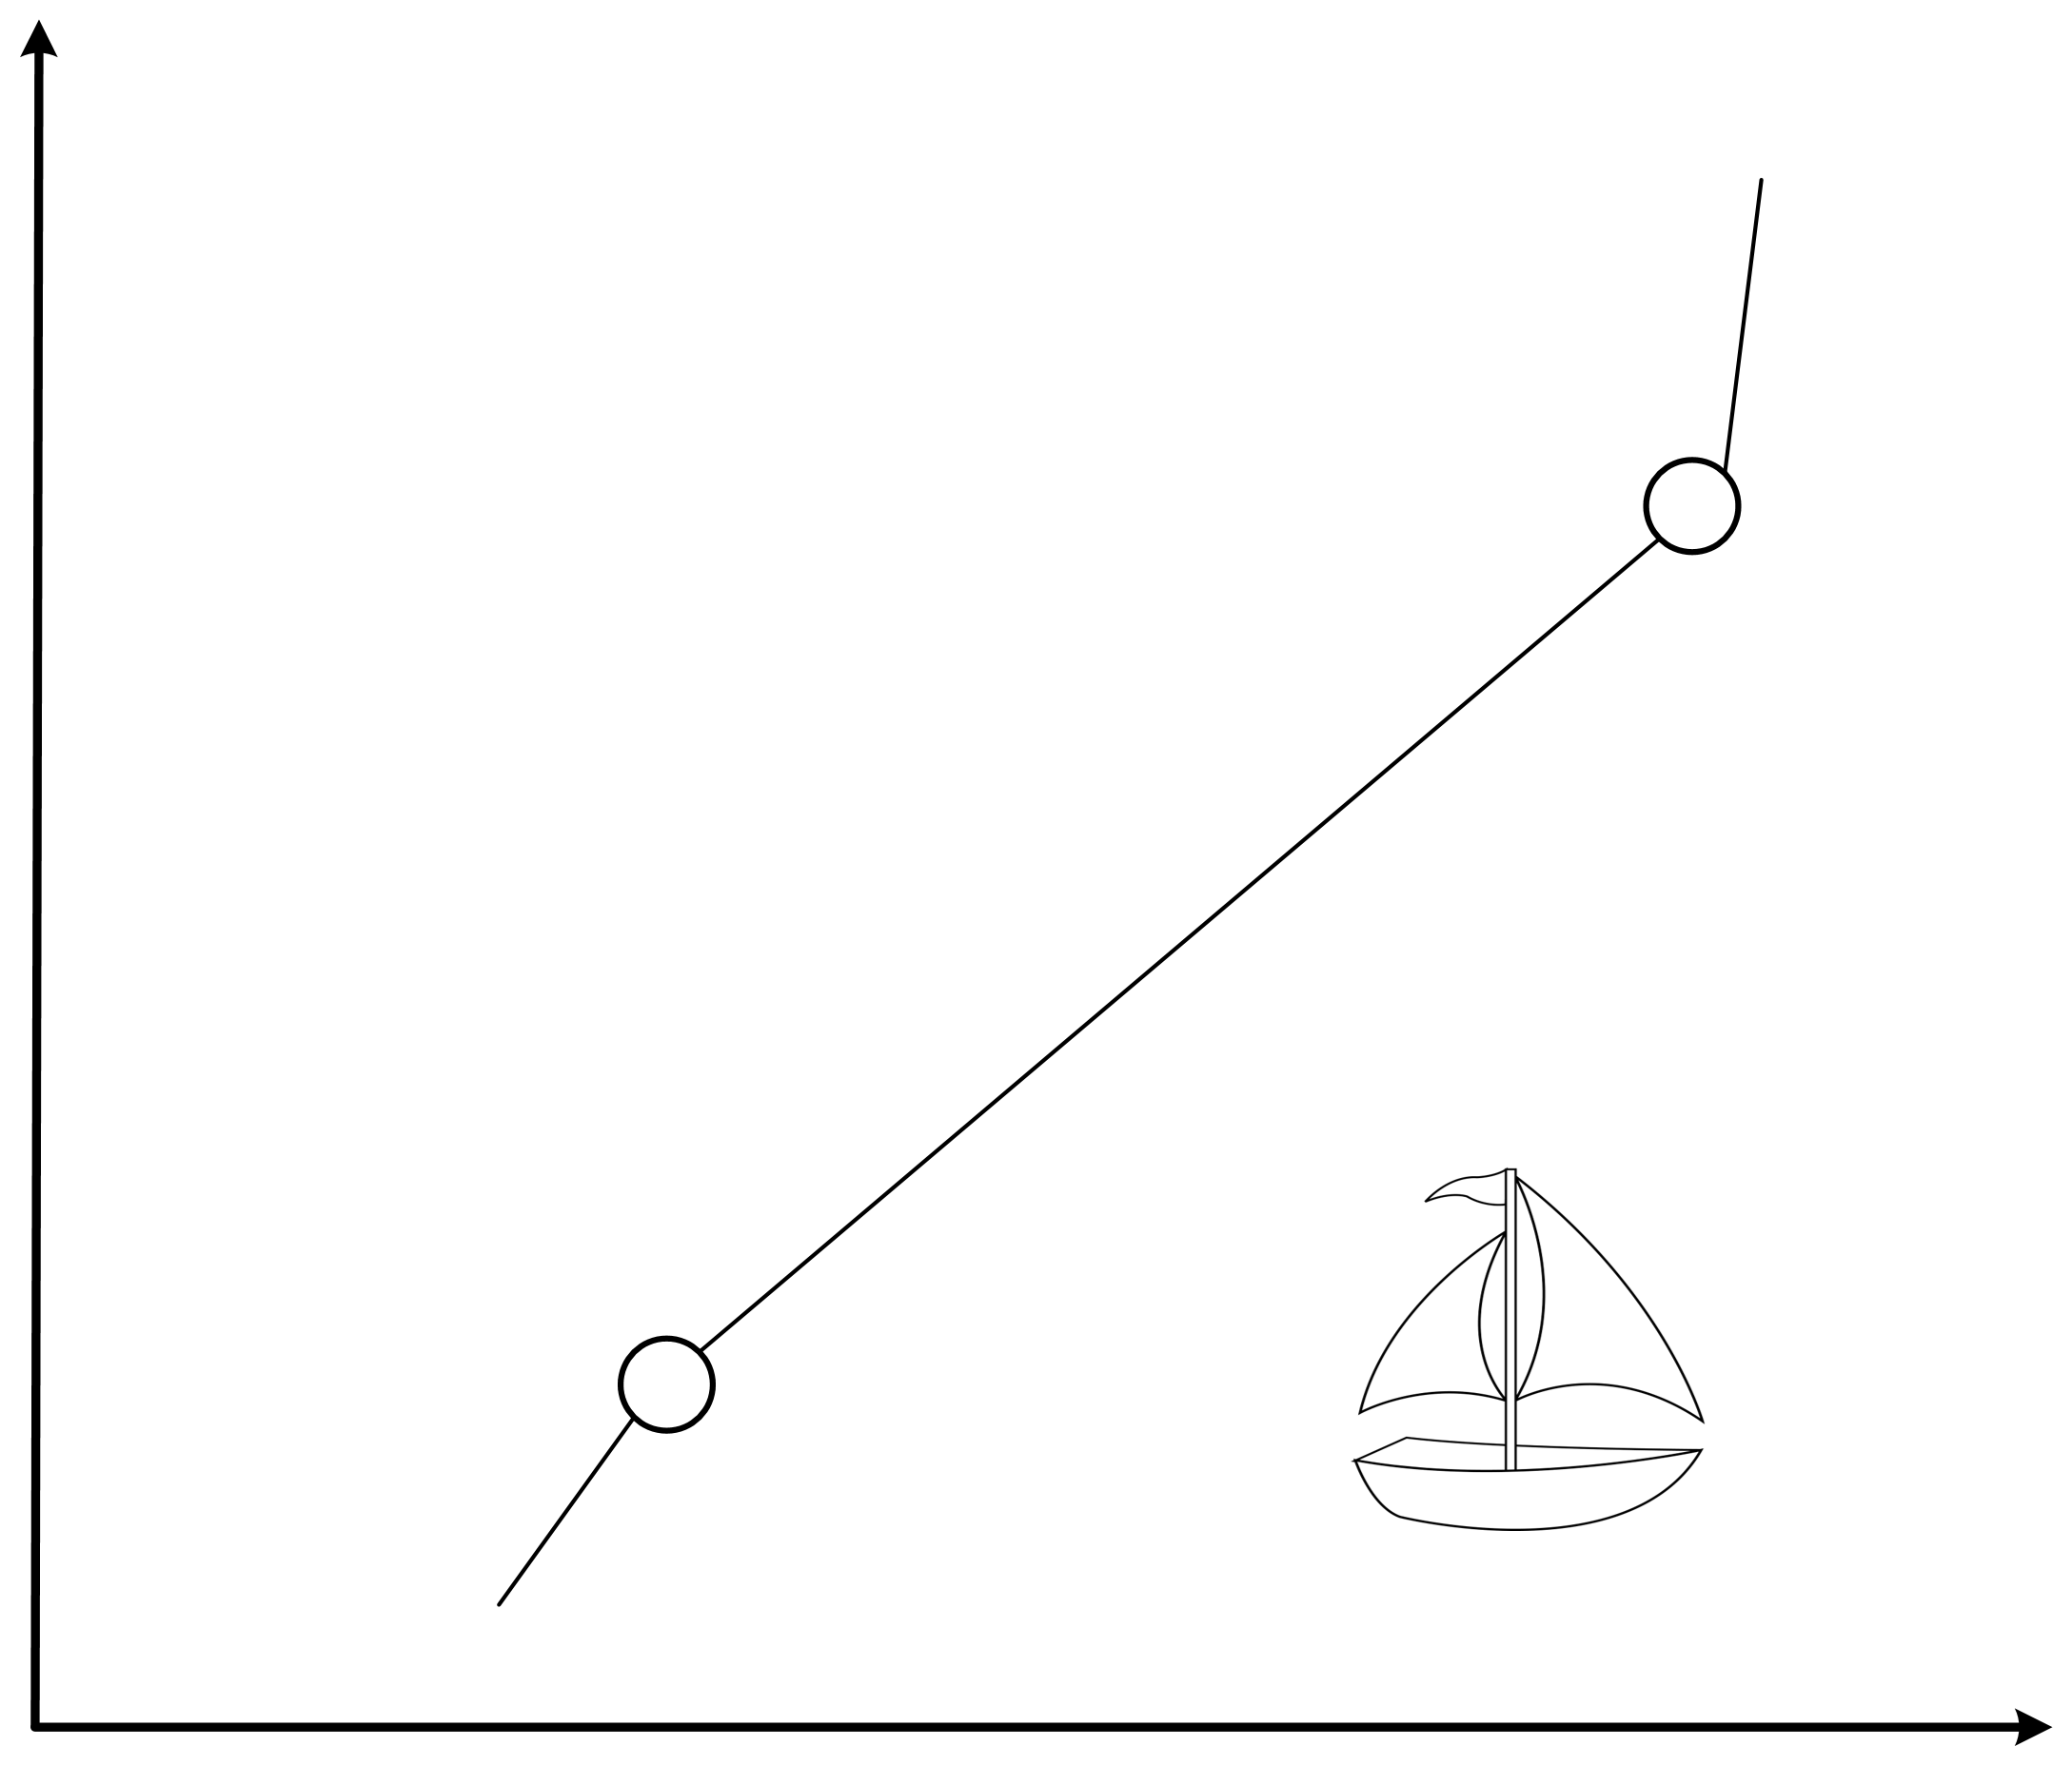
Motion Control System
Introduction
Overview
Sailboat Simulation
Motion Control
Future Work
N
Wind Direction (North-to-South)
Destination waypoint
(Ed, Nd)
ground track heading angle
Cross-track
(Es, Ns)
Source waypoint
(E, N)
E

Slide 21
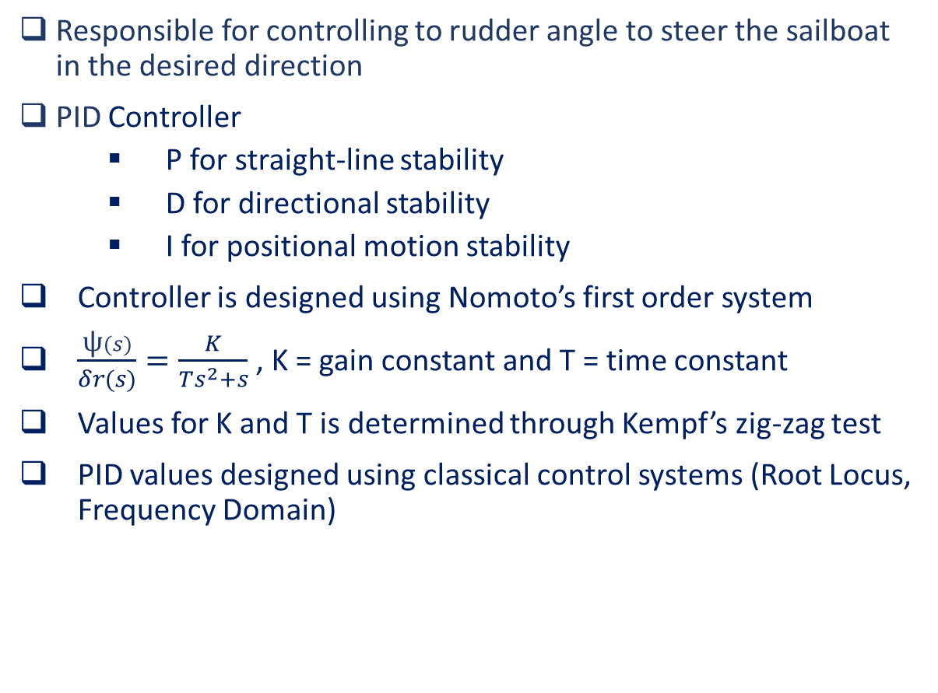
Motion Control: Steering Controller
Responsible for controlling to rudder angle to steer the sailboat in the desired direction
PID Controller
P for straight-line stability
D for directional stability
I for positional motion stability
Controller is designed using Nomoto’s first order system
$\frac{\text{ψ}(s)}{δr(s)}=\frac{K}{Ts^{2}+s}$ , K = gain constant and T = time constant
Values for K and T is determined through Kempf’s zig-zag test
PID values designed using classical control systems (Root Locus, Frequency Domain)
Introduction
Overview
Sailboat Simulation
Motion Control
Future Work
Notes:
Straight-Line stability: If new path is straight after a disturbance in yaw the craft is said to have straight-line stability. Uncontrolled vessels new path will differ from initial path due to no restoring forces
Directional Stability: Direction stability requires the final path to be parallel to the initial path that is obtained
Positional Motion Stability: Position Motion Stability implies that the vessel should return to its original path after its disturbance

Slide 22
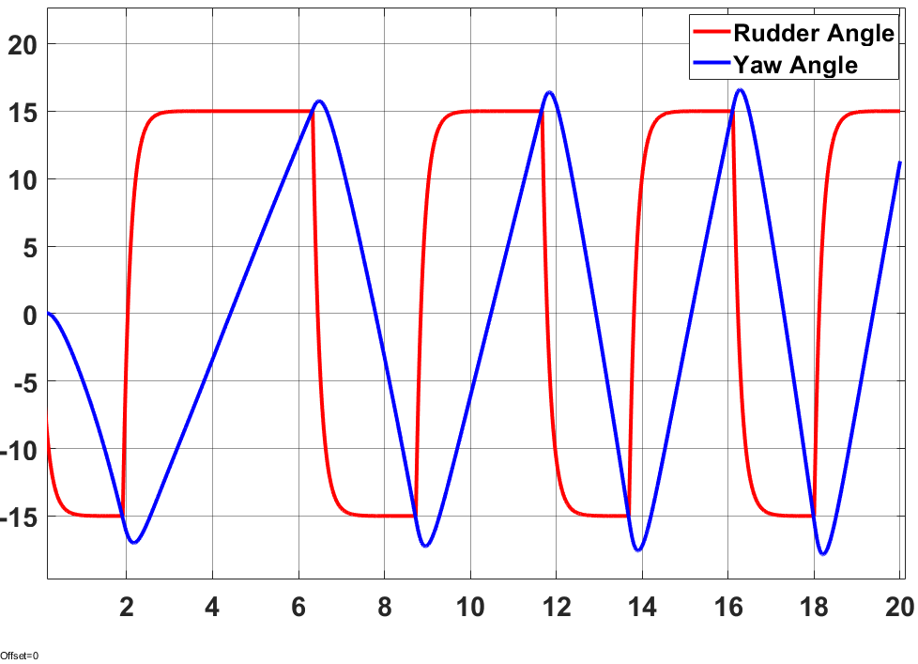
Motion Control: Steering Controller
Zig-Zag Test
K = 2.6005 & T = 0.4364
Introduction
Overview
Sailboat Simulation
Motion Control
Future Work

Slide 23
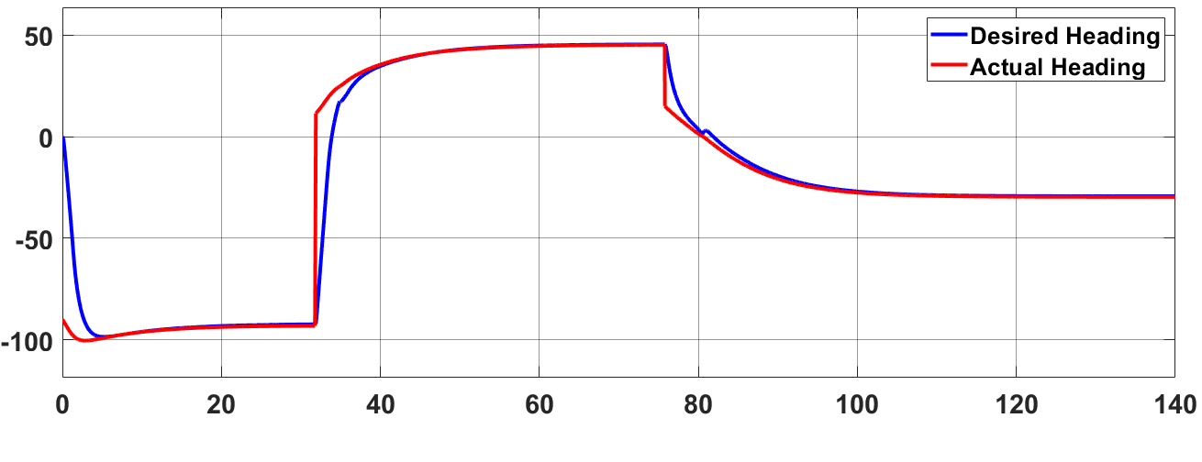
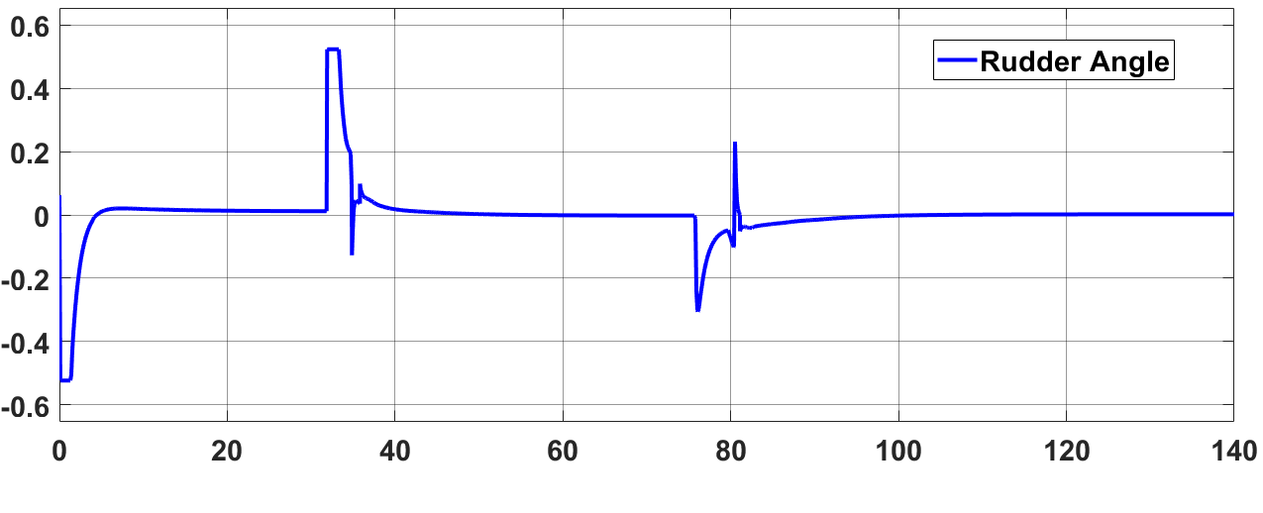
Motion Control: Steering Controller
Introduction
Overview
Sailboat Simulation
Motion Control
Future Work

Slide 24
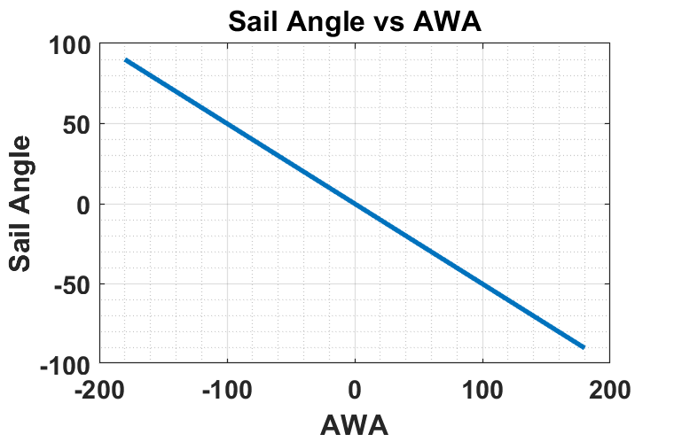

Motion Control: Sail Angle Reference
Control objective is to achieve maximum forward propulsion for a given wind angle
Find maximum value for Fs with varying ${\text{δ}}_{s}$ (sail angle)
${\text{ψ}}_{aω}$ = $\text{ψ}\text{ − }{\text{ψ}}_{ω}−π$
$F_{s}=sin\left(δ_{s}−{\text{ψ}}_{aω}\right)sin⁡(δ_{s}$)
Solution: $δ_{s}=−0.5 ∗ {\text{ψ}}_{aw}$ + a*φ ( -180 < ${\text{ψ}}_{aw}$ < 180, -60 < $δ_{s}$ < 60)
Introduction
Overview
Sailboat Simulation
Motion Control
Future Work

Slide 25
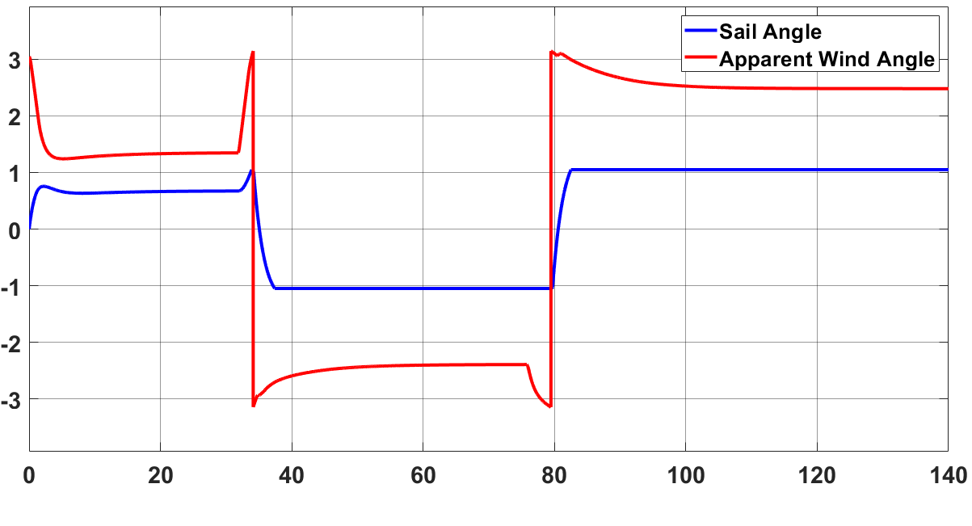
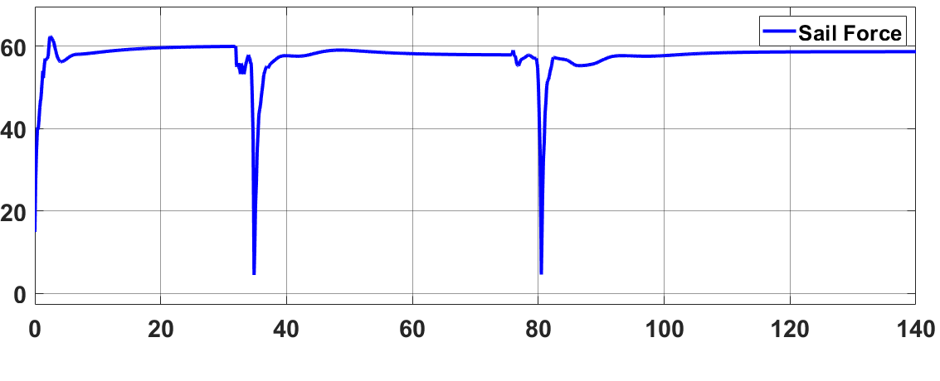
Motion Control: Sail Angle Reference
Introduction
Overview
Sailboat Physics
Motion Control
Future Work

Slide 26
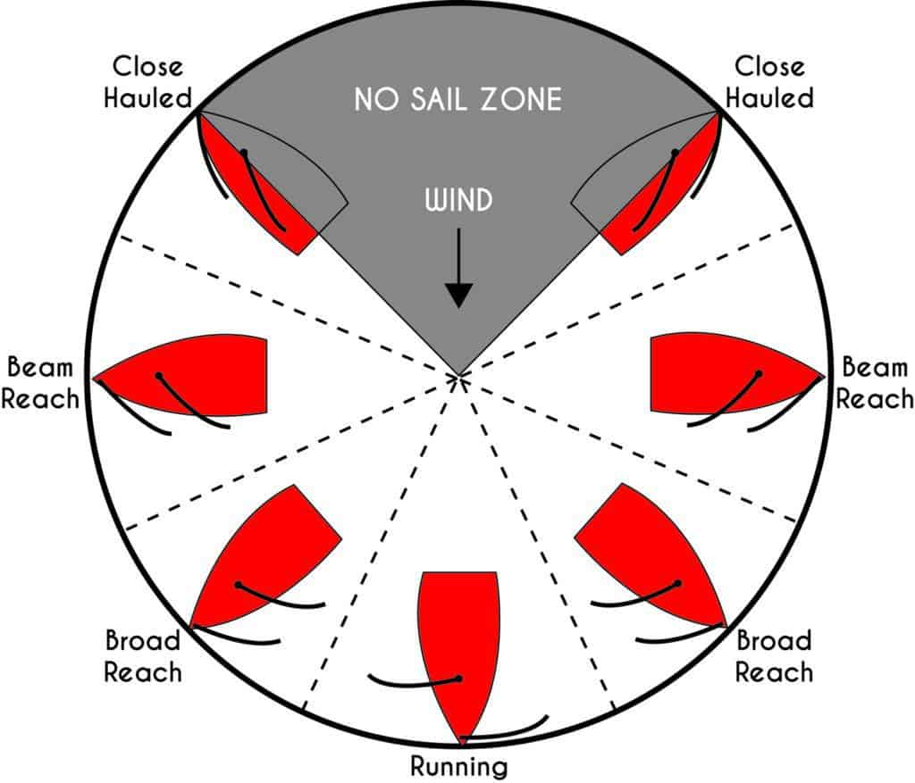
Motion Control: Tacking Controller
Required to sail into the wind
3 Tacking Controllers
Direct Tack
Indirect Tack
Zone Tacking
Tacking Controller feeds heading angle into Heading Controller
Introduction
Overview
Sailboat Simulation
Motion Control
Future Work

Slide 27
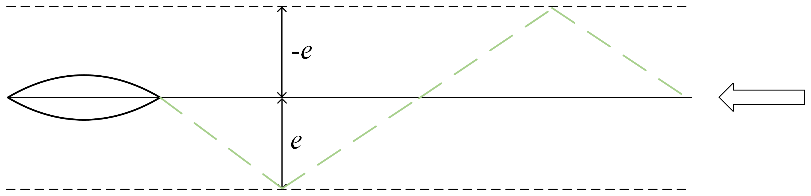
Motion Control: Direct Tack
Direct Tack is defined as a tack maneuver were the cross-track error determines what side the sailboat should tack
Introduction
Overview
Sailboat Simulation
Motion Control
Future Work

Slide 28
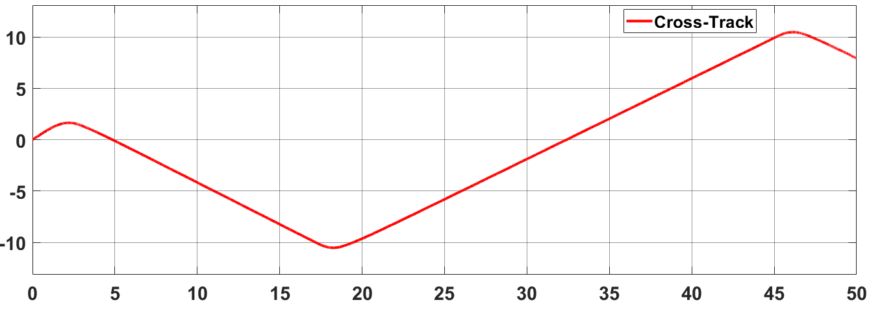
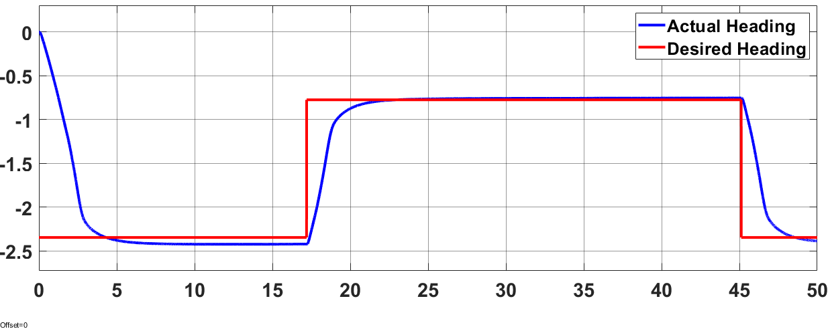
Motion Control: Direct Tack
Introduction
Overview
Sailboat Simulation
Motion Control
Future Work

Slide 29
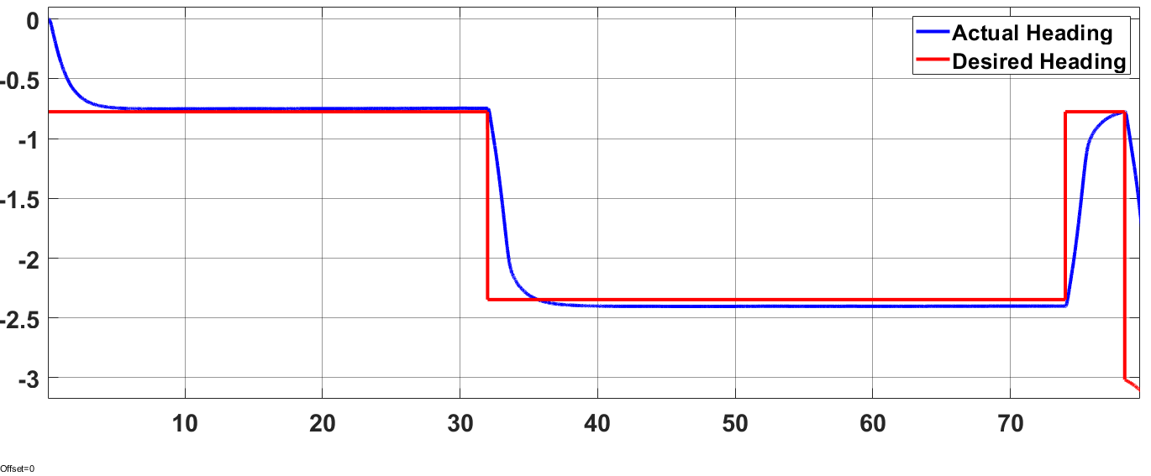

Motion Control: Indirect Tack
Indirect Tack is defined as the maneuver when the sailboat aims to only tack once
This is achieved by sailing out to the lay line and once the lay line is reached tack back to the waypoint
$\text{ϴ}=\tan^{−1}{\frac{Cross Track Distance}{Distance to Waypotin}}$
Introduction
Overview
Sailboat Simulation
Motion Control
Future Work

Slide 30
Motion Control: Zone Tack
Zone/Dynamic tack considers the wind angle when tacking
A tack switch is only performed when the wind forces it
Introduction
Overview
Sailboat Simulation
Motion Control
Future Work

