Slide 1
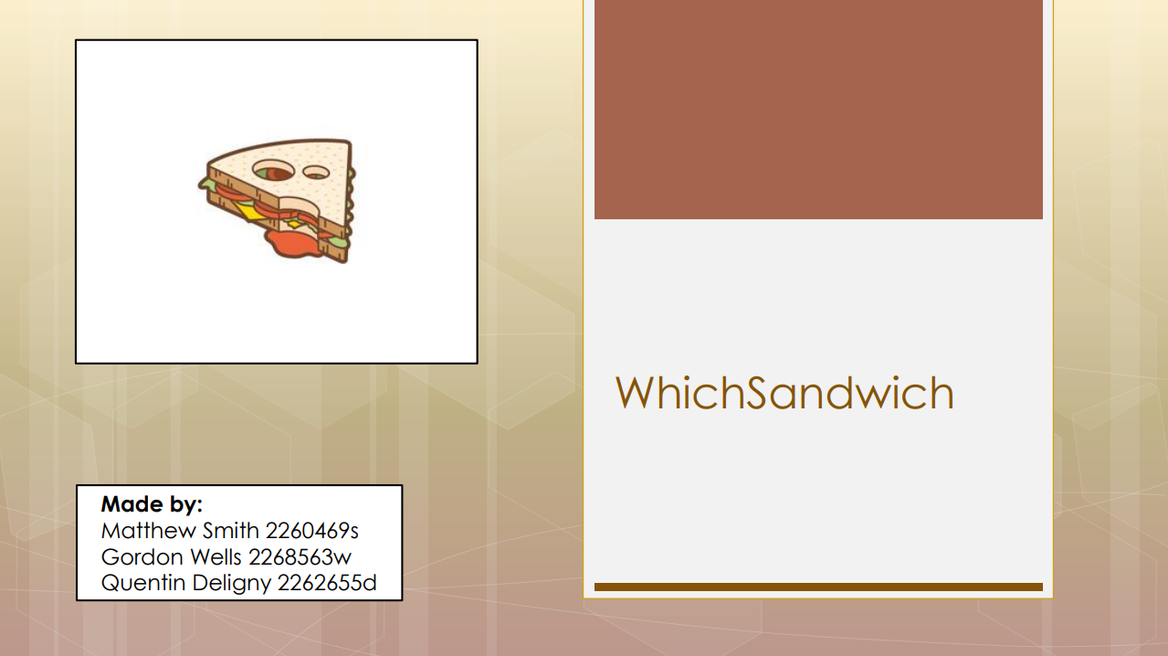

Product Name

Slide 2
Overview
WhichSandwich is a website that was designed with sandwich enthusiast: the goal is to help people keep in touch with the latest sandwich trends, while developing their creativity.
It can be a valuable tool for small business owners to gauge their market. It could also come in handy to please your family and friends with awesome custom made sandwiches.
Notes:
2

Slide 3
Functionalities
Registered users can interact with WhichSandwich’s content:
They can share, favourite, comment and rate other sandwiches created by the community.
View how the completed sandwich should look, as well as the list of ingredients used in the making.
Browse the latest, best and most controversial sandwiches.
Create their own sandwiches from a wide range of ingredients and upload the finished product to Facebook or Twitter.

Slide 4
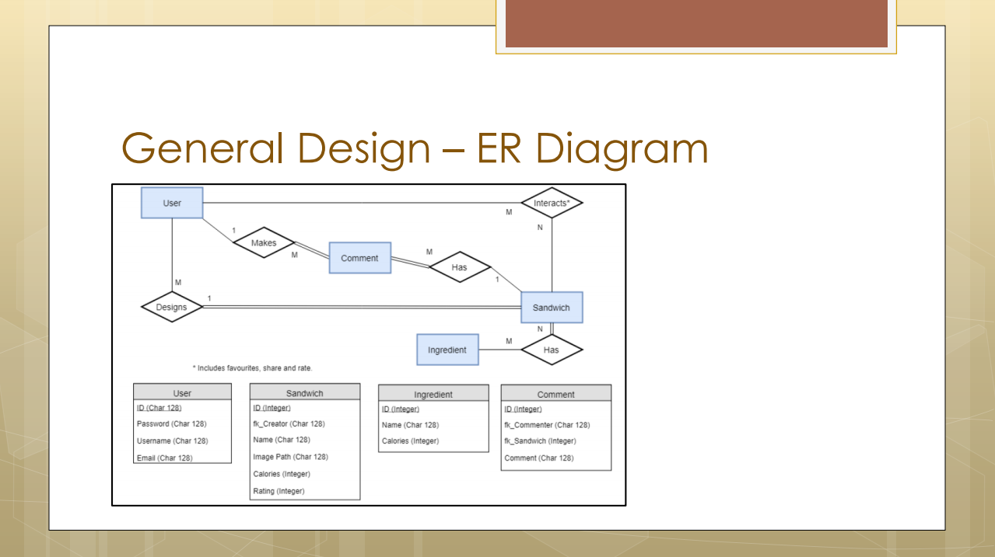
Applications
Discuss how the product or service can be used by different groups, giving real user examples where possible.

Slide 5
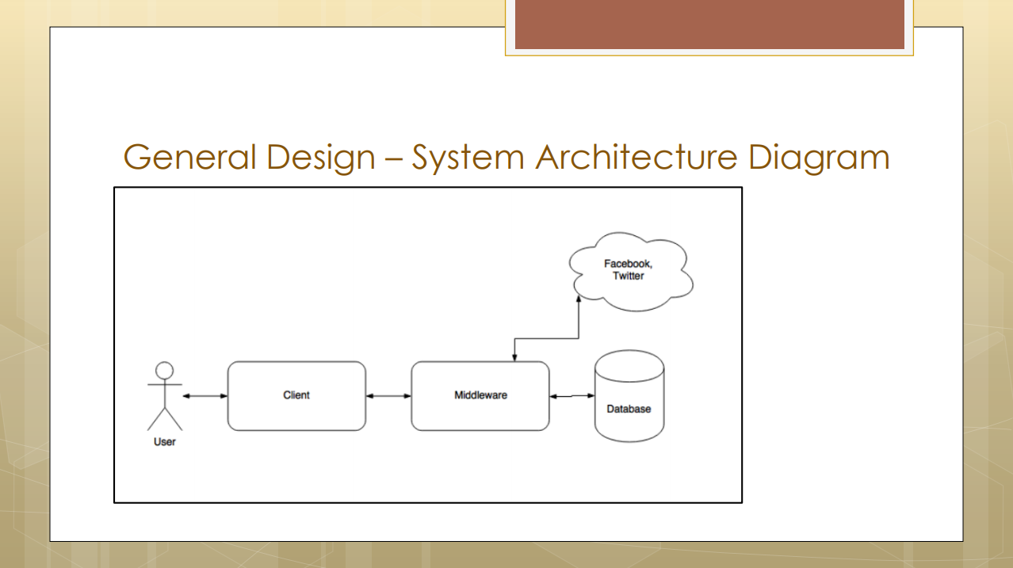
Specifications
For products, give relevant technical specifications, using as many slides as necessary.
For services, detail the terms and conditions under which the service is offered.

Slide 6
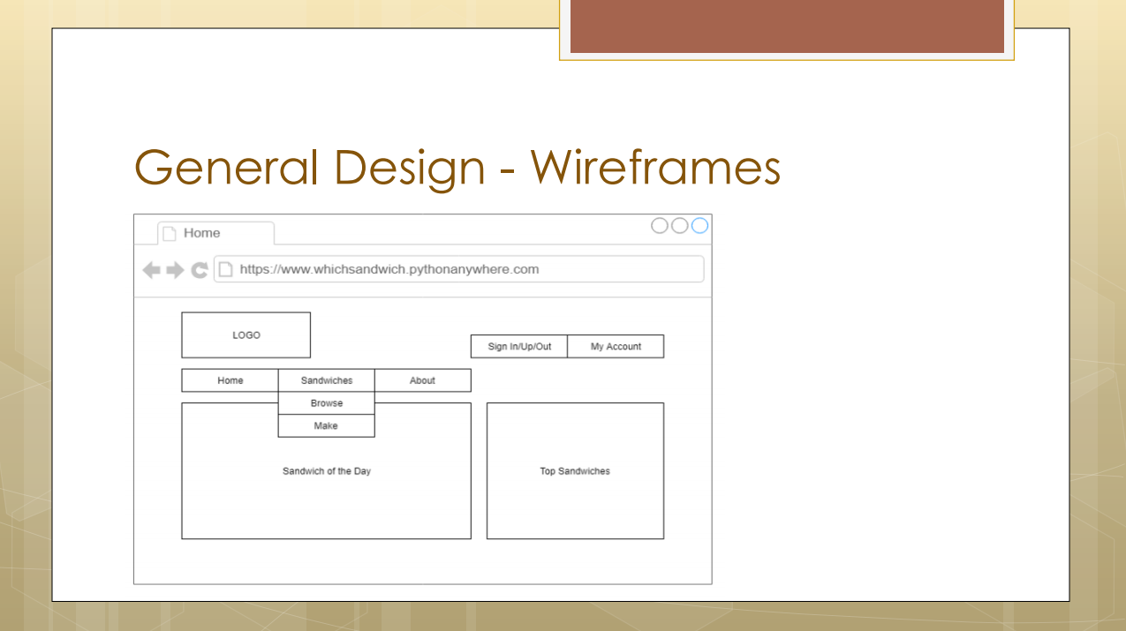
Pricing
Detail the product models available and list specific prices for each model and additional options.

Slide 7
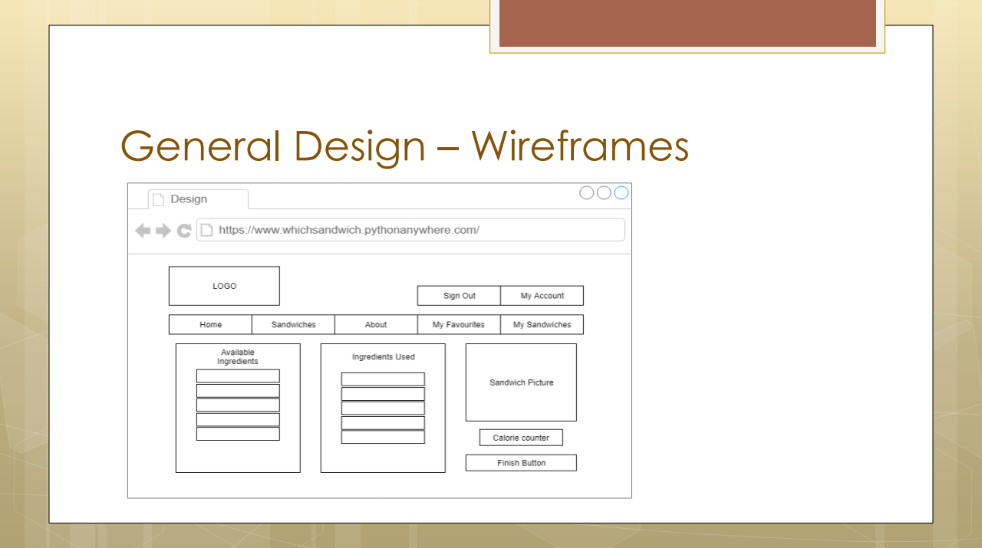
Pricing
Detail the product models available and list specific prices for each model and additional options.

Slide 8
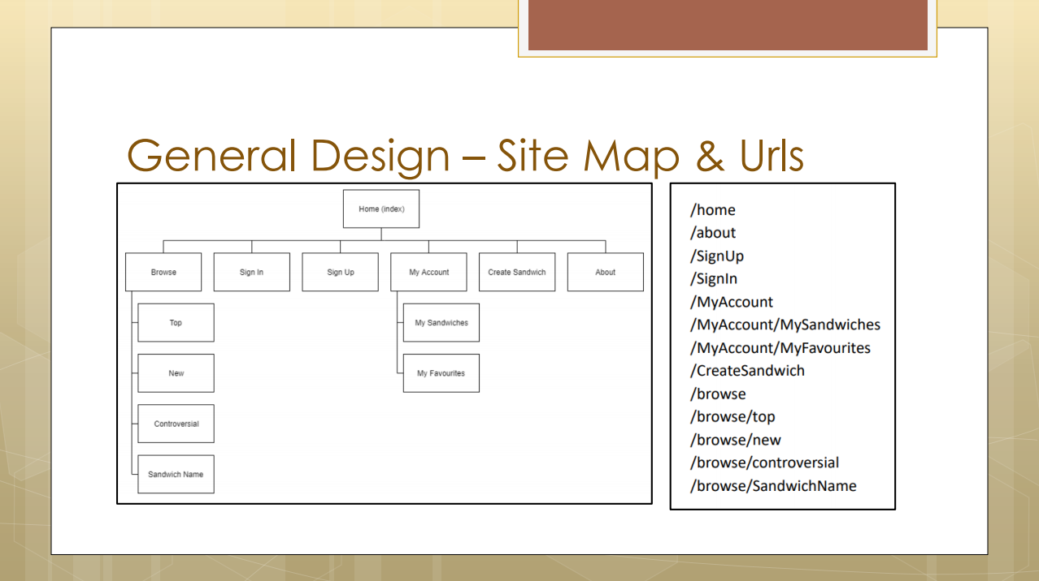
Pricing
Detail the product models available and list specific prices for each model and additional options.

Slide 9
Technologies Used:
HTML
CSS
Bootstrap
JavaScript
Python Anywhere
Django
Notes:
7

Slide 10
Contributions
Matthew Smith:
Gordon Wells:
Quentin Deligny: worked on ER diagram, user personas, forms, views, user authentication and urls.
Notes:
7

Slide 11
Demonstatrion:
WhichSandwich
Notes:
7

