Slide 1


Department of Computer Science & Engineering
PROJECT PHASE-1
B. Tech IV Year I Sem CSE-A
GESTURE DROP – TOUCHLESS TEXT AND IMAGE TRANSFER USING COMPUTER VISION AND HUMAN-COMPUTER INTERACTION
Under the guidance of :
Mrs. P. Swapna, B. Tech M. Tech
Assistant Professor, Dept of CSE
Presented By Team no : 03
G. Snigdha (226P1A0555)
D. Sruthi (226P1A0544)
D. Amulya (226P1A0545)
B. Cassia Praise (226P1A0509)

Slide 2
TABLE OF CONTENT
S.NO | CONTENTS
1. | Abstract
2. | Introduction
3. | Existing System
4. | Proposed System
5. | Literature Survey
6. | Requirements
7. | System Architecture & Methodologies
8. | UML Diagrams
9. | Output
10. | Test Cases
11. | Conclusion
12. | Future Enhancement
13. | References

Slide 3
ABSTRACT
Gesture Drop is an innovative touchless interaction system designed to facilitate seamless text and image transfer through intuitive hand gestures. In environments where hygiene, accessibility, and natural user experience are paramount, Gesture Drop eliminates the need for physical contact with input devices. Using a standard webcam and computer vision frameworks such as Media Pipe and OpenCV, the system detects and interprets hand gestures in real time to perform essential operations like scrolling, Switching tabs, copying, pasting, selecting, and capturing screenshots. The core of Gesture Drop lies in its gesture-to-action mapping pipeline, which translates hand landmark data into system-level commands using automation tools like PyAutoGUI and Pyperclip. This enables users to interact with digital content in a fluid, contact-free manner. The system is lightweight, hardware-agnostic, and deployable across various platforms, making it suitable for healthcare settings, educational environments, public kiosks, and accessibility-focused applications. By bridging the gap between gesture recognition and desktop automation, Gesture Drop redefines how users engage with digital interfaces in a post-touch era.

Slide 4
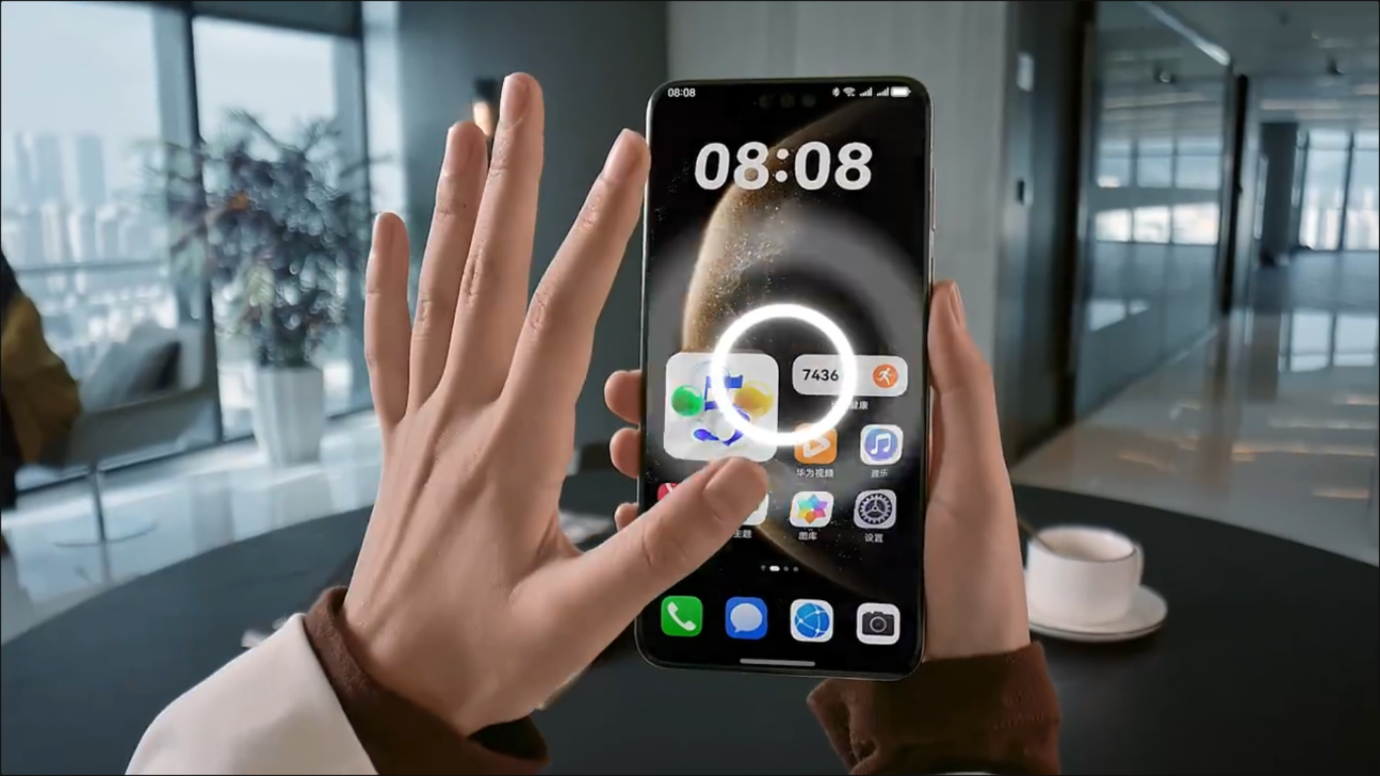
INTRODUCTION
In recent years, the demand for touchless interfaces has surged due to concerns around hygiene, accessibility, and the need for intuitive interaction in smart environments. Traditional input devices like keyboards, mouse, and touchscreens require physical contact, which may not be feasible or desirable in certain contexts. Gesture Drop addresses this gap by introducing a vision-based system that allows users to interact with digital content using hand gestures alone. The system supports essential operations such as scrolling through documents, switching into tabs, copying and pasting text, selecting items, and taking screenshots—all without touching the device. This innovation opens new possibilities for gesture-controlled computing in both personal and professional settings.

Slide 5
EXISTING SYSTEM
The current landscape of human-computer interaction (HCI) is dominated by traditional input methods and limited gesture-based systems. These include:
1. Traditional Input Devices: Touchscreens, keyboards, and mice provide accurate interaction but need physical contact, making them unhygienic and unsuitable for touchless use.
2. Voice-Controlled Interfaces : Virtual assistants like Siri and Alexa allow hands-free control but struggle in noisy places, with accents, or in privacy-sensitive tasks
Limitations:
Not ideal in noisy environments.
Struggles with accents, speech impairments, or privacy-sensitive tasks.
Cannot perform precise visual tasks like selecting text or taking screenshots.
3. Existing Gesture Recognition Systems: Used in gaming and smart TVs, these systems need special sensors or gloves, are costly, and lack desktop productivity integration.

Slide 6
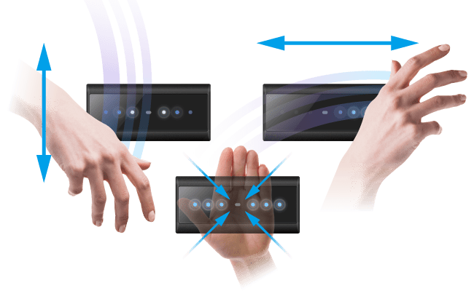
PROPOSED SYSTEM
1. Key Functions (Touchless Interaction)
The system enables users to control the PC without touching the mouse or keyboard:
• Navigation: Scroll documents , Scroll text/regions.
• Editing: Copy, paste.
• Utilities: Take screenshots.
Benefit: Enhances hygiene and accessibility.
2. Technology Used (Software-Driven)
The system relies on established libraries to function:
• MediaPipe: Detects hand landmarks in real-time through Emojis.
• OpenCV: Processes the video feed and displays visual feedback.
• PyAutoGUI: Emulates desktop actions (mouse clicks and keyboard strokes) based on gestures.

Slide 7
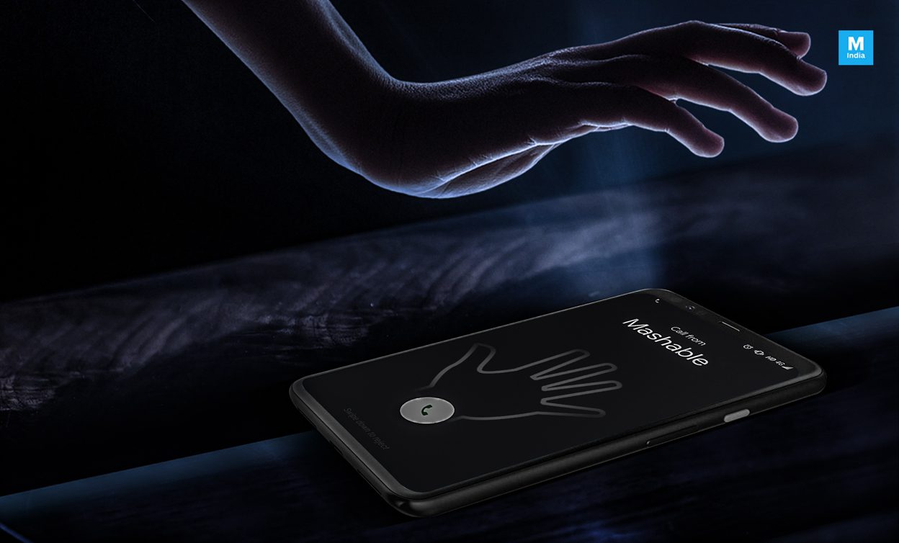
3. System Advantages
• Hardware Independence : Works with any standard webcam; no special equipment (like depth sensors or gloves) is needed.
• Low Requirements: Runs on basic computing hardware (e.g. 4GB RAM, standard OS).
• Scalable & Customizable: Gesture-to-action mappings can be easily modified or extended.
4. Real-World Applications
The touchless feature is valuable in environments where cleanliness or limited
mobility is a concern:
• Healthcare: Navigating medical records without touching surfaces.
• Education: Controlling presentations and annotations hands-free.
• Public Kiosks: Enabling safe, physical-contact-free interaction.
• Accessibility: Assisting users with limited mobility or dexterity.

Slide 8
LITERATURE SURVEY
1. Vision-based hand gesture recognition – K. Sharma et al. (2019):
T0 develop a vision-based system that uses machine learning to recognize hand gestures. The main goal is to enable touchless interaction for controlling computer operations in real-time.
2. Gesture controlled interface- A. Kumar and S. Reddy (2021) :
The goal was to create a gesture-controlled interface using OpenCV and MediaPipe to detect finger landmarks. This demonstrated efficient gesture mapping for common Human-Computer Interaction tasks like scrolling, zooming, and clicking.
3. Gesture-Based PC automation – R. Mehta and L. Das (2022) :
This research aimed to integrate gesture recognition with PC automation using a webcam for detection. The purpose was to provide real-time control and intuitive feedback for manipulating system functions.

Slide 9
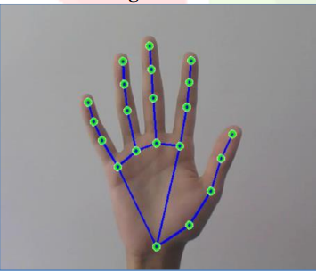
SOFTWARE & HARDWARE REQUIREMENTS
Software Requirements:
Programming Language - Python – 3.10
Libraries - OpenCV, MediaPipe, PyAutoGUI, Pyperclip
IDE – Visual Studio Code
Browser - Chrome, Firefox
OS - Window/Linux/macOS
Hardware Requirements:
Webcam - 720p or higher
Processor - Intel i7
RAM - Min 4GB

Slide 10













SYSTEM ARCHITECTURE
SYSTEM ARCHITECTURE
Input
Action Execution
(PyAutoGUI, Pyperclip)
User
Hand Detection
(OpenCV)
Visualization
Web Cam
Gesture Based Command.
(Gesture valid = Command)
Gesture Recognition
(MediaPipe)
Output

Slide 11
METHODOLOGIES
1. Input (Seeing Your Hand) - The system uses your webcam to capture live video.
• The video is flipped (like a mirror) so your movements feel natural to you.
2. Hand Tracking (Finding the Fingers) - It uses a tool called MediaPipe to instantly find your hand.
• It identifies 21 key points (like fingertips, joints, and wrist) to get the exact location of every part of your hand.
• Why it's good: It works accurately even if your hand is slightly hidden or the lighting changes.
3. Gesture Recognition (What You Are Doing) - The system compares the detected pattern of your fingers (the landmarks) to a list of stored gestures (e.g., Select, Copy, Scroll).
• Once a match is found, the system knows the name of the gesture you performed.
4. Action (Executing the command) - Copy → ctrl + c, Paste →ctrl+ v, Select → mouse click, Switching tabs →
Alt+tab, Screenshot →prtSc, Scroll → scroll action, Exit → Closes the application Window. It uses PyAutoGUI and Pyperclip libraries to control the computer interactions.

Slide 12
UML DIAGRAMS
DATA FLOW DIAGRAM :
Input
User
Web Cam
(OpenCV)
Hand Detection
(MediaPipe)
Gesture Recognization
Invalid
valid
Gesture State=0
Gesture
Gesture-Based Command
Action Execution
(PyAutoGUI, Pyperclip)
Visualization
Output

Slide 13
USE-CASE DIAGRAM :
Capture Gesture
Detect Gesture
Screenshot
Copy data
Paste
Scroll
System
User
Switching tabs
Transfer data
Exit

Slide 14
CLASS DIAGRAM :
Media Pipe Handler
-mp_hands
-mp_drawing
Gesture Controller (webcam)
-capture
-hands
-mp_drawing
-prev_gesture
-copied_data
-action_delay
-last_action_time
+process_frame()
User
-presence_status
-hand_visibility
-peferred_hand
Gesture Action
System Interface
+perform_gesture()
+view_feedback()
+toggle_control()
+adjust_delay(time)
-clipboard_data
-mouse_position
-screen_resolution
-system_status
-gesture_type
-gesture_detected
-action_state
-timestamp
+get_fingers_state()
+identify_gesture()
+perform_action()
+run()
+copy_action()
+paste _action()
+select _action()
+zoom_in _action()
+zoom_out _action()
+scroll _action()
+exit _action()
+execute_shortcut()
+mouse_click()
+scroll_screen ()
+copy_to_clipboard ()
+paste_from_clipboard ()

Slide 15
ACTIVITY DIAGRAM :
Start
Capture Hand via Camera
Detect Landmarks
Analyze Finger States
Identify Gesture
Scroll
Screenshot
Copy
Paste
Switching tabs
Transfer Data
Display Results

Slide 16




SEQUENCE DIAGRAM :
Gesture Recognition Module
User
Camera
Command Processor
Sender System
Show Gesture
Capture image
Receiver System
Captured
Recognize gesture
If gesture=copy
Command
If gesture=Paste
If gesture=Scroll
If gesture=Switching
tabs
If gesture=Exit
Gesture Detected
Output
Display output

Slide 17

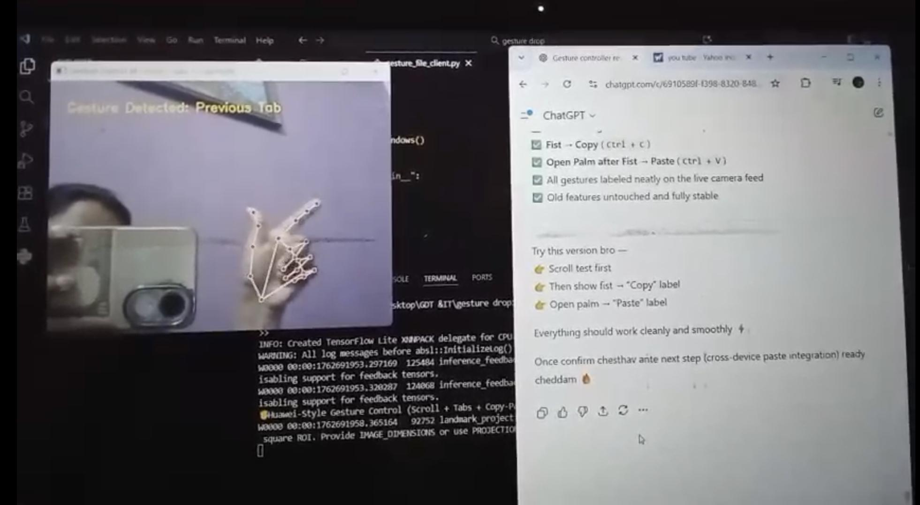
OUTPUT

Slide 18
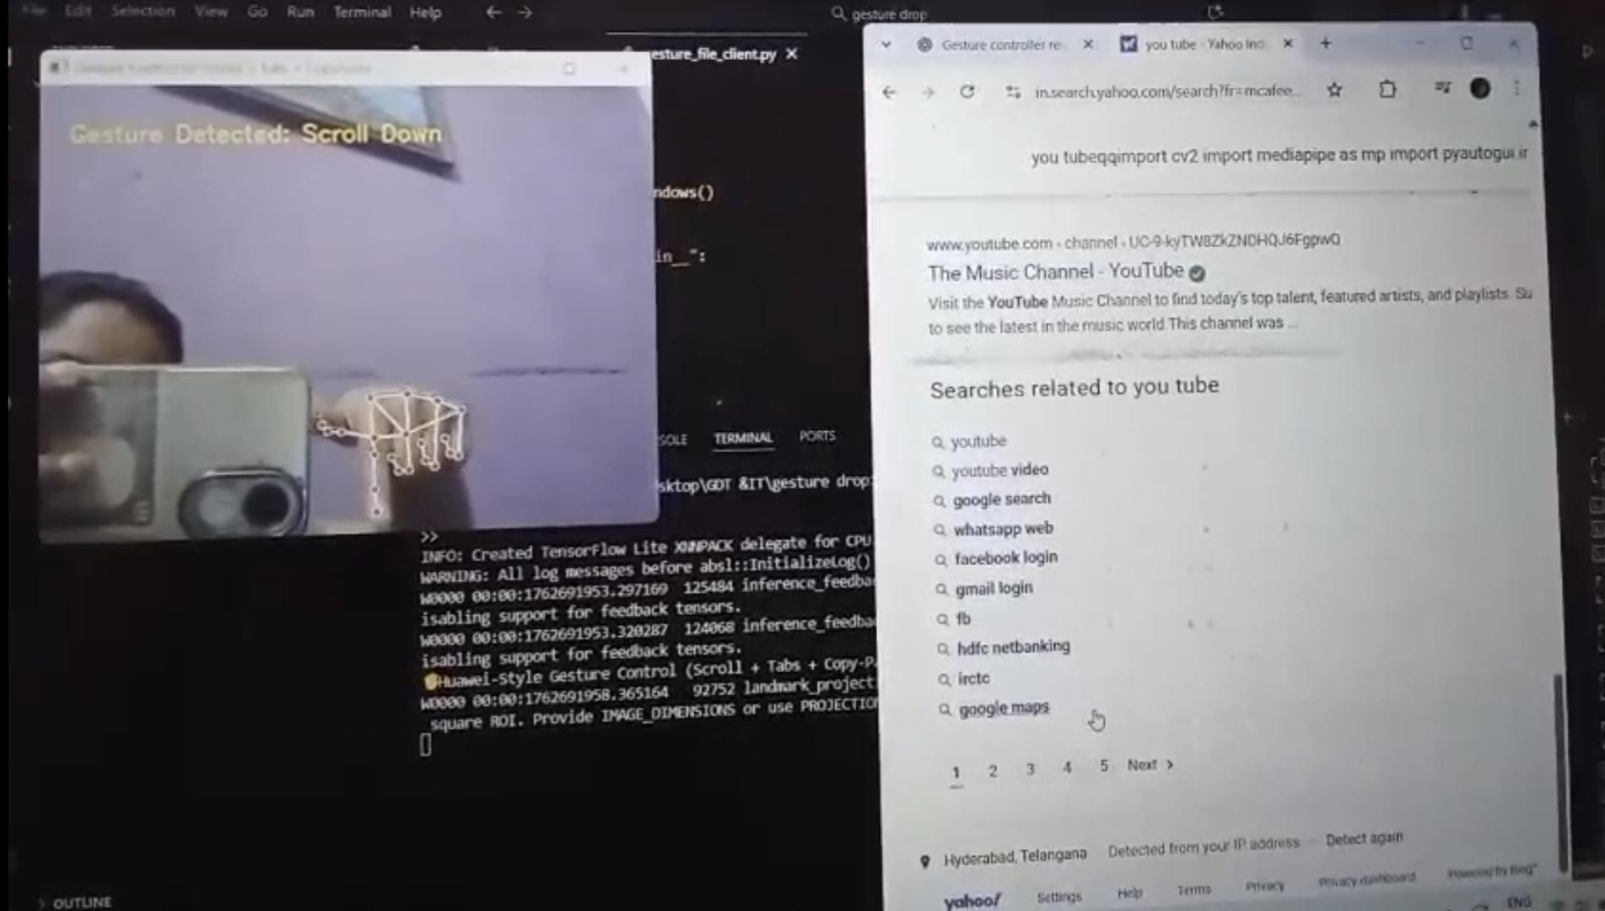

Slide 19
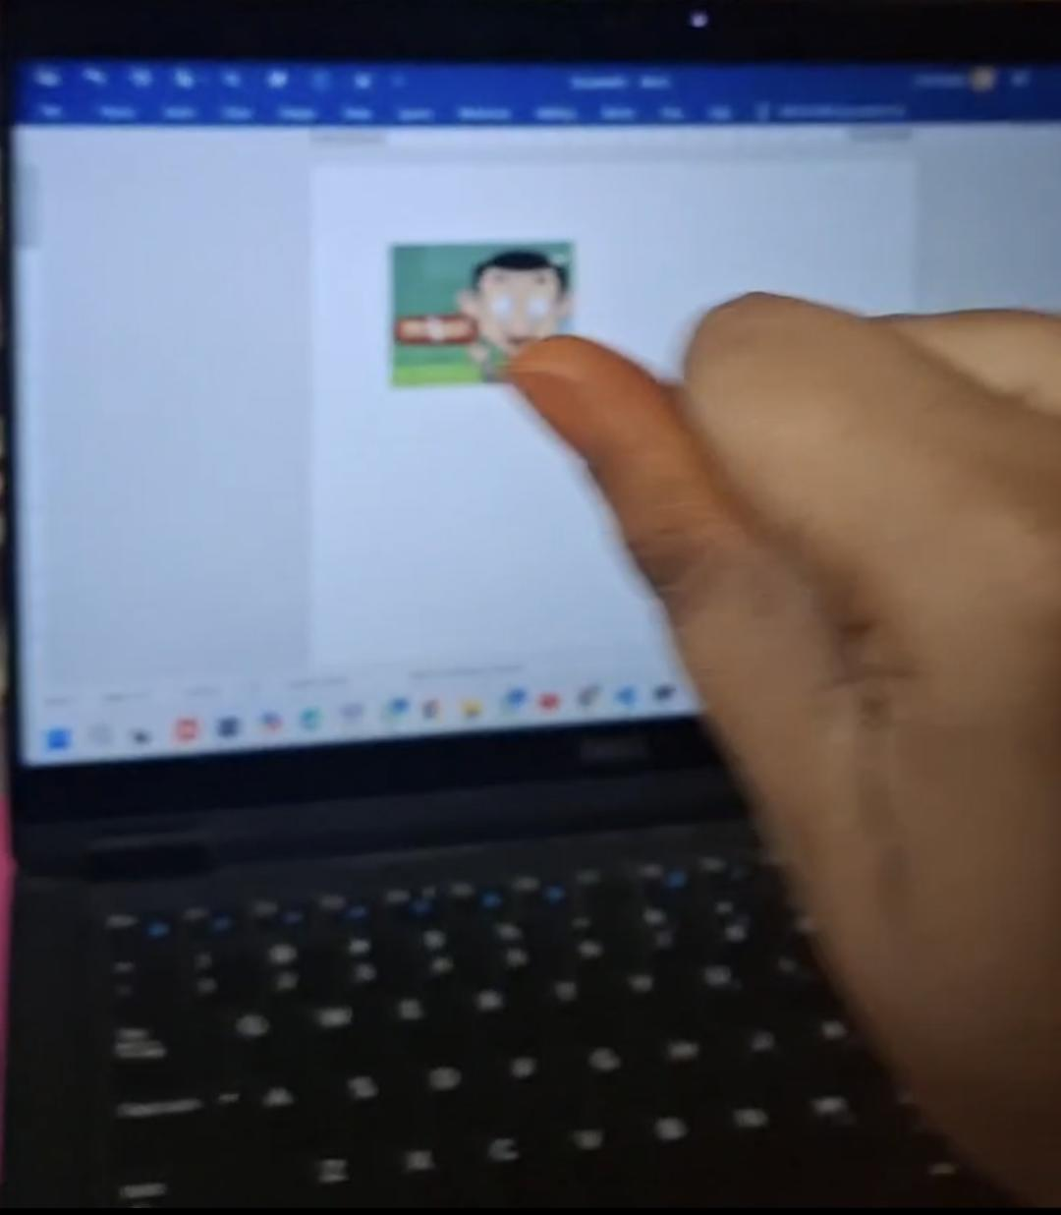
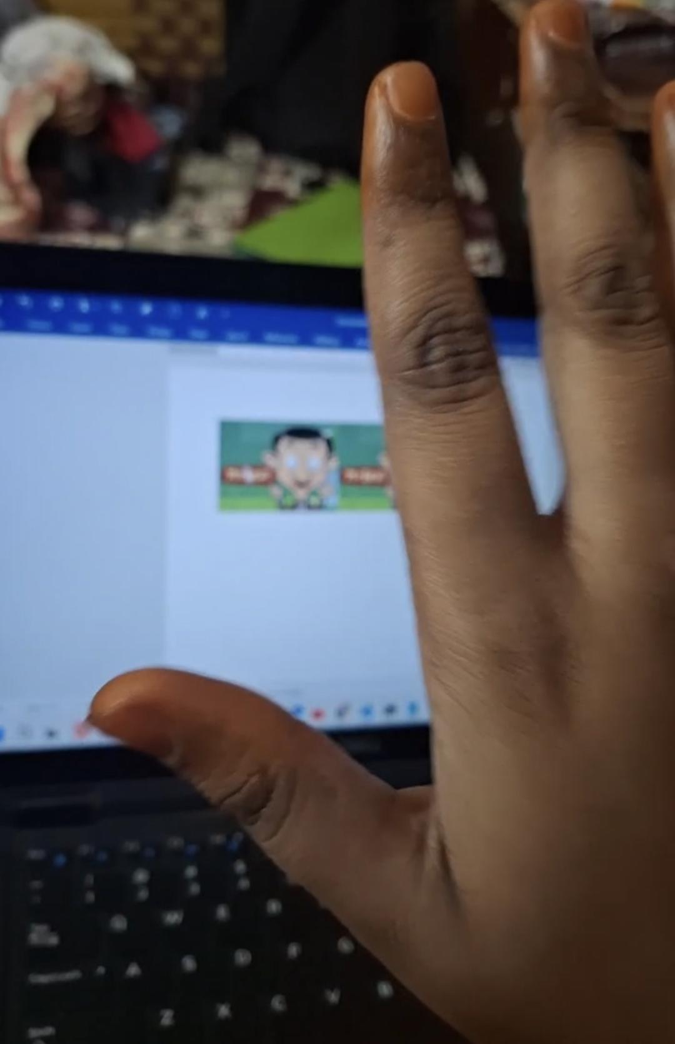
Gesture: ✊Copy
Gesture: 🤚Paste

Slide 20
TEST CASES
Test Case ID | Test Scenario | Test Steps | Expected Result | Actual Result | Status
TC01 | Application Launch | Run the integrated gesture_transfer.py on the device. | Camera opens, receiver thread starts, and sender window is visible. | Camera opens, receiver thread starts, and sender window is visible. | ✅
TC02 | Copy Gesture (✊) | Show a closed fist (✊) in front of the camera. | The system detects the “Copy” gesture and sends a text message to the receiver. Receiver console prints the received text. | The system detects the “Copy” gesture and sends a text message to the receiver. Receiver console prints the received text. | ✅
TC03 | Paste Gesture (🖐️) | Show an open palm (🖐️) to the camera. | The system detects the “Paste” gesture and sends an image to the receiver. Receiver displays the received image. | The system detects the “Paste” gesture and sends an image to the receiver. Receiver displays the received image. | ✅
TC04 | Exit Gesture (✌️) | Show the victory sign (✌️). | The system detects the “Exit” gesture, closes camera window, and terminates socket connections gracefully. | The system detects the “Exit” gesture, closes camera window, and terminates socket connections gracefully. | ✅

Slide 21
TC05 | Simultaneous Send/Receive Test (Same Device) | Run sender and receiver in the same script (localhost 127.0.0.1). | Text and image transfer occur within the same device successfully. No connection error. | Text and image transfer occur within the same device successfully. No connection error. | ✅
TC06 | Network Failure Simulation | Stop receiver manually while sender is active. | Sender displays connection error; program handles it gracefully without crashing. | Sender displays connection error; program handles it gracefully without crashing. | ✅
TC07 | Performance under Continuous Gestures | Perform multiple gestures repeatedly for 1 minute. | The system detects gestures consistently and transmits all messages without delay or freezing. | The system detects gestures consistently and transmits all messages without delay or freezing. | ✅
TC08 | Invalid Gesture Handling | Show random or incomplete hand signs. | System correctly ignores them (no false detection, no transmission). | System correctly ignores them (no false detection, no transmission). | ✅

Slide 22
CONCLUSION
1.The Gesture Drop – Touchless Text and Image Transfer system introduces a contactless digital communication method using computer vision, gesture recognition, and socket programming — replacing traditional inputs like keyboards and touchscreens with natural hand gestures.
2.The system uses MediaPipe and OpenCV to detect gestures and perform actions like copy, paste, select, scroll, screenshot, and clear. With Python sockets, it enables smooth data transfer between devices, ensuring efficiency and ease of use.
3.The project showcases AI-based gesture recognition as a way to enhance digital accessibility, benefiting physically challenged users and those in hygiene-sensitive environments such as hospitals and labs by reducing physical contact and contamination risks.
4.Gesture Drop lays the groundwork for applications in IoT, AR/VR, smart environments, and remote collaboration, combining real-time vision with intuitive gesture control for futuristic, hands-free computing.
Overall, the project demonstrates that gesture recognition is a powerful, efficient, and sustainable approach to modern human–computer interaction, paving the way for further innovation and research.

Slide 23
FUTURE ENHANCEMENT
1.Gesture Accuracy Optimization : Future updates can use deep learning models to improve gesture accuracy under varying lighting, hand positions, and backgrounds.
2.Cross-Platform Support : Extend compatibility to Android and iOS for gesture-based data transfer across laptops, smartphones, and tablets.
3.Encrypted Data Transfer : Add end-to-end encryption to ensure secure and private transmission of text and image data.
4.Gesture Customization : Allow users to create personalized gestures for actions like copy, paste, delete, or open, increasing flexibility and user control.
5.Real-Time Multi-User Communication : Enable multiple users to interact and share data simultaneously, supporting collaboration in classrooms, meetings, and remote work.
6.Improved UI and Feedback : Develop an interactive interface with visual and audio feedback to confirm gestures, transfers, and connection status.
1.

Slide 24
REFERENCES
1. MediaPipe Documentation
https://developers.google.com/mediapipe
2. Python Socket Programming Guide
https://realpython.com/python-sockets/
OpenCV and MediaPipe Integration Example
https://learnopencv.com/mediapipe-hand-tracking/
4. Python Threading and Networking Concept
https://docs.python.org/3/library/threading.html
5. Pillow (PIL) Image Processing Library
https://pillow.readthedocs.io/en/stable/

Slide 25


