Slide 1
Pracownia Programowania 1 Computer Programming 1
PP1/CP1
Course Introduction

Slide 2
Communication
Use course forum on Teams
Use Microsoft Teams chat
Take part in office hours (details on teacher’s e-card)
Send an email (details on teacher’s e-card)
My e-card
https://e-uczelnia.uek.krakow.pl/course/view.php?id=218

Slide 3
Course Details

Slide 4
Course Content
Class Topics
Course Introduction
Part 1: PROGRAMING BASICS (variable, control structure, function)
Part 2: DATA STRUCTURES (array, file, dictionary, set)
Part 3: PROGRAMMING PARADIGMS (class, object, method)
Tests Retake (only for absent students)
Final Class/Grades

Slide 5
Passing Course
You can get points from three tests
In case of an excused absence, you can complete the test at the end of the semester
If you are not prepared for the regular classes, you may lose some points
Course item | Points
Test 1 | 0-6
Test 2 | 0-7
Test 3 | 0-7
TOTAL | 0-20

Slide 6
Final Grade
The final grade is determined on the basis of the obtained number of points
Total Points | Final Grade
>= 18 | 5.0
>= 16 | 4.5
>= 14 | 4.0
>= 12 | 3.5
>= 10 | 3.0
< 10 | 2.0

Slide 7
Tools

Slide 8

Source-Code Editor
https://code.visualstudio.com

Slide 9

Version Control System
https://git-scm.com

Slide 10

Programming Language
https://www.python.org

Slide 11
Python Tutorials
Python for Everybody (book)
https://www.py4e.com/book
Python Tutorial
https://docs.python.org/3/tutorial/index.html
W3Schools Python Tutorial
https://www.w3schools.com/python/default.asp
SoloLearn Python Course (for mobile devices)
https://play.google.com/store/apps/details?id=com.sololearn&hl=en

Slide 12
Internet Services
Log in to Teams, Moodle, and Github

Slide 13
Sign up for Course on Teams
Run Microsoft Teams
Log in to your account
Display team list
Select „join a team”
Use a team code minz3eq

Slide 14
Sign up for Course on Moodle
Log in to Moodle https://moodle.uek.krakow.pl
Find the course Pracownia Programowania 1 / Computer Programming 1
Sign up for the course As the access key, use your full group number (from University Schedule)

Slide 15
Create Account on Github
Go to the Github service https://github.com
Create an account or use your private account
In Github Settings enter your real full name (first and last name)

Slide 16
Make Copy of Class Materials
Log in to Github
Find the course materials (github repository) stalj/pp1
Fork (copy) the repository
Make sure you have your own private copy of the course materials on your account on Github

Slide 17
Homework
Tools Installation

Slide 18
Watch the video
Python Tutorial for Beginners with VS Code by Dave Gray
https://youtu.be/6i3e-j3wSf0

Slide 19
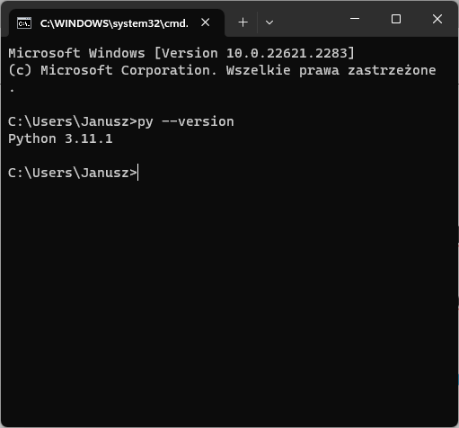
Install Python
Install Python https://www.python.org
Check Python on your computer
Open command prompt window
Enter command python --version or py --version

Slide 20
Install Visual Studio Code
Install Microsoft Visual Studio Code (VSCode)
Install VSCode extensions for Python (Microsoft)
Check Python working in VSCode
On your computer desktop, create a folder TestPython
Run VSCode
Open the created folder
In the folder, create a file hello.py
Enter Python statements as it was in the video
Run the program

Slide 21
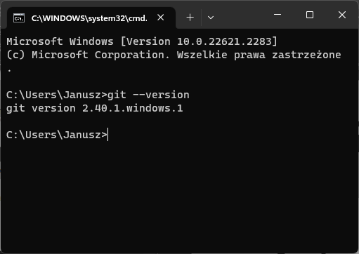
Install Git
Install Git Control Version System https://git-scm.com
Check Git on your computer
Open command prompt window
Enter command git --version

Slide 22
Homework
Course Materials

Slide 23
Clone Your Course Repository
Find out on how to use Git command git clone
Open command prompt window
Clone (copy) your own copy of the course repository (materials) from github to your personal computer

Slide 24
Read the Course Syllabus
In your local repository, open a folder 01-CourseIntroduction
Familiarise yourself with the course syllabus PP1-Syllabus.docx

Slide 25
Prepare for the next class
In your local repository, open a folder 02-TypesAndVariables
Open the document for the next class 02-TypesAndVariables.docx
Complete all tasks contained in the section BEFORE CLASS

