Slide 1

嵌入式
系统设计
LOGO
Only by changing the way we treat the environment can we get along well with it.Only by saving the environment can save ourselves.
汇报人：第22组

Slide 2

行业PPT模板http://www.1ppt.com/hangye/
目录/Contents
实验(b)背景与原理
实验(b)结果展示
01
嵌入式操作系统的虚拟化机制设计
02
嵌入式操作系统的虚拟化机制设计
实验(d)背景与原理
实验（d)结果展示
03
嵌入式操作系统的系统调用编译设计
04
嵌入式操作系统的系统调用编译设计

Slide 3
PART ONE
01
实验(b)背景与原理
嵌入式操作系统的虚拟化机制设计背景与原理

Slide 4
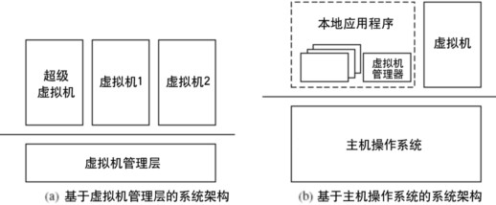
嵌入式操作系统的虚拟化机制背景
随着嵌入式系统的发展和普及，嵌入式操作系统在各个领域的应用越来越广泛。嵌入式系统通常具有资源受限、功耗低、实时性强等特点，因此对于嵌入式操作系统的虚拟化机制设计提出了更高的要求。
虚拟化技术能够有效地提高嵌入式系统的资源利用率、降低系统开发和维护成本，并且能够实现多个应用程序或操作系统的隔离和安全性保护。
因此，设计一种适用于嵌入式操作系统的虚拟化机制成为当前的研究热点之一。
在这样的背景下，开展嵌入式操作系统的虚拟化机制设计实验具有重要的理论和实践意义。

Slide 5
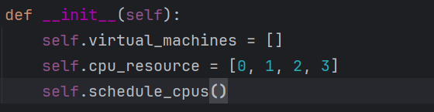
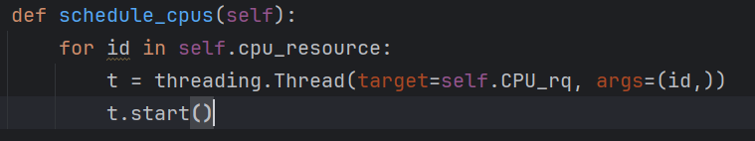
嵌入式操作系统的虚拟化机制设计原理
hypervisor对象初始化时，设定可以使用的CPU资源，并执行CPU调度程序。如下图程序
虚拟机监控器（Hypervisor）实现: 设计一个轻量级的Hypervisor框架，支持加载和运行虚拟机实例。实现硬件资源的抽象化和虚拟化，包括CPU、内存和I/O设备。
CPU调度程序的实现：
为每一个CPU创建一个轮询线程，每隔一个固定的时间将此CPU的占用切换给其他虚拟机。如右图

Slide 6
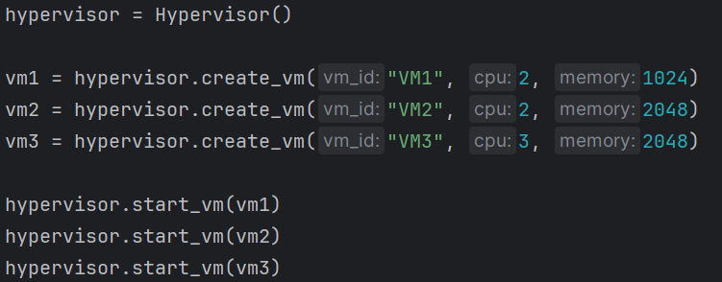
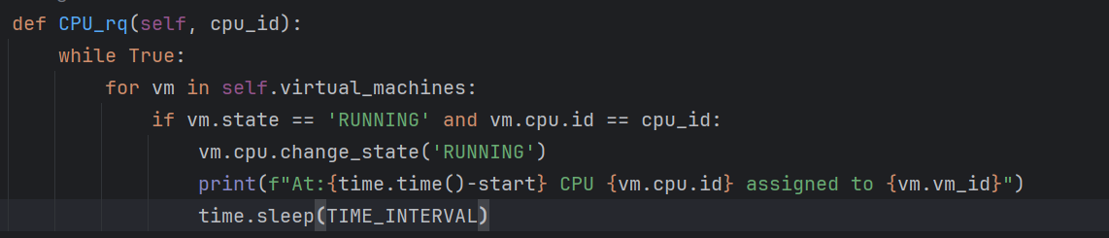
嵌入式操作系统的虚拟化机制设计原理
虚拟CPU管理: 开发虚拟CPU调度器，模拟CPU时间片分配给不同的虚拟机。实现虚拟CPU状态管理，包括创建、运行、挂起和恢复等状态。
测试程序：
创建三个虚拟机并运行，其中VM1,2占用CPU2，VM3占用CPU3。在运行过程中，设置轮训时间片为5s。
为每一个核创建一个轮训线程。

Slide 7

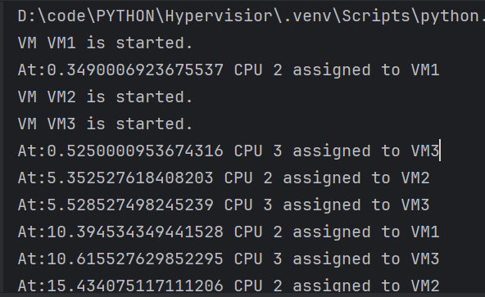
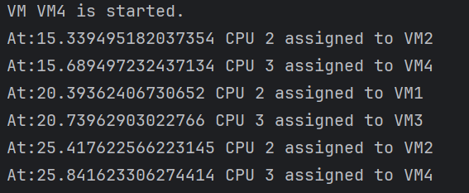
嵌入式操作系统的虚拟化机制设计原理
运行结果如下：
VM1,2每隔5s会完成CPU占用的切换，VM3独占CPU，不会完成CPU占用权的切换
在VM4启动之后，CPU调度程序也能完成对CPU3的时间片分配，每隔5s在VM3,4间切换。如下图
设定15s之后VM4开始运行，vm4同样占用CPU3。也就是说在15s之后CPU3由vm3,4共享。

Slide 8
单击此处输入标题文本
单击此处输入标题
单击此处输入标题
单击此处输入标题
Only by changing the way we treat the environment can we get along well with it.Only by saving the environment can save ourselves.
Only by changing the way we treat the environment can we get along well with it.Only by saving the environment can save ourselves.Only by changing the way we treat the environment can we get along well with it.
单击此处输入标题
单击此处输入标题

Slide 9

单击此处输入标题文本
单击此处输入标题
1
I love you more than I've ever loved any woman. And I've waited longer for you than I've waited for any woman.
单击此处输入标题
2
I love you more than I've ever loved any woman. And I've waited longer for you than I've waited for any woman.
单击此处输入标题
3
I love you more than I've ever loved any woman. And I've waited longer for you than I've waited for any woman.

Slide 10
单击此处输入标题文本
单击此处输入标题
Only by changing the way we treat the environment can we get along well with it.Only by saving the environment can save ourselves.
单击此处输入标题
单击此处
输入标题
单击此处
输入标题
Only by changing the way we treat the environment can we get along well with it.Only by saving the environment can save ourselves.

Slide 11
PART TWO
02
请输入标题
Only by changing the way we treat the environment can we get along well with it.Only by saving the environment can save ourselves.

Slide 12


单击此处输入标题文本
单击此处输入标题
Only by changing the way we treat the environment can we get along well with it.
单击此处输入标题
Only by changing the way we treat the environment can we get along well with it.
单击此处输入标题
Only by changing the way we treat the environment can we get along well with it.
单击此处输入标题
Only by changing the way we treat the environment can we get along well with it.

Slide 13

单击此处输入标题文本
I love you more than I've ever loved any woman. And I've waited longer for you than I've waited for any woman.
I love you more than I've ever loved any woman. And I've waited longer for you than I've waited for any woman.
I love you more than I've ever loved any woman. And I've waited longer for you than I've waited for any woman.
I love you more than I've ever loved any woman. And I've waited longer for you than I've waited for any woman.

Slide 14
单击此处输入标题文本
单击此处输入标题
单击此处输入标题
I love you more than I've ever loved any woman. And I've waited longer for you than I've waited for any woman.
I love you more than I've ever loved any woman. And I've waited longer for you than I've waited for any woman.
单击此处输入标题
单击此处输入标题
I love you more than I've ever loved any woman. And I've waited longer for you than I've waited for any woman.
I love you more than I've ever loved any woman. And I've waited longer for you than I've waited for any woman.

Slide 15

单击此处输入标题文本
Only by changing the way we treat the environment can we get along well with it.Only by saving the environment can save ourselves.Only by changing the way we treat the environment can we get along well with it.Only by saving the environment can save ourselves..
单击此处输入标题
单击此处输入标题
Only by changing the way we treat the environment can we get along well with it.Only by saving the environment can save ourselves.
Only by changing the way we treat the environment can we get along well with it.Only by saving the environment can save ourselves.

Slide 16


单击此处输入标题文本
I love you more than I've ever loved any woman. And I've waited longer for you than I've waited for any woman.I love you more than I've ever loved any woman. And I've waited longer for you than I've waited for any woman.
单击此处输入标题
单击此处输入标题
I love you more than I've ever loved any woman. And I've waited longer for you than I've waited for any woman.
And I've waited longer for you than I've waited for any woman.
I love you more than I've ever loved any woman. And I've waited longer for you than I've waited for any woman.
And I've waited longer for you than I've waited for any woman.

Slide 17
PART THREE
03
请输入标题
Only by changing the way we treat the environment can we get along well with it.Only by saving the environment can save ourselves.

Slide 18






单击此处输入标题文本
1
单击此处输入标题
I love you more than I've ever loved any woman. And I've waited longer for you than I've waited for any woman.
2
单击此处输入标题
I love you more than I've ever loved any woman. And I've waited longer for you than I've waited for any woman.
3
单击此处输入标题
I love you more than I've ever loved any woman. And I've waited longer for you than I've waited for any woman.

Slide 19
单击此处输入标题文本
S
W
O
T
输入标题
输入标题
输入标题
输入标题
I love you more than I've ever loved any woman. And I've waited longer for you than I've waited for any woman.
I love you more than I've ever loved any woman. And I've waited longer for you than I've waited for any woman.
I love you more than I've ever loved any woman. And I've waited longer for you than I've waited for any woman.
I love you more than I've ever loved any woman. And I've waited longer for you than I've waited for any woman.

Slide 20


单击此处输入标题文本
单击此处输入标题
I love you more than I've ever loved any woman. And I've waited longer for you than I've waited for any woman.
单击此处输入标题
I love you more than I've ever loved any woman. And I've waited longer for you than I've waited for any woman.
单击此处输入标题
I love you more than I've ever loved any woman. And I've waited longer for you than I've waited for any woman.

Slide 21
单击此处输入标题文本
单击此处输入标题
单击此处输入标题
单击此处输入标题
I love you more than I've ever loved any woman. And I've waited longer for you than I've waited for any woman.
I love you more than I've ever loved any woman. And I've waited longer for you than I've waited for any woman.
I love you more than I've ever loved any woman. And I've waited longer for you than I've waited for any woman.

Slide 22
单击此处输入标题文本
单击此处输入标题
I love you more than I've ever loved any woman. I love you more than I've ever loved any woman. And I've waited longer for you than I've waited for any woman.
I love you more than I've ever loved any woman. And I've waited longer for you than I've waited for any woman.I love you more than I've ever loved any woman. And I've waited longer for you than I've waited for any woman.
I love you more than I've ever loved any woman. And I've waited longer for you than I've waited for any woman

Slide 23
PART FOUR
04
请输入标题
Only by changing the way we treat the environment can we get along well with it.Only by saving the environment can save ourselves.

Slide 24

单击此处输入标题文本
1
单击此处输入标题
I love you more than I've ever loved any woman. And I've waited longer for you than I've waited for any woman.
2
单击此处输入标题
I love you more than I've ever loved any woman. And I've waited longer for you than I've waited for any woman.
3
单击此处输入标题
I love you more than I've ever loved any woman. And I've waited longer for you than I've waited for any woman.

Slide 25

单击此处输入标题文本
单击此处输入标题
I love you more than I've ever loved any woman. And I've waited longer for you than I've waited for any woman.I love you more than I've ever loved any woman. And I've waited longer for you than I've waited for any woman.
I love you more than I've ever loved any woman. And I've waited longer for you than I've waited for any woman.I love you more than I've ever loved any woman. And I've waited longer for you than I've waited for any woman.
单击此处输入标题
I love you more than I've ever loved any woman. And I've waited longer for you than I've waited for any woman.I love you more than I've ever loved any woman. And I've waited longer for you than I've waited for any woman.

Slide 26
单击此处输入标题文本
单击输入标题
单击输入标题
单击输入标题
单击输入标题
I love you more than I've ever loved any woman. And I've waited longer for you than I've waited for any woman.
I love you more than I've ever loved any woman. And I've waited longer for you than I've waited for any woman.
I love you more than I've ever loved any woman. And I've waited longer for you than I've waited for any woman.
I love you more than I've ever loved any woman. And I've waited longer for you than I've waited for any woman.
Notes:
模板来自于： 第一PPT https://www.1ppt.com/

Slide 27


单击此处输入标题文本
单击此处输入标题
I love you more than I've ever loved any woman.
And I've waited longer for you than I've waited for any woman.
I love you more than I've ever loved any woman.
单击此处输入标题
I love you more than I've ever loved any woman.
And I've waited longer for you than I've waited for any woman.
I love you more than I've ever loved any woman.
DREAM

Slide 28
THANK YOU
Only by changing the way we treat the environment can we get along well with it.Only by saving the environment can save ourselves.
汇报人：第一PPT

Slide 29

可以在下列情况使用
个人学习、研究。
拷贝模板中的内容用于其它幻灯片母版中使用。
不可以在以下情况使用
任何形式的在线付费下载。
网络转载、线上线下传播。
PPT模板： www.1ppt.com/moban/ 行业PPT模板：www.1ppt.com/hangye/
节日PPT模板：www.1ppt.com/jieri/ PPT素材： www.1ppt.com/sucai/
PPT背景图片：www.1ppt.com/beijing/ PPT图表： www.1ppt.com/tubiao/
优秀PPT下载：www.1ppt.com/xiazai/ PPT教程： www.1ppt.com/powerpoint/
Word模板： www.1ppt.com/word/ Excel模板： www.1ppt.com/excel/
个人简历： www.1ppt.com/jianli/ PPT课件： www.1ppt.com/kejian/
手抄报： www.1ppt.com/shouchaobao/ 试题下载： www.1ppt.com/shiti/
教案下载： www.1ppt.com/jiaoan/ 字体下载： www.1ppt.com/ziti/

