Slide 1

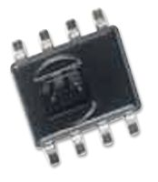

Team 2 Real time weather station accessible on web server
Damir Gulamov (web server), Craig McCallum (data processing), Aurelie Crawford (electronics)
Pressure sensor
Humidity and temperature sensor
Level shifter

Slide 2
Image of PCB circuit design
Technologies used: - i2c protocol
PCB design in Multisim and Ultiboard
C++ Timer
GUI (web interface, php, mysql, ngnix)
Image of graphs created on web server

