Slide 1
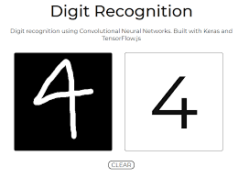
MINI PROJECT
HAND WRITTEN DIGIT RECOGNITION Using MNIST Dataset
NAME- SANA AFREEN
SECTION-E
ROLLNO.-48
UNI.ROLLNO.-2014831

Slide 2
Abstract
The handwritten digit recognition is the capability of computer applications to recognize the human handwritten digits.
It is a hard task for the machine because handwritten digits are not perfect and can be made with many different shapes and sizes.
The handwritten digit recognition system is a way to tackle this problem which uses the image of a digit and recognizes the digit present in the image.
So it’s quite challenging to train a model that can predict handwritten text with high accuracy. We have developed a CNN (Convolutional Neural Network) model that can recognize digits from images with a 99.83% accuracy.

Slide 3
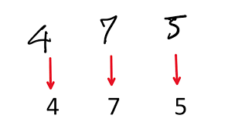
Introduction
Handwritten digit recognition is the ability of a computer to recognize the human handwritten digits from different sources like images, papers, touch screens, etc, and classify them into 10 predefined classes (0-9). This has been a topic of boundless-research in the field of deep learning.
Digit recognition has many applications like number plate recognition, postal mail sorting, bank check processing, etc. In Handwritten digit recognition, we face many challenges because of different styles of writing of different peoples as it is not an Optical character recognition.
The main purpose is to analyze the variation of outcome results for using a different combination of hidden layers of Convolutional Neural Network.

Slide 4
About MNIST Dataset
The MNIST dataset is an acronym that stands for the Modified National Institute of Standards and Technology dataset.
It is a dataset of 60,000 small square 28×28 pixel grayscale images of handwritten single digits between 0 and 9.
classify a given image of a handwritten digit into one of 10 classes representing integer values from 0 to 9.
It is a widely used and deeply understood dataset and, for the most part, is “solved.” Top-performing models are deep learning convolutional neural networks that achieve a classification accuracy of 99.83%

Slide 5
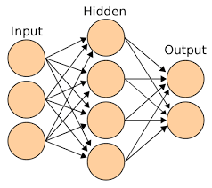
CNN
CNN is a deep learning algorithm that is widely used for image recognition and classification. It is a class of deep neural networks that require minimum pre-processing.
CNN contains 3 layers namely, an input layer, an output layer, and multiple hidden layers which include Convolutional layers, Pooling layers(Max and Average pooling), Fully connected layers (FC), and normalization layers.
CNN employs different activation functions at each layer to add some non-linearity. As we move into the CNN, we observe the height and width decrease while the number of channels increases.
Dense Layer is used to classify image based on output from convolutional layers.

Slide 6
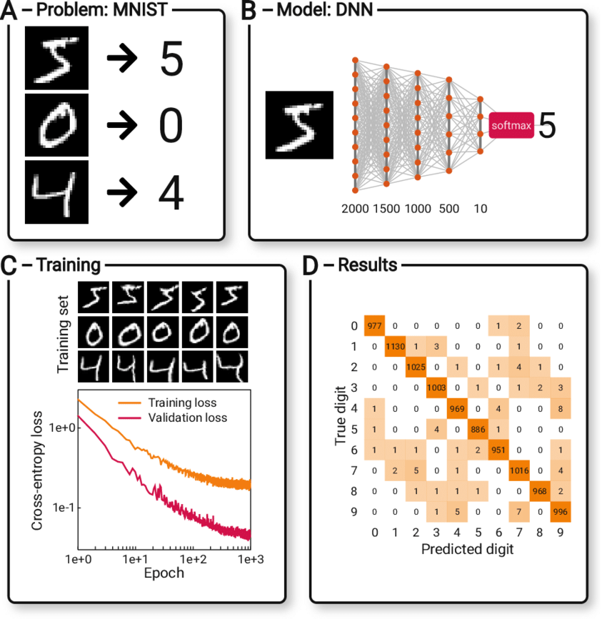
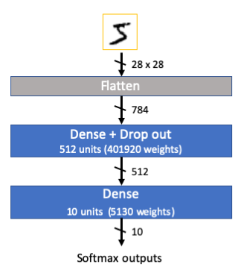
The Architecture

Slide 7
Implementation
https://github.com/2286-SANA/Hand-Written-Digit-Recognition-/blob/main/HWDR.ipynb

Slide 8
FUTURE OPPORTUNITIES
In this project, we have implemented model for handwritten digit recognition using MNIST datasets, based on deep and machine learning algorithms. CNN gave the most accurate results for handwritten digit recognition. So, this makes us conclude that CNN is best suitable for any type of prediction problem including image data as an input. Next, by comparing execution time of the algorithms we have concluded that increasing the number of epochs without changing the configuration of the algorithm is useless because of the limitation of a certain model and we have noticed that after a certain number of epochs the model starts overfitting the dataset and give us the biased prediction.
The future development of the applications based on algorithms of deep and machine learning is practically boundless. In future, different architectures of CNN, namely, hybrid CNN, viz., CNN-RNN and CNN-HMM models, and domain-specific recognition systems, can be investigated. Evolutionary algorithms can be explored for optimizing CNN learning parameters, namely, the number of layers, learning rate and kernel sizes of convolutional filters.

Slide 9
REFERENCES
https://ieeexplore.ieee.org/document/9388351
https://www.researchgate.net/publication/302871740_Handwritten_Digit_Recognition_Using_Convolutional_Neural_Networks

Slide 10
Thank you

