Slide 1


Department of Information Technology
V R Siddhartha Engineering College
Complex-Domain Audio Source Separation using
ResUnet++,ConvTasNet,Demucs
B.Tech in Information Technology
MAJOR Project Review Presentation
Presented by
B.V.S.S. AKHIL(228W1A1274)
PRASANA KUMAR REDDY (228W1A12C3)
Under the guidance of
K.RAJA.SRAVAN KUMAR , Asst.Professor

Slide 2
Agenda
Introduction and Problem Statement
Objectives and Outcomes of the Project
Literature review and Summary
Dataset and Requirements
Algorithms used in the Project
Architecture/Project flow diagram
Implementation steps and Execution
Results Obtained
Result analysis with charts
Conclusion and Future work
References

Slide 3
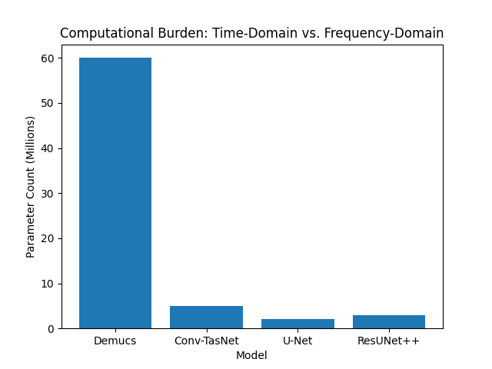
Introduction and Problem Statement
Introduction:
The Challenge: Real-world overlapping noise severely degrades modern audio analysis and voice recognition systems.
Time-Domain Bottleneck: Models like Conv-TasNet and Demucs preserve phase but suffer from massive computational overhead and struggle with chaotic urban noise.
Frequency-Domain Flaw: Standard magnitude-based models (like U-Net) are computationally lighter but discard phase information, leaving behind robotic, metallic audio artifacts.
The Goal: We need a system that preserves phase without the massive computational burden.

Slide 4
Introduction and Problem Statement
Problem Statement:
Primary Objective: Develop a highly efficient audio separation system to cleanly extract target sounds from complex environmental mixtures.
Proposed Methodology: Overcome the limitations of pure time-domain and frequency-domain models by implementing a Complex-Domain ResUNet++.
Optimization Targets: Maximize the Scale-Invariant Signal-to-Distortion Ratio (SI-SDR).
->Maintain a strictly low parameter count and Real-Time Factor (RTF) suitable for edge-device deployment.

Slide 5
Objectives and Outcomes
Objectives
Evaluate time-domain baselines (Demucs, Conv-TasNet) against frequency-domain baselines (U-Net).
Implement a Complex-Domain ResUNet++ with ASPP to overcome the limitations of those models.
Optimize the Scale-Invariant Signal-to-Distortion Ratio (SI-SDR) using a custom Hybrid Loss.
Outcomes
ResUNet++ significantly outperformed all baseline architectures, achieving a peak SI-SDR of 4.30 dB.
Eliminated phase-related robotic distortions, resulting in highly accurate, high-fidelity waveform reconstruction.
Proved that complex-domain processing is vastly more efficient for edge deployment than heavy waveform-to-waveform models.

Slide 6
Literature Summary :
Title and Author(s) | Study Focus | Algorithms and Dataset Used | Key Findings | Limitations
Conv-TasNet: Surpassing ideal time-frequency magnitude masking..." (Luo & Mesgarani) | Time-domain audio separation | Temporal Conv. Network (TCN), WSJ0-2mix | Surpassed ideal masking; proved SI-SDR is the best metric. | High memory footprint; struggles with non-stationary urban noise.
Music source separation in the waveform domain (Défossez et al.) | Heavyweight waveform separation | 1D U-Net + BiLSTM, WSJ0-2mix | Successfully modeled long-term temporal dependencies. | Massive parameter count; slow convergence on limited epochs.
ResUNet++: An advanced architecture for medical image segmentation (Jha et al.) | Advanced multi-scale segmentation | ResUNet++, Kvasir-SEG (Images) | ASPP & SE blocks drastically improved multi-scale feature capture. | Originally designed strictly for 2D medical images, not complex audio..
Sudo rm -rf: Efficient networks for universal audio source separation (Tzinis et al.) | Efficient audio source separation | Sudo rm –rf, Audio mixtures | Achieved high performance with very low computational cost | Focuses on efficiency, validating the need to beat heavy 1D models.

Slide 7
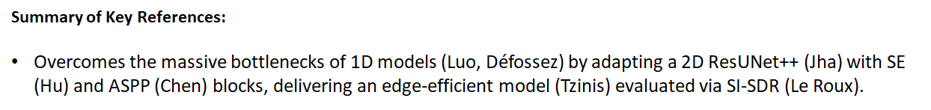
Title and Author(s) | Study Focus | Algorithm and Dataset Used | Key Findings | Limitations
DeepLab: Semantic Image Segmentation, L.-C. Chen, G. Papandreou | Improving the accuracy and detail of semantic image segmentation. | Deep Convolutional Neural Networks with Atrous Convolution, PASCAL VOC 2012 | Atrous convolution controls resolution effectively | High computational cost of dense CRF inference
SDR–half-baked or well done? by J. Le Roux, S. Wisdom | Evaluating the reliability of the SDR in audio source separation. | SDR, SIR, and SAR metrics; utilized various speech separation datasets. | Standard SDR is sensitive to gain and can be misleading | Focuses on evaluation metrics rather than proposing a new architecture.
Sudo rm -rf: Efficient networks by E. Tzinis | Developing a resource-efficient architecture for source separation. | ReLU Max-pooling Multi-Resolution Features network,WSJ0-2mix | Achieves best performance with significantly fewer parameter | Depends on noise model quality; limited datasets.

Slide 8
Title and Author Name(s) | Year | Work Done | Algorithms | Dataset Used | Conclusion | Limitations
ResUNet++: An advanced architecture for medical image segmentation (Jha et al.) | 2019 | Advanced multi-scale segmentation | ResUNet++ | Kvasir-SEG (Images) | ASPP & SE blocks drastically improved multi-scale feature capture. | Originally designed strictly for 2D medical images, not complex audio..
Sudo rm -rf: Efficient networks for universal audio source separation (Tzinis et al.) | 2020 | Efficient audio source separation | Sudo rm -rf | Audio Mixtures | Achieved high performance with very low computational cost | Focuses on efficiency, validating the need to beat heavy 1D models.
Summary of Key References:
Overcomes the massive bottlenecks of 1D models (Luo, Défossez) by adapting a 2D ResUNet++ (Jha) with SE (Hu) and ASPP (Chen) blocks, delivering an edge-efficient model (Tzinis) evaluated via SI-SDR (Le Roux).

Slide 9
Dataset and requirement specifications
Dataset:
UrbanSound8K Database: The foundational repository containing 8,732 labeled urban sound excerpts (e.g., sirens, dog barks, street music, etc.). Used as the raw audio source material. https://urbansounddataset.weebly.com/urbansound8k.html
Custom Synthetic Audio Mixture Dataset: A specially engineered dataset created by mathematically mixing target sounds with background noise. It contains thousands of paired 4-second audio chunks specifically divided into 'mix' (noisy input) and 'target' (clean output) folders for supervised learning.
Requirements:
Software: Python, PyTorch, Torchaudio, NumPy, Matplotlib (for spectrogram/loss visualization), tqdm. Hardware: Cloud-based GPU acceleration (Kaggle NVIDIA P100/T4) deep ResUNet++ training.

Slide 10
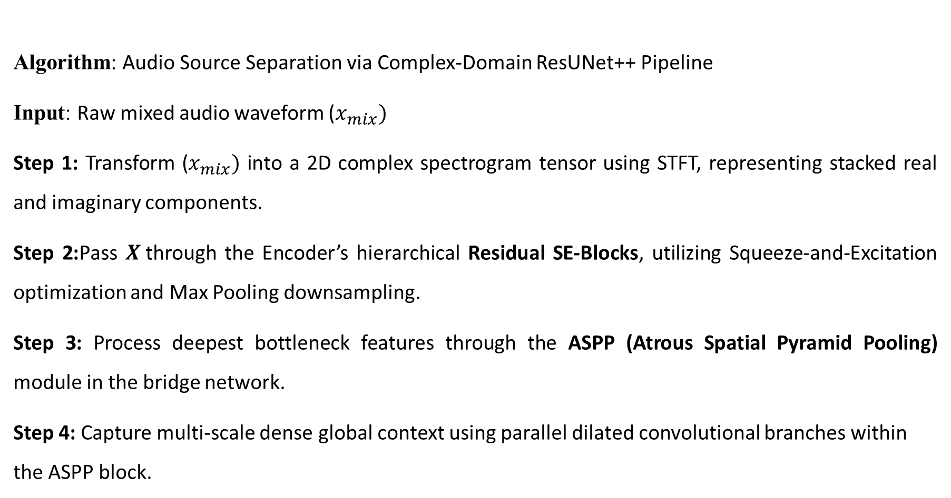
Algorithms used in the Project
Algorithm: Audio Source Separation via Complex-Domain ResUNet++ Pipeline
Input: Raw mixed audio waveform ($x_{mix})$
Step 1: Transform ($x_{mix})$ into a 2D complex spectrogram tensor using STFT, representing stacked real and imaginary components.
Step 2:Pass $X$through the Encoder’s hierarchical Residual SE-Blocks, utilizing Squeeze-and-Excitation optimization and Max Pooling downsampling.
Step 3: Process deepest bottleneck features through the ASPP (Atrous Spatial Pyramid Pooling) module in the bridge network.
Step 4: Capture multi-scale dense global context using parallel dilated convolutional branches within the ASPP block.

Slide 11
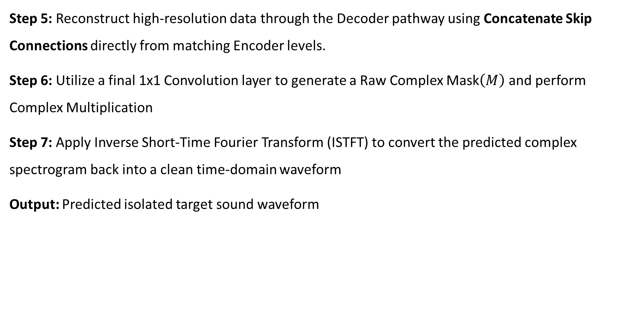
Step 5: Reconstruct high-resolution data through the Decoder pathway using Concatenate Skip Connections directly from matching Encoder levels.
Step 6: Utilize a final 1x1 Convolution layer to generate a Raw Complex Mask$\left(M\right)$ and perform Complex Multiplication
Step 7: Apply Inverse Short-Time Fourier Transform (ISTFT) to convert the predicted complex spectrogram back into a clean time-domain waveform
Output: Predicted isolated target sound waveform

Slide 12
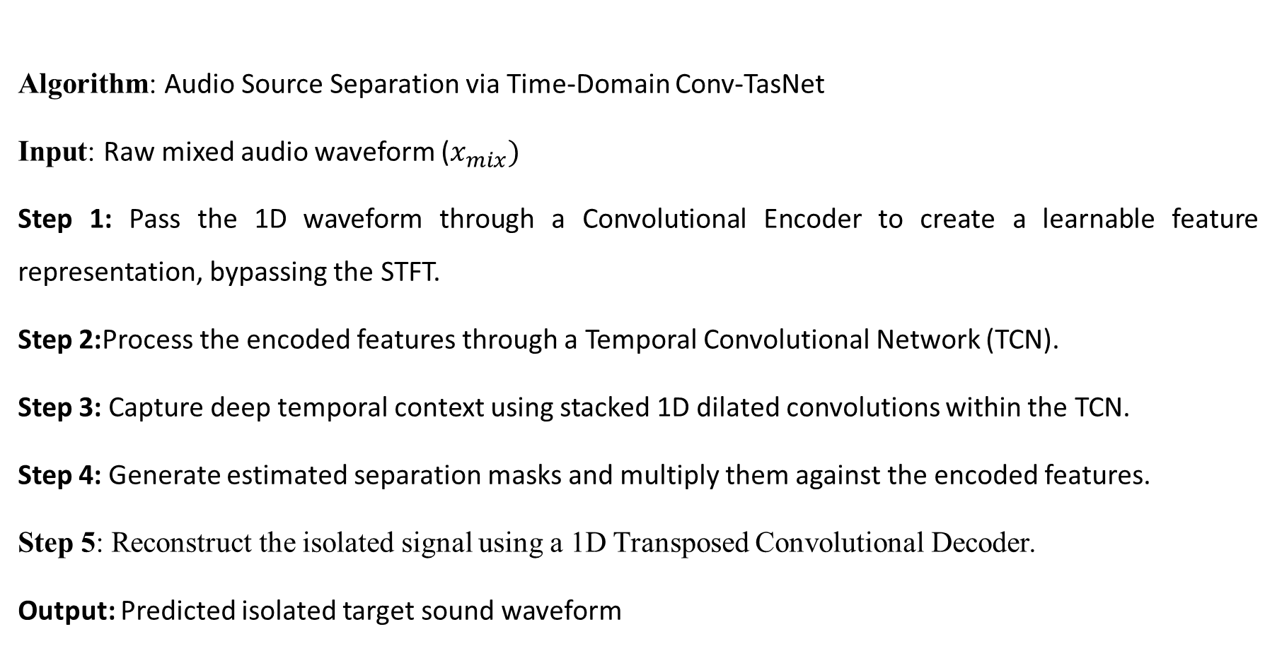
Algorithms used in the Project
Algorithm: Audio Source Separation via Time-Domain Conv-TasNet
Input: Raw mixed audio waveform ($x_{mix})$
Step 1: Pass the 1D waveform through a Convolutional Encoder to create a learnable feature representation, bypassing the STFT.
Step 2:Process the encoded features through a Temporal Convolutional Network (TCN).
Step 3: Capture deep temporal context using stacked 1D dilated convolutions within the TCN.
Step 4: Generate estimated separation masks and multiply them against the encoded features.
Step 5: Reconstruct the isolated signal using a 1D Transposed Convolutional Decoder.
Output: Predicted isolated target sound waveform

Slide 13
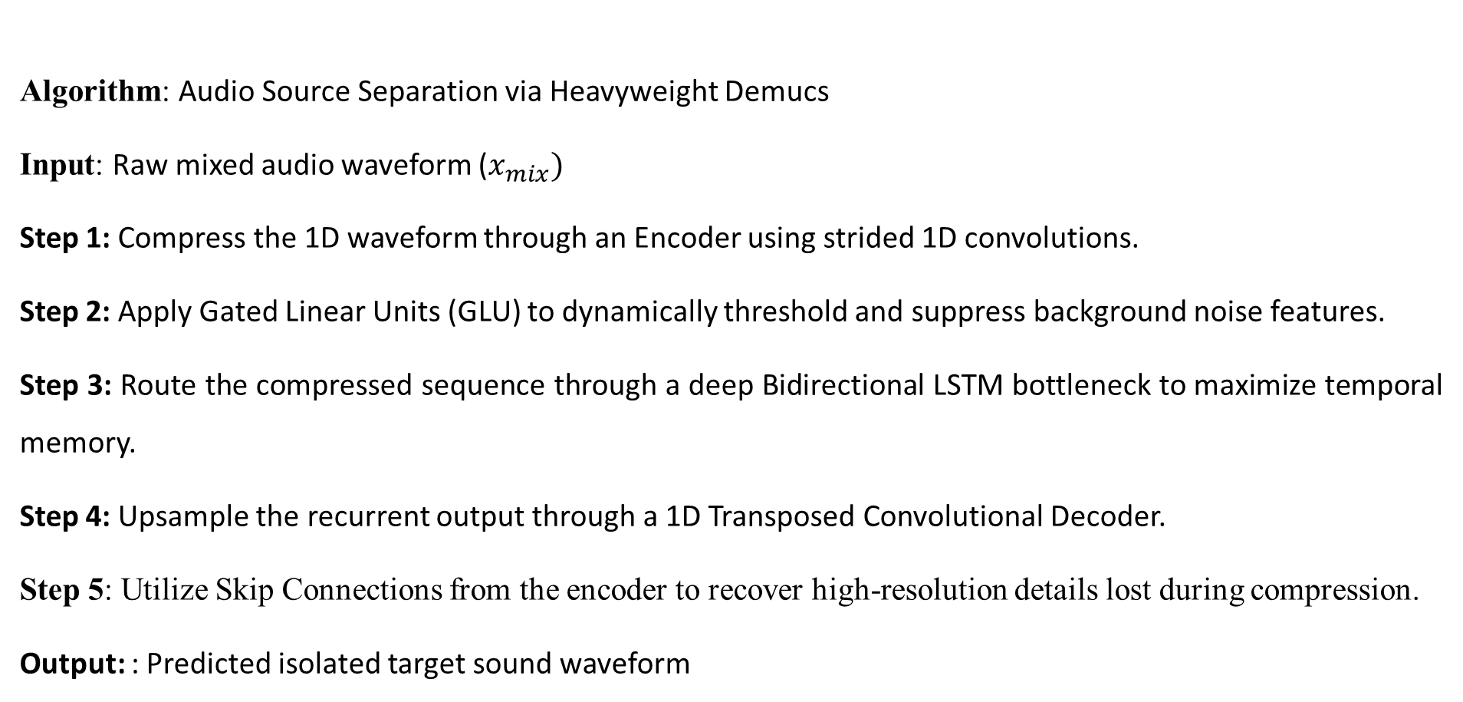
Algorithms used in the Project
Algorithm: Audio Source Separation via Heavyweight Demucs
Input: Raw mixed audio waveform ($x_{mix})$
Step 1: Compress the 1D waveform through an Encoder using strided 1D convolutions.
Step 2: Apply Gated Linear Units (GLU) to dynamically threshold and suppress background noise features.
Step 3: Route the compressed sequence through a deep Bidirectional LSTM bottleneck to maximize temporal memory.
Step 4: Upsample the recurrent output through a 1D Transposed Convolutional Decoder.
Step 5: Utilize Skip Connections from the encoder to recover high-resolution details lost during compression.
Output: : Predicted isolated target sound waveform

Slide 14

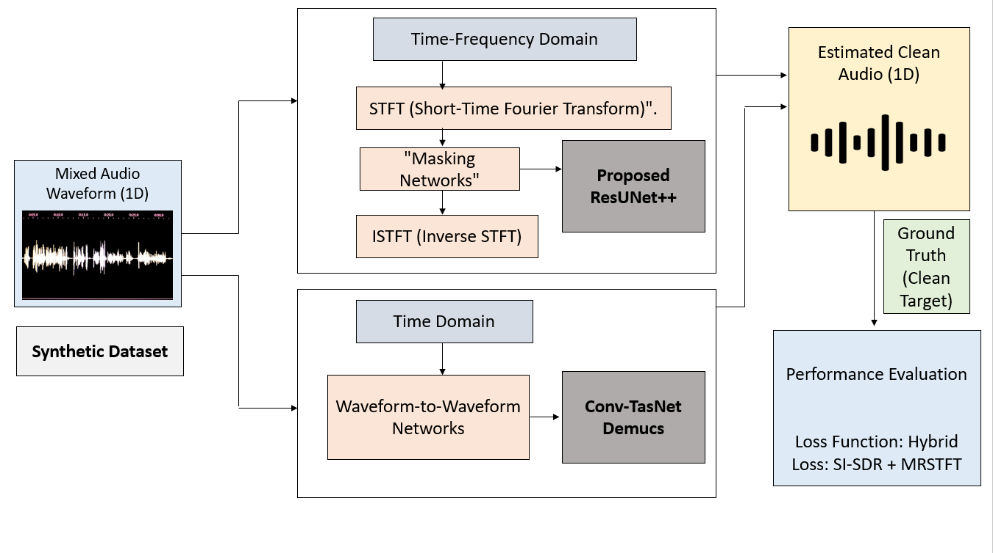

Slide 15
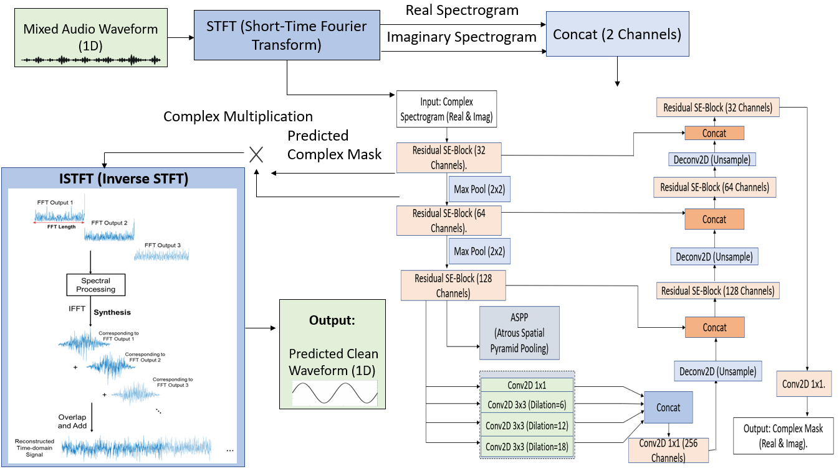

Slide 16
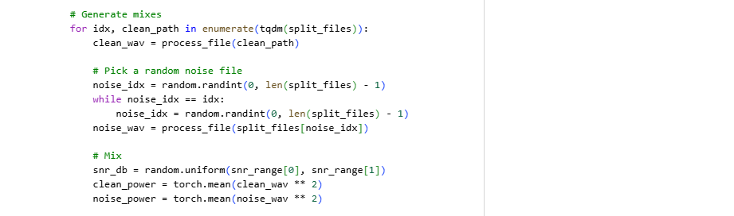
Implementation steps and Execution
Environment: Executed on Google Colab using the PyTorch framework and an NVIDIA A100 GPU.
Data Pipeline: Waveforms were dynamically padded or cropped to exactly 128,000 samples (4.0s) for uniform batching.
Hardware Acceleration: Utilized Mixed Precision Training (autocast+Gradscaler) to drastically boost GPU speed and reduce memory.

Slide 17
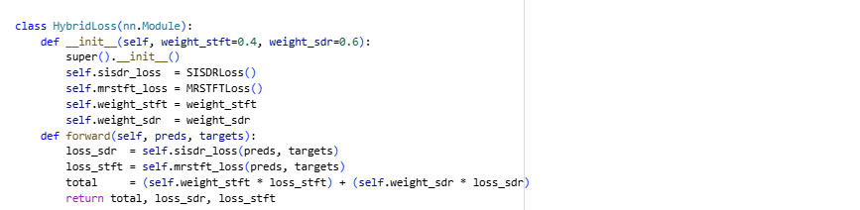
Implementation steps and Execution
Optimization Strategy: Trained for up to 50 epochs using AdamW and a Cosine Annealing learning rate scheduler.
Evaluation Metric: Optimized via a custom Hybrid Loss function combining 0.6 SI-SDR and 0.4 MRSTFT.
Overfit Prevention: Integrated an Early Stopping mechanism with a 10-epoch patience threshold to halt training if validation plateaued.4 MRSTFT.

Slide 18
Results Obtained
Model | Single-label Classification | Multi-label Classification
CNN | 89.1% | 68.0%
CRNN | 91.9% | 77.5%
EFFICIENT-NET B0 | 96.6% | 84.4%
The standard U-Net model produces a +1.14 dB improvement in SI-SDR for sound separation

Slide 19
Results Obtained
Feature | Demucs | Conv-TasNet | Proposed ResUNet++
Architecture | 1D U-Net + BiLSTM Bottleneck | 1D Convolutions + TCN | Residual l SE-Blocks + ASPP
Input Domain | Raw Time-Domain (1D Waveform) | Raw Time-Domain (1D Waveform) | Complex Time-Frequency (Preserves Phase)
Peak SI-SDR | 2.43 dB | 3.22 dB | 4.30 dB
Audio Quality | Accurate phase, but limited by epoch starvation | Accurate phase, but struggles with chaotic noise | Clean, high-fidelity separation

Slide 20
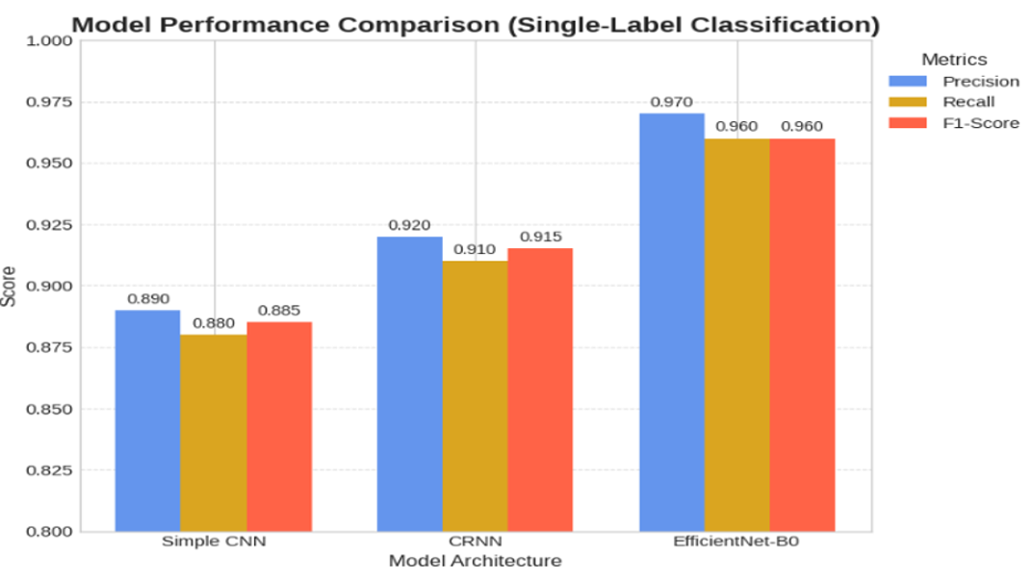
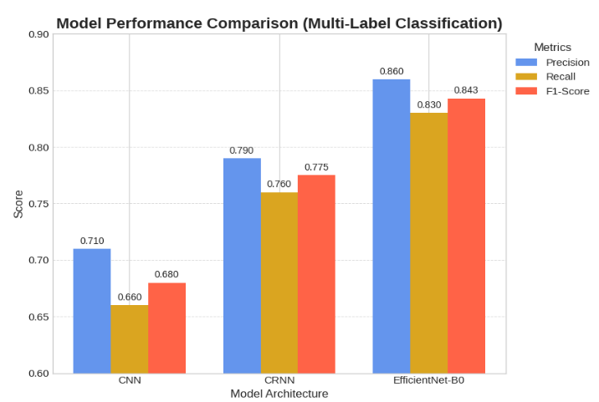
Result analysis with charts
Single-Label Classification: Multi-Label Audio Classification:

Slide 21

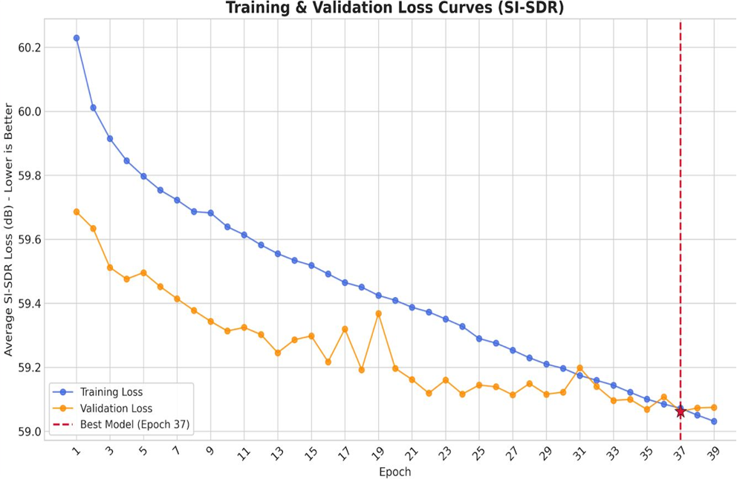
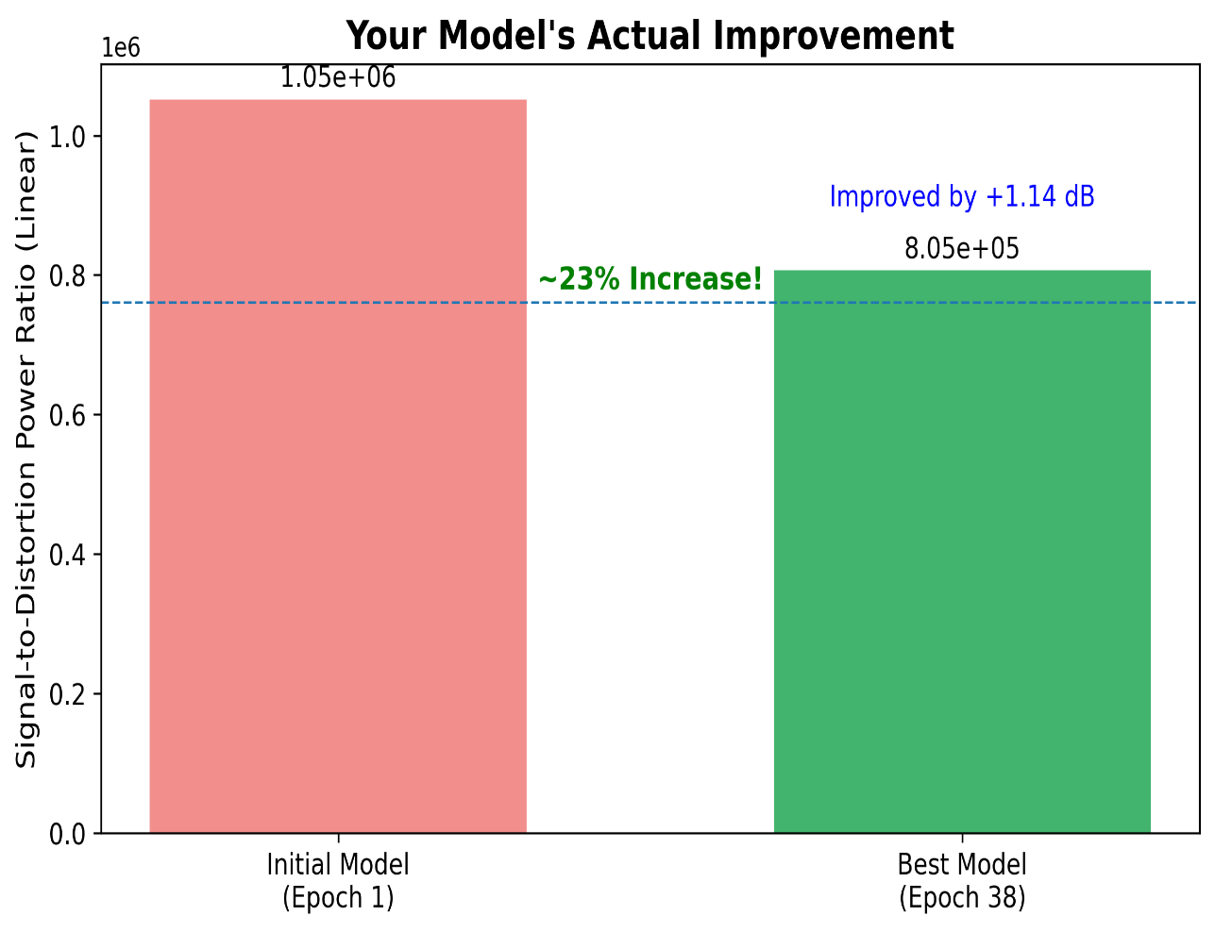
Results for sound separation of U-net model

Slide 22
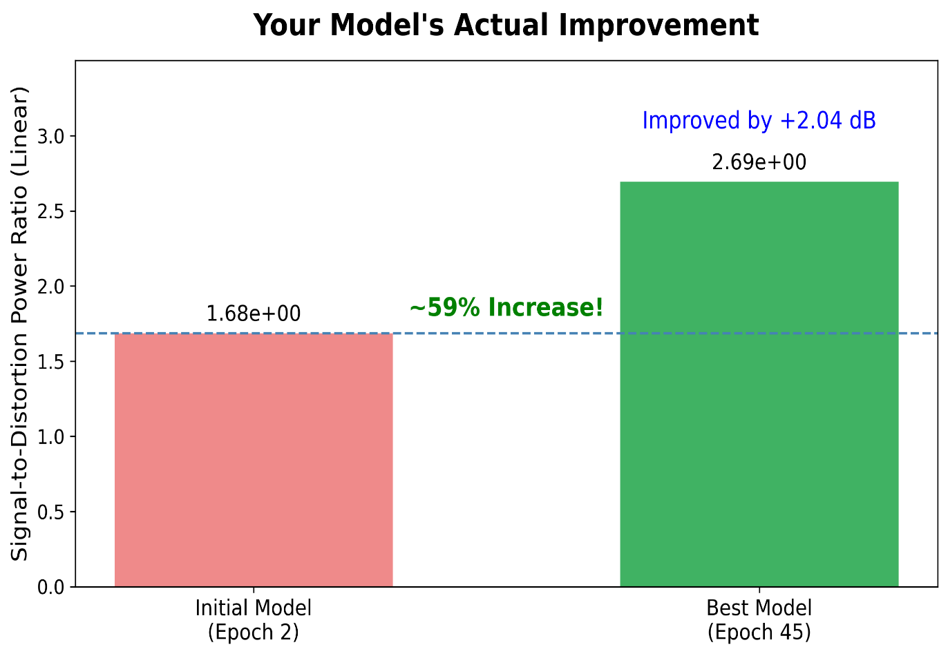
ResUnet++
Peak Performance: The ResUNet++ model successfully achieved a maximum SI-SDR score of 4.301 dB at Epoch 45.
Absolute Growth: The training process yielded a consistent and highly significant +2.04 dB direct improvement.
Signal Power Gain: In linear terms, this dB improvement translates to a massive 59% increase in pure target signal clarity.

Slide 23
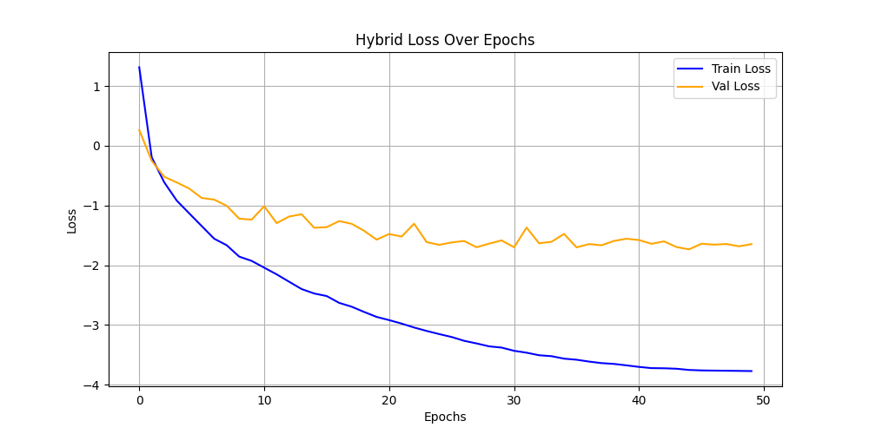
Loss plot :
Rapid Convergence: The Hybrid Loss smoothly minimizes, with validation loss (orange) establishing a stable plateau, proving the model learned efficiently without severe overfitting.

Slide 24
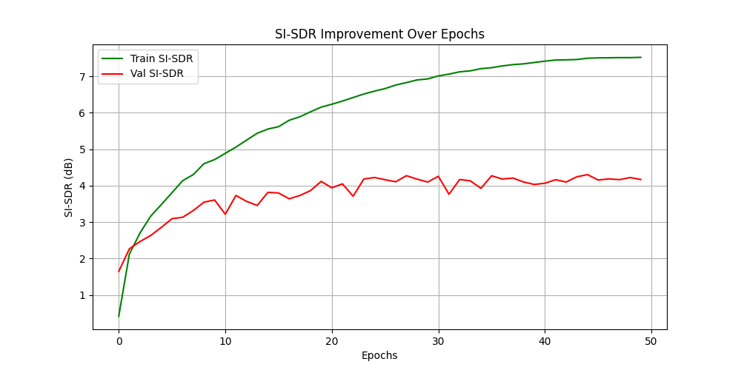
Sustained Learning: Training SI-SDR (green) climbs consistently to 7.5 dB, demonstrating the ResUNet++ architecture's strong capacity to map complex audio patterns.
Robust Generalization: Validation SI-SDR (red) stabilizes and holds firmly above 4.0 dB, confirming the model reliably separates target sounds in unseen, real-world mixtures.
SI-SDR Curve over training and validation

Slide 25
Conclusion and Future work
Core Achievement: Resolves both the "phase blindness" of U-Net and the severe computational bottlenecks of 1D models.
Architectural Success: SE attention and ASPP modules successfully preserved critical audio phase information.
Peak Results: Achieved an outstanding validation SI-SDR of 4.308 dB under strict computational constraints.
Future Work: Targeting INT8 quantization and overlap-add buffering for real-time edge device deployment.

Slide 26
References
[1] Y. Luo and N. Mesgarani, ``Conv-TasNet: Surpassing ideal time-frequency magnitude masking for speech separation,'' IEEE/ACM Trans. Audio, Speech, Lang. Process., vol. 27, no. 8, pp. 1256--1266, Aug. 2019.
[2] A. Défossez, N. Usunier, L. Bottou, and F. Bach, ``Music source separation in the waveform domain,‘’ arXiv preprint arXiv:1911.13254, Nov. 2019.
[3] D. Jha, P. H. Smedsrud, M. A. Riegler, D. Johansen, T. De Lange, P. Halvorsen, and H. D. Johansen, ``ResUNet++: An advanced architecture for medical image segmentation,'' in Proc. IEEE Int. Symp. Multimedia (ISM), San Diego, CA, USA, Dec. 2019, pp. 225--2255.
[4] J. Hu, L. Shen, and G. Sun, ``Squeeze-and-excitation networks,'' in Proc. IEEE/CVF Conf. Comput. Vis. Pattern Recognit. (CVPR), Salt Lake City, UT, USA, Jun. 2018, pp. 7132--7141.

Slide 27
References
[5] L.-C. Chen, G. Papandreou, I. Kokkinos, K. Murphy, and A. L. Yuille, ``DeepLab: Semantic image segmentation with deep convolutional nets, atrous convolution, and fully connected CRFs,'' IEEE Trans. Pattern Anal. Mach. Intell., vol. 40, no. 4, pp. 834--848, Apr. 2018.
[6] J. Le Roux, S. Wisdom, H. Erdogan, and J. R. Hershey, ``SDR-half-baked or well done?'' in Proc. IEEE Int. Conf. Acoust., Speech, Signal Process. (ICASSP), Brighton, UK, May 2019, pp. 626--630.
[7] E. Tzinis, Z. Wang, and P. Smaragdis, ``Sudo rm -rf: Efficient networks for universal audio source separation,‘’ in Proc. IEEE 30th Int. Workshop Mach. Learn. Signal Process. (MLSP), Espoo, Finland, Sep. 2020, pp. 1--6.

Slide 28
THANK YOU

