Slide 1
HCL KNOWLEDGE ASSISTANT
Presented by: B.V.S.S AKHIL
Day 10 - AI Internship Capstone Project
February 2025

Slide 2
Table Of Contents
1. Problem Statement
3. System Architecture
4. Key Technologies
5. Core Features
6. Live Demonstration
7. Technical Implementation
8. Real-time Data Integration
9. Security and deployment

Slide 3
PROBLEM STATEMENT
🤖 HCL KNOWLEDGE ASSISTANT
An intelligent AI system that provides:
✅ Instant Answers (1-3 seconds)
✅ 24/7 Availability
✅ Multiple Information Sources
✅ Real-time Data Integration
✅ Natural Language Interface
POWERED BY:
- RAG (Retrieval-Augmented Generation)
- Multi-Agent AI System
- Real-time Data Feeds
- Modern Web Technologies

Slide 4
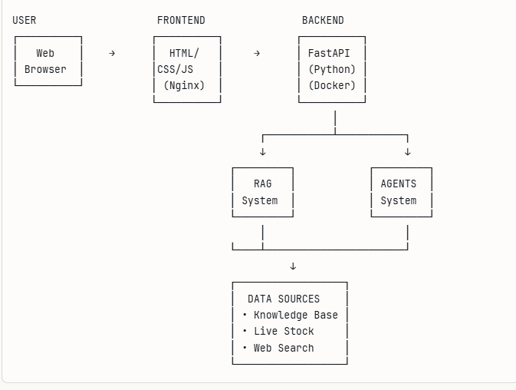
SYSTEM ARCHITECTURE

Slide 5
KEY TECHNOLOGIES
💻 TECHNOLOGY STACK
BACKEND FRONTEND
- FastAPI - HTML5/CSS3
- Python 3.11 - JavaScript
- Groq (Llama 3.3) - Responsive Design
AI & DATA INFRASTRUCTURE
- RAG System - Docker
- Multi-Agent -Docker Compose
- yfinance (Stocks) -Nginx
- DuckDuckGo (Search) -SQLite
WHY THESE CHOICES?
✓ Fast performance
✓ Modern & scalable
✓ Industry standard
✓ Easy maintenance

Slide 6
CORE FEATURES
THREE QUERY MODES (RAG,AGENT,HYBRID)
REAL-TIME DATA(Live HCL stock prices from NSE)
WEB SEARCH(Current news & information)
KNOWLEDGE BASE (50+ HCL documents indexed)
SMART ROUTING(AI chooses best information source)
SECURE ACCESS(JWT authentication & CORS protection)

Slide 7
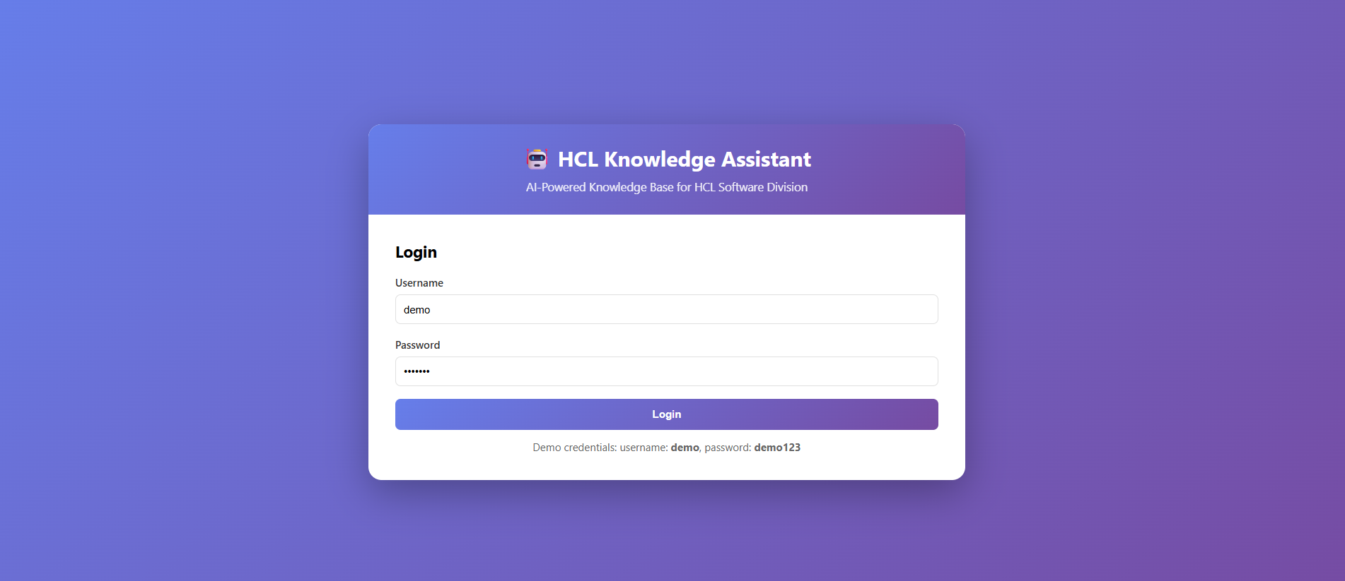
LIVE DEMONSTRATION
We'll demonstrate:
Login Process:

Slide 8
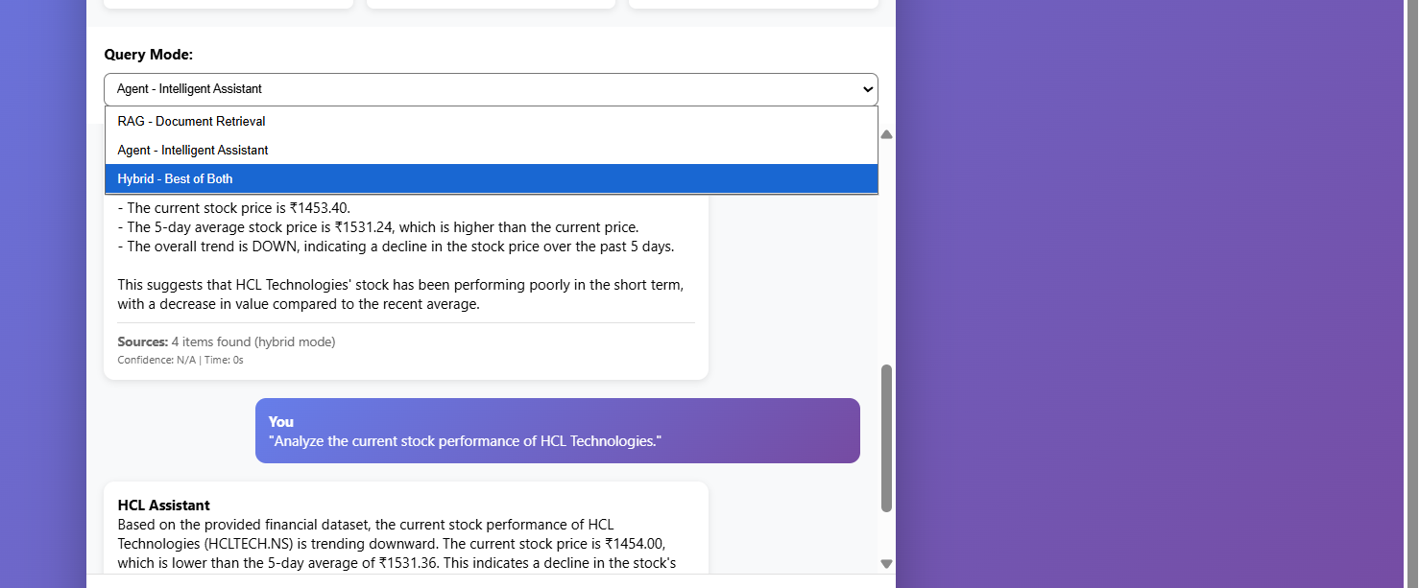
2. Different modes in project:

Slide 9
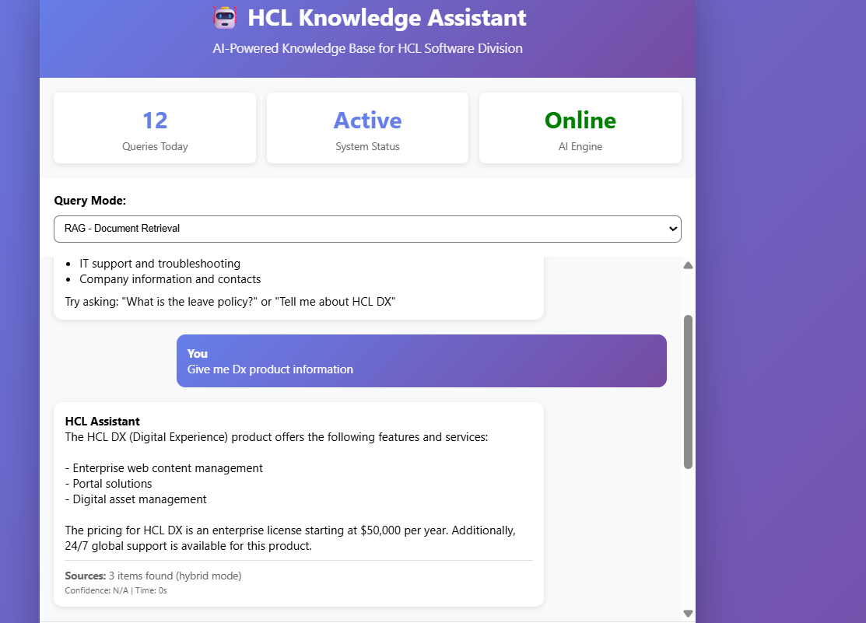
3.Rag model retrieval:

Slide 10
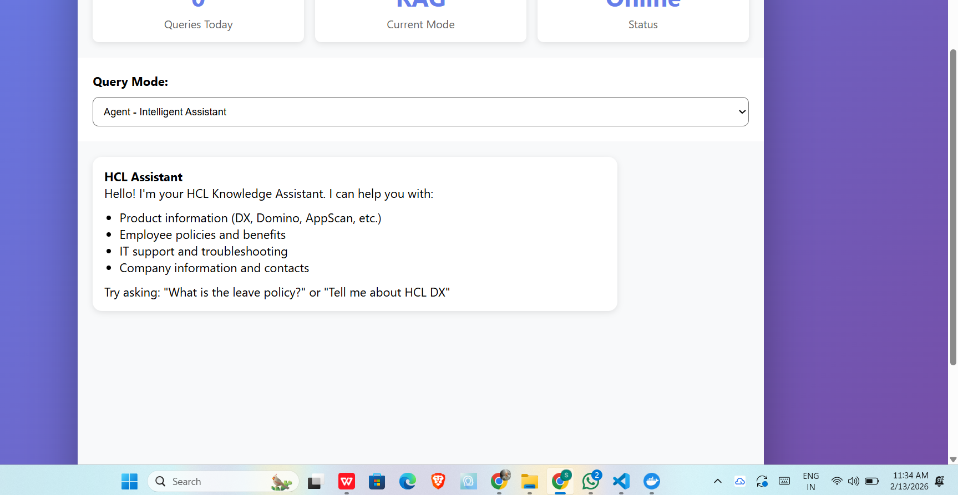
4.Agent model retrieval:

Slide 11
TECHNICAL DEEP DIVE
RAG:
DOCUMENT PREPARATION
QUERY PROCESSING
CONTEXT RETRIEVAL
ANSWER GENERATION(Using groq)
AGENTS:
Query Analysis
Agent Selection
Tool Execution
Data Processing
Response Formation

Slide 12
REAL-TIME DATA INTEGRATION
LIVE DATA SOURCES
HCL STOCK DATA (yfinance)
WEB SEARCH (DuckDuckGo)
INTEGRATION FLOW:
User Query
Agent detects need for live data
Calls appropriate tool
Fetches real-time information
Combines with knowledge base
AI synthesizes complete answer

Slide 13
SECURITY AND DEPLOYMENT
Security:
AUTHENTICATION
DATA PROTECTION
RELIABILITY
MONITORING
Deployment:
Uses docker for deployment (ONE-COMMAND DEPLOYMENT: $ docker-compose up -d )
Builds backend container
Builds frontend container
Creates network
Starts services
Runs health checks
✅ Application ready!

Slide 14


