Slide 1
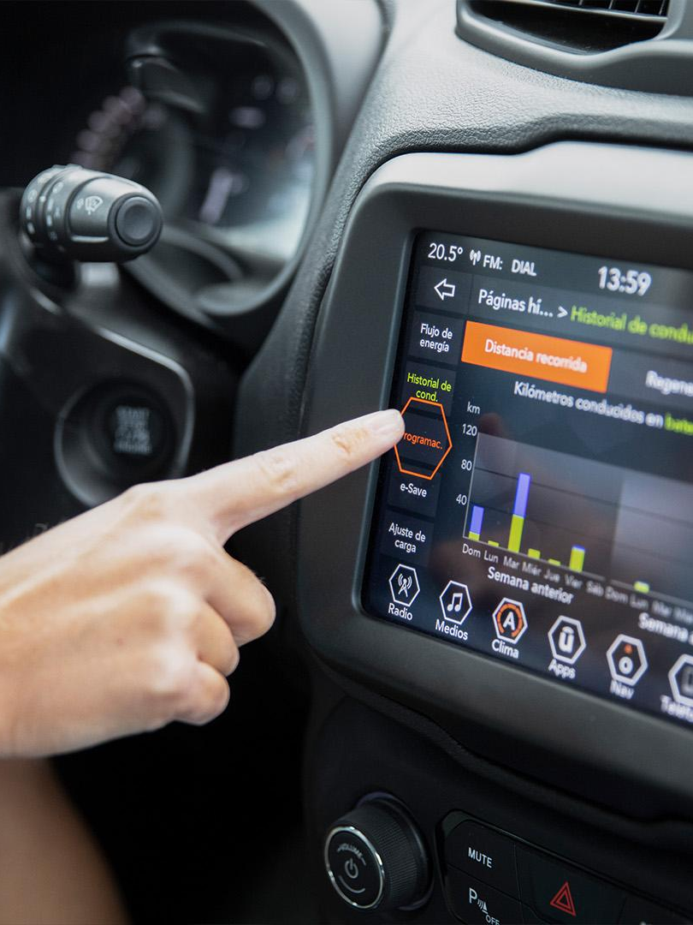


Fuel Consumption Prediction
Understanding the factors influencing fuel consumption is crucial for optimizing efficiency and reducing costs. Engine size is a key variable
Presented by: Model Master's

Slide 2
Overview of Flask Framework
Lightweight and Versatile
Flask is a powerful micro-framework for web development in Python, known for its flexibility and minimalistic design, making it ideal for fuel consumption prediction app development.
Extensive Libraries
It offers a wide range of libraries and tools to simplify tasks, enabling efficient integration and deployment of machine learning models for fuel consumption prediction.
Scalability and Customization
Flask allows for easy scaling and customization, critical for adapting to the specific needs of fuel consumption prediction application

Slide 3
Machine learning and its role in fuel consumption prediction
PATTERN RECOGNITION
PREDICTIVE MODELING
DATA-DRIVEN INSIGHTS
Machine learning algorithms can identify complex patterns in fuel consumption data, helping to predict trends.
Through regression and classification models, machine learning predicts fuel efficiency based on engine size and other variables.
It provides data-driven insights into how engine size contributes to fuel consumption patterns.

Slide 4
Data Collection and Preprocessing
DATA COLLECTION
DATA PREPROCESSING
DATA PREPARATION
Separate the features (independent variables) from the target variable (fuel consumption rate). Feature Selection/Engineering: Identify relevant features that are likely to influence fuel consumption based on your exploratory data analysis.
Gathering relevant data on engine sizes, fuel consumption, driving conditions, and related variables is crucial
Filtering, normalization, and feature engineering are essential steps to prepare data for model training.

Slide 5
Model Training and Evaluation
Model Selection
Evaluating Performance
Training the Model
Choose appropriate machine learning algorithms for regression tasks. Selected algorithm for regression is Linear Regression
Training the model on the gathered dataset to learn patterns and optimize predictions.
Assessing the model's performance using evaluation metrics such as accuracy and error rates.

Slide 6
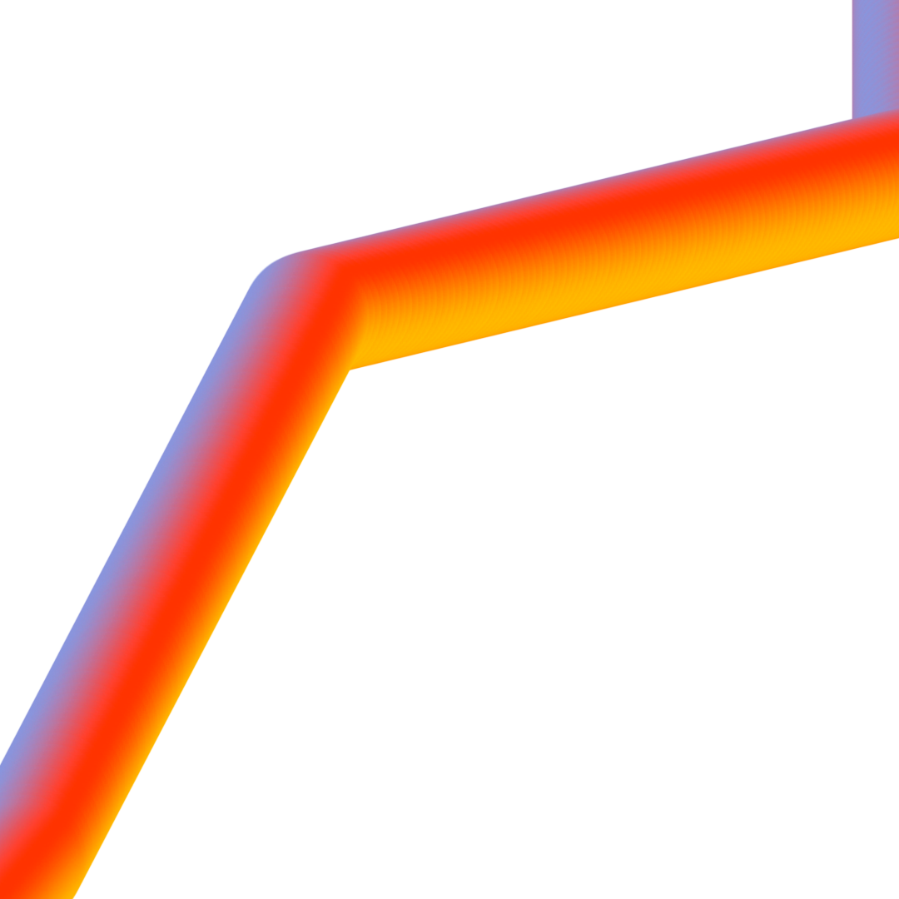
Simple Linear Regression
Simple linear regression is used when there is only one independent variable. The relationship between the independent variable X and the dependent variable y is
modeled using a straight line equation:
y=B0+B1X+ɛ
Where,B0 is the intercept,
B1 is the coefficient for the independent variable x,
ɛ is the error term

Slide 7
Integration of the Model with Flask Framework
We used Flask, a Python web framework, to easily integrate our machine learning model into a seamless fuel consumption prediction web app. By defining routes and endpoints, processing user input, and displaying results using dynamic HTML templates, we empower users to make informed decisions regarding their fuel usage and encourage sustainable practices.

Slide 8
Demonstration of the Web Application
Responsive UI
Real-Time Predictions

Slide 9
Conclusion and Future Work
Accomplishments
Summary of the achievements in developing an efficient fuel consumption prediction system using Flask and machine learning.
Future Enhancements
An outline of potential enhancements and research directions to further improve the accuracy and scope of the prediction system.

Slide 10
References
“Flask Web Development” by Krish naik
“Hands-On Machine Learning with Scikit-Learn, Kera's, and TensorFlow” by GFG
"Simple linear regression "By Scribbr”

Slide 11
Thank You….!!!

