Slide 1
“Tic-Tac-Toe Game with AI ” Using Python
Presented by:
Bhagyashree Gore

Slide 2
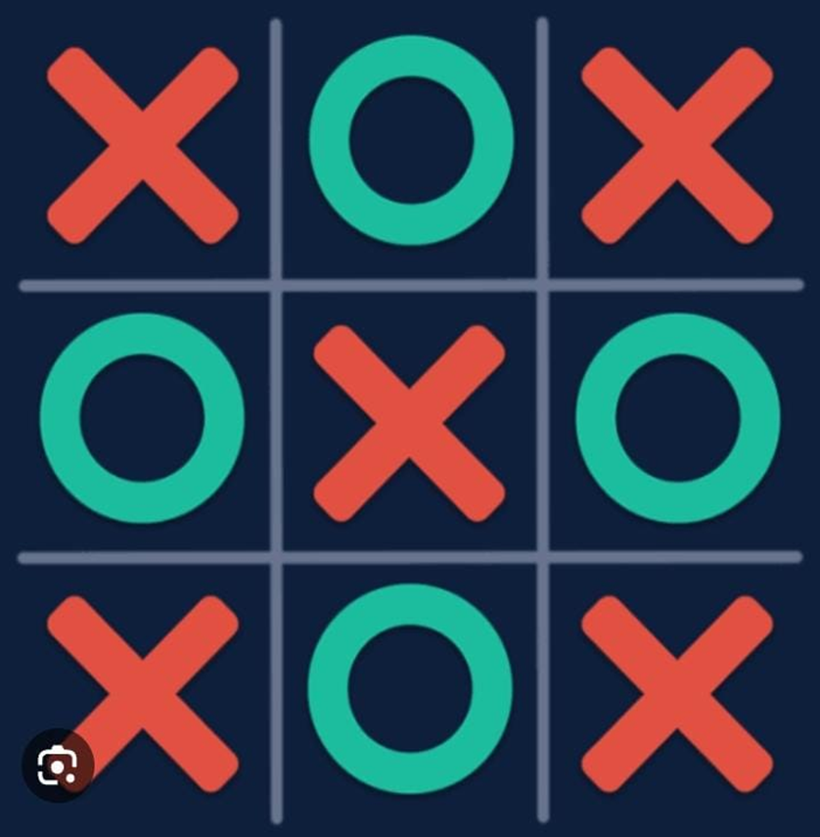
“Tic-Tac-Toe Game with AI Using python”
In the partial fulfilment of the requirement for the Engineering in Artificial Intelligence and Data Science

Slide 3
TOPICS TO BE DISCUSSED!!
Introduction
Problem statement
flowchart
Why this Project??
Project Features
Outcomes
System requirements
Wining conditions
Advantages/Disadvantages
Limitation
Conclusion
Project implementation(result)

Slide 4
INTRODUCTION:
This game is very popularly and fairly simple by itself It is actually a two player’s game. In this game , there is a board with n x n squares . In my game, it is 3 x 3 squares.
The goal of Tic-Tac-Toe is to be one of the players to get three same symbols in a row-horizontally, vertically or diagonally-on 3 x 3 grid.
After starting the game, a GUI board appears, other rules are the same. First, the player has to select whether the user wants to play with human or AI. It contains the Minimax algorithm

Slide 5
Tic-tac-toe Game project is written in Python. The project file contains python script and image files This is a simple GUI based strategy board game which is very easy to understand and use. Talking about the gameplay, all the playing rules are the same just like we play in real time tic-tac-toe.
Our project is a Tic Tac Toe game which consist of a robot that paly against human. Players soon discover that the best play from both parties leads to a draw. Hence, tic-tac-toe is often played by young children who may not have discovered the optimal strategy.

Slide 6
PROBLEM STATEMENT(AIM)
The objective of this tic-tac-toe game python project is to build a tic-tac-toe game so you can play it without wasting paper and improve your concentration.

Slide 7
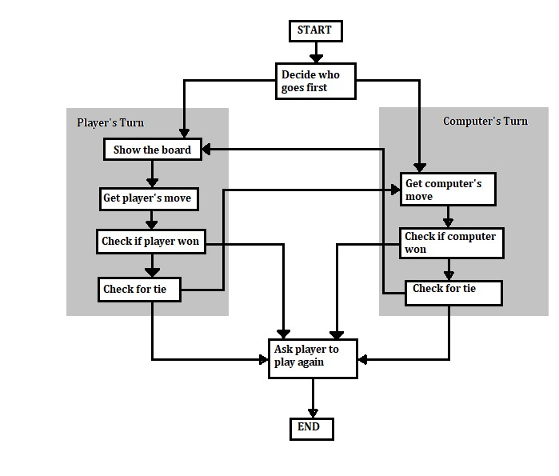
SEQUENCE OF EXECUTION LIKE THIS:

Slide 8
WHY THIS PROJECT?
As Artificial Intelligence technology occupies the world ,it becomes an essential part of all fields around us , it aims to become more interactive and interesting
So we try to employee artificial intelligence to play Tic Tac Toe in more interesting way.
It also provide real source of enjoyment .

Slide 9
FEATURES
The game can start by any one of the two player.
The main features of our project that we can play any level of tic tac toe with the robotic arm (Simple, Medium, Hard).
The result after the game finish will see on the LCD.
The game can detect if the player play or not by itself without click any button to hint it.

Slide 10
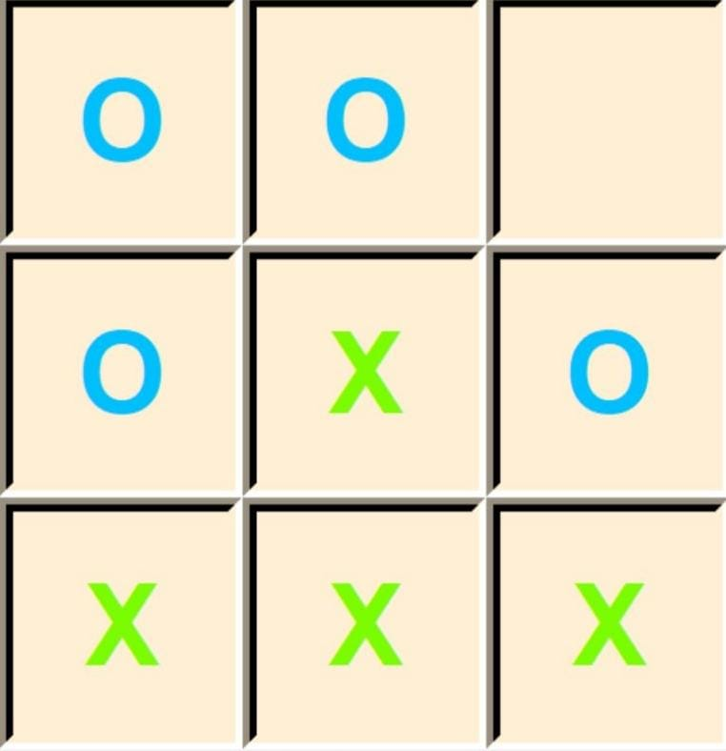
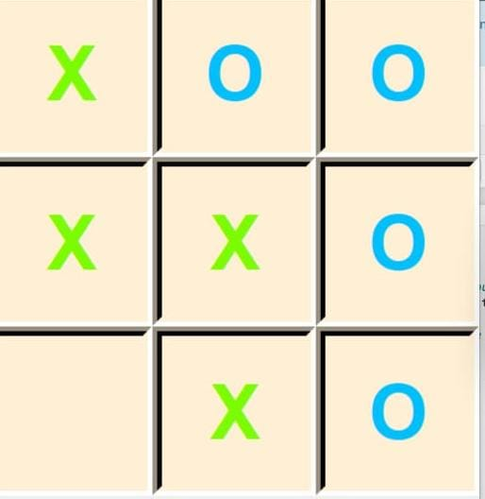
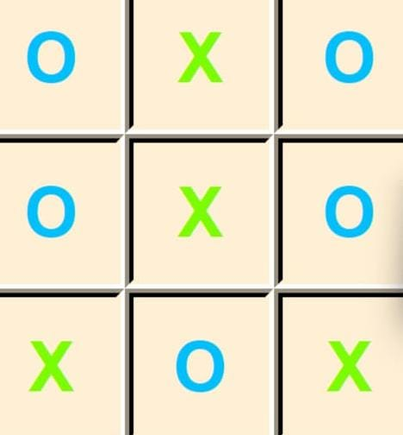
OUTCOMES:
‘x’ has won
‘O’ has won
The match ended with draw(no win)

Slide 11
SYSTEM REQUIREMENTS
In order to run the project, you must have installed Python and Pygame library on your PC.
Graphical user interface(GUI) toolkit.

Slide 12
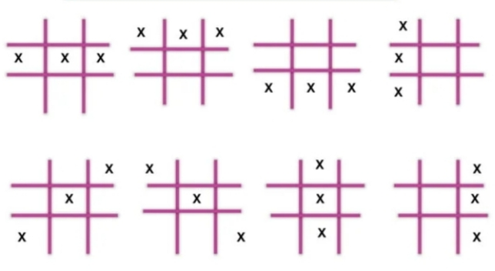
WINNING CONDITIONS

Slide 13
ADVANTAGES
Teaches strategy skills.
Develops logical thinking.
Improves the ability to concentrate and focus.
Teaches good sportsmanship.
Sets the foundation for learning more complex games.
Provides a simple and fun way for the family to bond.
Develops problem-solving skills.
Developmental growth in problem solving ,hand eye coordination, turn taking and strategizing

Slide 14
DISADVANTAGES
The game can be addictive and can lead to wasting a lot of time It can get boring if every game ends in a tie.
When you know how to win, the game isn’t very challenging.
The game usually takes less than a minute to play.
It can get boring knowing that you are going to win every single time.

Slide 15
LIMITATION
Only one player can play at a time.
If any of the players have filled a square then the other player and the same player cannot override that square.
There are only two conditions that may match will be draw or may win.
GUI is not so attractive.

Slide 16
CONCLUSION
The player who succeeded in placing three respective marks in a horizontal, vertical, or diagonal row wins the game. The Tic Tac Toe is a great way to pass your free time whether you're standing in a line or spending time with your kids.

Slide 17
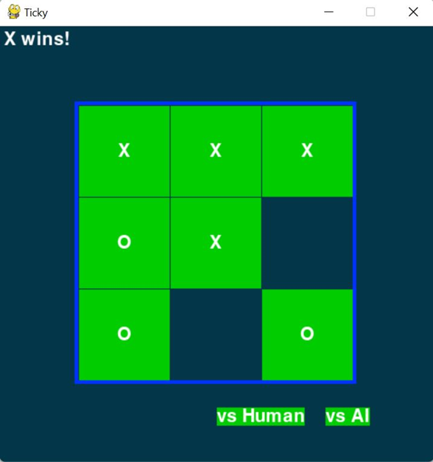
Results be like

Slide 18
REFERENCES
https://www.vtupulse.com/artificial-intelligence/solve-tic-tac-toe-game-in-artificial-intelligence/
https://www.slideshare.net/manikakumari/ai-141694706
www.google.com

Slide 19
Thank you…!!!

