Slide 1

STUDENT CREDENTIALS
HARSH KUMAR
UNSTOP CAMPUS AMBASSADOR PROGRAM
CAMPUS
AMBASSADOR
Enrollment / Roll No
Program & Semester
25SCS1003002291
B.Tech (CSE)
A ONE-MONTH STUDENT OUTREACH &
EVENT MANAGEMENT INTERNSHIP REPORT
INTERNSHIP DURATION
JULY 2026 (4 WEEKS)
UNSTOP
UNSTOP

Slide 2
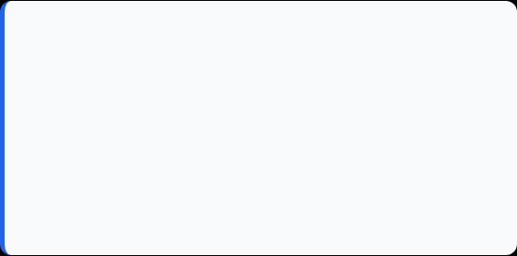
Candidate & Program Overview
Candidate Details
Internship Profile
Student Name: Harsh Kumar
Program Name: Unstop Campus Ambassador Program
Roll Number: 25SCS1003002291
Internship Domain: Campus Ambassador
Degree: B.Tech (Computer Science & Engineering)
Duration: 4 WEEKS (01st JUL 2026 – 31st JUL 2026)
Academic Batch: 2025-2029
SECTION: 2CSE7 (3rd Sem)
University: IILM University, Greater Noida, U.P.
Issue Date: 12th August 2026

Slide 3
Organization Profile: Unstop
Unstop (Formerly Dare2Compete) is a platform operated by Flive Consulting Private Limited that bridges the gap between students and opportunities by hosting competitions, hackathons, scholarships, and other career-building events
Campus Ambassador Program
Enables students across colleges to represent Unstop on their campuses, helping peers discover competitions, hackathons, and scholarships relevant to their goals.
Practical Outreach & Events
Focuses on organizing awareness sessions, campus events, and peer engagement to maximize student participation on the platform.
Mission
To bridge the gap between talent and opportunity by connecting students with competitions, scholarships, and career-building experiences relevant to their goals.

Slide 4

Role, Responsibilities & Scope
The Campus Challenge
The Ambassador Role
Students often remain unaware of the competitions, scholarships, and career opportunities genuinely relevant to their goals and growth.
This internship covers the complete outreach cycle: identifying opportunities, planning campus events, and driving student sign-ups and engagement.
Even highly relevant opportunities create little impact until students actually discover them through a trusted, on-campus channel
Building practical skills in event planning, communication, and outreach using tools like (WhatsApp, Google Forms, Instagram, LinkedIn, Sheets) to drive real campus-level impact.

Slide 5
Work Methodology (July 2026)
1. Requirement Analysis & Planning
To identify upcoming opportunities on Unstop relevant to students at IILM University and prepare event schedules in coordination with faculty.
A clear plan of relevant competitions, scholarships, and awareness sessions ready for campus-wide rollout.
2. Promotion & Outreach
To create awareness of Unstop opportunities through campus announcements, social media, and peer networks.
Increased visibility of the platform and its opportunities among the student community.
3. Event Coordination
To work with fellow students and faculty to plan and execute on-campus events and awareness sessions.
Well-attended events that connected students directly with relevant opportunities on Unstop.
4. Follow-up & Reporting
To encourage sign-ups and participation, address student queries, and share updates and outcomes with the Unstop team.

Slide 6
Certification & Official Verification
Verification Metric | Official Record / Credential Details
Internship Title | Unstop Campus Ambassador Program (2025–26)
Issuing Organization | Unstop (Formerly Dare2Compete)
Academic Patronage | IILM University, Greater Noida
Letter Date | 12th August 2026

Slide 7
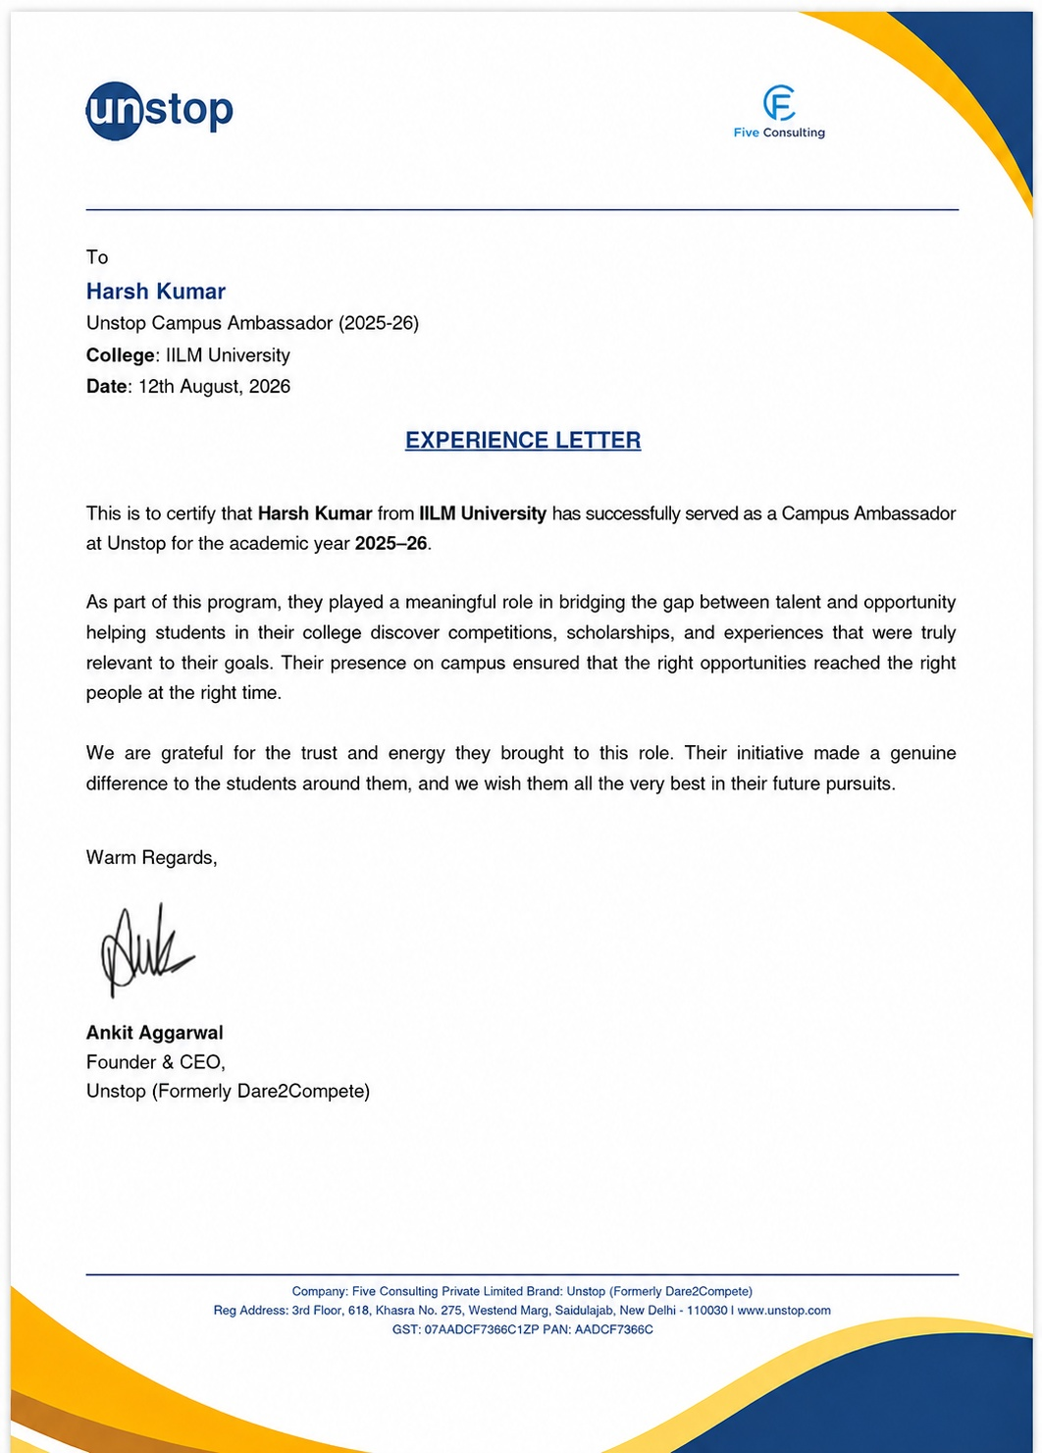
Certification & Official Verification

Slide 8

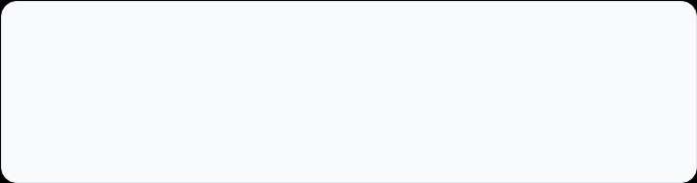
Thank You!
Harsh Kumar
School of Computer Science & Engineering
Roll No: 25SCS1003002291
IILM University, Greater Noida, U.P.

