Slide 1
Time Series of Intel Lab Data
A Mini Project

Slide 2
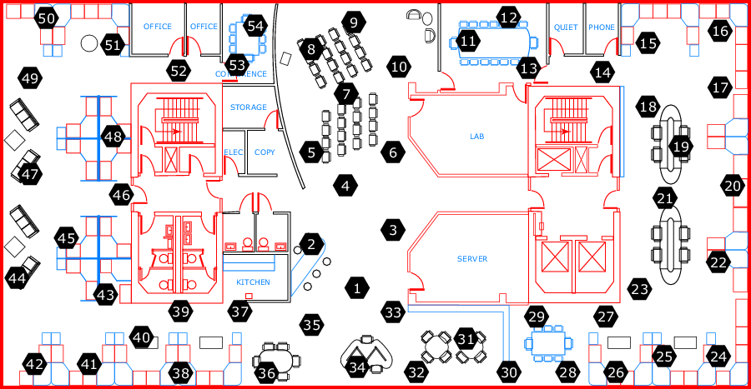
Background
54 sensors in the Intel Berkeley Research lab
Temperature, humidity, light, and voltage
Every 30 seconds between February 28 and April 5, 2004
2.3 million records
http://db.csail.mit.edu/labdata/labdata.html

Slide 3
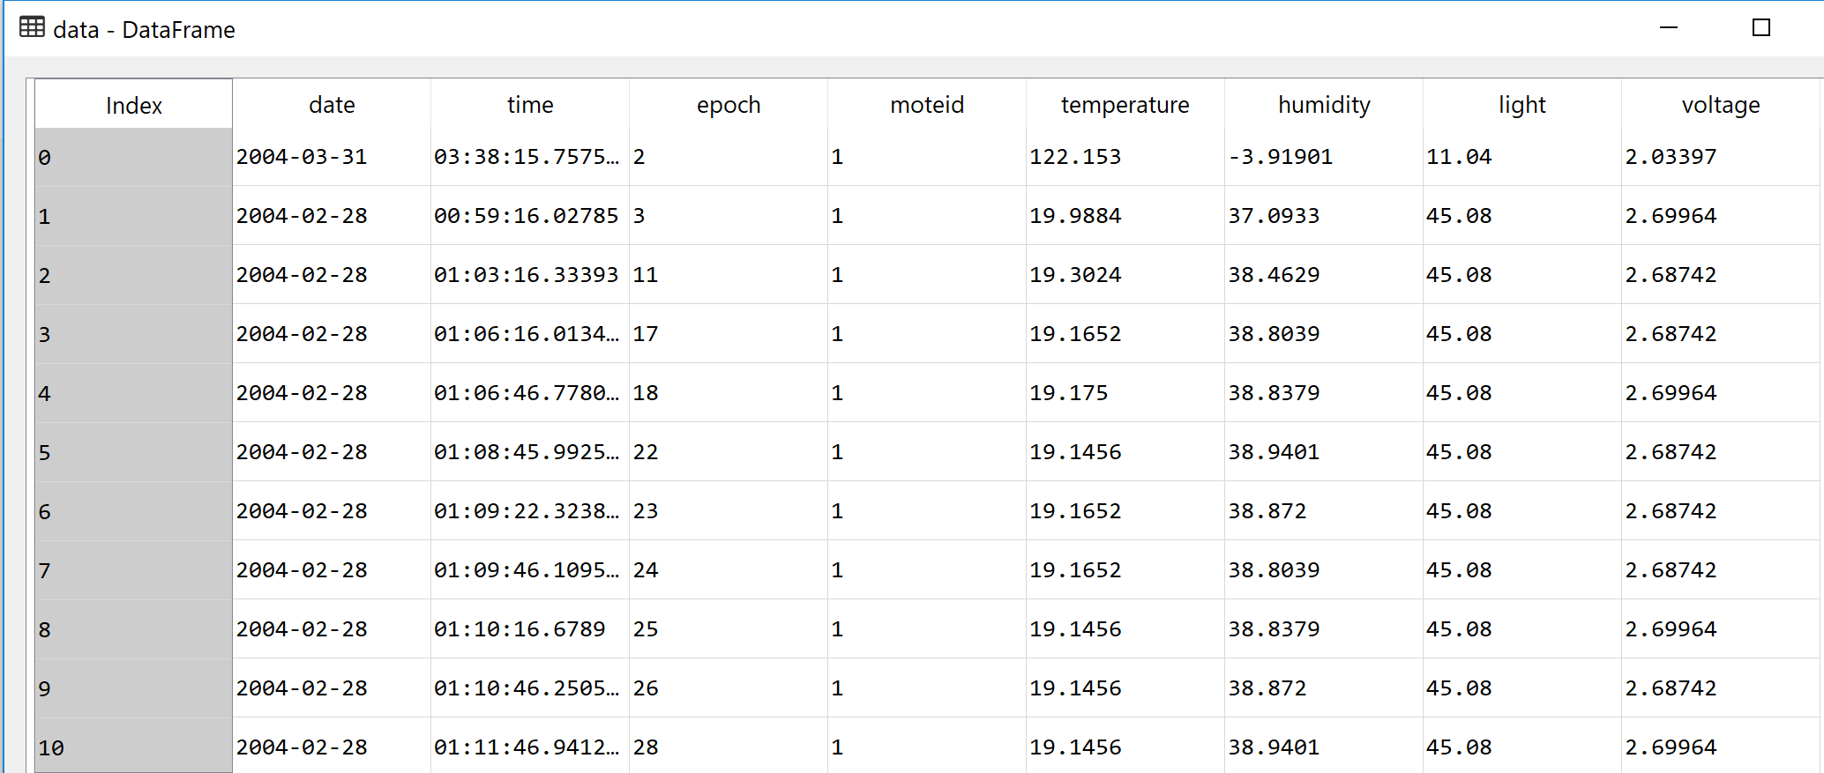
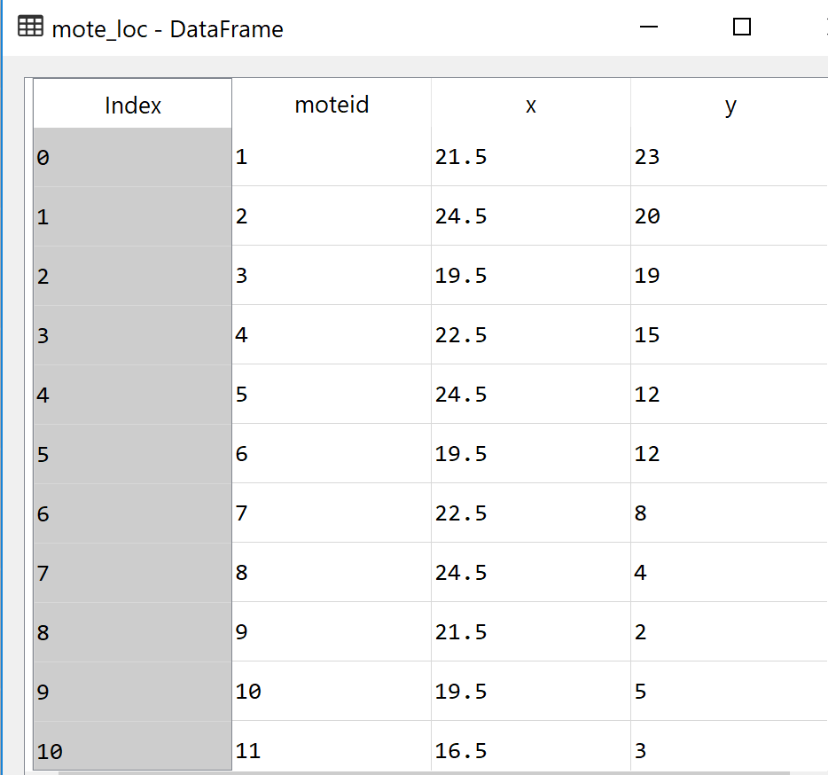
Data Exploration
Two text files
Time series of temperature, humidity, light and voltage
Location of sensors

Slide 4
Data Exploration
Data processing and cleaning
Calculate the time offset from the earliest deployment for each epoch
Visualize the time series and get the first impression
Data cleaning
Raw Data
Cleaned Data

Slide 5
Objective
Determine when to change battery

Slide 6
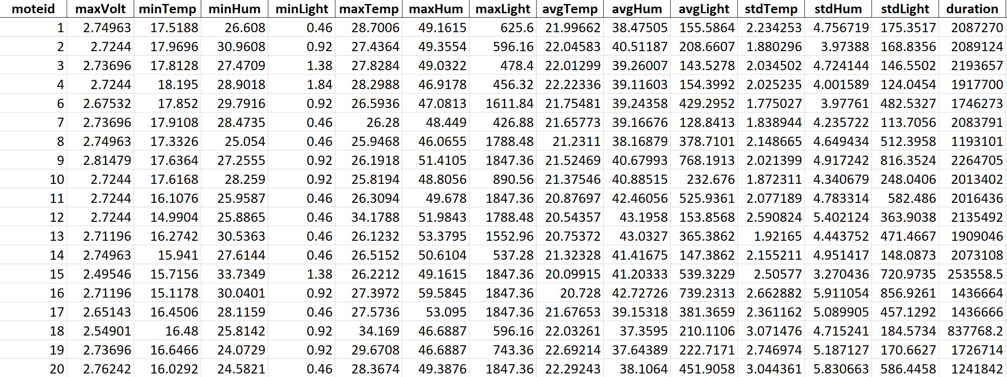
Features
Extract features
Determine thirteen features for each sensor
Max voltage + min, max, mean, and std of temperature, humidity, and light
Keep the features simple as this is not for production
More complex features may be extracted from FFT analysis
target

Slide 7
Model
In total, 52 sensors
Randomly choose 10 as validation dataset, and remaining 42 as training
Linear regression without regularization vs Ridge, Lasso through GridSearchCV
No regularization is needed

Slide 8
Discussion
It seems possible to predict the battery life from environmental data
This may help to prevent the sensor failure
But improvements are still needed
Try clustering analysis to better understand the sensor environments
Approach = K-means; Number of clusters = 10

Slide 9
Discussion
There are some patterns found, but exact information is not known
Because of relatively small dataset, further improvements were not performed

