Slide 1

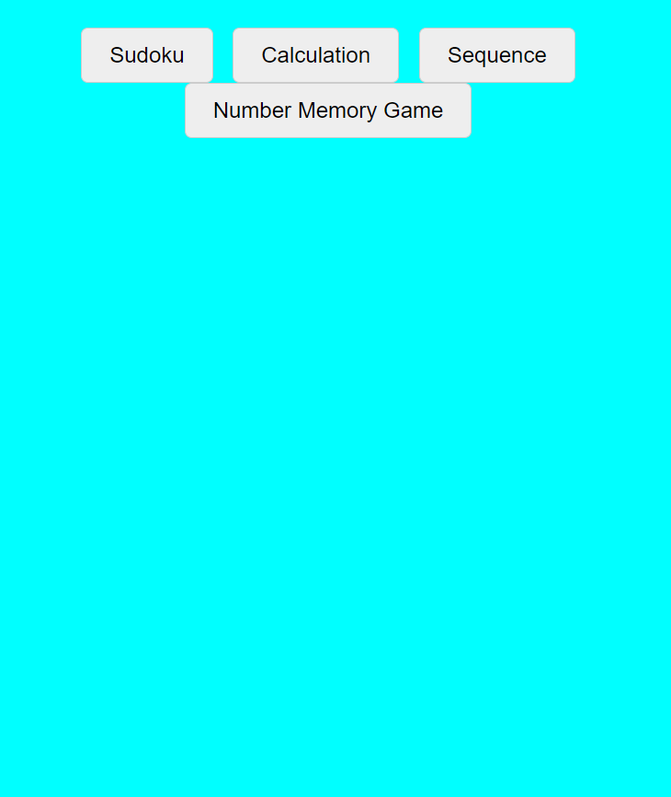
GAME MODEL
BY:
TEAM
T.Chakri 22BRS1317
G.Abiram 22BRS1236

Slide 2
GAME MODEL
1.Sudoku Game
2.Calculation Game
3.Sequence Game
4.Number memory Game

Slide 3
Sudoku Game

Slide 4
Sudoku Game
People play Sudoku for various reasons, and the game's popularity can be attributed to several factors:
Mental Exercise
Relaxation and Stress Relief
Accessible and Portable
No Language Barrier
Sense of Accomplishment
Entertainment and Leisure
Competition and Records

Slide 5
Calculation Game

Slide 6
Calculation Game
Gameplay:
The game begins when the player clicks "Start Test."
Questions are generated randomly, and the player has 30 seconds to answer each question.
The player types the answer in the input field and clicks "Check Answer" to get feedback.
The player can stop the test at any time using the "Stop Test" button.
After the test duration ends, the final results are displayed, including the number of correct and incorrect answers.

Slide 7
Sequence Game

Slide 8
Sequence Game
Gameplay :
The player starts by clicking the "Start Level" button.
A sequence of highlighted cells is displayed for the player to remember.
After the sequence display, the player clicks the cells in the same order.
If the player successfully completes the sequence, they advance to the next level.
If the player makes a mistake, an alert informs them, and the game resets to Level 1.
The player can click "Next Level" to progress after successfully completing a level.

Slide 9
Number memory Game

Slide 10
Number memory Game
Gameplay :
The player clicks "Start" to initiate the game.
A sequence of numbers is displayed, which the player must remember.
The sequence disappears, and the player enters their guess in the input field.
The game checks if the input matches the generated sequence.
If correct, the player advances to the next level; if incorrect, they are prompted to try again.
The game continues until the player completes all levels

Slide 11
THANK YOU

