Slide 1
RETAIL SALES FORECASTING SYSTEM Using Machine Learning Models and Flask API
Name : N.Srija Kiran College : Sasi Institute of Technology and Engineering

Slide 2
INTRODUCTION
Retail businesses depend heavily on accurate sales forecasting for planning inventory, managing supply chains, and improving profitability.
However, sales patterns are influenced by multiple factors such as seasonality, demand fluctuations, and market trends, making prediction difficult.
This project develops an intelligent forecasting system using machine learning models to predict future retail sales and expose results through a Flask-based REST API.

Slide 3
PROBLEM STATEMENT
Retail companies often face challenges in predicting future sales accurately due to:
Seasonal variations in demand
Unpredictable customer behavior
Lack of advanced forecasting tools
Manual forecasting errors
Poor forecasting leads to:
Overstocking
Stock shortages
Financial losses
Aim: To build an automated forecasting system that predicts future sales using historical data and machine learning models.

Slide 4
OBJECTIVES
To analyze historical retail sales data
To apply machine learning models for forecasting
To compare model performance using RMSE
To generate 8-week future sales predictions
To deploy predictions using Flask REST API
To provide real-time JSON output

Slide 5
TECHNOLOGY STACK
The following technologies were used:
Python (Core programming language)
Pandas & NumPy (Data processing)
Matplotlib & Seaborn (Visualization)
Scikit-learn (Machine learning)
Statsmodels (Time-series models)
Facebook Prophet (Forecasting model)
Flask (REST API development)

Slide 6
DATASET DESCRIPTION
The dataset consists of historical retail sales data stored in Excel format.
Key Features:
Weekly sales data
Multiple states (Texas, California, etc.)
Time-series structured data
Purpose:
The dataset is used to identify patterns, trends, and seasonal variations in sales to train forecasting models.

Slide 7
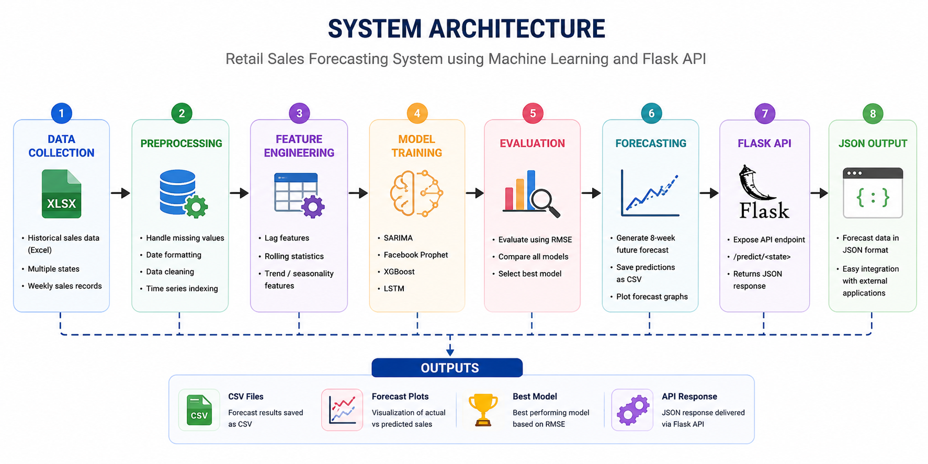
SYSTEM METHODOLOGY & ARCHITECTURE
The project follows a structured machine learning pipeline:
Data Collection
Data Preprocessing (handling missing values, formatting)
Feature Engineering (lag features, rolling averages)
Model Training
Model Evaluation using RMSE
Best Model Selection
Forecast Generation (8 weeks)
API Deployment using Flask

Slide 8
MODELS USED
Multiple forecasting models were implemented:
SARIMA (Seasonal ARIMA)
Facebook Prophet
XGBoost Regressor
LSTM (Deep Learning model)
Each model was evaluated using RMSE (Root Mean Squared Error), and the best-performing model was selected for final predictions.

Slide 9
OUTPUTS GENERATED
The system produces the following outputs:
8-week future sales forecasts
Model performance comparison (RMSE)
Best model selection results
CSV files with predictions
Forecast visualization graphs

Slide 10
FLASK API IMPLEMENTATION
A REST API is developed using Flask to serve predictions.
API Endpoint:
/predict/<state>
Example:
http://127.0.0.1:5000/predict/Texas
Response Format:
{ "state": "Texas", "forecast": [ { "Week": 1, "Predicted_Sales": 936914300 } ] }
This enables real-time forecasting access.

Slide 11
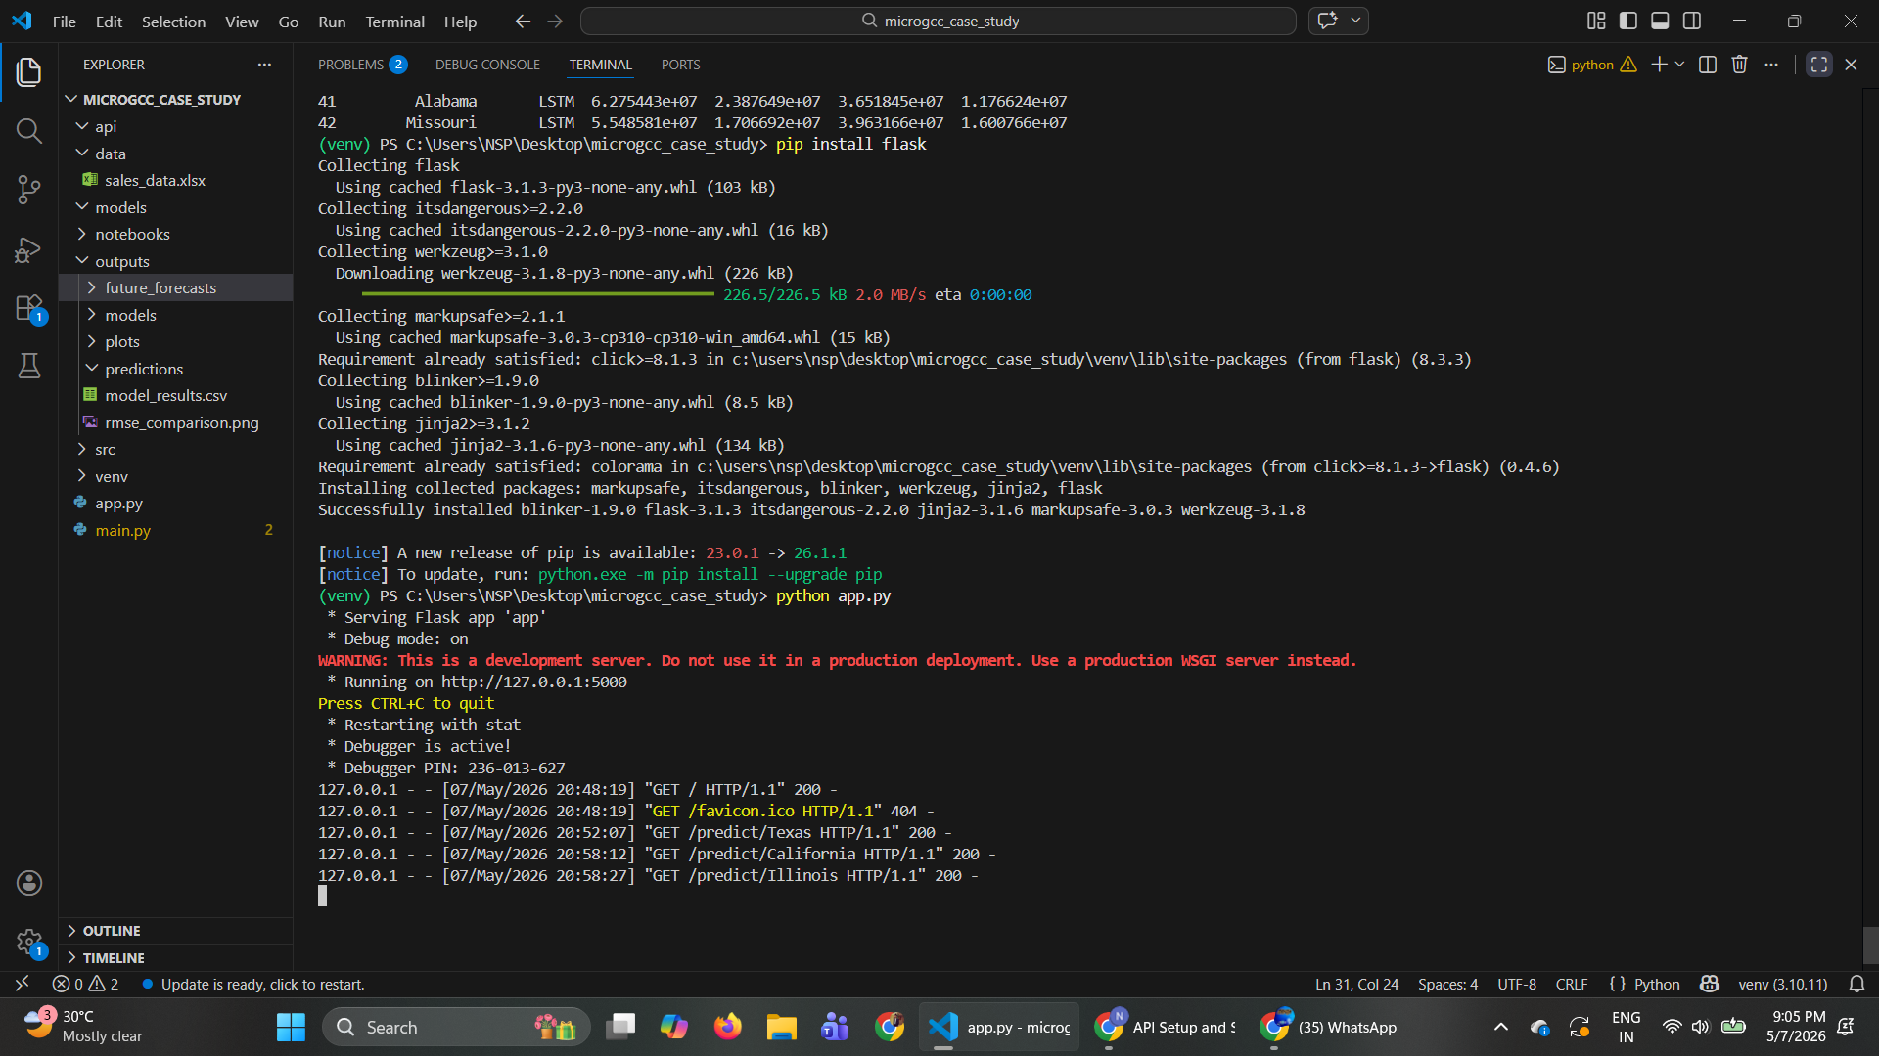
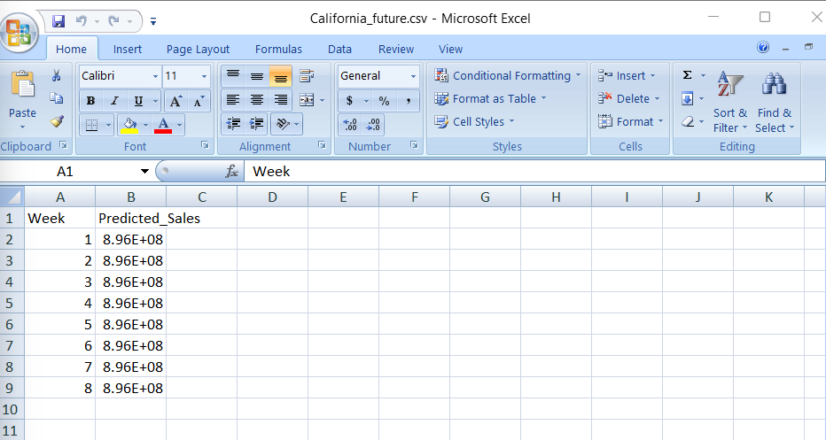
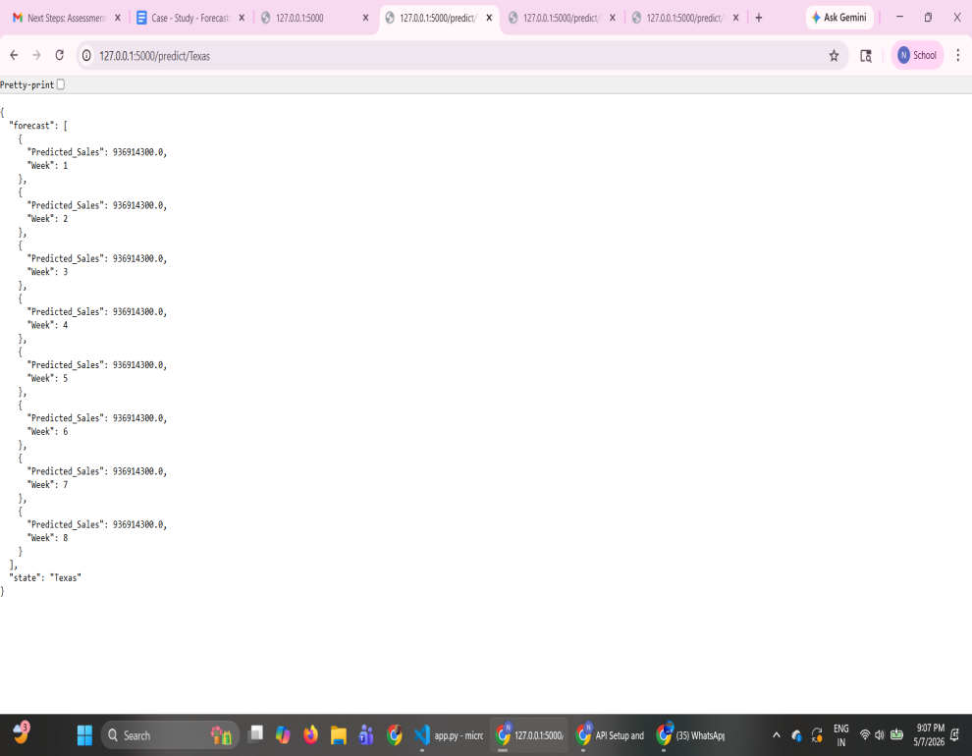
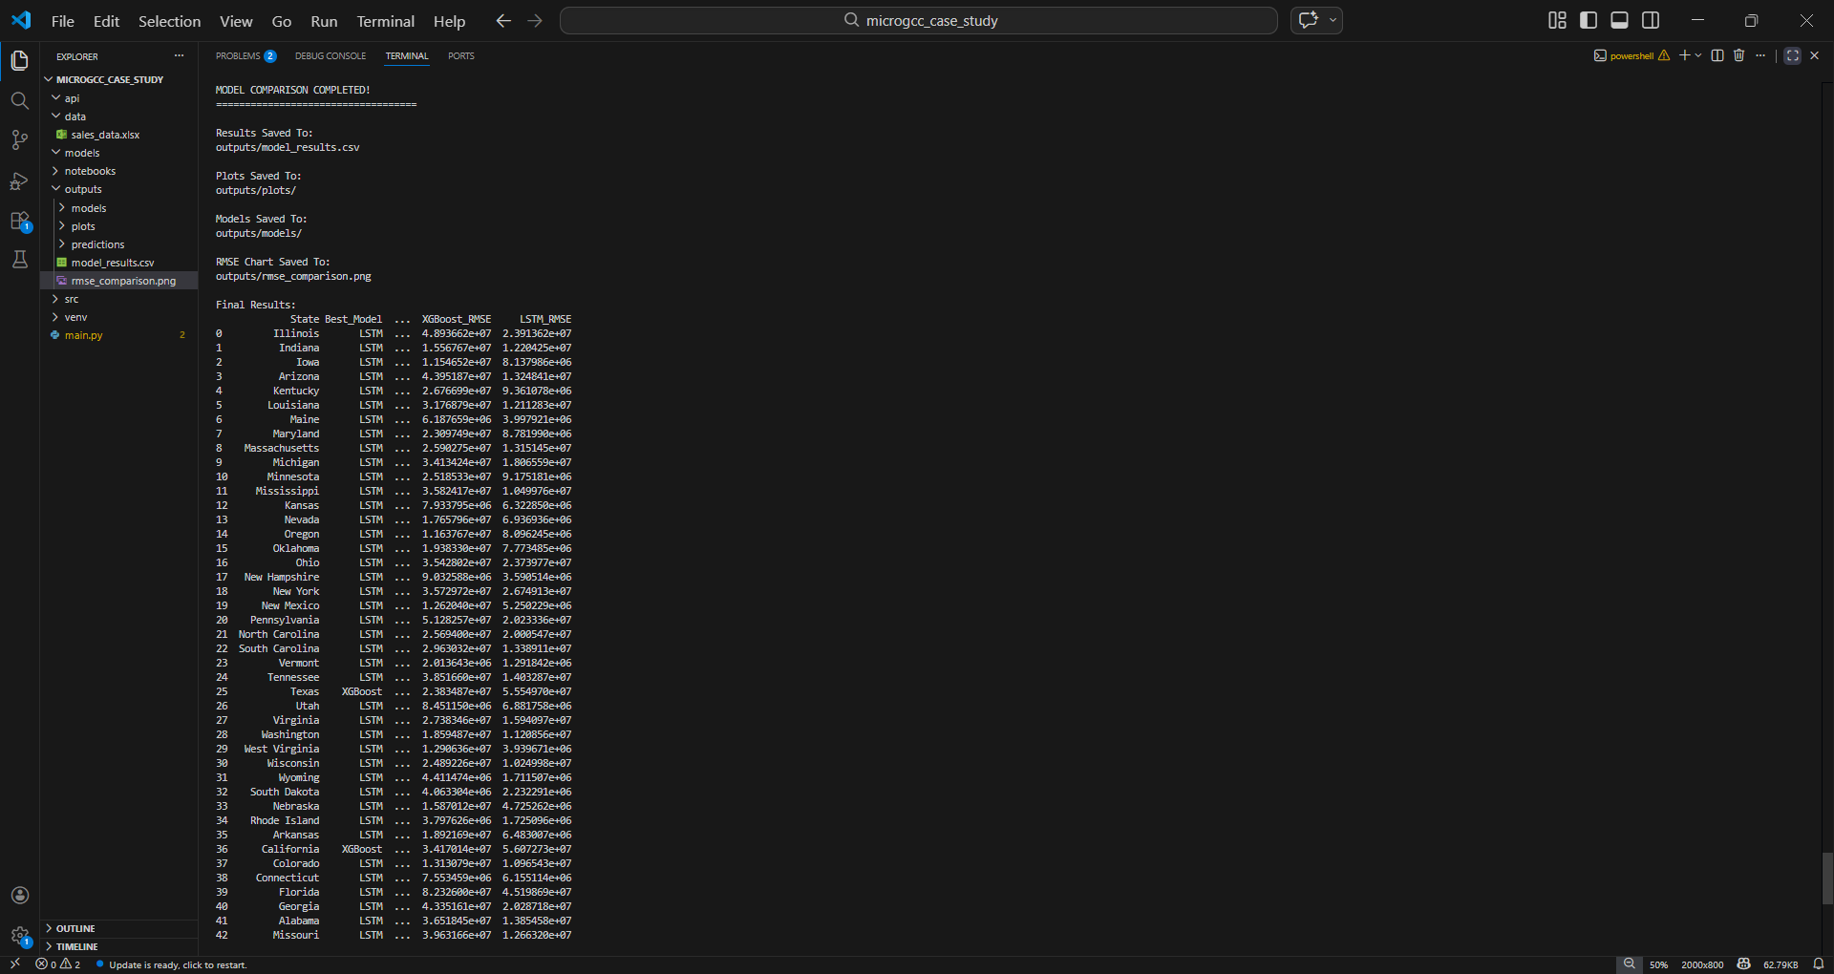

Slide 12
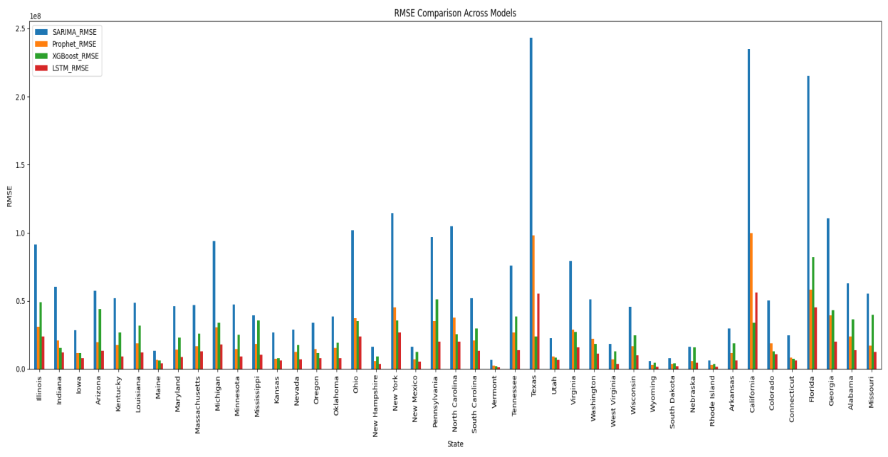
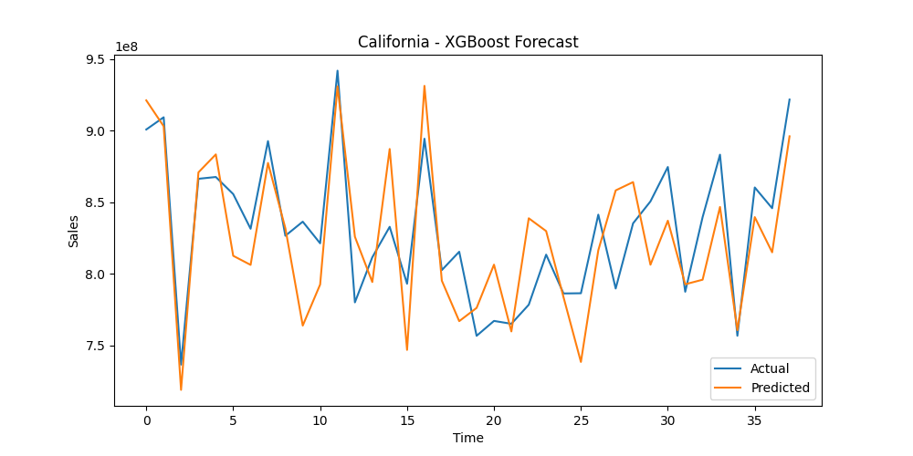
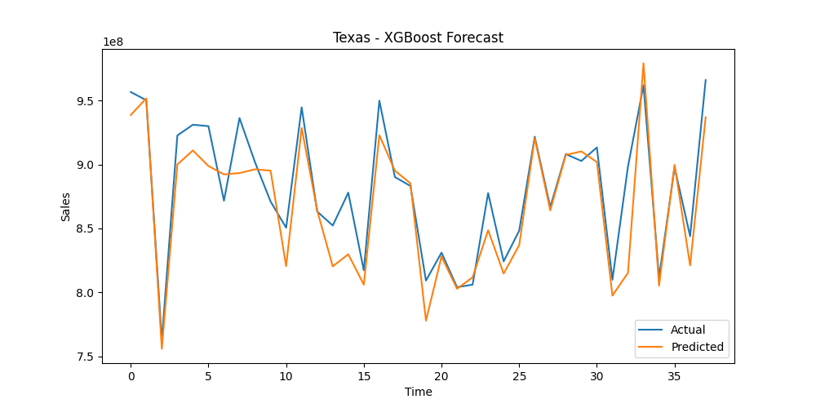
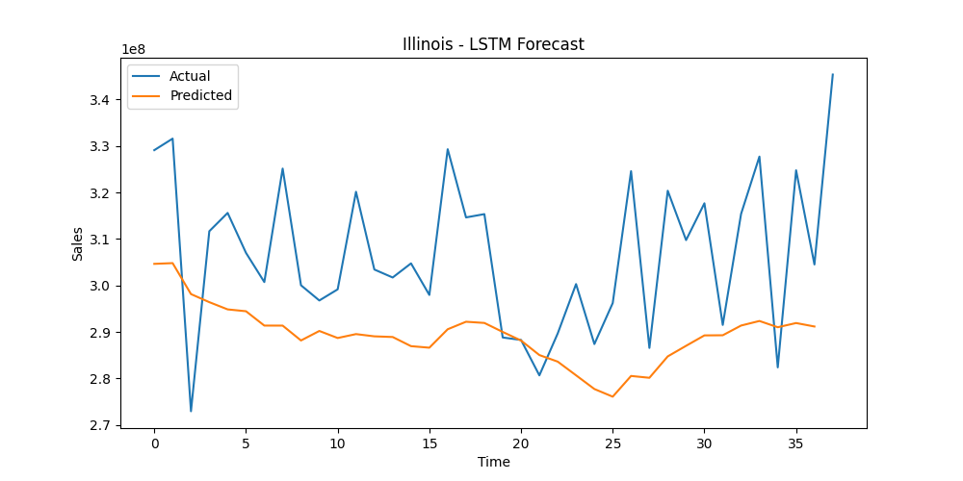

Slide 13
RESULTS
Forecasting system successfully predicts future sales
Multiple models compared using RMSE
Flask API returns real-time predictions
Outputs include CSV files and visualization graphs
System works for multiple states

Slide 14
FUTURE ENHANCEMENTS
Integration with real-time streaming data
Cloud deployment (AWS / Azure / GCP)
Advanced deep learning optimization
Interactive dashboard (Power BI / Streamlit)
Auto model retraining system

Slide 15
CONCLUSION
This project successfully demonstrates an end-to-end machine learning system for retail sales forecasting.
It integrates multiple forecasting models, evaluates their performance, and deploys the best model using a Flask REST API.
The system is scalable, efficient, and suitable for real-world business applications.

Slide 16
Thank You!

