Slide 1

Github Actions
Darío Gutiérrez Mori (UO282435)
Diego Villanueva Berros (UO283615)
Diego Murias Suárez (UO290009)
Jorge Cano Martínez (UO289845)

Slide 2
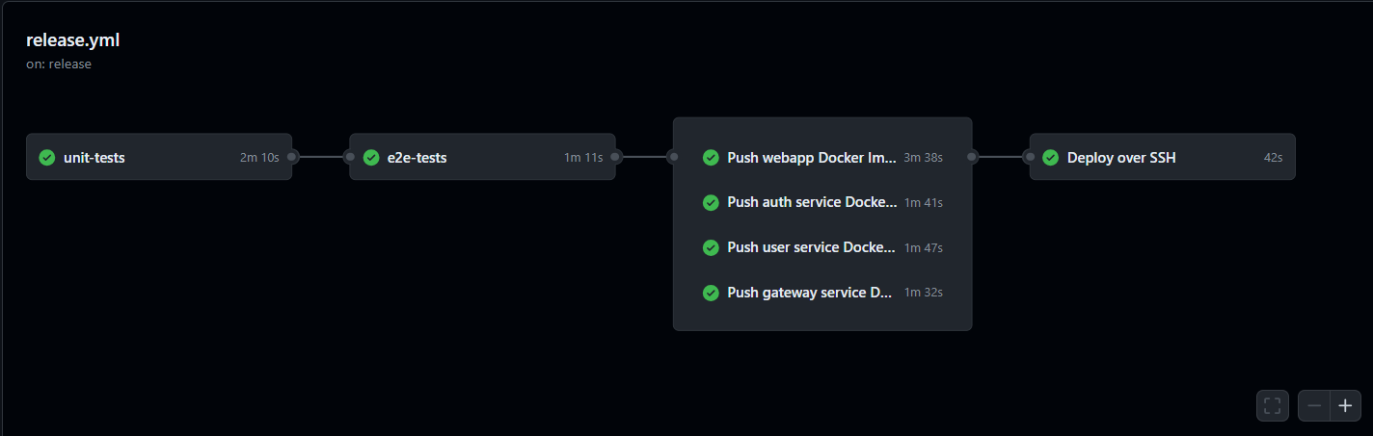

What are Github Actions?
Customizable workflows that allow you to automate tasks within your GitHub repository
GitHub Actions serves as an ideal solution for CI and CD.
Configure workflows to automatically run tasks triggered by some events.
Automate unit tests, integration tests, artifact building, and more for seamless integration of code changes.

Slide 3
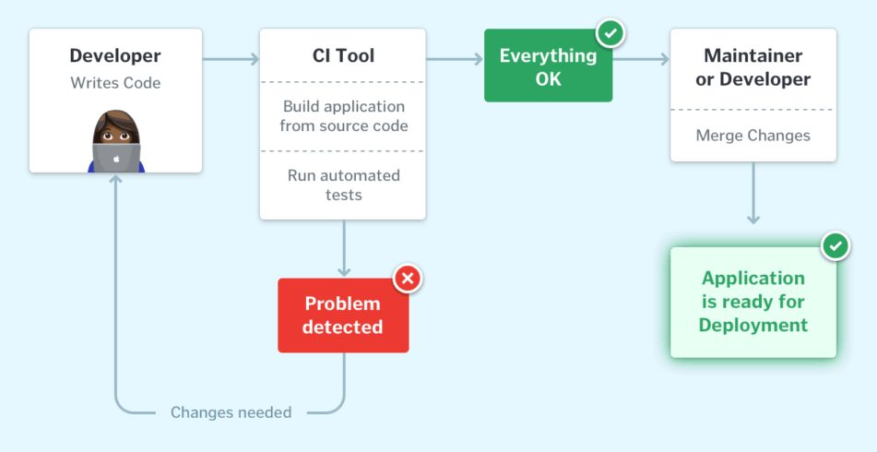
Continuous Integration
CI is essential for efficient software development.
Without CI, code changes can lead to fragmentation and conflicts.
CI, enabled via GitHub Actions, automates workflows triggered by events.
Tasks include running tests and deploying the application.
Early bug detection reduces time and effort for fixes.
CI promotes collaboration and trust through automated testing.
Recommending the use of dependabot

Slide 4
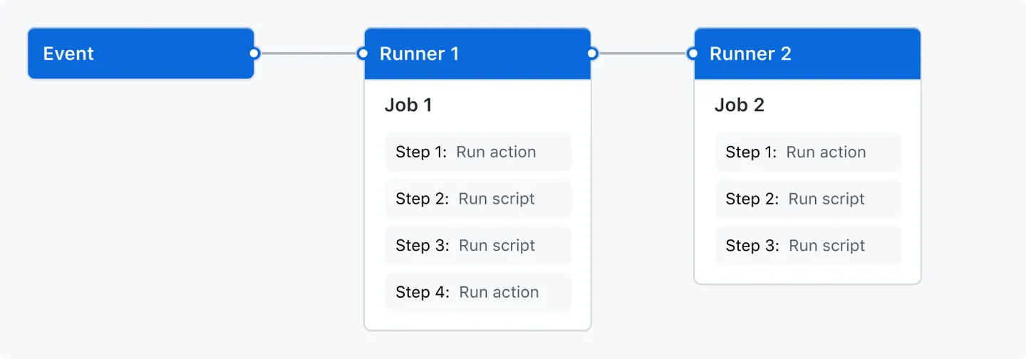

Continuous Deployment
Workflows:
Automated process that will run one or more jobs.
Jobs:
Set of steps in a workflow that is executed on the same runner

Slide 5
Continuous Deployment
Events:
A specific activity in a repository that triggers a workflow run.
Pull request
Pushing a commit
Opening an issue
Basically, anything that can happen in the repo

Slide 6
Ok, but why should I care about this?
(and how do I use it in my projects)

Slide 7
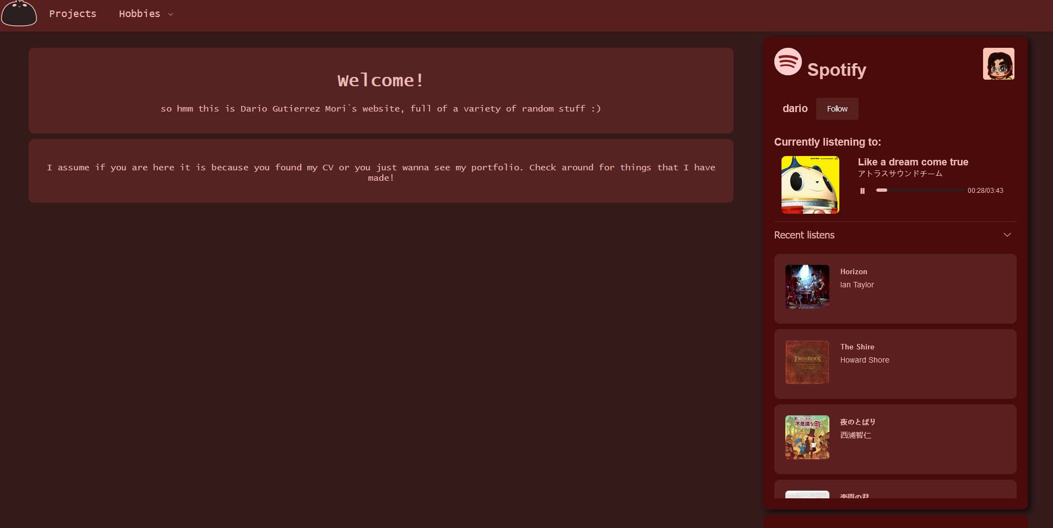
A practical example

Slide 8
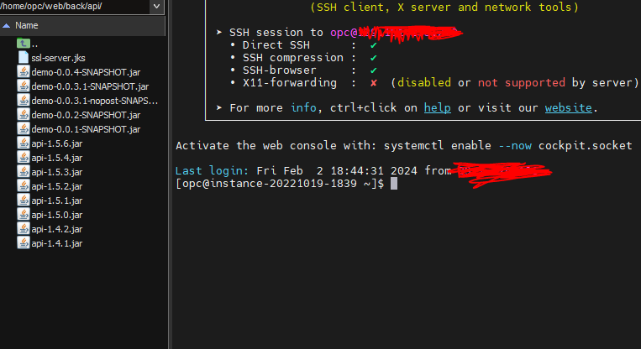
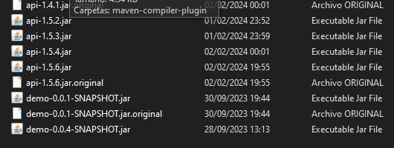
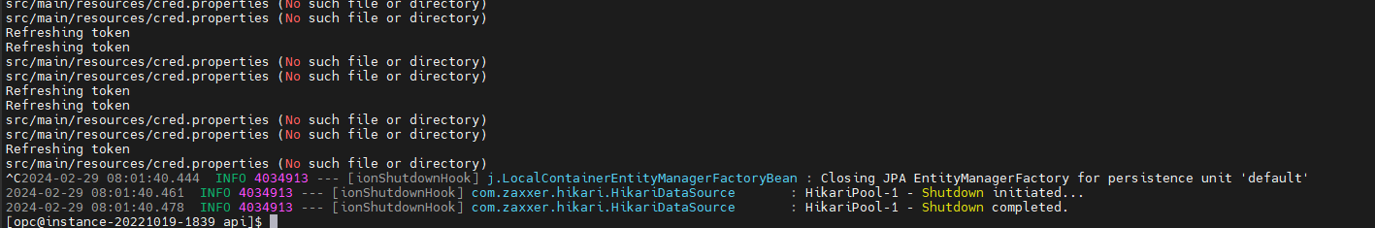

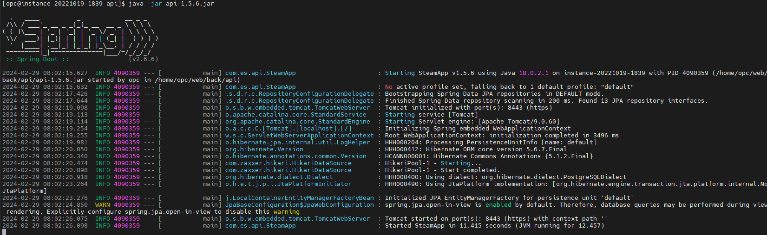
What I had (and still have) to do:

Slide 9
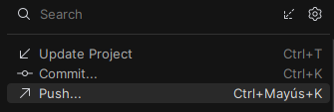
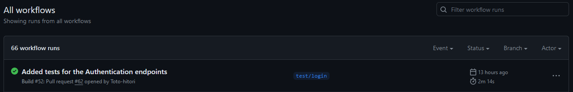
But if I had Github actions setup…
(and I would have tests!)

Slide 10

Ok but, where is the catch?

Slide 11
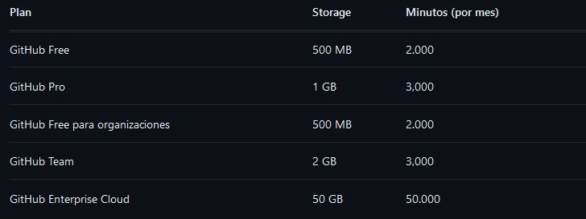
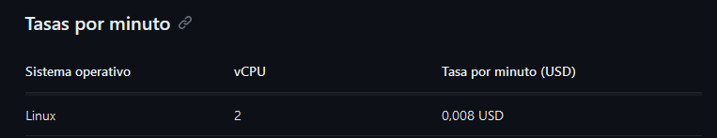
(here it is :/)

Slide 12
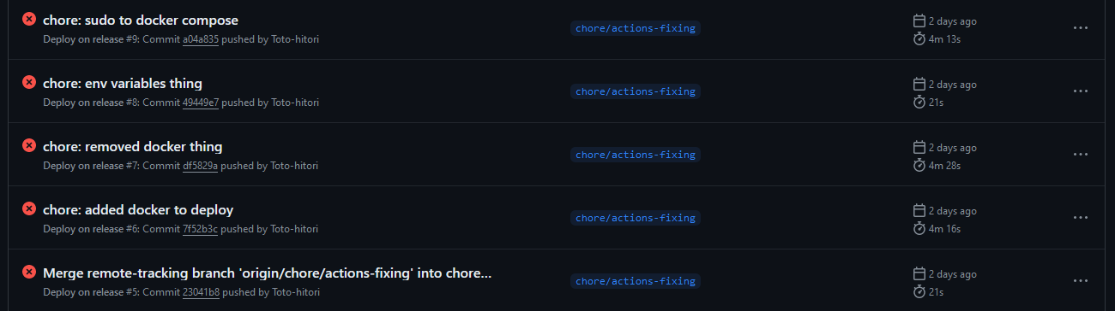
you have around 50 hours so don’t worry!

Slide 13




Where could I deploy my applications?
OR

Slide 14
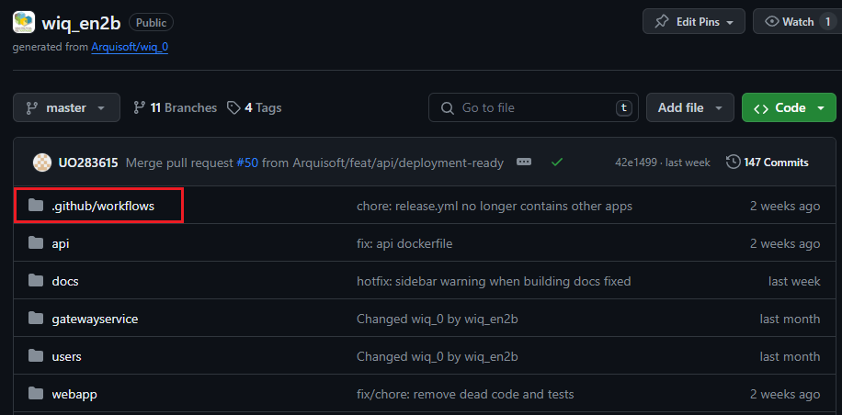
How are actions defined?
build.yml
name: Build
on:
push:
branches:
- master
pull_request:
types: [opened, synchronize, reopened]
jobs:
unit-tests:
runs-on: ubuntu-latest
steps:
- uses: actions/checkout@v4
with:
fetch-depth: 0
- uses: actions/setup-node@v4
with:
node-version: 20
- run: npm --prefix users/authservice ci
- run: npm --prefix users/authservice test --
--coverage
- name: Analyze with SonarCloud
uses: sonarsource/sonarcloud-github-action@master
env:
GITHUB_TOKEN: ${{ secrets.GITHUB_TOKEN }}
SONAR_TOKEN: ${{ secrets.SONAR_TOKEN }}

Slide 15
Some keywords
name: The identifier for your action
inputs: Data that will be used in runtime
outputs: Data that an actions sets. Can be used by following actions
runs: Specifies if it is a JavaScript, Docker or composite action.
jobs: What will be done

Slide 16
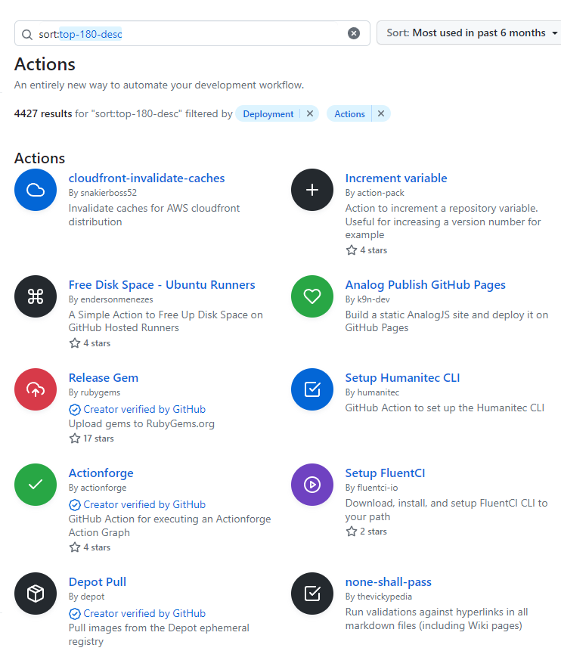
Actions Marketplace
Someone has probably done that before

Slide 17

Thanks

