Slide 1
The evolution of a Software aRchitecture
University of Oviedo
Santiago Fernández Carballal
Pedro Limeres Granado
Mario Pérez Fernández
Notes:
piola

Slide 2
What we are going to talk about
Ebay’s Architectural Evolution
N-tier architectures
Web Servers, Web Containers and Application Servers
Service Oriented Architectures (SOA)
MicroServices

Slide 3

Software engineering radio podcast
- Chief Engineer and Distinguished Architect at eBay
- Vice-president of Engineering at WeWork
- Vice-president of Engineering at Ebay &
Chief Architect at Ebay (now)
RANDY shoup

Slide 4
V1
V2
V3
V4
V5
EBAY’s Architectural Evolution
5 Stage evolution
Randy joined in the middle of the transition from V2 to V3 (2004)
NERD Project
Microservice Architecture

Slide 5


V1
V2
V3
V4
V5
Founder version
Every item was a file
No escalability
NERD Project
Notes:
File of 3.4M lines of code that reached

Slide 6

Engineering?
V1
V2
V3
V4
V5
Monolith
DLL of 3.4M
lines of code
(hitting compiler limits)
Transition to V3
Started in 2002
Single class
Nearly imposible teamwork
Two “monster”
databases
Notes:
They were hitting compiler limits on the number of methods per class. Back then, the limit was 16K.
One primary database, one backup. Evolved into domain-specific databases (several hundred).

Slide 7

2002
V1
V2
V3
V4
V5
220 “Mini applications”
(not even microservices)
Domain-specific Teams
Verticaly sliced domains
Difficult to trace the source of an error
Domain-Specific
Databases
(shared with V2)
Central logging system
Monolithic Frontend

Slide 8




N-Tier Architectures
One-tier
Architecture
Two-tier
Architecture
Three-tier
Architecture

Slide 9


One-tier architecture
Also known as Standalone Application
All components are on the same app or server
Advantages:
High effciency
Easy to implement
Disadvantage
No support for remote or distributed Access to data

Slide 10
tWO-tier architecture
Also known as Client-Server Application
Presentation is part of the client app, the Business and Database layer is part of the Server
Advantages:
Easy to maintain
Easy to make modifications
Quiet fast communication
Disadvantage
Performance decreases as the number of clients increase
Banking app

Slide 11
three-tier architecture
Also known as Web-based Application
Client handles Presentation, Applications layer is handled by the Application server and the Server System handles the Database layer.
Advantages:
Higher security
High scalability
Disadvantage
Complex structure
LoMap

Slide 12
WebServers, Webcontainers and Application servers
HTTP Protocol
HTTP, JSP
Web Servers
Web Containers
Application Servers

Slide 13


Web servers
Gigant computer where the content of the web is stored
Store, process and deliver web pages to users
Web servers can run static content, as HTML, CSS, JS,…
The communication is done using the HTTP Protocol
HTTP Protocol

Slide 14

Web containers
WebServer + Dynamic content
WebContainers are slower serving static content
Can run JSPs, Servlets, Enterprise Java Beans, …
Designed with higher proccessment capacity and higher memory resources
HTTP, JSP

Slide 15


Application server
Specifically designed to run applications
Provides a platform for executing and managing apps.
Works in conjunction with other components
High maintenance costs
Very powerful
Highly scalability and availability

Slide 16
Service oriented Architecture
Service
CONSUMER
API
Service

Slide 17

Service oriented Architecture
Service-orientation: modular, reusable, and loosely-coupled.
Services expose their functionality through standardized interfaces
Services define their contracts
Designed to be loosely coupled: they can be developed, deployed, and maintained independently.
Agile, reusable, standards-based
Simple development process
Improve the maintability
Service
CONSUMER
API
Service

Slide 18
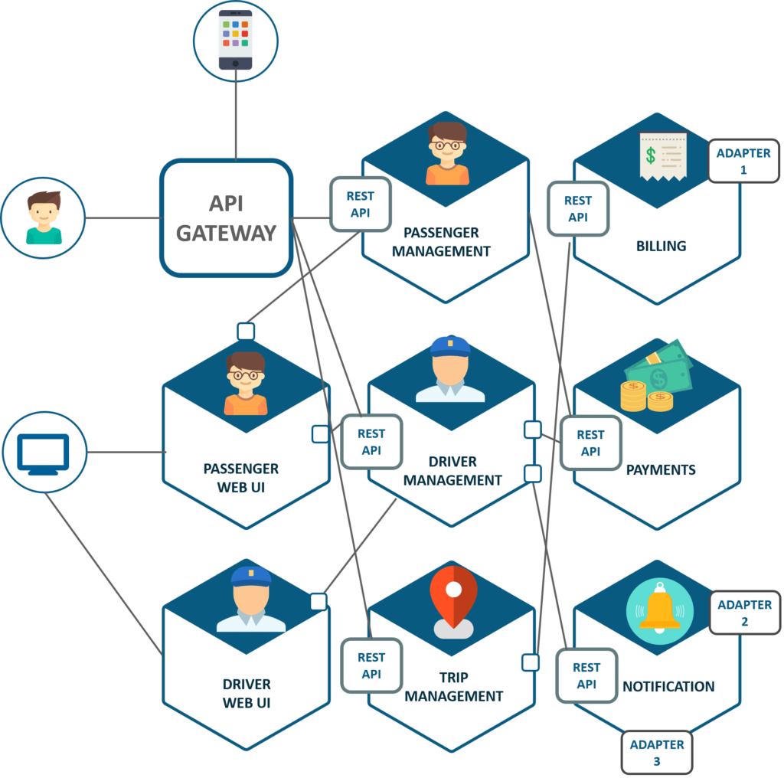
Microservices

Slide 19


Microservices
Small independent services
Communication through well defined APIs
Each service performs a single business function
Developed, deployed and scaled independently
Designed to be fault-tolerant
Technology diversity
Fast time-to-market
High complexity managing multiple microservices

Slide 20
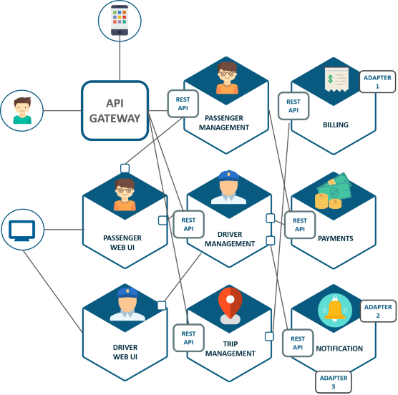
Questions?
HTTP, JSP
Service
CONSUMER
API
Service

