Slide 1

Project Title: Email Spam Classifier
Slides: Project Overview and Result
Presented By: Group-32
Date:
1. Sobhana verma (MSD2306),
2. Kashish Chhabra (MSD2301),
3. Sahil Bhardwaj (MSD2309),
4. Ranjan Das (MSD23012).

Slide 2
Introduction
Objective: Build a classifier that accurately distinguishes spam from non-spam emails.
Datasets: Merged from multiple Kaggle sources.
Methods Used: Text preprocessing, feature engineering, model training, and handling data imbalance.

Slide 3
Project Goals
Develop a reliable, accurate classifier.
Standardize and clean email text data.
Engineer features to improve model performance.
Handle class imbalance effectively.
Train multiple models and tune for optimal accuracy.

Slide 4
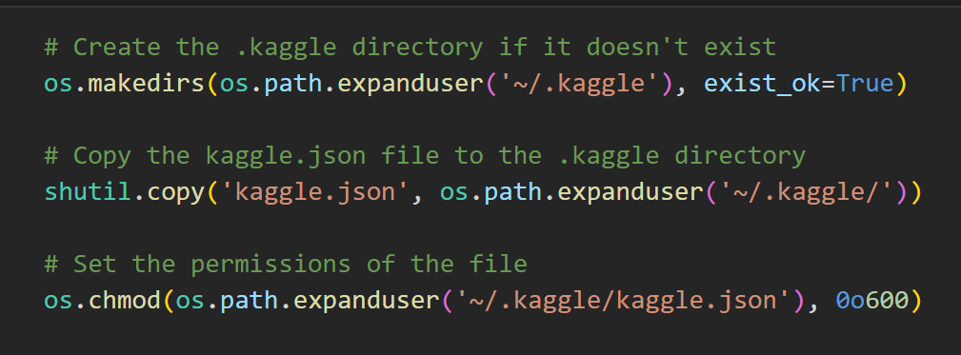
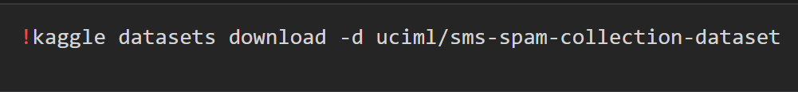
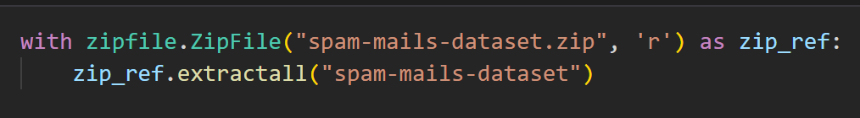
1. Kaggle Directory
Similarly, We performed the same process for all 4 datasets.
2. Download Datasets
3. Unzip Datasets

Slide 5

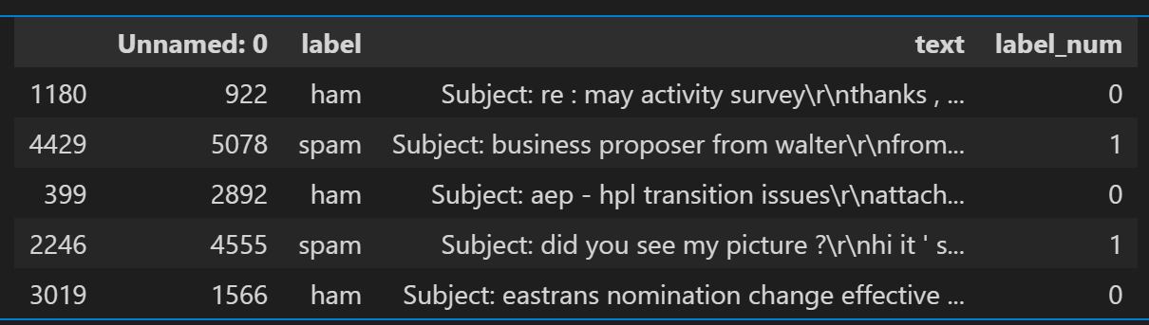
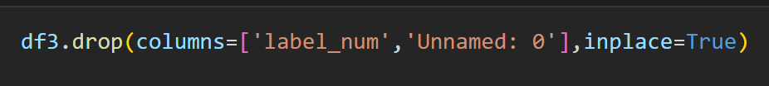
1. Create Data Frame
Data Frame
2. Drop Column

Slide 6
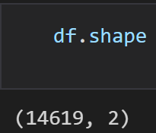
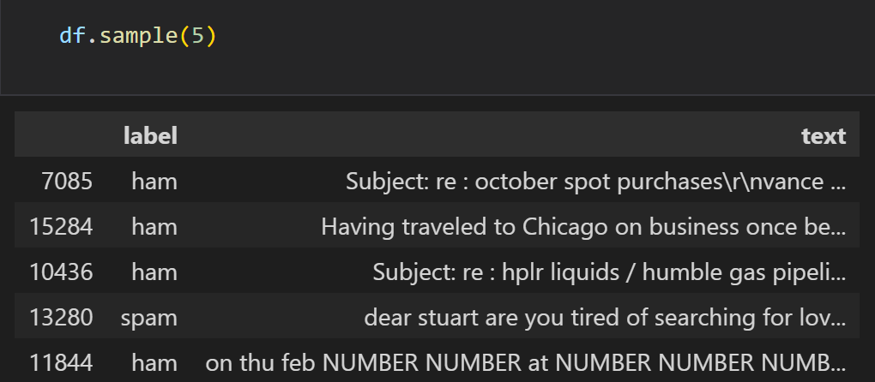
3. Combined Dataset
5. Shape of the Dataset
4. Sample Data

Slide 7
Data Preprocessing
Lower case conversion for consistency,
Whitespace and newline removal,
Removal of stopwords (keep essential ones like “not” and “but”),
Lemmatization for word consistency,
Cleaning out URLs, email addresses, and HTML tags
Sample Code
HTML Tags Removal:
Newline Removal:

Slide 8
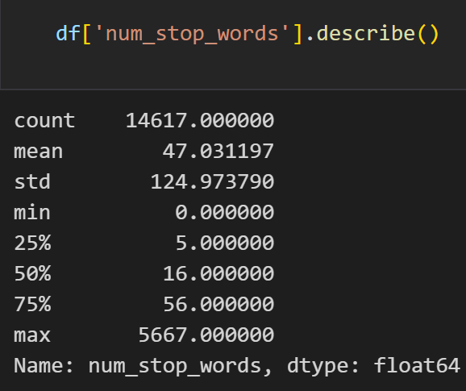
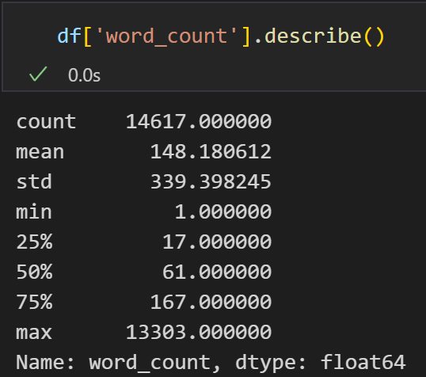
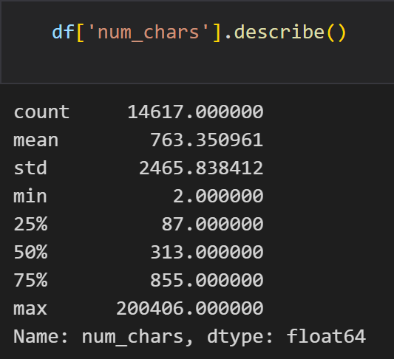
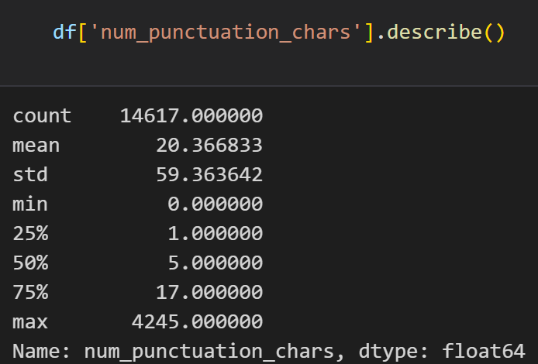
Feature Engineering
Stopwords Description
Word Count: Before and after cleaning.
Character Count: Measures text length before and after cleaning.
Stopwords Count: Total count before and after removal.
Punctuation Count: Captures punctuation as a feature.
Word Count Description
Character Description
Punctuation Character Description

Slide 9
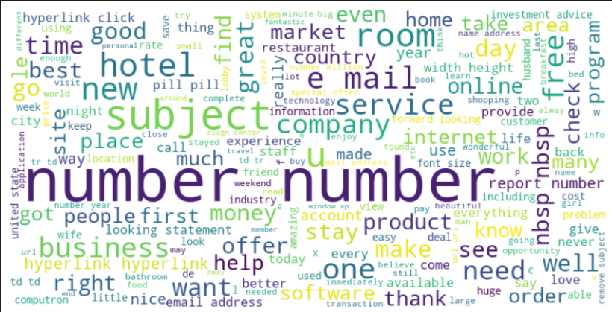
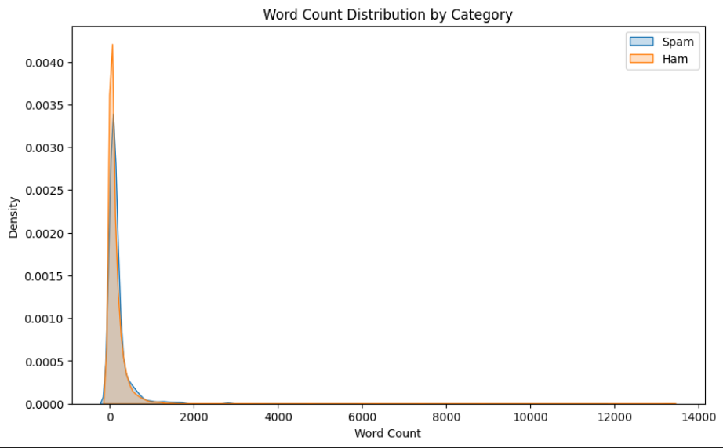
Exploratory Data Analysis
Most Used Words
Word Count Distribution by Category

Slide 10
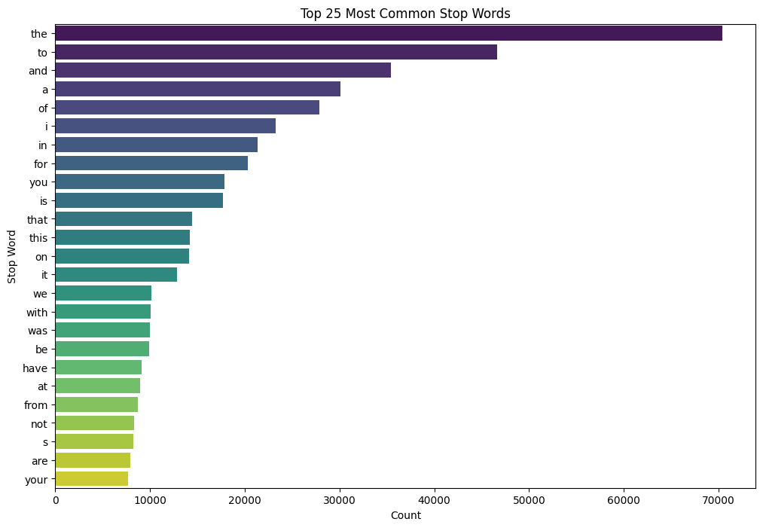
Top 25 Common Stop Words

Slide 11
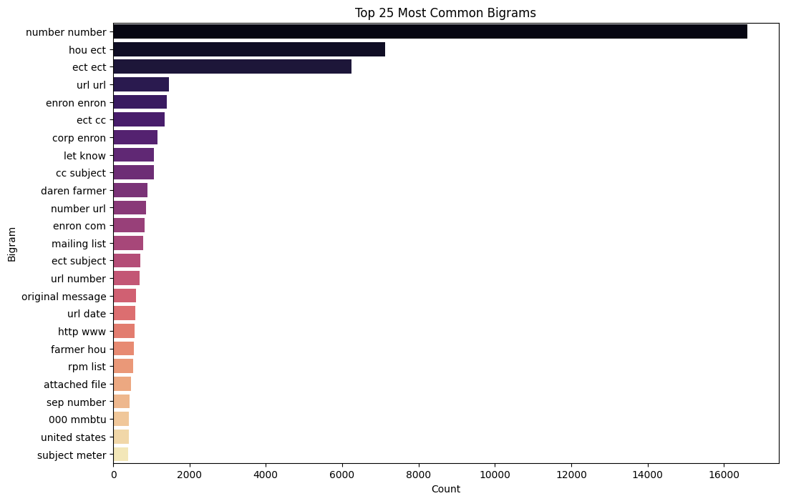
Top 25 Common Bi-grams

Slide 12
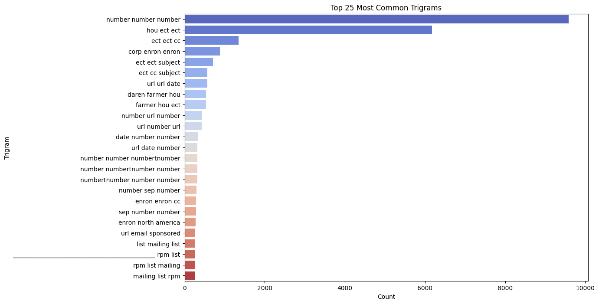
Top 25 Common Tri-grams

Slide 13
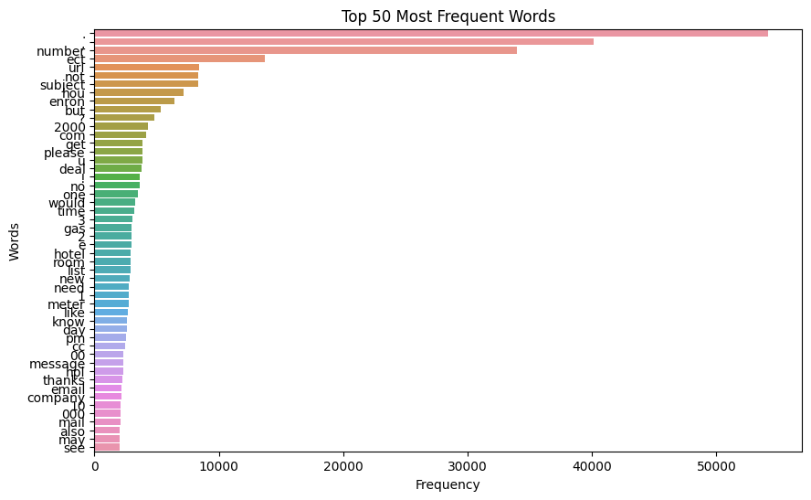
Top 50 Frequent Words

Slide 14
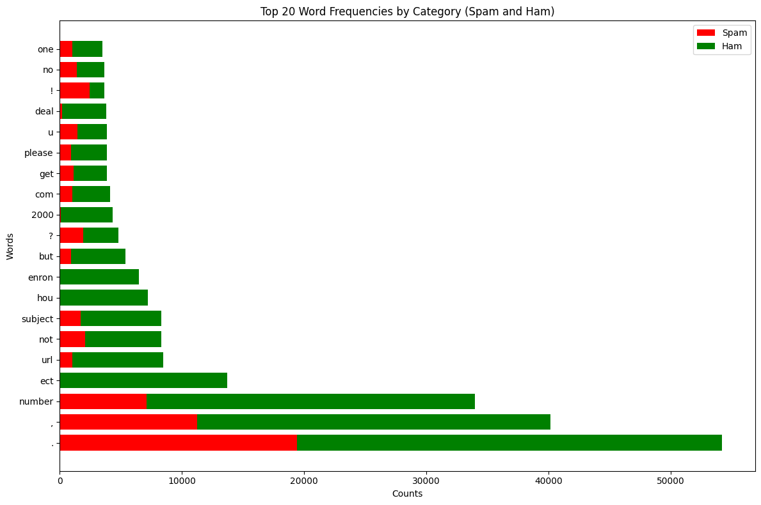
Top 20 Frequent Words by Category

Slide 15
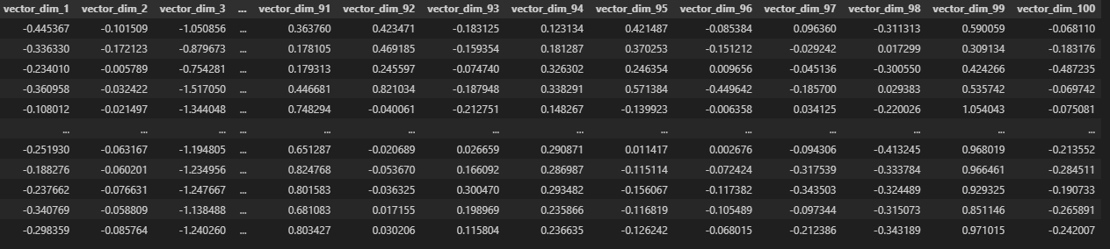
Contextual Embedding with Word2Vec
Embedding: Used Word2Vec for generating 100-dimensional vectors.
Purpose: Captures the semantic meaning of words, aiding in accurate classification.

Slide 16
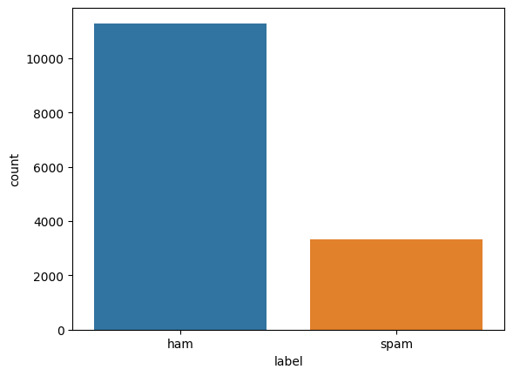
Handling Imbalanced Data
Problem: Class imbalance common in spam classification.
Solutions:
Undersampling: Reduced non-spam emails to balance classes.
Oversampling: Duplicated spam emails.
SMOTE: Created synthetic samples of spam emails for further balance.

Slide 17
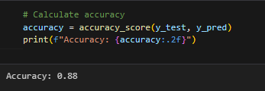
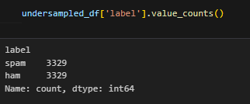
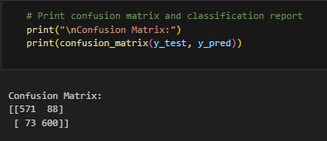
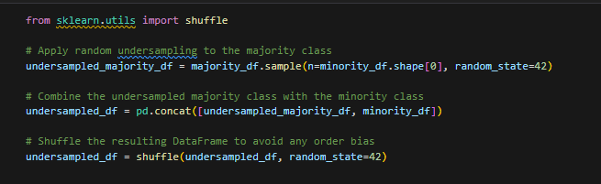
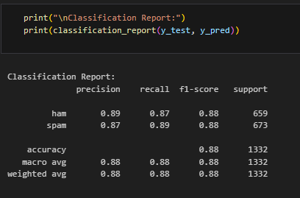
Undersampling

Slide 18
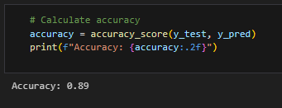
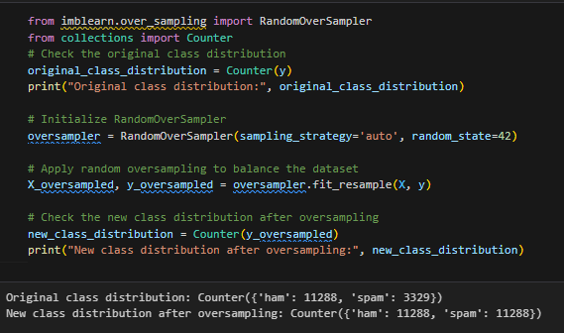
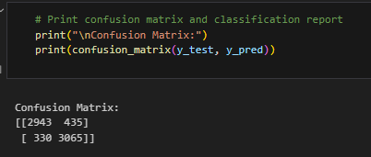
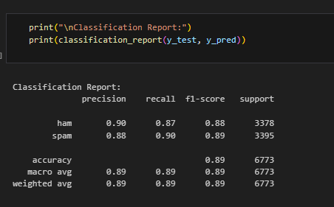
Oversampling

Slide 19
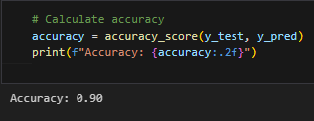
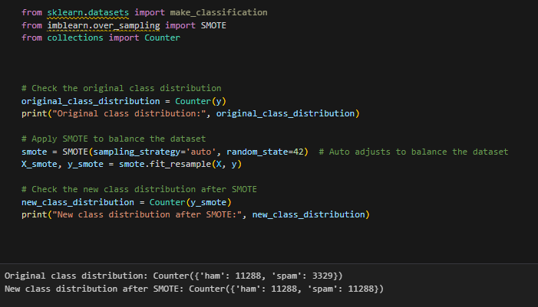
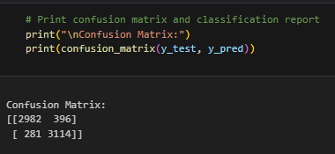
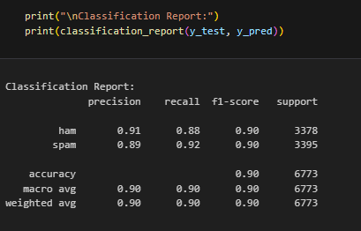
Smote

Slide 20


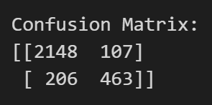
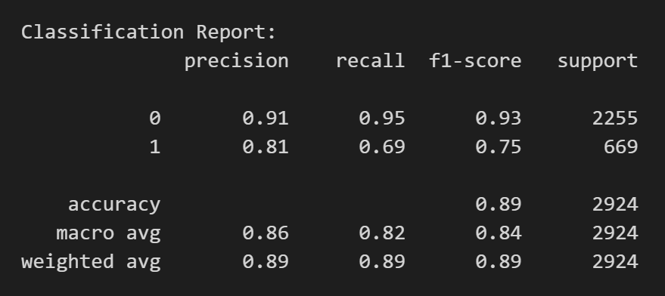
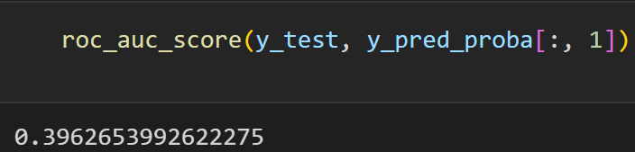
Model – 1:
Accuracy:
Confusion Matrix:
Classification Report:
AUC-ROC Score

Slide 21
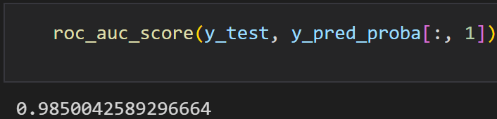
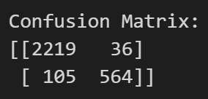
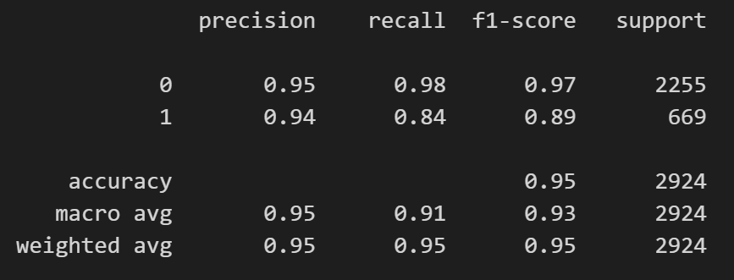
Model – 2:
Random Forest Classifier
ROC-AUC Score
Confusion Matrix
Classification Report

Slide 22

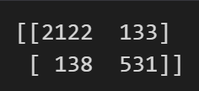
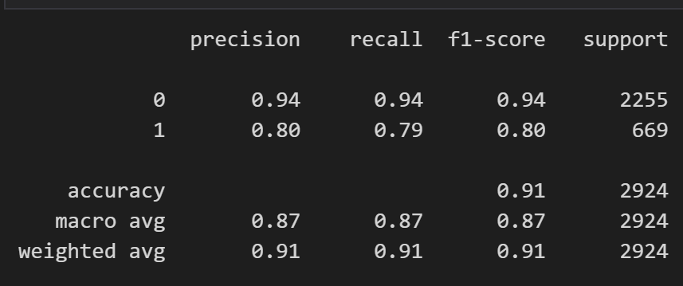
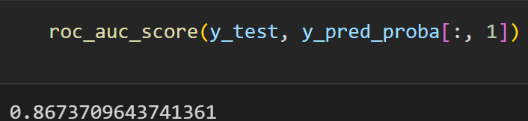
Model – 3:
Confusion Matrix
Classification Report
ROC-AUC Score

Slide 23
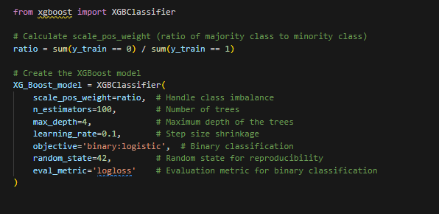
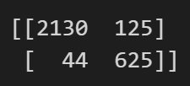
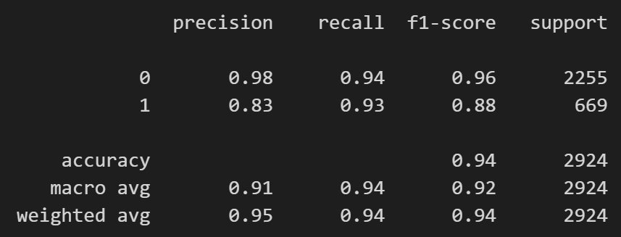

Model – 4:
XGBoost
Confusion Matrix
Classification Report
AUC-ROC Score

Slide 24
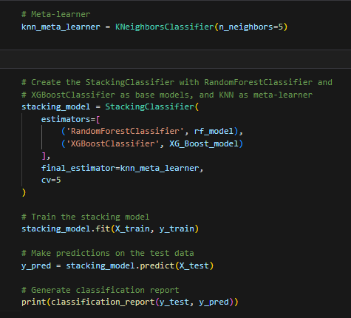

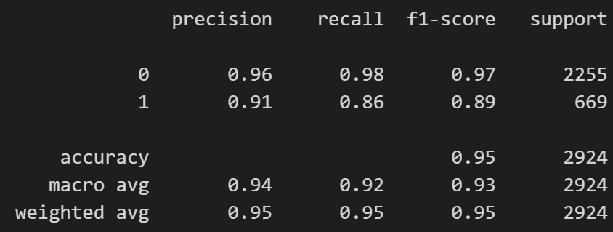
Model – 5:
Stacking
Confusion Matrix
Classification Report

Slide 25
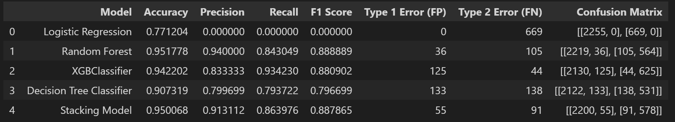
Models Performance

Slide 26
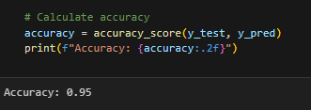
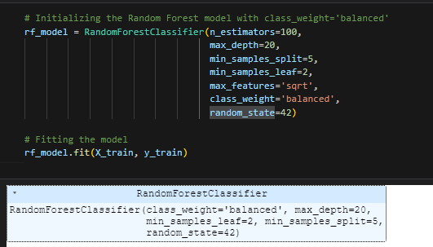



Hyperparameter Tuning
Best Model: Random Forest Classifier.

Slide 27


Prediction

Slide 28
Thank You

