Slide 1
HEALTHCARE ANALYTICS FOR DOCTOR VISITS
NAME : Ravuri Yasaswi Venkata Naga Sravani
AICTE ID : STU6464b4d2cdec61684321490
COLLEGE : Shri Vishnu Engineering College for Women

Slide 2


PROBLEM STATEMENT
Patient Segmentation:
Involves dividing a group of patients into subgroups based on certain characteristics, such as age, gender, or income. This segmentation helps healthcare providers understand the unique needs and behaviors of different patient groups.

Slide 3
PROJECT DESCRIPTION Segmentation Criteria: Determine which demographic characteristics you want to use for segmentation. Common criteria include age, gender, income, education level, and geographic location. Data Collection: Collect relevant patient data, including demographic information, visit history, and health metrics such as illness severity and chronic condition status. Segmentation: Use statistical techniques or simple filters to divide the patient population into subgroups based on the chosen criteria. For example, you can divide patients into age groups (e.g., <18, 18-35, 36-50, 51-65, 65+) or income brackets (e.g., low-income, middle-income, high-income). Analysis: Once patients are segmented, analyze visit patterns, illness severity, and chronic condition prevalence within each subgroup. This analysis helps identify trends and patterns specific to each segment.

Slide 4
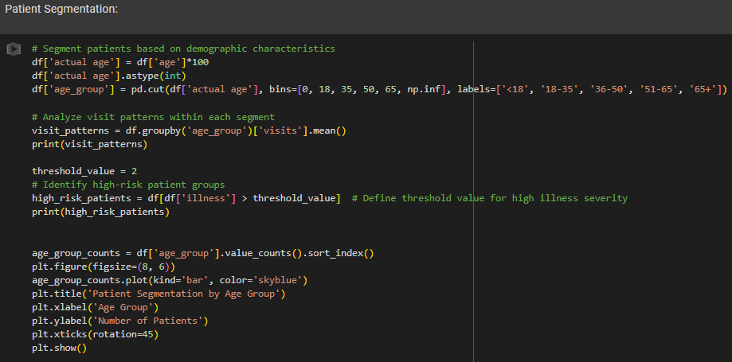
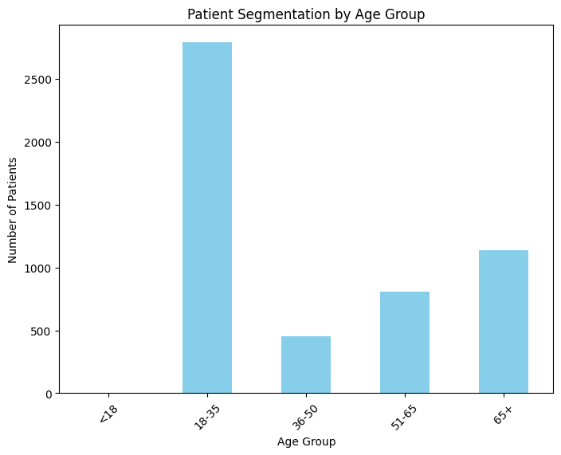
RESULTS
Demo Link

Slide 5

IMPACT OF SOCIOECONOMIC FACTORS
When examining the impact of socioeconomic factors on healthcare utilization and health outcomes, we focus on variables such as income, which can significantly influence access to healthcare services and health outcomes.

Slide 6
STEPS
Categorizing Patients by Income:
We classify patients into distinct groups or brackets based on their income levels.
Income brackets can be defined using various criteria such as annual income, household income, or socioeconomic status.
For example, we may divide patients into low-income, middle-income, and high-income groups based on predefined income thresholds or percentiles.
Analyzing Healthcare Metrics:
Once patients are categorized by income, we examine various healthcare metrics to understand how income levels impact healthcare utilization and health outcomes.
Healthcare metrics may include:
Illness Severity: The severity or acuteness of illnesses experienced by patients.
Chronic Condition Prevalence: The prevalence or frequency of chronic health conditions such as diabetes, hypertension, or heart disease.
Healthcare Utilization: The frequency and type of healthcare services utilized by patients, including doctor visits, hospitalizations.

Slide 7
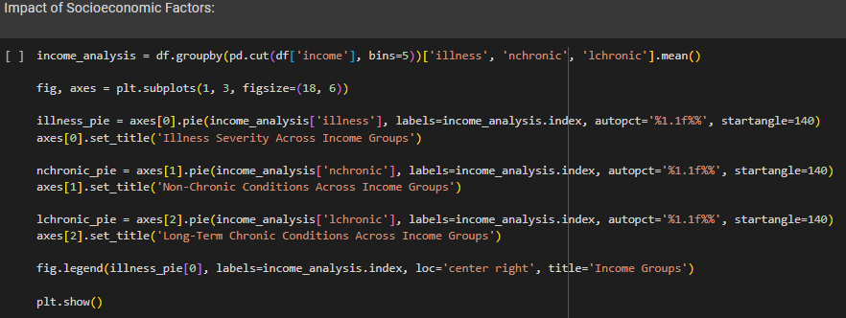
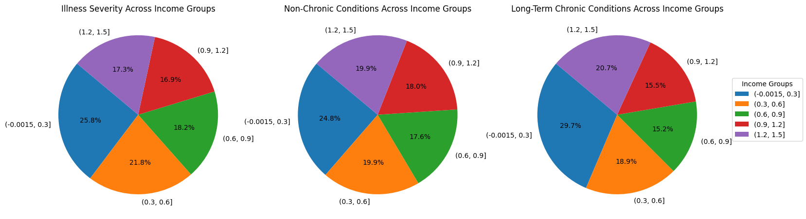
RESULTS

Slide 8
CORRELATION ANALYSIS
Correlation analysis is a powerful tool in healthcare data analysis for understanding relationships between variables and identifying potential factors influencing health outcomes.

Slide 9
UNDERSTANDING CORRELATION:
It examines the relationship between two or more variables to determine if changes in one variable are associated with changes in another.
A positive correlation indicates that as one variable increases, the other variable also tends to increase.
A negative correlation means that as one variable increases, the other variable tends to decrease.
INTERPRETING CORRELATION RESULTS:
FOR EXAMPLE a positive correlation between illness severity and chronic conditions indicates that patients with more chronic conditions tend to have higher illness severity.
FOR INSTANCE a negative correlation between income and hospitalization rates suggests that higher-income individuals may have lower hospitalization rates.
VISUALIZING CORRELATIONS:
Correlation matrices and scatter plots are commonly used to visualize correlations between multiple variables.
Heatmaps can also be used to represent correlation matrices visually, with colors indicating the strength and direction of correlations.

Slide 10
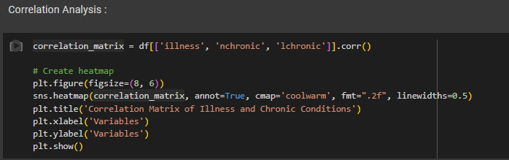
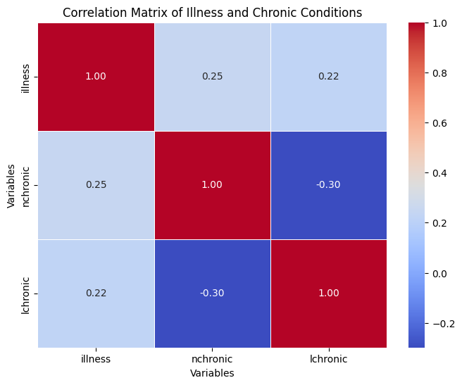
RESULTS

Slide 11

WHO ARE THE END USERS
Healthcare Providers and Clinicians:
Includes doctors, nurses, and allied health professionals
Uses the analyses to understand patient demographics, identify high-risk groups, and tailor treatment plans to individual patient needs.
Healthcare Administrators and Managers:
Use to optimize resource allocation, improve operational efficiency, and identify areas for quality improvement.
Public Health Professionals:
Uses to identify population health trends, monitor disease prevalence, and develop public health interventions and policies.
Researchers and Academics:
Uses to conduct epidemiological studies, evaluate healthcare interventions, and contribute to the evidence base for clinical practice and policy.
Policy Makers and Government Agencies:
Uses to inform healthcare policies, funding decisions, and regulatory initiatives.

Slide 12








TECHNOLOGY USED
Python
pandas
NumPy
Matplotlib
seaborn
scikit-learn
Jupyter Notebook
HERE IS THE LINK FOR STEPS OF ANALYZING
DEMO LINK
GIT LINK

Slide 13
Thank you

