Slide 1

DS-2002: Data Science Systems
A Survey of Data Management Systems
Prof. Jon Tupitza – Fall 2022

Slide 2
Class Mechanics
A Survey of Data Management Systems

Slide 3
Who is… Teaching this Course?
Jon Tupitza @ Microsoft: Sr. Cloud Solution Architect for Data, AI & Analytics
Lead Enterprise Data Science Program (EDSP) for Retail & Consumer Goods OU
Mentor & Courseware developer for EDSP Mentoring Program – Certification Proctor
MS Data Analytics – 2018
More Industry Certifications than I can remember – see LinkedIn (MCP since 1999)
Microsoft Guy: 25+ yrs. Focusing on Microsoft technologies
Software Engineering & Architecture
Data Platform Architect – Data Engineer – Business Intelligence – Data Science
PubSec/National Security SME: 22 yrs. Supporting DoD (Army, DARPA), IC (NGA, FBI)
Past @ Buchanan-Edwards: CTO/Solution Architect – Practice Lead: Predictive Analytics
Past @ Microsoft Consulting: Sr. Consultant specializing in SQL Server & Business Intelligence
Past @ Avanade: Principal Solution Developer (.NET)
Past @ Microsoft Partners: Data Scientist, Data Warehouse Architect, Software Architect

Slide 4
Who am I ?
Love to Teach: Born to be a Professor… no kidding – it’s been my life’s goal
Wanted to be interesting (and financially secure) so I’ve done lots of other professional stuff first
Philadelphia area (Valley Forge) native… Where they throw snowballs @ Santa
Recent Transplant from DC Metro area – Alexandria, VA (Mt. Vernon)
2 Kids and 1 Wife… of 32 yrs.
Wife (Karen): CFP, MS Financial Planning – VP of Wealth Mgmt. & Trust… Plans my financial future
Daughter (Jill): UVA Alum 2016 – PhD Candidate @ LSU (Oceanography & Coastal Sciences)
Son (Jake): VaTech Alum 2019 – Eagle Scout, Baseball, Musician – Works in the Clean Energy sector
Transitioned from an Earlier Career in Advertising… Art Director & Agency Computer Wiz (Mac)
BFA Degree (Fine Art)… from a long line of artists and craftsmen
41+ yrs. studying & 28 yrs. teaching Okinawan & Japanese Martial Arts
9th Dan – Hanshi – Shoshinkan-ha Shorinken Karate/Kobudo & Itto-Ryu Kenjutsu
5th Dan – Kyoshi – Classical Judo

Slide 5




Class Mechanics: Course Content
Lectures:
In-Person
Discussion:
Readings / Videos:
Articles and Posts
Supporting tools and videos
~Hours per Week Prep for Mondays Class
Labs:
Hands-On, Virtual & Wednesday.
I may Provide a Zoom invite.
Mondays as a part of Lecture Day
First Class of the Week (Monday)

Slide 6

Class Mechanics: Course Content
Labs
Frequent Hands-On Labs
AWS, Azure, OCI, GCP (Amazon, Microsoft, Oracle, Google)
1 Per Week (More Available)
Begin on Wednesdays and Have Completed by Friday

Slide 7

Class Mechanics: Grading
Data Projects
Concrete Examples of Implementation (Two in total)
Released long before they’re due
Detailed Instructions will be in Collab
No Time Limits!

Slide 8
Class Mechanics: Grading
Component | Weight | Frequency
Student Survey |  | First Week
Lectures / Readings / Material |  | Weekly
Engaged Discussion | 5% | Weekly
Quiz | 15% | 3 or 4
Labs | 30% | Weekly
Data Projects | 50% | 2 projects (25% each)

Slide 9
Class Mechanics: Things You Need to Know
How this course will be conducted: Class Location, Course Materials, Communications
We will be IN-PERSON on Tuesdays…
Wednesdays we may be on Zoom for Hands-on Labs
Sometimes we’ll do them in groups
…And sometimes you’ll do them alone
The schedule is prone to updates: I’ll be sure to keep everyone informed!
Everything will be updated on GitHub: https://github.com/JTupitza-UVA/DS-2002-002
Quizzes, Projects and Grades will be released on Collab
You can DM me on Discord with Questions or to Set-up Office Hours

Slide 10
Learning Objectives
Develop Robust Facility for Handing Data
Acquire a Strong Understanding of SQL and NoSQL Databases
Understand Systems Options in the Public Cloud
Gain Fluency in Tools, Processes, and Services …and How to Choose Among Them
Data Retrieval
Data Shipping
Data Schemas
Data Ingestion
Data Processing
Data Normalization
Data Analysis

Slide 11
Overview
of the Semester Topics
A Survey of Data Management Systems

Slide 12
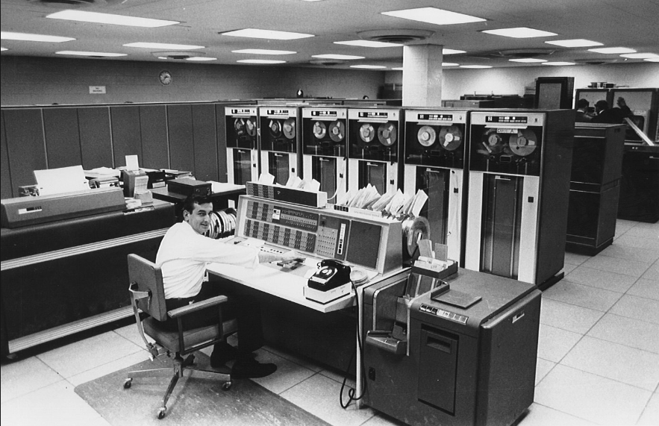
In the Beginning… There Was Mainframe
Data stored in ISAM files (indexed sequential access method)
Flat files having fixed-length fields
Centralized computing and storage resources
“Dumb” terminal clients
Only affordable to large, wealthy enterprises:
Governments
Large Banks

Slide 13
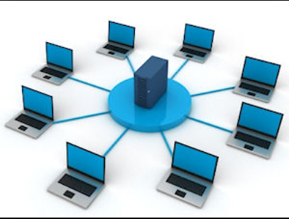
Then Came… Client/Server Networks
Data stored in Relational Database Management Systems (RDBMS):
Oracle
SQL Server
Enterprise Data Centers:
Company owned & managed
Based on commodity hardware
Some computation and storage resources shared by clients

Slide 14
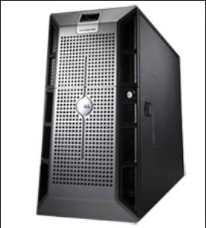
Which Gave Us… SMP Servers
Relational Database Management running on Symmetric Multi-Processing Servers
Dedicated Database Servers:
RDBMS (Relational Database Management Server)
Oracle, SQL Server, DB2, etc.
OLTP (Online Transaction Processing)
High Volume of Small, Discrete Operations
Online Sales, Bank Deposits & Transfers
Highly Normalized Database Schema
OLAP (Online Analytical Processing)
Low Volume of Large Read Operations
Periodic Post-hoc Analysis (What Happened?)
De-Normalized Multi-Dimensional Data Warehouses
Notes:
Back in the days when Mainframe computers ruled the earth, their primary job was to store vast quantities of data upon which to perform statistical analysis. Though many things have changed in the computing ecosystem, this task is as prevalent now as it was at the dawn of the computing era. “Traditionally” these tasks have been performed using Synchronous Multi-Processing (SMP) servers; powerful machines that achieve amazing results by increasing their CPU, Memory and Storage capacities to meet an ever-increasing demand. Not unlike the mainframes of the past, this “scale-up” approach strives to meet growing demand by increasing the data processing capability of a single server instance. Following this approach decades of innovation have rendered increasingly powerful hardware, but everything has its limit. No matter how powerful, computers have a logical upward bound. So what were the data geeks to do next?

Slide 15
Which Gave Us… SMP Servers
Relational Database Management running on Symmetric Multi-Processing Servers
Dedicated Database Servers:
RDBMS (Relational Database Management Server)
Oracle, SQL Server, DB2, etc.
OLTP (Online Transaction Processing)
Characterized by a large volume of transactions each of which affect a small number of rows
Online Sales, Bank Deposits & Transfers
Highly Normalized Database Schema
OLAP (Online Analytical Processing)
Characterized by a small volume of read transactions each of which affect a large number of rows
Periodic Post-hoc Analysis (What Happened?)
De-Normalized Multi-Dimensional Data Warehouse Schema
Notes:
Back in the days when Mainframe computers ruled the earth, their primary job was to store vast quantities of data upon which to perform statistical analysis. Though many things have changed in the computing ecosystem, this task is as prevalent now as it was at the dawn of the computing era. “Traditionally” these tasks have been performed using Synchronous Multi-Processing (SMP) servers; powerful machines that achieve amazing results by increasing their CPU, Memory and Storage capacities to meet an ever-increasing demand. Not unlike the mainframes of the past, this “scale-up” approach strives to meet growing demand by increasing the data processing capability of a single server instance. Following this approach decades of innovation have rendered increasingly powerful hardware, but everything has its limit. No matter how powerful, computers have a logical upward bound. So what were the data geeks to do next?

Slide 16

But Then… An Explosion of Data – “BIG Data”
A Rapid, Exponential Proliferation of New Devices: The Internet of Things (IoT)
olume (Size)
Explosion in social media, mobile apps, digital sensors, RFID, GPS, and more have caused exponential data growth.
ariety (Structure)
Traditionally BI has sourced structured data, but now insight must be extracted from unstructured or poly-schematic data like large text blobs, digital media, sensor data, etc.
eracity (Quality)
The anonymity of the WWW, incredible sources like social networking and duplicate systems bring into question the authenticity of the information being generated and collected.
elocity (Speed)
Sources like social networking and sensor signals create data at a tremendous rate; making it a challenge to capture, store, and analyze that data in a timely or economical manner.

Slide 17
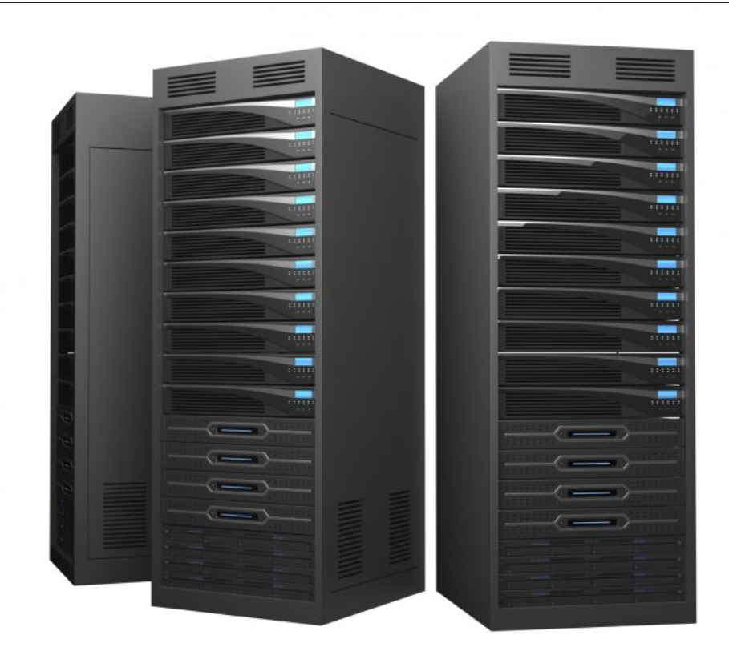
But… How Can We Manage All That Data: Scalability
The Advent of Big Data Drove a Need to Increase Scale to the Petabyte Level: $$$$$
SMP: Symmetric Multi-Processing
MPP: Massively Parallel Processing
This
Became
Scale Up (Limited)
Scale Out (Practically Unlimited)

Slide 18
And Today… Cloud-hosted Databases & Services
Re-centralization of Servers ▪ Based on Commodity HW ▪ Resources Shared by Client
Essential Characteristics
On-Demand Self-Service
Broad Network Access
Resource Pooling
Rapid Elasticity
Measured Service
Service Models
Infrastructure as a Service (IaaS)
Platform as a Service (PaaS)
Software as a Service (SaaS)
Deployment Models
Public Cloud
Private Cloud
Community Cloud
Hybrid Cloud

Slide 19
Service Models: On-Premises vs Cloud-Hosted
Managed by Owner
Managed by Service Provider
On Premises
IaaS
PaaS
SaaS
Applications
Applications
Applications
Applications
Data
Data
Data
Data
Runtime
Runtime
Runtime
Runtime
Middleware
Middleware
Middleware
Middleware
OS
OS
OS
OS
Virtualization
Virtualization
Virtualization
Virtualization
Servers
Servers
Servers
Servers
Storage
Storage
Storage
Storage
Networking
Networking
Networking
Networking

Slide 20
Data Management… In the Cloud
Economies of Scale Afforded by the Cloud Have Enabled Massive Storage & Compute
File-based Storage: Blobs, Queues, Tables, Data Lakes
Relational Database Management Systems:
Online Transaction Processing (OLTP) systems:
IaaS: Cloud-hosted VMs Running RDBMS Software & Databases
PaaS: Managed RDBMS Instance
SaaS: (Database as a Service) – Single Databases or Multi-Database Pools
Online Analytical Processing (OLAP) systems:
Massively Parallel Processing (MPP) Data Warehouse
NoSQL Database Management Systems:
Semi-Structured or Poly-Schematic data
Massively Parallel Processing
Data partitioned and replicated across many server machines (nodes)
Data typically stored in file-based format (e.g., JavaScript Object Notation (JSON)

Slide 21
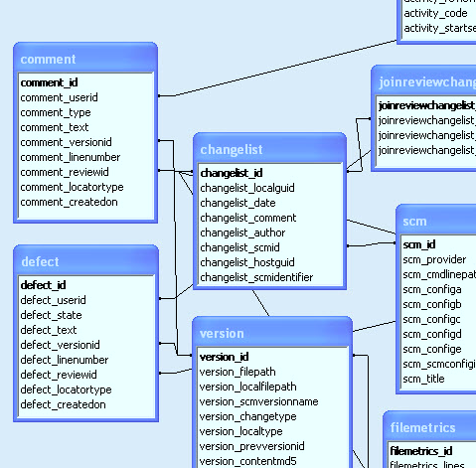
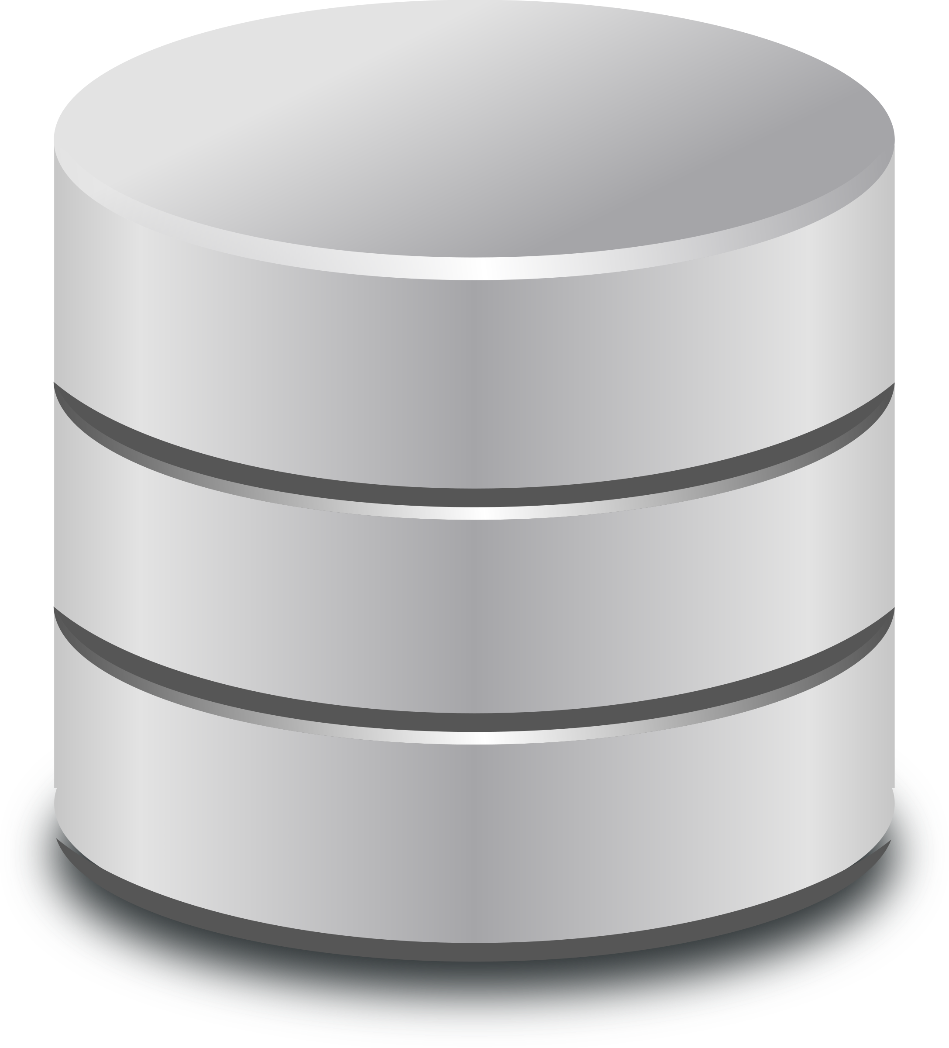

Paradigms: Data Storage and Retrieval
Schema on Write versus Schema on Read
Schema on Write: Stores data in an organized structure (schema)
Client or Process
Writes Data to
Schema
Client or Process
Reads Data from
Schema
RDBMS
Schema on Read: Applies schema only when read, data stored in its original format
Client or Process
Writes Data
To Storage
Client or Process
Reads Data into Schema
From Storage
Data Lake

Slide 22
NoSQL: Not Only SQL
Key-value stores
The simplest NoSQL database; based on “dictionaries” or “maps”.
Items are stored in associative arrays; pairing a name (or "key"), with a value.
Riak, FoundationDB, and Redis
Pairs keys with complex data structures (documents) using XML, JSON or BSON.
Documents may contain key-value pairs, key-array pairs, and nested documents.
MongoDB, MarkLogic, and Apache CouchDB
Graph stores
Stores interrelated networks of data such as social connections, or network topologies.
Optimized for interconnected data elements with an undetermined number of relations.
AllegroGraph, Neo4J and HyperGraphDB.
Column stores
Combines a key, value and timestamp for each item.
Optimized for large datasets by storing columns of data together, rather than in rows.
Cassandra, BigTable and HBase
Document databases
Often called "Not only SQL" because they may also support SQL-like queries. Many NoSQL stores compromise consistency in favor of availability & partition tolerance.

Slide 23
SQL versus NoSQL Databases
 | SQL Databases | NoSQL Databases
Types | One: Relational Database | Many: Key-value, document, column, and graph databases
Data Storage | Records are stored as rows in tables that represent entities. Entity relationships are modeled by joining tables. | Records may be stored as “documents“ using XML or JSON. Entity relationships are modeled by nesting them hierarchically.
Schemas | Static: Structure & data types are fixed at design time. Adding new elements requires schema design changes. | Dynamic: New elements can be added at runtime. Poly-schematic: Dissimilar data can be stored together as necessary.
Scaling | Vertically: A single server must be made increasingly powerful to cope with increasing demand. | Horizontally: New commodity servers and storage are added to an array. Data is automatically distributed across all servers.
Transactions | Full transactional consistency (ACID) | Single element (document) only.
Manipulation | Using platform-specific languages (SQL) | Using OSS API’s, low-level lang., JavaScript
Consistency | Supports strong consistency | Per-product: Most are eventually consistent.

Slide 24
Onward to Data Science
A Brief Overview of How Data Systems are Involved

Slide 25
The Data Science: Hierarchy of Needs
LEARN / OPTIMIZE
AGGREGATE / LABEL
EXPLORE / TRANSFORM
MOVE / STORE
COLLECT
AI, Deep Learning
A/B Testing, Experimentation, Simple ML Algorithms
Analytics, Metrics, Segments, Aggregates, Features, Training Data
Cleaning, Anomaly Detection, Prep
Reliable Data Flow, Infrastructure, Pipelines, ETL, Structured & Unstructured Data Storage
Instrumentation, Logging, Sensors, External Data, User-Generated Content

Slide 26
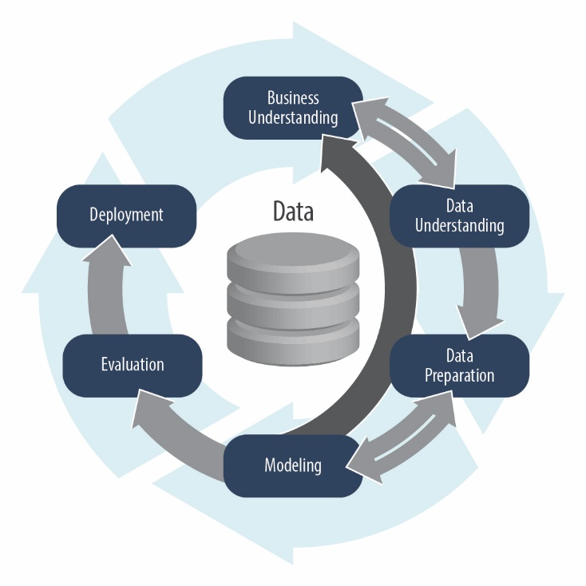
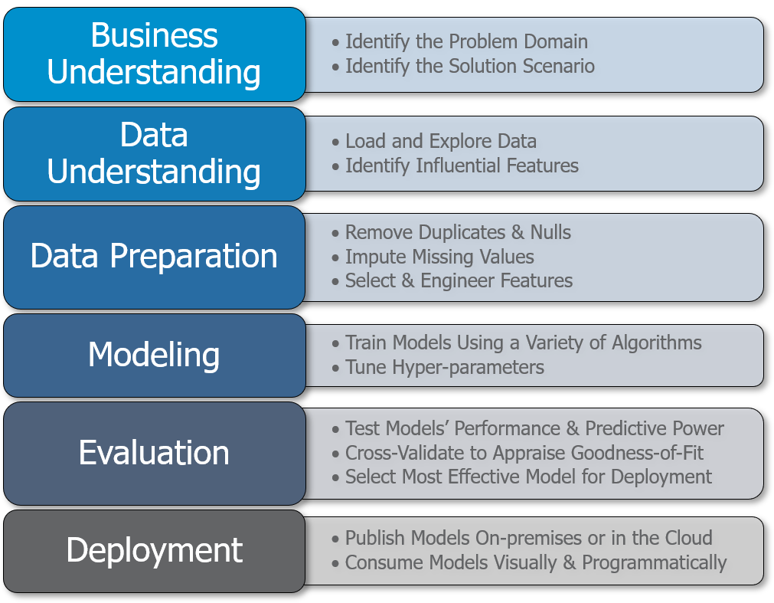
CRISP-DM: Cross-Industry Standard Process-Data Mining
First Introduced in 1996!

Slide 27
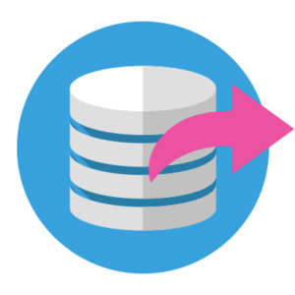


Data Engineering… for Data Science
Frequently, Data Must Be Moved from Sources to a Database and/or Data Lake
Extract
This is the step where sensors wait for upstream data sources to land. Once available, we transport the data from their source locations to further transformations.
Transform
The heart of any ETL job: apply business logic, perform actions such as filtering, grouping, and aggregation to translate raw data into analysis-ready datasets.
Load
Load the processed data and transport to a final destination. Can now be consumed directly by end-users or treated as yet another upstream dependency.

Slide 28




Data Engineering… for Data Science
Ingest
Store
Prep & Train
Model & Serve
Logs, files and media
(unstructured)
Ad-hoc analysis
Azure Data Factory
Azure Data Lake Storage
Azure Databricks
(Spark, Delta Lake)
Power BI
Optimized Connector
Business/custom apps
(Structured)
Azure Machine Learning
PolyBase
Azure Synapse (DW)

Slide 29




Design Pattern: Modern Data Warehousing
Step 1
Load raw data to Azure Data Lake Storage
Step 2
Use Azure Databricks to:
Combine streaming & batch
Save data as Delta format
Step 3
Use Azure Databricks to
1. Join, enrich, clean, transform data
2. Develop, train, and score ML models with Azure ML + MLFlow
Step 4
Load data into serving layers like
1. Azure Synapse Data Warehouse for enterprise BI scenarios.
2. Cosmos DB for real-time Apps
Sensors and IoT
(unstructured)
Cosmos DB
Apps
+
Logs (unstructured)
Azure Event Hub
Azure IoT Hub
Kafka
Polybase
Azure Data Factory
Raw Format
Delta Format
(Bronze Table)
Delta Format
(Silver Table)
Delta Format
(Gold Table)
Azure Synapse Data Warehouse
Power BI
Azure Data Lake Storage

Slide 30
Q & A
A Survey of Data Management Systems

