Slide 1

DS-3002: Data Systems
An Overview of SQL Databases
Prof. Jon Tupitza – Spring 2022

Slide 2
SQL Database Design
Understanding the Principles that Govern Database Structure

Slide 3
Fundamental Structures: Enforcing Data Integrity
Essential Design Concepts & Database Objects Required for Enforcing Data Integrity
Entity Integrity
Enforced by the Table
Entities (nouns):
Concrete: Employees, Customers, Products
Domain Integrity
Enforced by the Column
Data Type definition:
Constraints:
Relational Integrity
Enforced by the Foreign Key Relationship
One-to-Many: Foreign key relates to Primary key
Many-to-Many: Primary keys relate to Foreign keys via a Juncture table
Int, Decimal, Float, Char, Nchar, Varchar, Nvarchar, DateTime
Primary Key, Check, Unique, & Default
People, Places and Things
Conceptual: Sales, Scenarios, etc.

Slide 4
Database Normalization: The Normal Forms
There are other Normal Forms, but Resolving to 3rd NF is Considered Appropriate
First Normal Form (1NF)
A tables columns must contain only atomic values; none may not contain multiple values
Ex: a column named telephone_number may contain only one phone number.
Second Normal Form (2NF)
The table must first satisfy the first normal form.
The table must be free of partial dependencies; i.e., all columns that are not the Primary Key must depend on the Primary Key
Third Normal Form (3NF)
The table must first satisfy both the first and second normal forms
The table must be free of transitive dependencies; i.e., no column may depend on any column that is not the Primary Key.
Notes:
Transitive dependency: It occurs due to an indirect relationship within the attributes when a non-prime attribute has a functional dependency on a prime attribute.

Slide 5
Workload Characteristics: Form Follows Function
Two Essentially Incompatible Workloads… They Have a Contentious Relationship
Online Transaction Processing (OLTP)
Characterized by a large volume of transactions each of which affect a small number of rows
Online Sales, Bank Deposits & Transfers
Highly Normalized Database Schema
Online Analytical Processing (OLAP)
Characterized by a small volume of read transactions each of which affect a large number of rows
Periodic Post-hoc Analysis (What Happened?)
De-Normalized Multi-Dimensional Schema
!
These two don’t play well together: They contend for the same hardware resources!

Slide 6
Database Paradigms: Design Approaches
The Design Approach Accommodates the Workload Characteristic
Normalized Relational Database:
Optimized for Online Transaction Processing (OLTP) workloads
Aims to Eliminate Data Redundancy and Minimize Storage Requirements
Complex: Sacrifices User-Friendliness in Favor of Transactional Performance
Multi-Dimensional Relational Database:
Optimized for Online Analytical Processing (OLAP) workloads
Aims to Optimize Query Performance and Provide an Intuitive User Experience
Simple: Accepts Data Repetition in Favor of User-Friendliness and Improved Query Performance

Slide 7
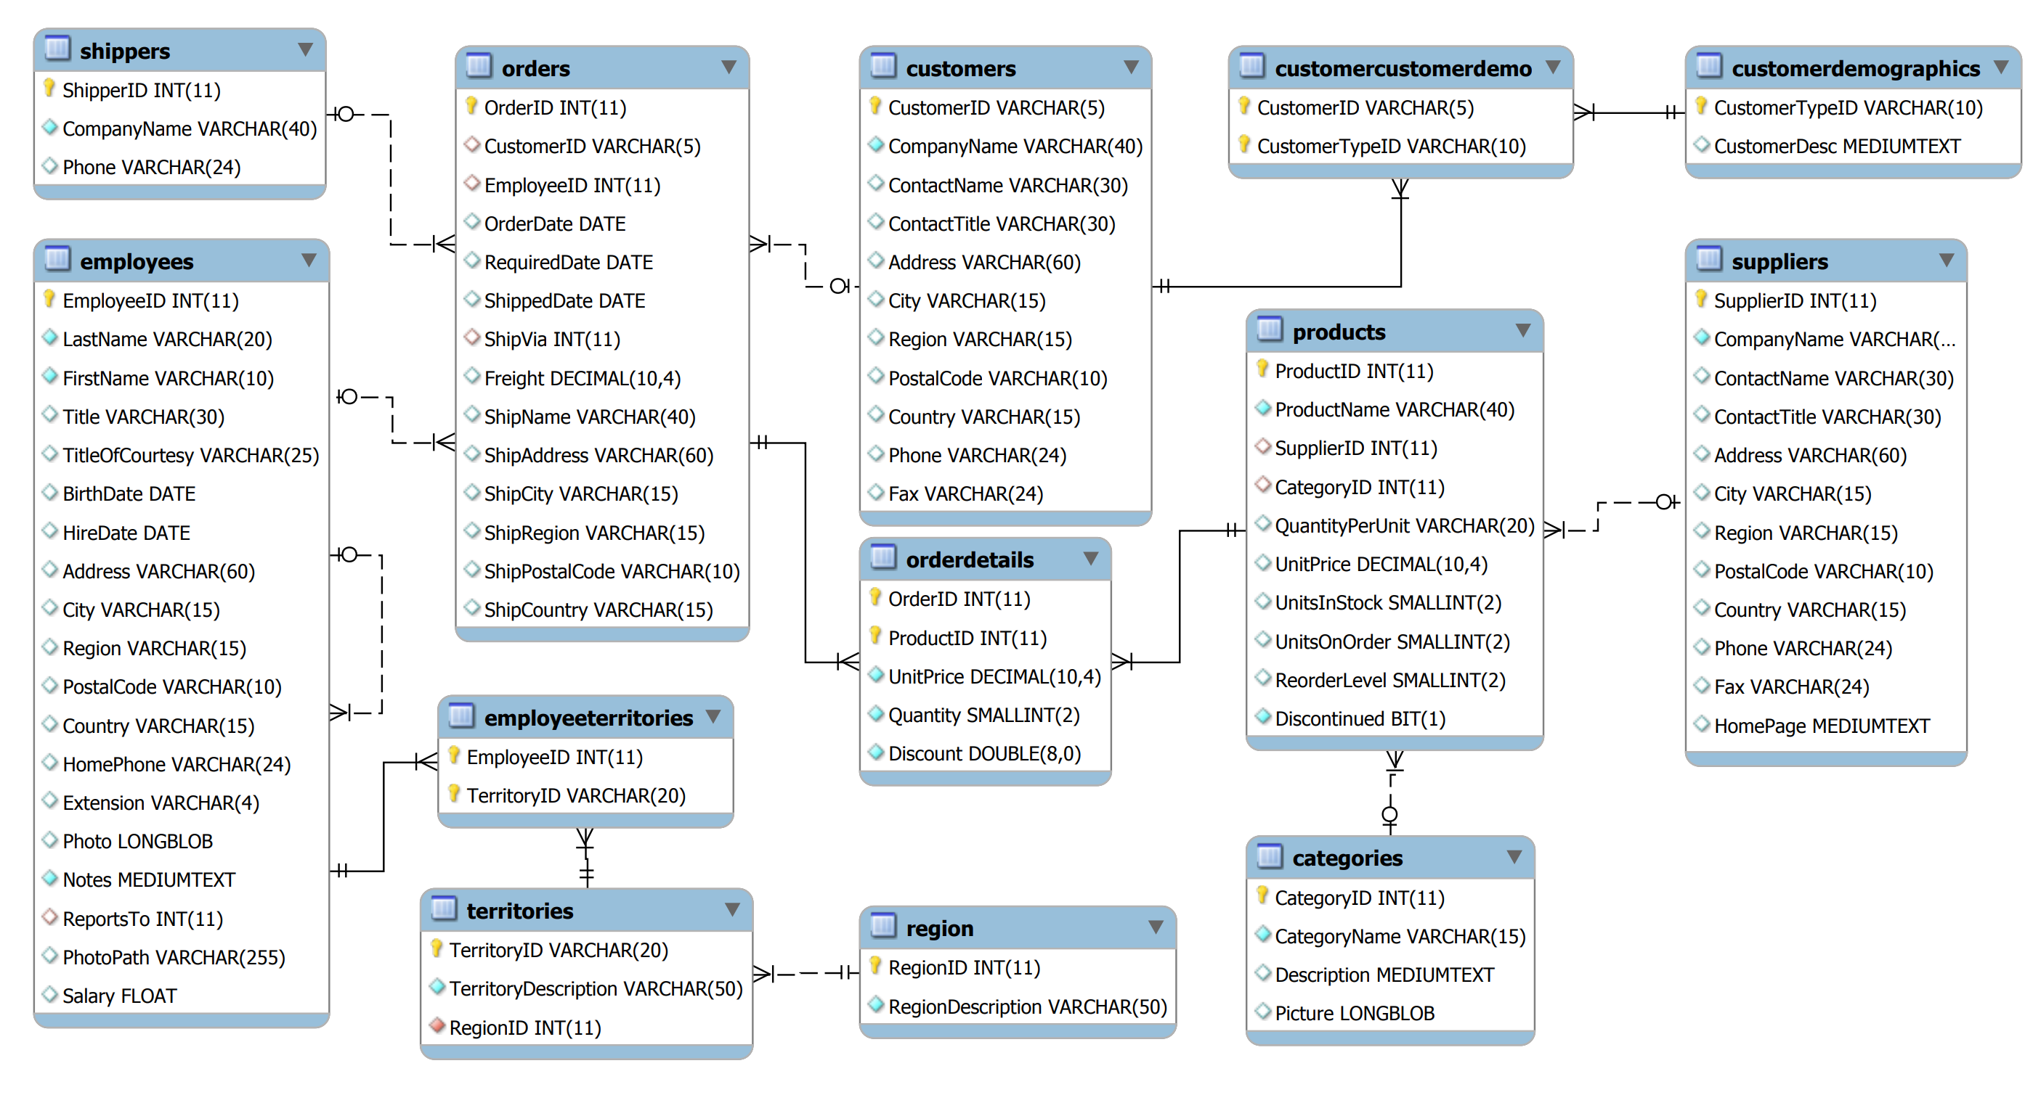
OLTP Database: Normalized Schema

Slide 8
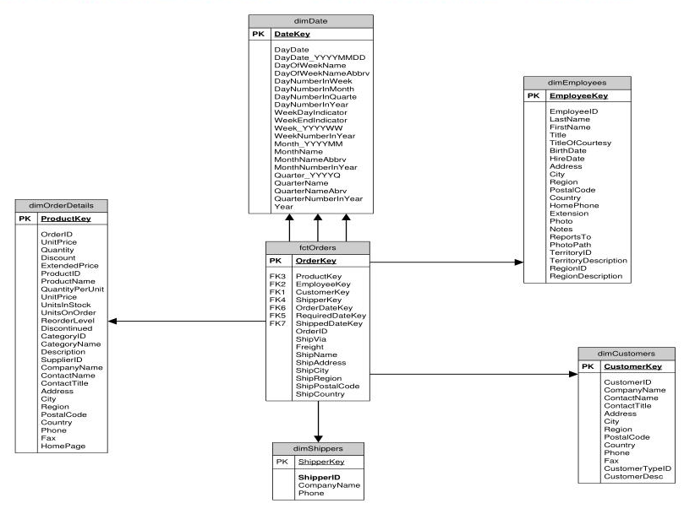
OLTP Database: Normalized Schema

Slide 9
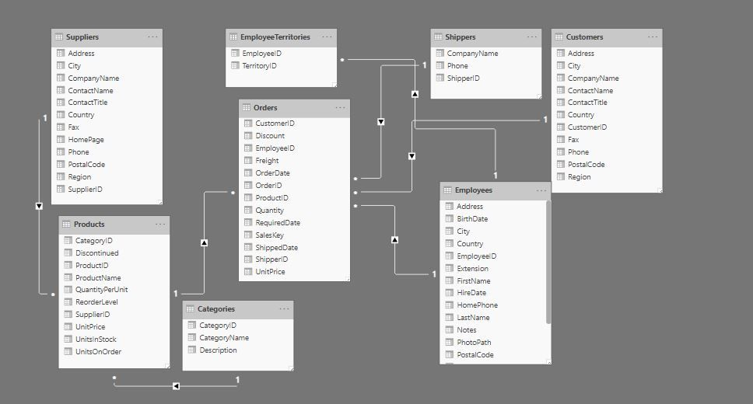
OLAP Database: Multi-Dimensional Schema

Slide 10
The SQL Language
Understanding the Structured Query Language

Slide 11
The SQL Language: Principal Components
Three Primary Aspects of the ANSI-Compliant SQL Language
Data Definition Language (DDL)
CREATE, ALTER, DROP, TRUNCATE TABLE, ENABLE & DISABLE TRIGGER
Used to manage database structures
Data Control Language (DCL)
GRANT, REVOKE, DENY, EXECUTE AS
Used to control access to server & database objects (permissions)
Data Manipulation Language (DML)
SELECT, INSERT, UPDATE, DELETE, MERGE, and BULK INSERT
Used to manipulate database content (data)
Microsoft Docs | Transact-SQL Reference (Database Engine)

Slide 12
Query a SQL Database: The SELECT Statement
Essential Components of Data Retrieval
SELECT
for specifying the required columns
FROM
for specifying the Table(s) being targeted
JOIN
for specifying additional Table(s)
GROUP BY
for specifying points of aggregation
ORDER BY
for sorting rows of the result set
Filtering Statements:
ON
specifies the column(s) that enable the joining of two Tables
WHERE
specifies conditions by which to reduce the rows returned
HAVING
specifies conditions by which Groups or Aggregates may be reduced

Slide 13
Q & A
A Survey of Data Management Systems

