Slide 1
GROUP 6 ASSINGMENT 2
Impact of Poultry Farming on University Students

Slide 2
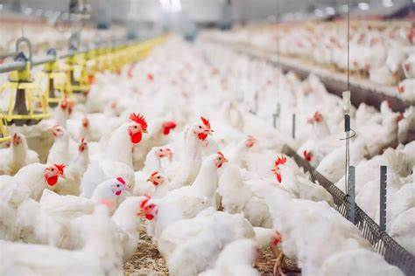
Esther Njau- 21/04118
Miriam Kamau -21/04641
Ann Mellisa - 22/03922
Mercy Jeptanui- 20/05149
Joy Njeru 21/04216
Yvonne Nduku 21/05256
Ryan Kangata 21/05401
Alexia Mbugua 23/01287
Midamba LeahJanet 21/05897
Ashleys Jane 21/04705
GROUP MEMBERS

Slide 3
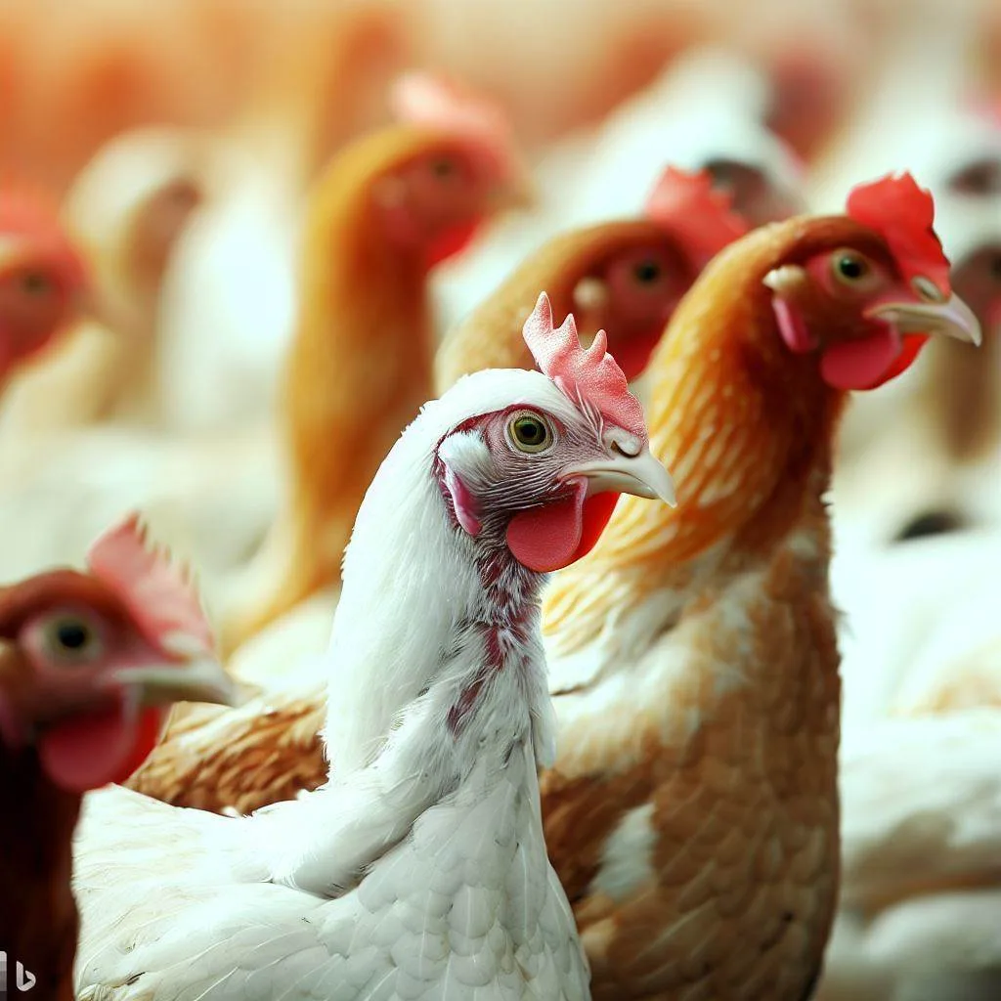

Impact of Poultry Farming on University Students
Financial Independence and Stability
Egg Production: Steady cash flow from regular sales.
Broiler Farming: Quick profit cycle (6-8 weeks) for tuition and expenses.
Entrepreneurial Skills Development
Business planning, financial management, marketing, and customer service.
Time Management and Responsibility
Balancing academics with business activities.
Hands-On Learning and Practical Experience
Practical knowledge in agriculture and animal husbandry.
Community Engagement and Networking
Selling to local markets and building valuable relationships.
Sustainability and Self-Sufficiency
Promoting local food security and self-reliance.
Health and Nutrition Awareness
Encouraging healthy dietary choices with fresh produce.

Slide 4
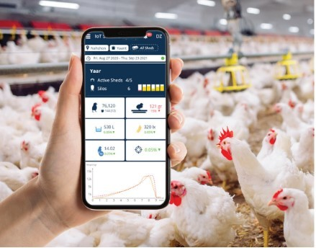
Ways Students Can Use Technology to Grow Their Egg Production and Broiler Chicken Farming Business
Digital Marketing: Use social media (e.g., Instagram, Facebook) to promote products.
E-Commerce Platforms: Set up online sales through platforms like Jumia or personal websites.
Mobile Apps: Utilize apps for inventory management and sales tracking.
E-Learning: Access poultry farming courses on YouTube or agricultural sites.
Automation: Implement smart feeding systems and monitoring technology.

Slide 5
THANK YOU

