Slide 1
ED Project Title: ML based Crop Consultant
Guide : Prof. Milind Rane
1. Vishal Hake - 65
2. Aditya Hingole - 66
3. Pratik Hublikar - 67
4. Atharva Ingle - 68

Slide 2
Content
Project
Domain
Technology
Tool

Slide 3
Project Objective
Common problem among the Indian farmers is that they don’t opt for the proper crop based on their soil necessities
To develop a system which can take in soil parameters as the input and will predict crop to grow for maximum yield
Also, suggesting the appropriate nutrients and fertilizers to add based on the parameters
To develop a system to detect the plant disease based on the image of the diseased leaf

Slide 4
Domain
Machine Learning
Deep Learning
Web Development

Slide 5
Technology
Deep Learning
Computer Vision
HTML, CSS, JavaScript, Python
Cloud platform

Slide 6
Tool
Sci-kit learn, NumPy, pandas
PyTorch
Kaggle kernels, P100 GPU
Git and GitHub
VsCode and Jupyter notebooks

Slide 7
Timeline For project Work
Form the groups – 17/08/2020 to 31/08/2020
Finalize the Problem Statement – 01/09/2020 to 14/09/2020
Understand and practice the tools – 14/09/2020 to 31/09/2020
Learn the technology & Design the System – 01/10/2020 to 14/10/2020
Develop/Select hardware and software
system – 15/10/2020 to 30/11/2020
Validation and Testing – 01/12/2020 to 07/12/2020
Final Prototype / Product – 15/12/2020

Slide 8
Students Benefits
Skills developed will be:
Web Development using flask as backend
Data pre-processing, augmentation and cleaning
Machine Learning
Convolutional Neural Networks
Cloud deployment
Scaling the project
Development of an end-to-end application

Slide 9
Industry funding
As these project is solely software based it does not require any capital investment

Slide 10
Description
CROP RECOMMENDATION SYSTEM
Objective :
To determine the most optimal crops which farmer can grow based on certain weather and soil parameters
Parameters used for determining the optimal crop to grow includes Nitrogen, Phosphorous, Potassium, temperature, humidity, ph and rainfall.

Slide 11
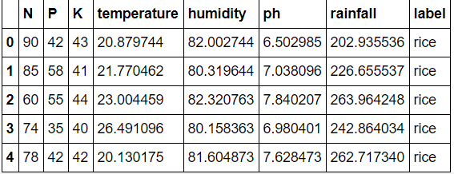
Description
CROP RECOMMENDATION SYSTEM
First five rows of data used for predictive modelling

Slide 12
Description
CROP RECOMMENDATION SYSTEM

Slide 13
Description
CROP RECOMMENDATION SYSTEM

Slide 14
Description
CROP RECOMMENDATION SYSTEM

Slide 15
Comparison
Algorithm | Accuracy
Decision Trees | 0.900
Naïve Bayes | 0.990
Support Vector Machines | 0.106
Logistic Regression | 0.952
Random Forest | 0.990
XGBoost | 0.993
For crop recommendation system best performing model is XGBoost

Slide 16
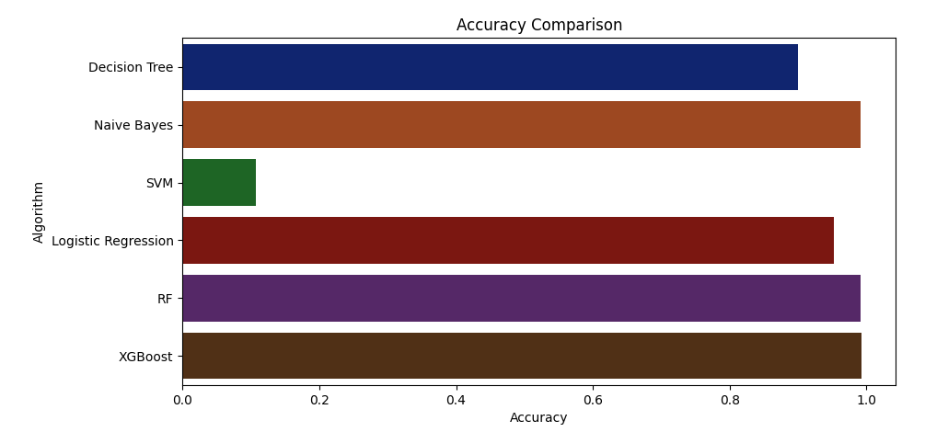
Graph
Graphical Representation of accuracy

Slide 17
Description
FERTILIZER RECOMMENDATION SYSTEM
Objective :
To suggest farmers about the do’s and don'ts of fertilizing the crops and help them to take informed decision about their farming strategy
Parameters used to suggest the fertilizing strategy are Nitrogen, Phosphorous and Potassium

Slide 18
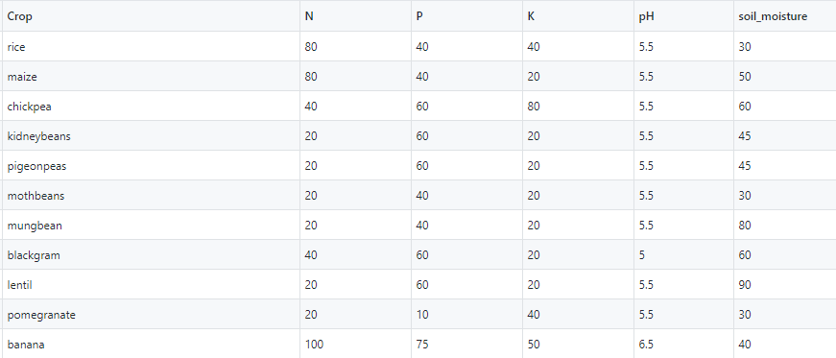
Description
FERTILIZER RECOMMENDATION SYSTEM
First five rows of data used for recommending fertilizers

Slide 19
Description
DISEASE PREDICTION SYSTEM
OBJECTIVE :
To predict the disease caught by the crop in early stage and suggest farmers to cure the disease

Slide 20
Description
70295
DISEASE PREDICTION SYSTEM
DATA:
The data used consists of 87,000 RGB images of healthy and diseased crop leaves which is categorized into 38 different classes.
70,295 images were used for training and remaining were used as a validation set
Additionally, there were 33 images to test the final predictive model built

Slide 21
Description
TECHNIQUES USED
Most widely used neural networks for image classification are CNN (convolutional neural networks)
Typical CNN do not work well as the depth of the network grows
ResNets (Residual Networks) allow to train very deep CNNs without vanishing and exploding gradient problems

Slide 22
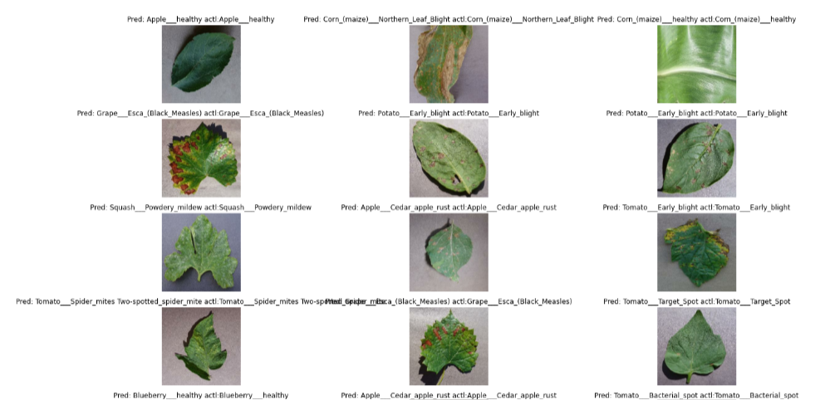
Image
Sample Images in the plant disease dataset

Slide 23
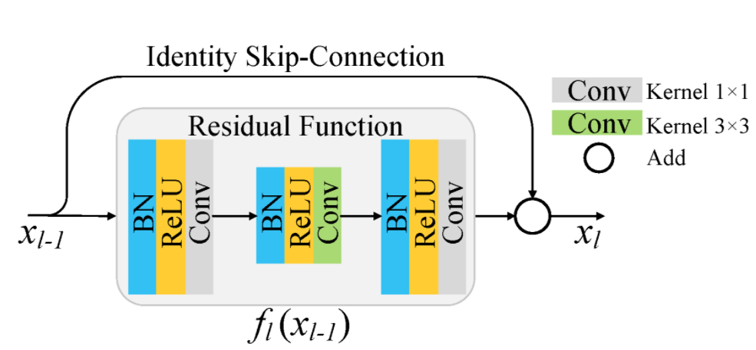
Description
A single ResNet block

Slide 24
Description
ADDITIONAL TECHNIQUES USED
Learning Rate Scheduling:
Instead of using a fixed learning rate, we will use a learning rate scheduler, which will change the learning rate after every batch of training
Weight Decay:
We also use weight decay, which is a regularization technique which prevents the weights from becoming too large by adding an additional term to the loss function.
Gradient Clipping :
Apart from the layer weights and outputs, it also helpful to limit the values of gradients to a small range to prevent undesirable changes in parameters due to large gradient values

Slide 25
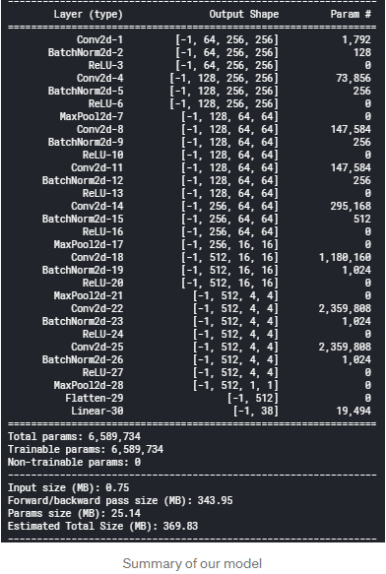
Image

Slide 26
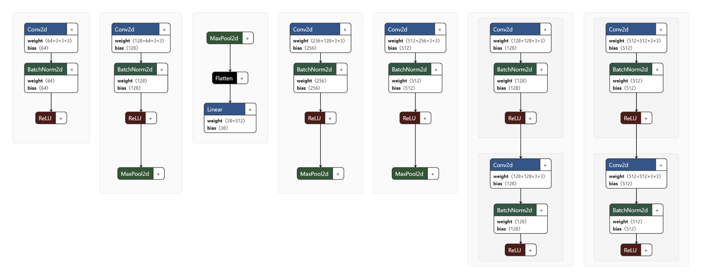
Image
Architecture used to train the model

Slide 27
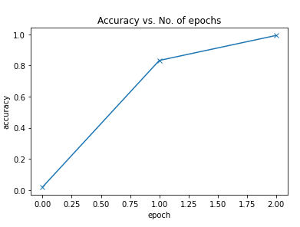
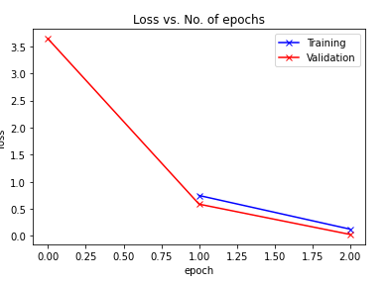
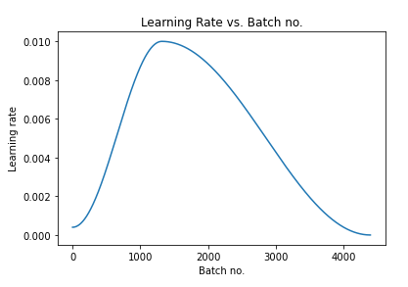
Image

Slide 28
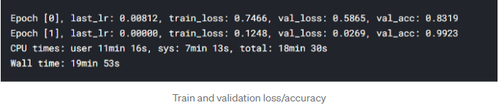
Result
We got a validation accuracy of 99.23 % and all the 31 test images were classified perfectly

Slide 29
Concluding Remarks
Ensemble techniques works best on most of the dataset and same is the observation we got in the crop recommendation system
ResNets dramatically increased the accuracy of the model and the model size was also reduced significantly.
This system can be used by the farmers to know the best crop to grow for maximum yield.
It will also help to know the deficiencies of the soil and suggestions to overcome them.
It will also help the farmers to detect the disease and provide a way to cure them

Slide 30
References
Datasets
https://www.kaggle.com/vipoooool/new-plant-diseases-dataset
https://github.com/Gladiator07/AI-Agriculture/blob/master/Data_final/Final_Data_recomm.csv
Papers
https://www.ijrte.org/wp-content/uploads/papers/v7i5c/E10300275C19.pdf
https://people.cs.umass.edu/~ksankaranara/cropinter.pdf
Resnet paper - https://arxiv.org/pdf/1512.03385.pdf
Documentation
PyTorch docs - https://pytorch.org/docs/stable/torchvision/
Sklearn docs - https://scikit-learn.org/stable/user_guide.html
Existing work
CIFAR10 ResNet Implementation - CIFAR10 ResNet Implementation

Slide 31
Thank You

