Slide 1
ED Project Title: ML based Crop Consultant
Guide : Prof. Milind Rane
1. Vishal Hake - 65
2. Aditya Hingole - 66
3. Pratik Hublikar - 67
4. Atharva Ingle - 68

Slide 2
Content
Project
Domain
Technology
Tool

Slide 3
Project Objective
Common problem among the Indian farmers is that they don’t opt for the proper crop based on their soil necessities
To develop a system which can take in soil parameters as the input and will predict crop to grow for maximum yield
Also, suggesting the appropriate nutrients and fertilizers to add based on the parameters
To develop a system to detect the plant disease based on the image of the diseased leaf

Slide 4
Domain
Machine Learning
Deep Learning
Web Development

Slide 5
Technology
Deep Learning
Computer Vision
HTML, CSS, JavaScript, Python
Cloud platform

Slide 6
Tool
Sci-kit learn, NumPy, pandas
PyTorch
Kaggle kernels, P100 GPU
Git and GitHub
VsCode and Jupyter notebooks

Slide 7
Timeline For project Work
Form the groups – 17/08/2020 to 31/08/2020
Finalize the Problem Statement – 01/09/2020 to 14/09/2020
Understand and practice the tools – 14/09/2020 to 31/09/2020
Learn the technology & Design the System – 01/10/2020 to 14/10/2020
Develop/Select hardware and software
system – 15/10/2020 to 30/11/2020
Validation and Testing – 01/12/2020 to 07/12/2020
Final Prototype / Product – 15/12/2020

Slide 8
Students Benefits
Skills developed will be:
Web Development using flask as backend
Data pre-processing, augmentation and cleaning
Machine Learning
Convolutional Neural Networks
Cloud deployment
Scaling the project
Development of an end-to-end application

Slide 9
Industry funding
As these project is solely software based it does not require any capital investment

Slide 10
Description
CROP RECOMMENDATION SYSTEM
Goal :
To determine the most optimal crops which farmer can grow based on certain weather and soil parameters
Parameters used for determining the optimal crop to grow includes Nitrogen, Phosphorous, Potassium, temperature, humidity, ph and rainfall.

Slide 11
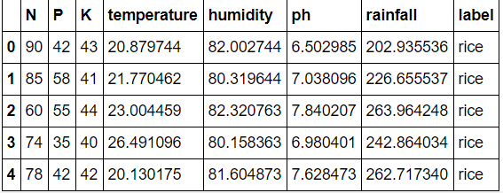
Description
CROP RECOMMENDATION SYSTEM
First five rows of data used for predictive modelling

Slide 12
Description
CROP RECOMMENDATION SYSTEM

Slide 13
Description
CROP RECOMMENDATION SYSTEM

Slide 14
Description
CROP RECOMMENDATION SYSTEM

Slide 15
Description
FERTILIZER RECOMMENDATION SYSTEM
Goal :
To suggest farmers about the do’s and don'ts of fertilizing the crops and help them to take informed decision about their farming strategy
Parameters used to suggest the fertilizing strategy are Nitrogen, Phosphorous and Potassium

Slide 16
Description
Plant disease prediction using images of diseased plant leaves
Augmented data of 15 plants having 88,000 rgb images and 38 classes
CNN based model

Slide 17
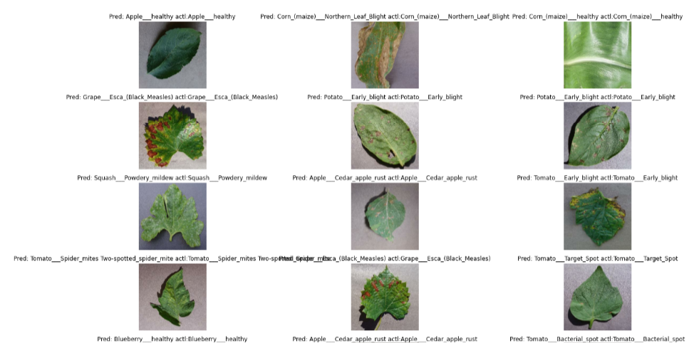
Only Image slide
Sample Images in the plant disease dataset

Slide 18
Description
Algorithm | Accuracy
Decision Trees | 0.900
Naïve Bayes | 0.990
Support Vector Machines | 0.106
Logistic Regression | 0.952
Random Forest | 0.990
XGBoost | 0.993
For crop recommendation system best performing model is XGBoost

Slide 19
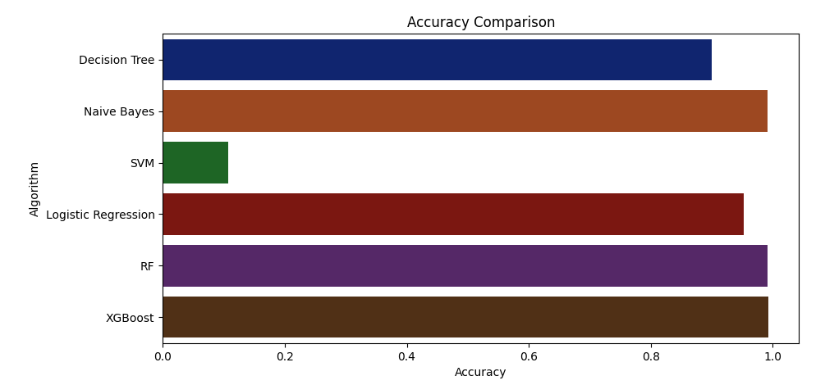
Graph
Graphical Representation of accuracy

Slide 20
Concluding Remarks
Ensemble techniques works best on most of the dataset and same is the observation we got.
This system can be used by the farmers to know the best crop to grow for maximum yield.
It will also help to know the deficiencies of the soil and suggestions to overcome them.

Slide 21
References
Datasets
https://www.kaggle.com/vipoooool/new-plant-diseases-dataset
https://github.com/Gladiator07/AI-Agriculture/blob/master/Data_final/Final_Data_recomm.csv
Papers
https://www.ijrte.org/wp-content/uploads/papers/v7i5c/E10300275C19.pdf
https://people.cs.umass.edu/~ksankaranara/cropinter.pdf

Slide 22
Thank You

