Slide 1

Conversational AI Voice Agent – Insurance Use Case (Policy & Claims Services)

Slide 2
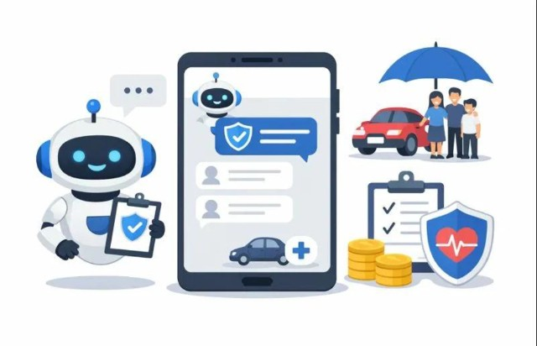
Week 1 Summary
Work Completed
Designed the authentication workflow.
Defined all core business intents.
Created end-to-end happy path conversation flows.
Documented user stories and acceptance criteria.
Implemented intent routing for insurance services.
Outcome
A functional conversational AI agent capable of handling policy inquiries, claims, benefits, policy renewal, onboarding, and agent escalation through happy path conversations.

Slide 3

Week 2 Objectives
During Week 2, our focus shifted from designing conversation flows to validating the chatbot for production readiness.
Activities Performed
Designed edge cases
Implemented fallback handling and callbacks
Created a New Agent to handle user requests
Designed human agent escalation
Prepared QA testing artifacts
Executed chatbot testing and evaluations

Slide 4
Edge Case Design To improve chatbot reliability, multiple edge cases were designed for different business scenarios.
Claims
Closed Claim
No Claims Found
Conversation
User Silence
Intent Switching
Human Escalation
Unsupported Queries
Authentication
Invalid phone number
Incorrect DOB
Authentication failure
Policy
Expired Policy
No Active Policy
Multi-Policy Handling

Slide 5
Retry & Fallback Strategy
The chatbot was designed to recover gracefully whenever invalid input or unexpected situations occur.
Retry Policy
Authentication → Maximum 3 attempts
API Timeout → Automatic Retry
Fallback Actions
Re-prompt the customer
Return to previous menu
Restart authentication
Escalate to live support when required

Slide 6
Callbacks
BENEFITS
Purpose
Callbacks were implemented to improve the chatbot's reliability, maintain session consistency, enhance security, and protect customer privacy during conversations.
Preserve conversation context
Maintains session consistency
Reduces hallucinations
Improves chatbot security
Protects customer privacy
Enhances overall conversation reliability

Slide 7
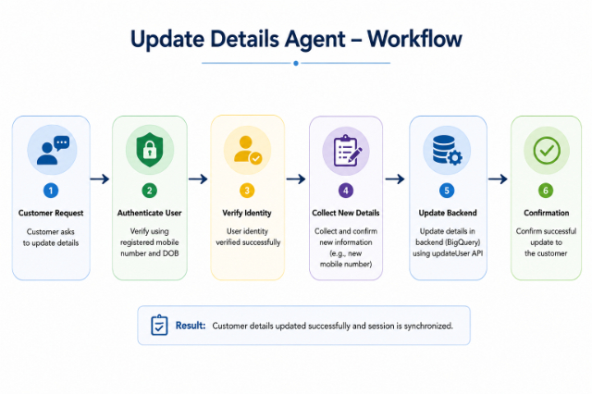
New Agent- Update Details
Objective
Enable customers to securely update their personal information through the conversational AI without requiring manual intervention.
Capabilities
Update registered mobile number
Synchronize updated details with the backend (BigQuery)
Confirm successful update to the customer

Slide 8

Multi-Policy Handling
- Allow customers with multiple insurance policies to access the correct policy without repeating authentication.
Key Features
Single authentication for multiple policies
Automatic selection when only one policy exists
Customer chooses the required policy when multiple are available
Selected policy is maintained throughout the conversation
Supports all insurance services using the selected policy

Slide 9
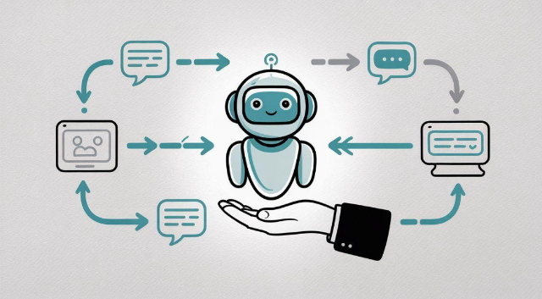
Human Agent Escalation
If the chatbot is unable to resolve the customer's issue, the conversation is transferred to a human support agent.
Escalation Conditions
Authentication failure
Backend API failure
Customer requests human support
Business rules requiring manual review
Context Transferred
Customer details
Authentication status
Policy information
Claim information
Conversation summary

Slide 10
Testing Strategy
To validate chatbot quality, three different testing approaches were followed.
Manual Testing
Validates chatbot functionality by interacting with the agent as an end user.
Golden Evaluation
Compares chatbot responses against predefined expected outputs.
Scenario-Based Evaluation
Evaluates complete end-to-end customer journeys and verifies whether business goals are achieved.
Testing
Manual Testing
Golden Evaluation
Scenario Evaluation

Slide 11
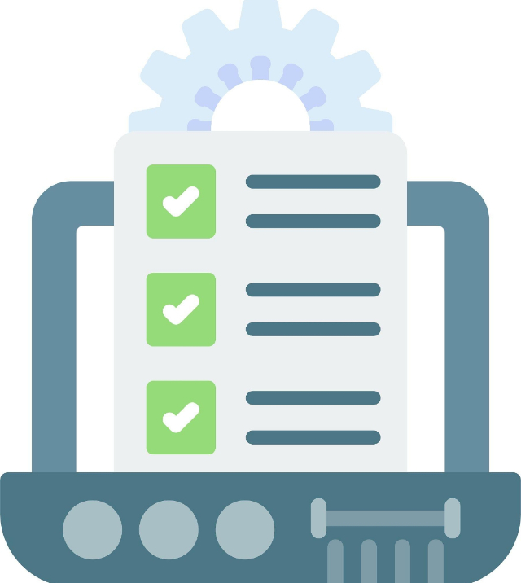
Manual Testing
Scope
Authentication
Policy Inquiry
Benefits Information
Claim Status
New Claim
Policy Renewal
Agent Escalation
Edge Cases
Result
✓ All functional test cases executed successfully.
✓ Conversation flows behaved as expected.
✓ Audio interactions were also validated successfully.

Slide 12
Golden Evaluation
Week 2 QA Testing
15
15
0
Total Evaluations
Passed
Failed
Objective: Evaluate chatbot responses against predefined golden conversations.
Metrics: Semantic Similarity, Tool Correctness, Hallucination, Response Quality.
Testing was executed multiple times; after resolving identified issues, the chatbot showed significant improvement and overall success rate compared to earlier executions.

Slide 13
Scenario-Based Evaluation
Current Status
Scenario evaluation setup completed.
Scenarios Created
Policy Inquiry, Benefits Information, Claim Status
Policy Renewal, New Claim
Motor, Health & Life Onboarding
Human Escalation
Multiple scenarios executed successfully.
Scenario prompts and evaluation conditions are being improved to achieve higher pass rates.
Objective
Validate complete user journeys using business scenarios.

Slide 14

Challenges Faced
During testing, several challenges were identified.
Fine-tuning evaluation prompts for Scenario-Based Testing.
Aligning user goals with expected evaluation criteria.
Handling complex onboarding scenarios.
Improving response consistency.
Optimizing tool invocation and workflow execution.

Slide 15
Next Steps
Improve
Improve Scenario Evaluation performance.
Resolve
Resolve remaining evaluation issues.
Optimize
Optimize chatbot responses.
Perform
Perform regression testing after fixes.
Prepare
Prepare chatbot for production-ready phase.

Slide 16
Thank You

