Slide 1
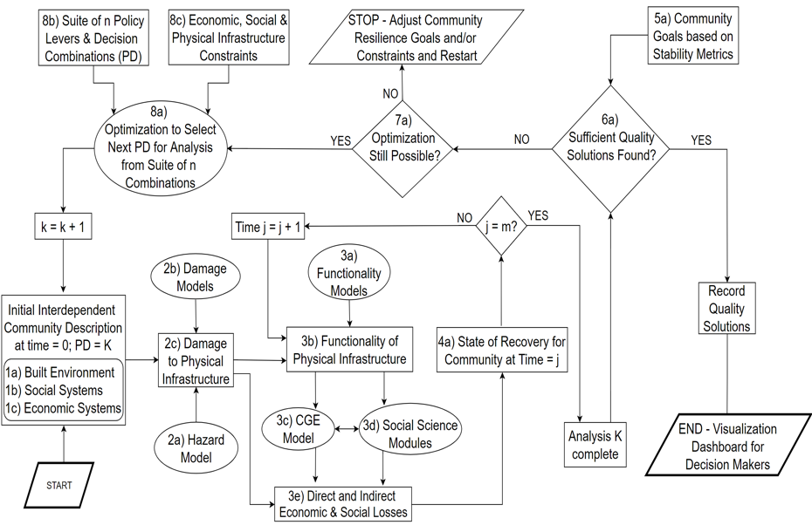
Original Flowchart

Slide 2
Seaside Flowchart
Sept. 7, 2021
STOP – Adjust community goals/constraints
8b) Suite of n policy levers and decision combinations (PD)
8c) Economic, social, and physical infrastructure constraints
5a) Community Goals Based on Stability Metrics
No
8a) Optimization to select next PD for analysis from suite of n combinations
Yes
No
6a) Sufficient Quality Solutions Found?
Yes
7a) Optimization Still Possible?
k=k+1
No
Yes
Time j=j+1
j=m?
2b) Damage Models
3a) Functionality Models
Initial Community Description
1a) Built Environment
1b) Social Systems
1c) Economic Systems
Record Quality Solutions
2c) Damage to physical Infrastructure
3b) Functionality of physical Infrastructure
4a) State of Recovery for community at time=j
2a) Hazard Models
3c) CGE Model
3d) Social Science Modules
END - Visualization
Start
2d) Casualty
Analysis K complete
3e) Direct and Indirect Economic & Social Losses

Slide 3
Seaside Flowchart
STOP – Adjust community goals/constraints
8b) Suite of n policy levers and decision combinations (PD)
8c) Economic, social, and physical infrastructure constraints
5a) Community Goals Based on Stability Metrics
No
8a) Optimization to select next PD for analysis from suite of n combinations
Yes
No
6a) Sufficient Quality Solutions Found?
Yes
7a) Optimization Still Possible?
k=k+1
No
Yes
Time j=j+1
j=m?
2b) Damage Models
3a) Functionality Models
Initial Community Description
1a) Built Environment
1b) Social Systems
1c) Economic Systems
Record Quality Solutions
2c) Damage to physical Infrastructure
3b) Functionality of physical Infrastructure
4a) State of Recovery for community at time=j
2a) Hazard Models
3c) CGE Model
3d) Social Science Modules
END - Visualization
Start
2d) Casualty
Analysis K complete
3e) Direct and Indirect Economic & Social Losses

Slide 4
Seaside Flowchart
1
STOP – Adjust community goals/constraints
8b) Suite of n policy levers and decision combinations (PD)
8c) Economic, social, and physical infrastructure constraints
5a) Community Goals Based on Stability Metrics
No
8a) Optimization to select next PD for analysis from suite of n combinations
Yes
No
6a) Sufficient Quality Solutions Found?
Yes
7a) Optimization Still Possible?
k=k+1
No
Yes
Time j=j+1
j=m?
2b) Damage Models
3a) Functionality Models
Initial Community Description
1a) Built Environment
1b) Social Systems
1c) Economic Systems
Record Quality Solutions
2c) Damage to physical Infrastructure
3b) Functionality of physical Infrastructure
4a) State of Recovery for community at time=j
2a) Hazard Models
3c) CGE Model
3d) Social Science Modules
END - Visualization
Start
2d) Casualty
Analysis K complete
3e) Direct and Indirect Economic & Social Losses

Slide 5
Seaside Flowchart
2
STOP – Adjust community goals/constraints
8b) Suite of n policy levers and decision combinations (PD)
8c) Economic, social, and physical infrastructure constraints
5a) Community Goals Based on Stability Metrics
No
8a) Optimization to select next PD for analysis from suite of n combinations
Yes
No
6a) Sufficient Quality Solutions Found?
Yes
7a) Optimization Still Possible?
k=k+1
No
Yes
Time j=j+1
j=m?
2b) Damage Models
3a) Functionality Models
Initial Community Description
1a) Built Environment
1b) Social Systems
1c) Economic Systems
Record Quality Solutions
2c) Damage to physical Infrastructure
3b) Functionality of physical Infrastructure
4a) State of Recovery for community at time=j
2a) Hazard Models
3c) CGE Model
3d) Social Science Modules
END - Visualization
Start
2d) Casualty
Analysis K complete
3e) Direct and Indirect Economic & Social Losses

Slide 6
Seaside Flowchart
3
STOP – Adjust community goals/constraints
8b) Suite of n policy levers and decision combinations (PD)
8c) Economic, social, and physical infrastructure constraints
5a) Community Goals Based on Stability Metrics
No
8a) Optimization to select next PD for analysis from suite of n combinations
Yes
No
6a) Sufficient Quality Solutions Found?
Yes
7a) Optimization Still Possible?
k=k+1
No
Yes
Time j=j+1
j=m?
2b) Damage Models
3a) Functionality Models
Initial Community Description
1a) Built Environment
1b) Social Systems
1c) Economic Systems
Record Quality Solutions
2c) Damage to physical Infrastructure
3b) Functionality of physical Infrastructure
4a) State of Recovery for community at time=j
2a) Hazard Models
3c) CGE Model
3d) Social Science Modules
END - Visualization
Start
2d) Casualty
Analysis K complete
3e) Direct and Indirect Economic & Social Losses

Slide 7
Seaside Flowchart
4
STOP – Adjust community goals/constraints
8b) Suite of n policy levers and decision combinations (PD)
8c) Economic, social, and physical infrastructure constraints
5a) Community Goals Based on Stability Metrics
No
8a) Optimization to select next PD for analysis from suite of n combinations
Yes
No
6a) Sufficient Quality Solutions Found?
Yes
7a) Optimization Still Possible?
k=k+1
No
Yes
Time j=j+1
j=m?
2b) Damage Models
3a) Functionality Models
Initial Community Description
1a) Built Environment
1b) Social Systems
1c) Economic Systems
Record Quality Solutions
2c) Damage to physical Infrastructure
3b) Functionality of physical Infrastructure
4a) State of Recovery for community at time=j
2a) Hazard Models
3c) CGE Model
3d) Social Science Modules
END - Visualization
Start
2d) Casualty
Analysis K complete
3e) Direct and Indirect Economic & Social Losses

Slide 8
Seaside Flowchart
5
STOP – Adjust community goals/constraints
8b) Suite of n policy levers and decision combinations (PD)
8c) Economic, social, and physical infrastructure constraints
5a) Community Goals Based on Stability Metrics
No
8a) Optimization to select next PD for analysis from suite of n combinations
Yes
No
6a) Sufficient Quality Solutions Found?
Yes
7a) Optimization Still Possible?
k=k+1
No
Yes
Time j=j+1
j=m?
2b) Damage Models
3a) Functionality Models
Initial Community Description
1a) Built Environment
1b) Social Systems
1c) Economic Systems
Record Quality Solutions
2c) Damage to physical Infrastructure
3b) Functionality of physical Infrastructure
4a) State of Recovery for community at time=j
2a) Hazard Models
3c) CGE Model
3d) Social Science Modules
END - Visualization
Start
2d) Casualty
Analysis K complete
3e) Direct and Indirect Economic & Social Losses

Slide 9
Seaside Flowchart
6
STOP – Adjust community goals/constraints
8b) Suite of n policy levers and decision combinations (PD)
8c) Economic, social, and physical infrastructure constraints
5a) Community Goals Based on Stability Metrics
No
8a) Optimization to select next PD for analysis from suite of n combinations
Yes
No
6a) Sufficient Quality Solutions Found?
Yes
7a) Optimization Still Possible?
k=k+1
No
Yes
Time j=j+1
j=m?
2b) Damage Models
3a) Functionality Models
Initial Community Description
1a) Built Environment
1b) Social Systems
1c) Economic Systems
Record Quality Solutions
2c) Damage to physical Infrastructure
3b) Functionality of physical Infrastructure
4a) State of Recovery for community at time=j
2a) Hazard Models
3c) CGE Model
3d) Social Science Modules
END - Visualization
Start
2d) Casualty
Analysis K complete
3e) Direct and Indirect Economic & Social Losses

Slide 10
Seaside Flowchart
7
STOP – Adjust community goals/constraints
8b) Suite of n policy levers and decision combinations (PD)
8c) Economic, social, and physical infrastructure constraints
5a) Community Goals Based on Stability Metrics
No
8a) Optimization to select next PD for analysis from suite of n combinations
Yes
No
6a) Sufficient Quality Solutions Found?
Yes
7a) Optimization Still Possible?
k=k+1
No
Yes
Time j=j+1
j=m?
2b) Damage Models
3a) Functionality Models
Initial Community Description
1a) Built Environment
1b) Social Systems
1c) Economic Systems
Record Quality Solutions
2c) Damage to physical Infrastructure
3b) Functionality of physical Infrastructure
4a) State of Recovery for community at time=j
2a) Hazard Models
3c) CGE Model
3d) Social Science Modules
END - Visualization
Start
2d) Casualty
Analysis K complete
3e) Direct and Indirect Economic & Social Losses

Slide 11
Seaside Flowchart
8
STOP – Adjust community goals/constraints
8b) Suite of n policy levers and decision combinations (PD)
8c) Economic, social, and physical infrastructure constraints
5a) Community Goals Based on Stability Metrics
No
8a) Optimization to select next PD for analysis from suite of n combinations
Yes
No
6a) Sufficient Quality Solutions Found?
Yes
7a) Optimization Still Possible?
k=k+1
No
Yes
Time j=j+1
j=m?
2b) Damage Models
3a) Functionality Models
Initial Community Description
1a) Built Environment
1b) Social Systems
1c) Economic Systems
Record Quality Solutions
2c) Damage to physical Infrastructure
3b) Functionality of physical Infrastructure
4a) State of Recovery for community at time=j
2a) Hazard Models
3c) CGE Model
3d) Social Science Modules
END - Visualization
Start
2d) Casualty
Analysis K complete
3e) Direct and Indirect Economic & Social Losses

Slide 13
Seaside Flowchart
2
STOP – Adjust community goals/constraints
8b) Suite of n policy levers and decision combinations (PD)
8c) Economic, social, and physical infrastructure constraints
5a) Community Goals Based on Stability Metrics
No
8a) Optimization to select next PD for analysis from suite of n combinations
Yes
No
6a) Sufficient Quality Solutions Found?
Yes
7a) Optimization Still Possible?
k=k+1
No
Yes
Time j=j+1
j=m?
2b) Damage Models
3a) Functionality Models
Initial Community Description
1a) Built Environment
1b) Social Systems
1c) Economic Systems
Record Quality Solutions
2c) Damage to physical Infrastructure
3b) Functionality of physical Infrastructure
4a) State of Recovery for community at time=j
2a) Hazard Models
3c) CGE Model
3d) Social Science Modules
END - Visualization
Start
3e) Direct and Indirect Economic & Social Losses
Analysis K complete

Slide 14
2b) Damage Models
Initial Community Description
1a) Built Environment
1b) Social Systems
1c) Economic Systems
2c) Damage to physical Infrastructure
2a) Hazard Models
Start

Slide 15
2b) Damage Models
Initial Community Description
1a) Built Environment
1b) Social Systems
1c) Economic Systems
2c) Damage to physical Infrastructure
2a) Hazard Models
Start

Slide 16
STOP – Adjust community goals/constraints
8b) Suite of n policy levers and decision combinations (PD)
8c) Economic, social, and physical infrastructure constraints
5a) Community Goals Based on Stability Metrics
No
8a) Optimization to select next PD for analysis from suite of n combinations
Yes
No
6a) Sufficient Quality Solutions Found?
Yes
7a) Optimization Still Possible?
k=k+1
No
Yes
Time j=j+1
j=m?
2b) Damage Models
3a) Functionality Models
Initial Community Description
1a) Built Environment
1b) Social Systems
1c) Economic Systems
Record Quality Solutions
2c) Damage to physical Infrastructure
3b) Functionality of physical Infrastructure
4a) State of Recovery for community at time=j
2a) Hazard Models
3c) CGE Model
3d) Social Science Modules
END - Visualization
Start
3e) Direct and Indirect Economic & Social Losses
Analysis K complete

