Slide 1
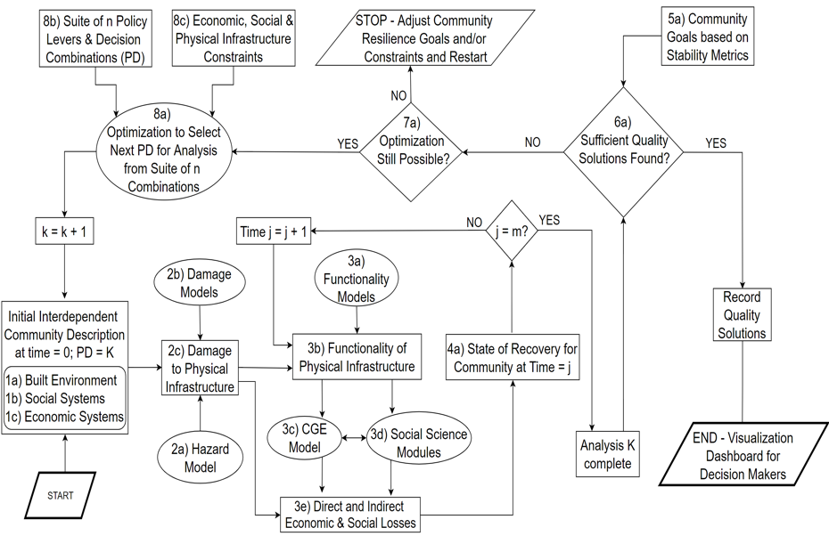
Original Flowchart

Slide 2
Seaside Flowchart
8c) Economic, social, and physical infrastructure constraints
8b) Suite of n policy levers and decision combinations (PD)
STOP – Adjust community goals/constraints
5a) Community Goals Based on Stability Metrics
Status Quo
Building codes:
EQ* & TSU**
Relocate*
Ex-Post
8a) Optimization to select next PD for analysis from suite of n combinations
No
*Exists in IN-CORE = modify initial community description
**Tsunami evacuation centers: Exist outside of IN-CORE
Yes
7a) Optimization Still Possible?
No
6a) Sufficient Quality Solutions Found?
Yes
Exists in IN-CORE
Exists outside IN-CORE
k=k+1
In progress in IN-CORE
No
Yes
Time j=j+1
j=m?
In progress outside of IN-CORE
2b) Damage Models
3a) Functionality Models
Does not exist yet
Initial Community Description
1a) Built Environment
1b) Social Systems
1c) Economic Systems
Record Quality Solutions
2c) Damage to physical Infrastructure
3b) Functionality of physical Infrastructure
4a) State of Recovery for community at time=j
2a) Hazard Models
3c) CGE Model
3d) Population Dislocation Model
END - Visualization
Start
2d) Casualty
3e) Direct and Indirect Economic & Social Losses
Analysis K complete

