Slide 1
Reward signal for ABM
Previous work

Slide 2
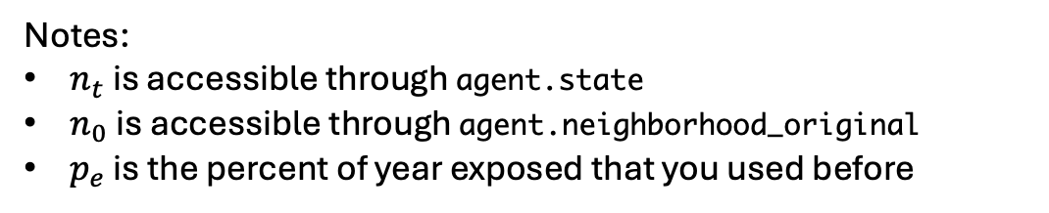
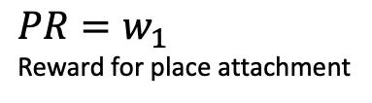
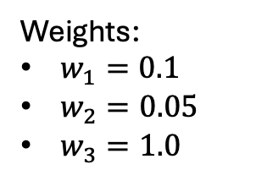

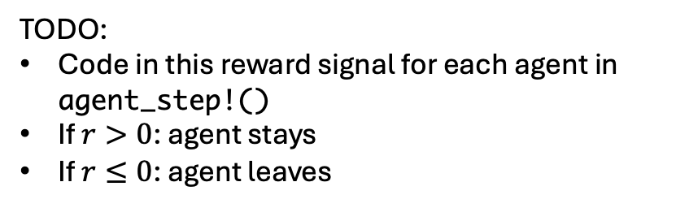
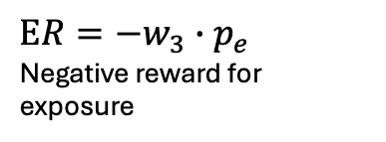
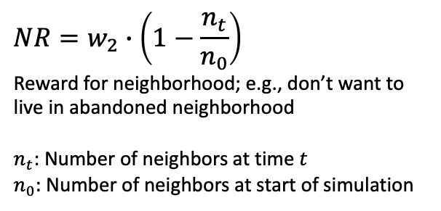
Reward Signal
TODO:
Code in this reward signal for each agent in agent_step!()
If $r>0$: agent stays
If $r≤0$: agent leaves
$$r=PR+NR+ER$$
Weights:
$w_{1}=0.1$
$w_{2}=0.05$
$w_{3}=1.0$
Place Reward
Neighbor Reward
Exposure Reward
(or penalty)
$$PR=w_{1}$$
Reward for place attachment
$$NR=w_{2}∙\left(1−\frac{n_{t}}{n_{0}}\right)$$
Reward for neighborhood; e.g., don’t want to live in abandoned neighborhood
$n_{t}$: Number of neighbors at time $t$
$n_{0}:$ Number of neighbors at start of simulation
$$ER=−w_{3}∙p_{e}$$
Negative reward for exposure
Notes:
$n_{t}$ is accessible through agent.state
$n_{0}$ is accessible through agent.neighborhood_original
$p_{e}$ is the percent of year exposed that you used before

Slide 3
Utility theory for ABM

Slide 4
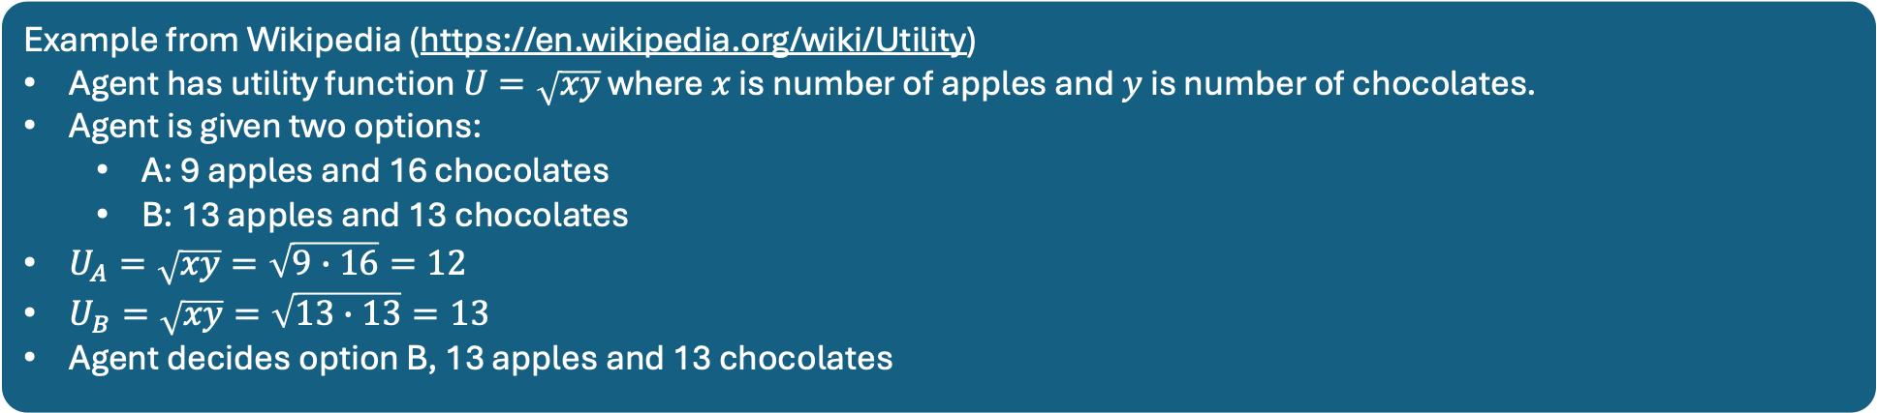
Utility theory
Agents make decisions based on “utility”
Example from Wikipedia (https://en.wikipedia.org/wiki/Utility)
Agent has utility function $U=\sqrt{xy}$ where $x$ is number of apples and $y$ is number of chocolates.
Agent is given two options:
A: 9 apples and 16 chocolates
B: 13 apples and 13 chocolates
$U_{A}=\sqrt{xy}=\sqrt{9∙16}=12$
$U_{B}=\sqrt{xy}=\sqrt{13∙13}=13$
Agent decides option B, 13 apples and 13 chocolates
Want to do the same for migration ABM
For example, each Agent has two options
A: do nothing (e.g., stay)
B: leave

Slide 5
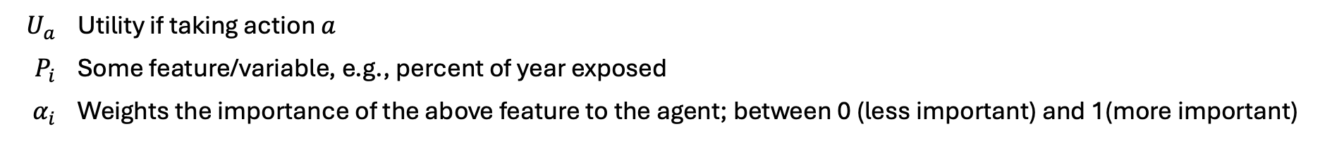
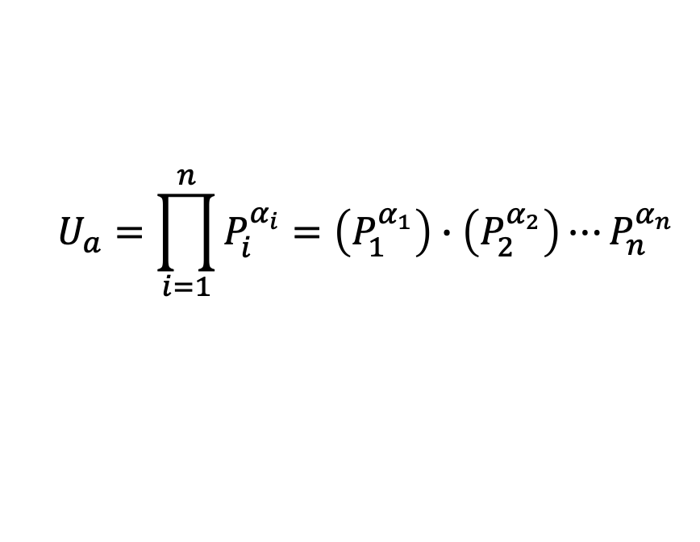
Cobb-Douglas Utility Function - General
$$U_{a}=\prod_{i=1}^{n}{P_{i}^{α_{i}}}=\left(P_{1}^{α_{1}}\right)∙\left(P_{2}^{α_{2}}\right)⋯P_{n}^{α_{n}}$$
$$U_{a}$$ | Utility if taking action $a$
$$P_{i}$$ | Some feature/variable, e.g., percent of year exposed
$$α_{i}$$ | Weights the importance of the above feature to the agent; between 0 (less important) and 1(more important)

Slide 6
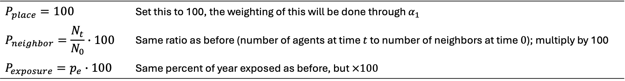

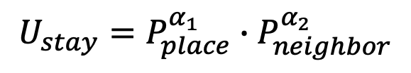
Cobb-Douglas Utility Function - Applied to Galveston
$$U_{stay}=P_{place}^{α_{1}}∙P_{neighbor}^{α_{2}}$$
$$U_{leave}=P_{exposure}^{α_{3}}$$
Features/variables to consider
$$P_{place}=100$$ | Set this to 100, the weighting of this will be done through $α_{1}$
$$P_{neighbor}=\frac{N_{t}}{N_{0}}∙100$$ | Same ratio as before (number of agents at time $t$ to number of neighbors at time $0$); multiply by 100
$$P_{exposure}=p_{e}∙100$$ | Same percent of year exposed as before, but $×100$

Slide 7
Cobb-Douglas Utility Function - Applied to Galveston
$$U_{stay}=P_{place}^{α_{1}}∙P_{neighbor}^{α_{2}}$$
$$U_{leave}=P_{exposure}^{α_{3}}$$
Dylan Added alpha_calc() function to misc_funcs.jl
Use this to determine alpha values for each agent

Slide 8
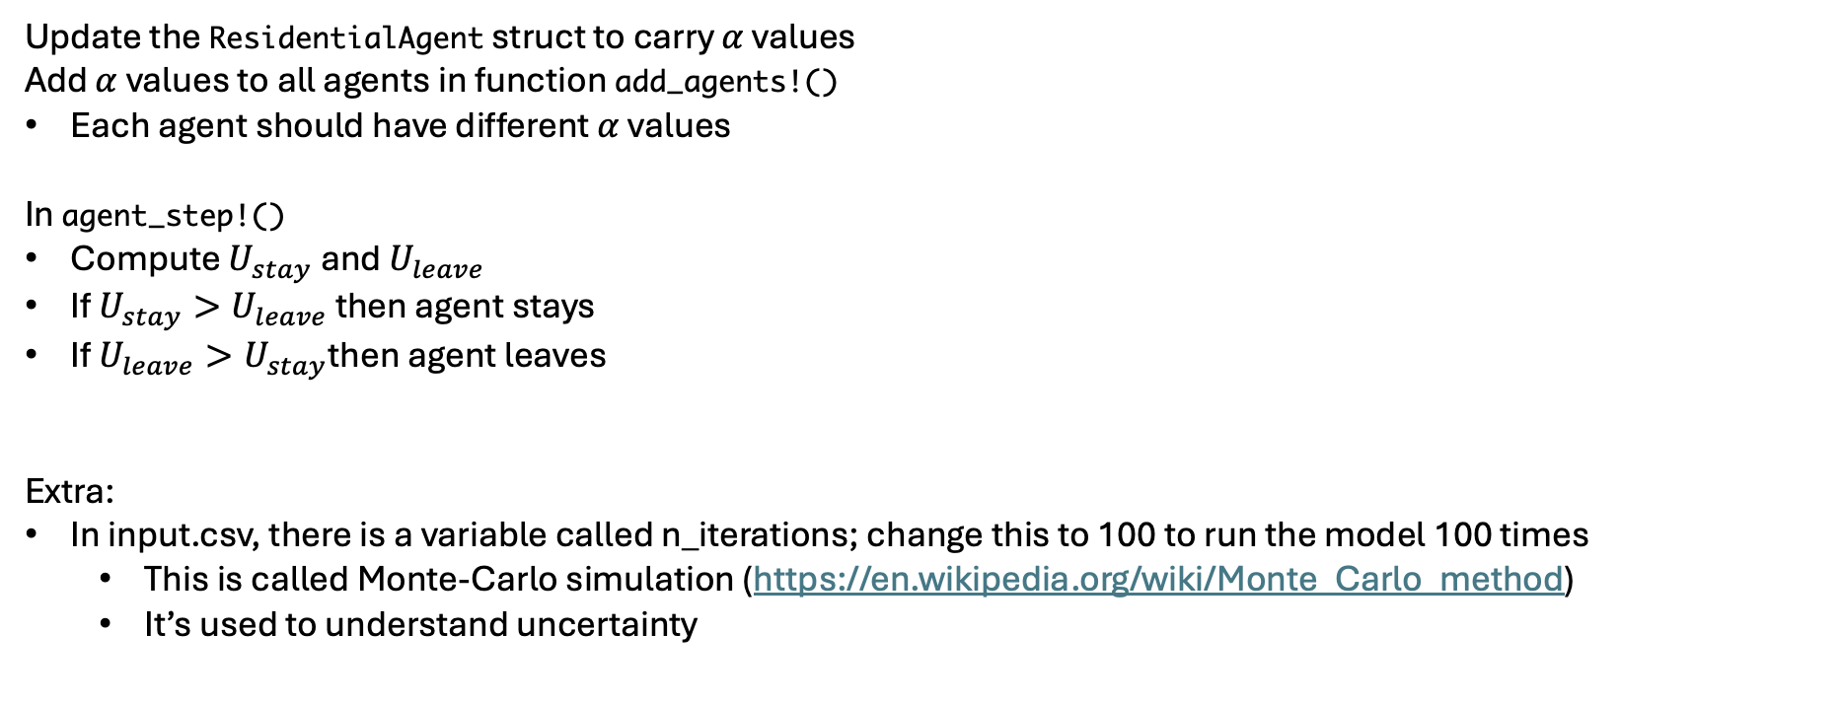
Nat: Next Steps
Update the ResidentialAgent struct to carry $α$ values
Add $α$ values to all agents in function add_agents!()
Each agent should have different $α$ values
In agent_step!()
Compute $U_{stay}$ and $U_{leave}$
If $U_{stay}>U_{leave}$ then agent stays
If $U_{leave}>U_{stay}$then agent leaves
Extra:
In input.csv, there is a variable called n_iterations; change this to 100 to run the model 100 times
This is called Monte-Carlo simulation (https://en.wikipedia.org/wiki/Monte_Carlo_method)
It’s used to understand uncertainty
I won’t be available for meetings June 21-25; however, you can text me. I’ll respond when I can.

