Slide 1



BUSINESS DATA MANAGEMENT CAPSTONE PROJECT
INVENTORY AND PRODUCT OPTIMIZATION THROUGH SALES ANALYTICS OF A FASHION OUTLET
Submitted by :
Jyoti Singh
22F3000182
1

Slide 2

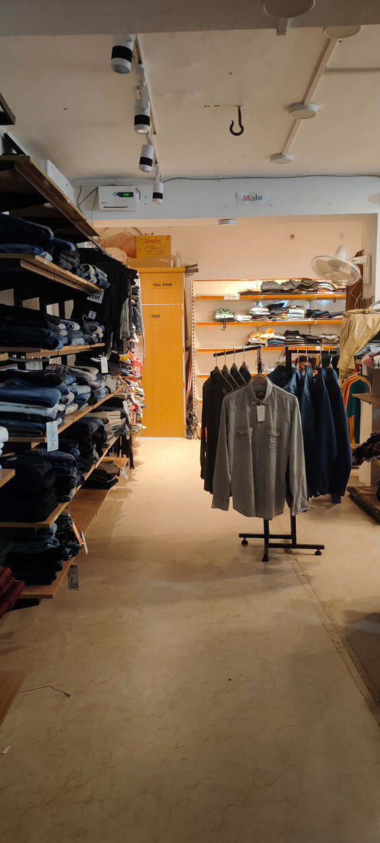
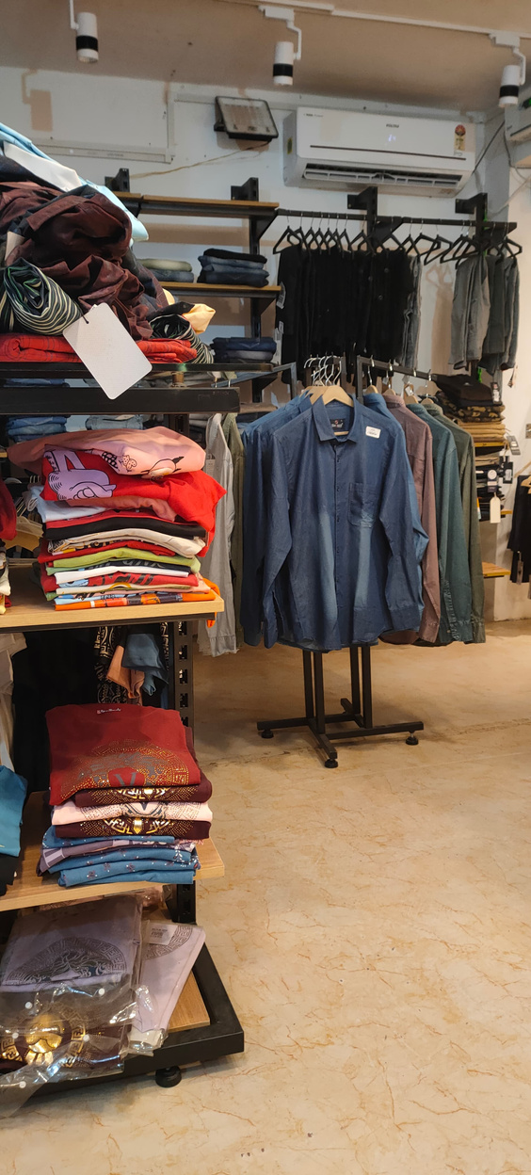
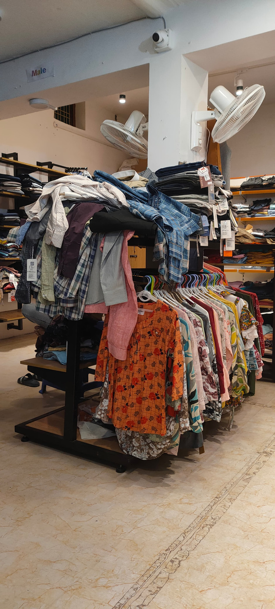
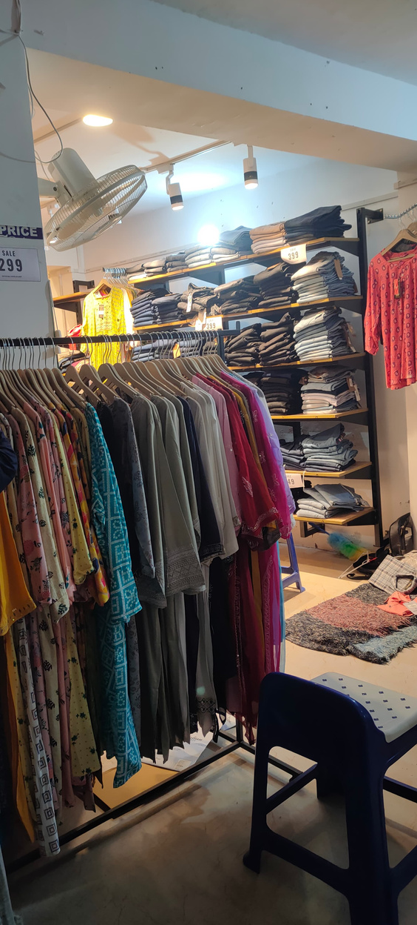
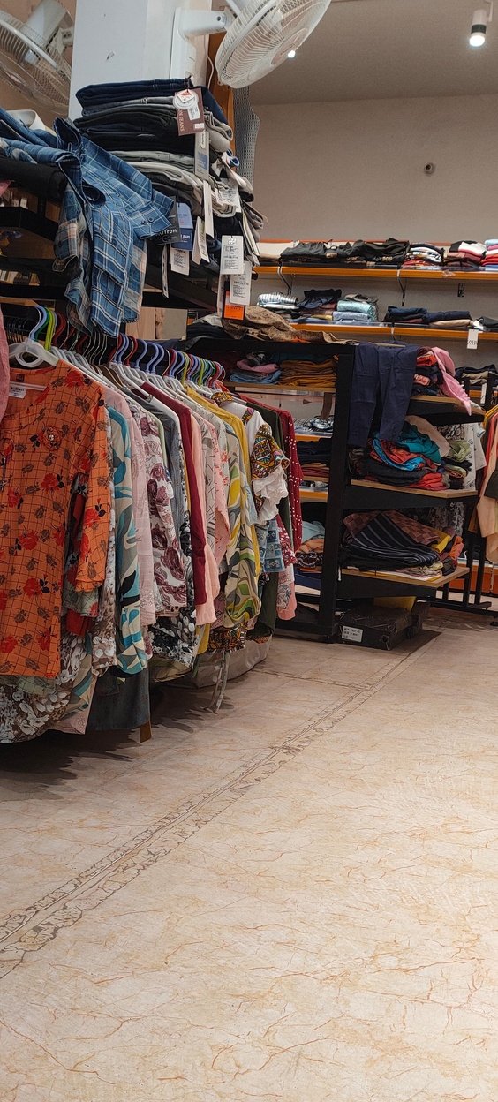
ORGANIZATION BACKGROUND
The Elegant is a B2C fashion outlet specializing in clothing and footwear for men and women. Established in April 2024 by Mr. Narendra Kumar, the store has quickly built a strong customer base.
❖ Location: Rath, Hamirpur, Uttar Pradesh
❖ Customer Base: 900-950 customers in 6 months (120-150 per month)
❖ Business Type: Retail fashion store catering to men & women
❖ Product Range: Clothing & Footwear collections
2

Slide 3
PROBLEM STATEMENT
❖ Stock Shortages:
Fast-moving items frequently go out of stock, leading to lost sales and dissatisfied customers.
❖ Overstocking:
Slow-moving items pile up, increasing storage costs and blocking funds that could be better
used.
❖ Seasonal Demand Mismatch:
Understocking during peak periods leads to missed revenue, while surplus inventory during
off-seasons affects cash flow.
❖ Slim Profit Margins:
Competitive pricing and unsold outdated stock reduce overall profitability and strain
financial resources.
3

Slide 4
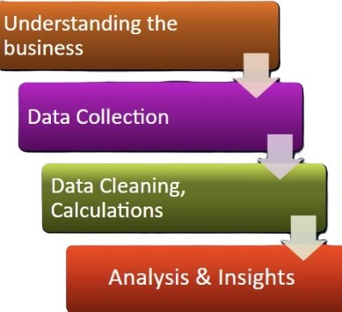
PROCESS OF DATA CLEANING AND ANALYSIS
❖ After getting the Authorization Letter from IIT Madras, we
had 2 In person meetings to discuss about the project &
business.
❖ After proposal approval, the data was shared as Excel sheets
for analysis.
❖ The data was then loaded in colab to plot graphs and data
preprocessing was done.
❖ Revenue and Monthly Trend Analysis, Category-Wise Sales
Performance, Seasonal Sales Patterns, and Profit Margin
Analysis were conducted.
4

Slide 5
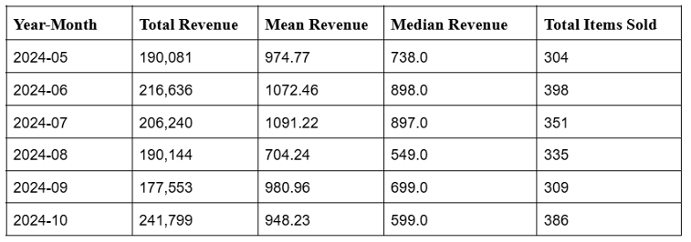
DESCRIPTIVE STATISTICS
Revenue & Sales Insights (May 2024 - Oct 2024)
❖ Revenue Trends:
Highest Total Revenue: October 2024 (241,799)
Lowest Total Revenue: September 2024 (177,553)
Mean Revenue: Ranges from 704.24 (August) to 1091.22 (July)
Median Revenue: Highest in June (898.0) and lowest in August (549.0)
❖ Sales Performance:
Highest Items Sold: June 2024 (398 items)
Lowest Items Sold: May 2024 (304 items)
5

Slide 6
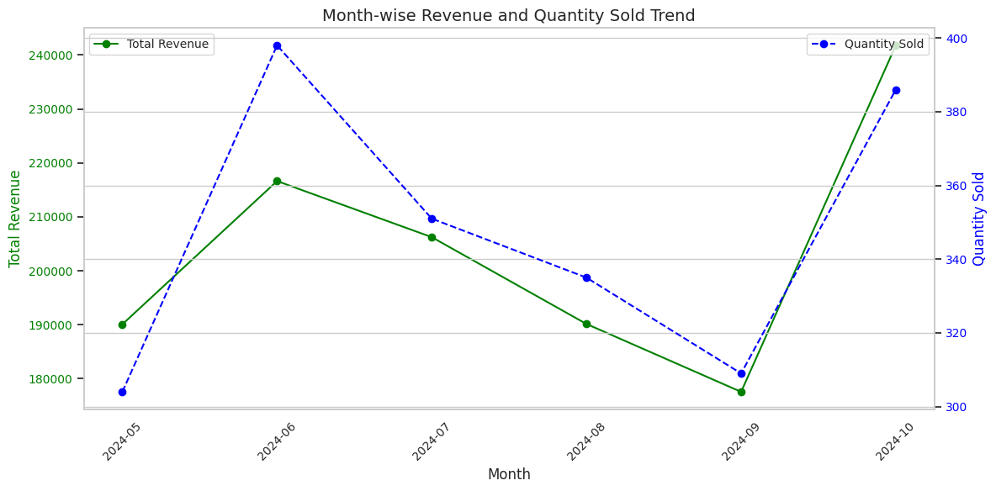
MONTHLY SALES ANALYSIS
Monthly trends in sales and revenue show seasonal demand shifts and pricing impact
❖ June: Highest sales volume, but revenue was not maximized
❖ October: Highest revenue due to high-priced items
❖ Insights: Price-sensitive demand, need for better inventory forecasting
6

Slide 7
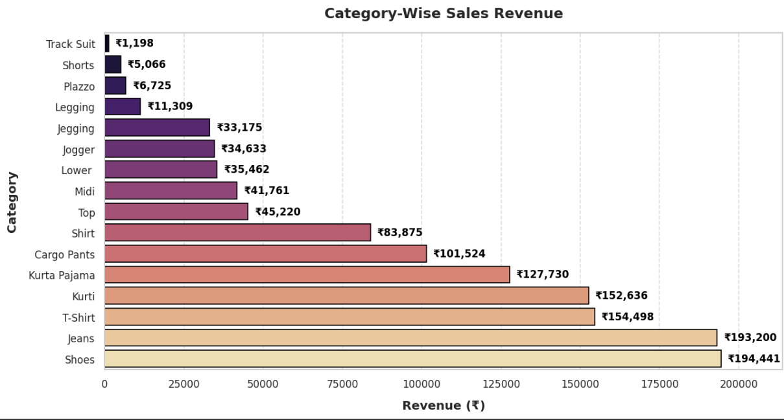
CATEGORY-WISE PERFORMANCE ANALYSIS
❖ Top Sellers: Shoes (₹194,441) and Jeans (₹193,200) lead sales, contributing significantly to revenue.
❖ Strong Performers: T-Shirts (₹154,498) and Kurtis (₹152,636) show high demand for casual wear.
❖ Moderate Sales: Kurta Pajama (₹127,730), Cargo Pants (₹101,524), and Shirts (₹83,875) perform
decently but trail top categories.
❖ Low Revenue Items: Track Suits (₹1,198), Shorts (₹5,066), and Plazzo (₹6,725) need better pricing or
marketing strategies.
7

Slide 8
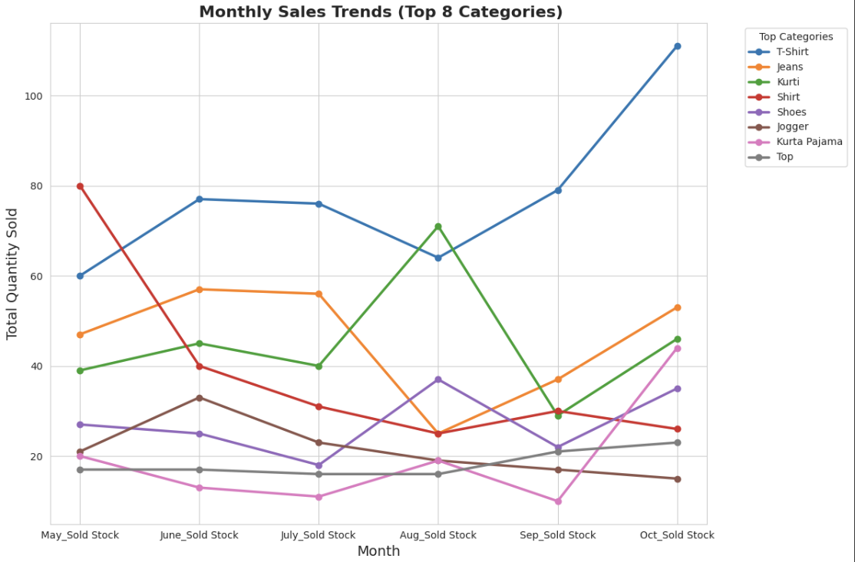
SEASONAL SALES PATTERNS AND REVENUE ANALYSIS
❖ Top Sellers: Shoes (₹194,441) and Jeans (₹193,200) lead in revenue.
❖ Strong Performers: T-Shirts (₹154,498) and Kurtis (₹152,636) show high demand.
❖ Moderate Sales: Kurta Pajama, Cargo Pants, and Shirts perform steadily.
❖ Stable but Lower Sales: Joggers and Tops show consistent but modest sales.
❖ Market Trends: Western wear dominates, while ethnic wear sees seasonal shifts.
8

Slide 9
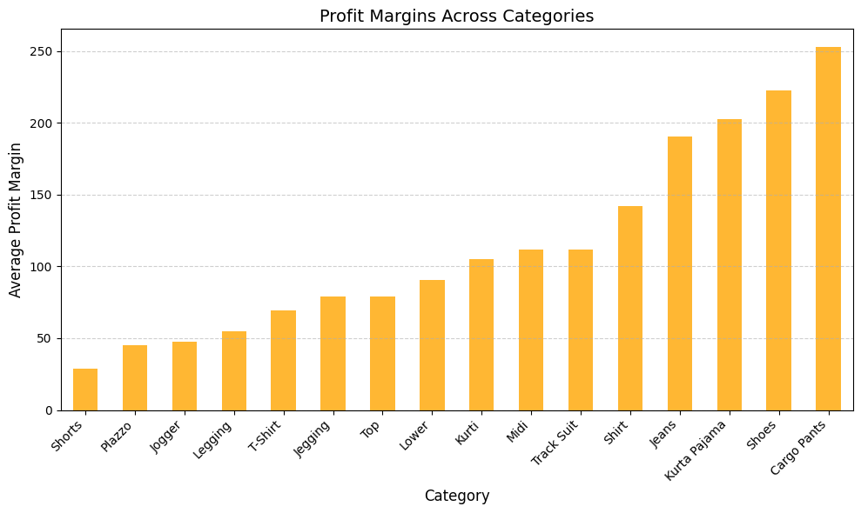
PROFIT MARGIN ANALYSIS
❖ Top Earner: Cargo Pants lead in profitability,
making them a key revenue driver.
❖ High-Profit Items: Shoes and Kurta Pajama show
strong margins, benefiting from demand and
premium pricing.
❖ Consistent Performers: Jeans and Shirts provide
steady revenue with mid-to-high profit margins.
❖ Low-Profit Segments: Shorts, Plazzo, and Joggers
yield minimal margins, requiring better pricing
strategies.
❖ Trend Insight: Bottom-wear categories like Cargo Pants and Jeans have higher profit margins
In contrast, casual wear items such as Shorts and Joggers generate lower margins.
9

Slide 10
RECOMMENDATIONS
❖ Enhance Inventory Management: Align stock levels with demand trends, conduct regular
assessments, and minimize overstocking to reduce costs and inefficiencies.
❖ Plan for Seasonal Demand: Anticipate peak sales by adjusting inventory and launching
targeted promotions to maximize revenue during high-demand periods.
❖ Optimize Pricing Strategy: Implement a value-based pricing model with strategic discounts
on high-margin products to enhance profitability while maintaining sales volume.
❖ Strengthen Category Performance: Prioritize high-margin products like Cargo Pants and
Shoes while repositioning or bundling low-profit items such as Shorts and Joggers to improve
overall profitability.
❖ Boost Marketing & Sales Strategies: Leverage customer insights, influencer collaborations,
and promotional campaigns to enhance visibility and drive demand for mid-tier and slow-
moving categories.
10

Slide 11
THANK YOU !
PROJECT LINK: https://drive.google.com/drive/folders/1Gff4MHouEXZ3cON3KrLF9_XnAHSWokY-?usp=sharing
11

