Slide 1



MILESTONE 3
Multimodal AI Assistant
for Smart Agriculture
TEAM
Sai Naman
Harish Sahadev
Ayushi Dixit
Manas Rastogi
Allanki Saketh Kumar
Advanced Model Architecture & End-to-End Pipeline Verification for Intelligent Farming Solutions.
IIT MADRAS | TEAM 8

Slide 2




01
Dataset Organization and Integrity
STRATIFIED SPLITTING FOR ROBUST EVALUATION
Class-wise Architecture
80-10-10 Stratified Split
Data is meticulously organized into class-specific folders to maintain structural clarity and ease of access during the training phase.
Implementation of a balanced 80% Training, 10% Validation, and 10% Testing split to ensure statistical representativeness across all 17 classes.
Zero Data Leakage
Manifest Tracking
Rigorous verification protocols are in place to prevent any overlap between training and evaluation sets, maintaining the integrity of the results.
Comprehensive manifest files track every single sample, ensuring fully reproducible experiments and transparent data lineage.
IIT MADRAS | TEAM 8 | MILESTONE 3

Slide 3






02
Preprocessing Pipeline Optimization
STANDARDIZED INPUT PREPARATION FOR HIGH-PERFORMANCE INFERENCE
Noise Reduction
RGB Conversion
Resizing
Augmentation
Normalization
Automated removal of duplicate images to prevent model bias and overfitting.
All inputs converted to RGB space for consistent feature extraction across datasets.
Standardized 224x224 resolution to match model input requirements perfectly.
Dynamic training-only augmentations to enhance model generalization capabilities.
Pixel values normalized using ImageNet statistics for faster convergence.
IIT MADRAS | TEAM 8 | MILESTONE 3

Slide 4





03
Advanced Model Architecture
LEVERAGING RESNET-50 FOR COMPLEX AGRICULTURAL FEATURE EXTRACTION
BACKBONE NETWORK
ResNet-50 Pretrained
Deep Residual Learning
Utilizes skip connections to mitigate vanishing gradients in deep networks.
INPUT TENSOR
3 x 224 x 224
Feature Hierarchy
OUTPUT CLASSES
Captures low-level textures and high-level semantic structures effectively.
17-Class Classifier
OPTIMIZATION
Custom Classification Head
Strategic Fine-tuning
Tailored fully connected layers for domain-specific agricultural identification.
Performance Stability
IIT MADRAS | TEAM 8 | MILESTONE 3
Engineered for high accuracy across varying lighting and environmental conditions.

Slide 5
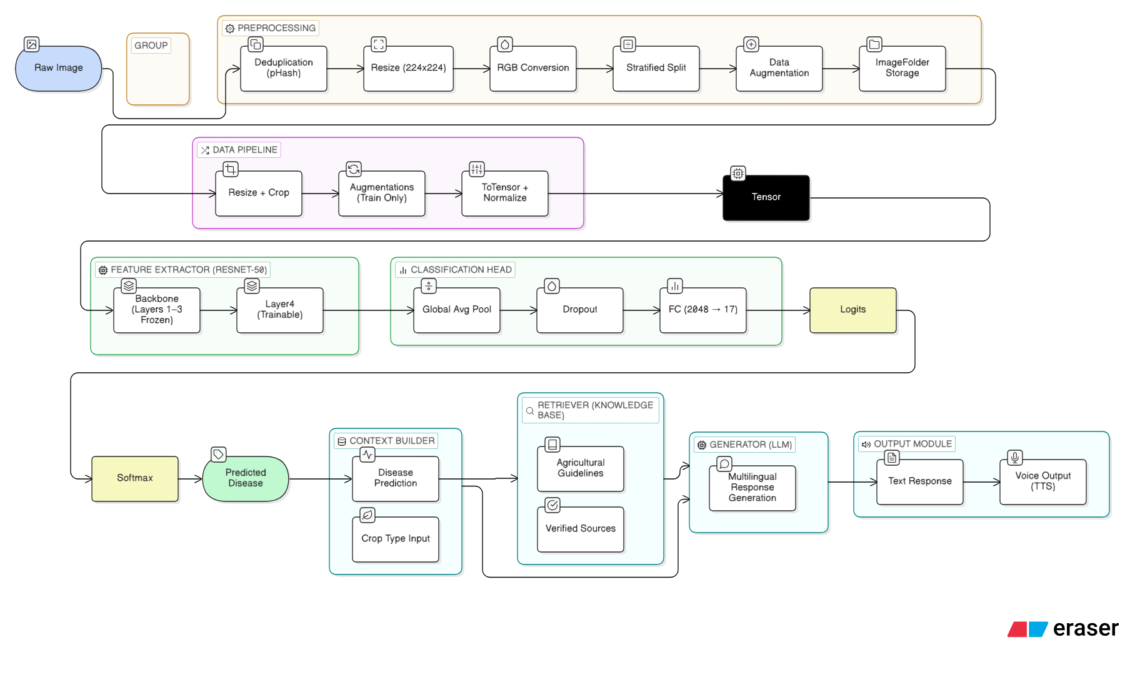
05
System Architecture Overview
COMPREHENSIVE END-TO-END MULTIMODAL PIPELINE
IIT MADRAS | TEAM 8 | MILESTONE 3

Slide 6






04
End-to-End Data Flow Pipeline
SEAMLESS INTEGRATION FROM RAW INPUT TO FINAL CLASSIFICATION
INPUT IMAGE
PREPROCESSING
RESNET-50
POOLING
OUTPUT
Feature Extraction: Sequential flow through the preprocessing pipeline and ResNet-50 feature extractor to capture salient visual patterns.
Decision Logic: Global spatial pooling followed by a multi-class classification head generating probabilistic outputs for 17 agricultural classes.
IIT MADRAS | TEAM 8 | MILESTONE 3

Slide 7



05
Rigorous Pipeline Verification
ENSURING RELIABILITY AND ACCURACY IN SMART AGRICULTURE SYSTEMS
Validation Protocols
Systematic testing of each pipeline component to ensure data integrity and transformation accuracy at every stage.
CONSISTENCY CHECKS
Preprocessing Output Alignment
Error Analysis
Model Input Tensor Verification
Identifying potential bottlenecks and edge cases in the data flow to optimize inference speed and model robustness.
Label Mapping Integrity
Latency Benchmark Testing
Academic Excellence
Data Leakage Prevention Audit
Adhering to IIT Madras's rigorous standards for scientific methodology and technical precision in AI research.
IIT MADRAS | TEAM 8 | MILESTONE 3

Slide 8




07
Architectural Rationale
WHY RESNET-50 IS THE OPTIMAL CHOICE
Vanishing Gradient Solution
Feature Hierarchy
Captures both low-level textures (leaf patterns) and high-level semantic structures (pest types) through deep hierarchical features.
Residual connections allow training deeper networks without degradation, ensuring stable learning across complex agricultural datasets.
50 Layers
Efficiency & Accuracy
Transfer Learning
DEEP RESIDUAL LEARNING
Balances computational cost and classification accuracy, suitable for real-time agricultural monitoring.
Pre-training on large datasets like ImageNet provides a strong foundation, requiring less domain-specific data for high accuracy.
IIT MADRAS | TEAM 8 | MILESTONE 3

Slide 9



07
Conclusion and Future Directions
MOVING TOWARDS A FULLY INTEGRATED MULTIMODAL ASSISTANT
Future Roadmap
Key Achievements
Multimodal Integration
Successfully verified the core ResNet-50 architecture and end-to-end data processing pipeline. Established a robust foundation for the smart agriculture assistant's visual capabilities, ensuring high accuracy and technical rigor in line with IIT Madras standards.
Incorporating sensor data and natural language processing for a comprehensive assistant.
Field Testing
Real-world deployment and validation across diverse agricultural environments.
Academic Vision
Pushing the boundaries of AI applications in sustainable and precision farming.
IIT MADRAS | TEAM 8 | MILESTONE 3

