Slide 1

MILESTONE 4 PRESENTATION
Multimodal AI Assistant
for Smart Agriculture
Crops
Corn · Potato · Rice
Wheat · Sugarcane
Classes
17 disease categories
Images
13,324 total
Model
MobileNet V3 Large
Crop Disease Detection + RAG Advisory System
for Indian Farmers
Group 8 - IITM - DSAI Lab - 2026
Notes:
Slide 2 — Dataset Overview
What to say:
"We used the Top Agriculture Crop Disease dataset from Kaggle — 13,324 images across 17 disease categories and 5 crops. The critical challenge here is the 14.9x class imbalance — Sugarcane has only 100 images per class while Rice Healthy has 1,488. This isn't just a number — it directly affects model fairness. A model trained naively would simply ignore Sugarcane predictions. We addressed this deliberately."
Why this dataset: Publicly available, covers major Indian crops, aggregates from multiple trusted sources — PlantVillage for lab images, Dhan-Shomadhan for Bangladeshi rice field images, and Kaggle-sourced wheat and sugarcane datasets. Real-world diversity built in.

Slide 2
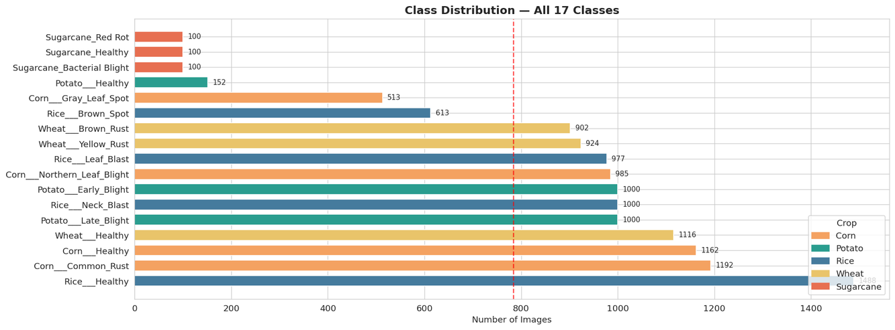
DATASET OVERVIEW
Kaggle — kamal01
13,324
17
5
14.9×
Total Images
Disease Classes
Crop Species
Imbalance Ratio
Crop
Classes
Corn
4 classes
Potato
3 classes
Rice
4 classes
Wheat
3 classes
Sugarcane
3 classes
⚠️ Sugarcane severely under-represented — addressed via targeted augmentation
Notes:
Slide 2 — Dataset Overview
What to say:
"We used the Top Agriculture Crop Disease dataset from Kaggle — 13,324 images across 17 disease categories and 5 crops. The critical challenge here is the 14.9x class imbalance — Sugarcane has only 100 images per class while Rice Healthy has 1,488. This isn't just a number — it directly affects model fairness. A model trained naively would simply ignore Sugarcane predictions. We addressed this deliberately."
Why this dataset: Publicly available, covers major Indian crops, aggregates from multiple trusted sources — PlantVillage for lab images, Dhan-Shomadhan for Bangladeshi rice field images, and Kaggle-sourced wheat and sugarcane datasets. Real-world diversity built in.

Slide 3
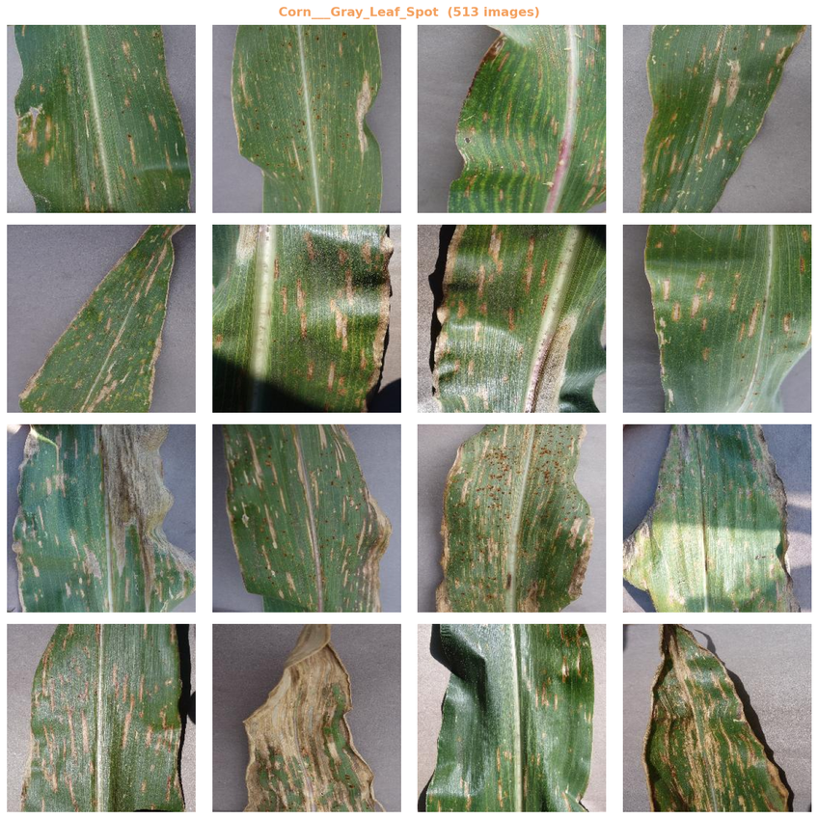
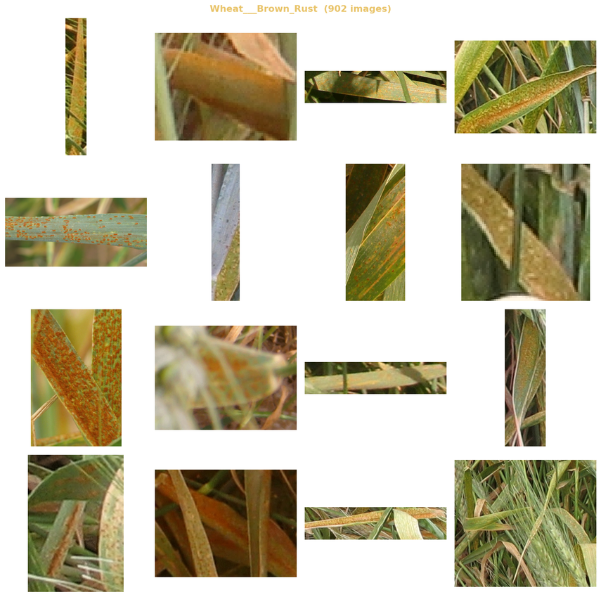
DATASET EXAMPLES
Notes:
<number>

Slide 4
EXPLORATORY DATA ANALYSIS — KEY FINDINGS
📐 Image Dimensions
🎨 Color Channels
🌿 Color Analysis
Extreme variability:
16px → 6,000px width
Mandatory resize to 224×224
All 13,324 images confirmed
RGB (3-channel)
No grayscale or RGBA found
Green channel dominant
in healthy leaves
Measurable shift in diseased classes
🔍 Duplicate Check
⚖️ Class Imbalance
✅ Data Quality
0 corrupt files
0 exact duplicates (MD5)
2 near-duplicate pairs (pHash)
Rice___Healthy: 1,488 imgs
Sugarcane classes: 100 imgs
Ratio: 14.9× imbalance
High overall quality
All files readable
Clean for model training
Notes:
Slide 3 — EDA Key Findings
What to say:
"Before touching the model, we did thorough exploratory analysis. Three findings drove our entire preprocessing design. First — image dimensions ranged from 16 pixels to 6,000 pixels. You cannot feed that directly into any neural network. Second — all images were RGB, which simplified things. Third — the green channel is measurably stronger in healthy leaves and drops in diseased ones. This confirmed that color information is genuinely discriminative, not just noise, which validated our choice of a colour-aware CNN over something simpler."

Slide 5
PREPROCESSING PIPELINE
1
2
3
4
5
6
Resize 224×224
RGB Conversion
Duplicate Removal
Augmentation
Normalisation
Stratified Split
LANCZOS resampling
ImageNet standard input
Safety step retained
0 non-RGB found
MD5 exact + pHash
near-duplicate removal
Minority classes only
Flip · Rotate · Brightness
ImageNet mean/std
For transfer learning
80 / 10 / 10
All 17 classes in each split
🔑 Augmentation applied ONLY to training images (never val/test) — prevents inflated evaluation metrics
Notes:
Slide 4 — Preprocessing Pipeline
What to say:
"Six steps, each with a clear justification. Resize to 224×224 using LANCZOS — the highest quality downsampling filter, chosen because leaf texture detail matters for disease classification. Augmentation applied only to minority classes — flips, rotations, brightness and contrast shifts — bringing Sugarcane from 100 images to 700 training images without collecting new data. The most important rule: augmentation only on training data, never validation or test. Augmenting test data would make your metrics look better than real-world performance."
Why ImageNet normalisation: All our models are pretrained on ImageNet. The weights were learned on data normalised to specific mean and standard deviation values. Using the same normalisation at inference ensures the pretrained weights transfer correctly.

Slide 6

Model & Pipeline Recap
MobileNet V3 Large (ImageNet pretrained) with frozen backbone + trained classifier head
Optuna Hyperparameter Optimization (5 trials, Macro F1 objective)
Best Trial (#4): AdamW | LR=4.28e-4 | Dropout=0.470 | Batch=16 | Weight Decay=1.8e-6
End-to-End Pipeline:
Image (224×224) → MobileNet (17-class prediction)
→ Context Builder (crop+disease)
→ ChromaDB Retrieval (top-4 chunks)
→ Llama 3.3 (Groq) → Multilingual Text + Voice Output
Design Choice: Freeze backbone → faster training + avoids overfitting

Slide 7
Evaluation Dataset & Preprocessing
Dataset Overview
Preprocessing (No Augmentation in Test)
Dataset: Kaggle Crop Disease Dataset (13,324 images, 17 classes, 5 crops)
Test Split: ~1,332 images (10%), Stratified (seed=42)
Severe Class Imbalance: 14.9×
Example: Rice Healthy ~149 vs Sugarcane classes ~10 images
Split: 80% Train / 10% Val / 10% Test
Resize 224×224 (LANCZOS), RGB conversion
Tensor scaling (0–1) + ImageNet normalization
Ensures no train-test distribution mismatch

Slide 8
Evaluation Setup & Metrics
Environment & Reproducibility
Primary Metric
Environment: Google Colab, NVIDIA T4 GPU, PyTorch 2.x, Python 3.10
Reproducibility: Fixed seed (42), strict test separation
Inference: model.eval() + torch.no_grad()
Primary Metric: Macro F1 (handles class imbalance)
Macro F1 gives equal weight to all 17 classes
Secondary Metrics
Accuracy (overall correctness), Micro F1 (consistency)
CrossEntropy Loss (confidence calibration)
Class-wise F1 + Confusion Matrix for error analysis

Slide 9
Quantitative Results & Comparison
Final Test Performance (Best Model — Trial #4)
92.09%
90.04%
92.09%
Accuracy
Macro F1
Micro F1
92.55%
0.2075
Validation Macro F1
Test Loss
Macro vs Micro gap (~2%) → balanced performance across classes
Architecture Comparison
MobileNet V2: ~91.6% | MobileNet V3: 92.09%
ResNet-50: ~95.8% (higher cost) | EfficientNet-B3: ~90.4%
MobileNet V3 chosen for accuracy-efficiency tradeoff (CPU deployment)
Class-wise Insight
High F1: Corn, Potato, Wheat | Low F1: Rice diseases, Sugarcane Red Rot

Slide 10
Qualitative Results & Error Analysis
Successful Predictions
Failure Cases
High confidence (~100%) on clear disease patterns
Correct predictions even for minority classes (Sugarcane Red Rot ~99%)
Rice disease confusion (Brown Spot vs Leaf Blast vs Neck Blast)
Environmental noise (water droplets, occlusion → low confidence ~50%)
Error Patterns
Intra-class similarity (Rice diseases)
Data scarcity (Sugarcane ~10 images)
Real-world distribution shift (noise, lighting, occlusion)
Key Observations
Val-Test gap ~2.5% (acceptable), augmentation boosted Macro F1 significantly
Limitations: Rice confusion, small dataset, frozen backbone, real-world drop

