Slide 1

Multimodal AI Assistant for Smart Agriculture
Deep Learning + RAG + Multilingual Voice Advisory for Indian Farmers
Milestone -1
Team - 8

Slide 2
Team Contributions
Member | Contribution
Harish Sahadev M | Structuring, drafting, and formatting technical report
Ayushi Dixit | Report research and PPT preparation
Manas Rastogi | Finalizing problem statement and Research for PPT
Saketh Allanki | Presentation, including problem definition, literature review, evaluation metrics, and gap analysis.
Sai Naman | Researching startups, analyzing features, identifying gaps, and comparing with proposed system

Slide 3
Multimodal AI Assistant for Smart Agriculture
Problem Context
  Leaf diseases cause major yield loss
  Manual inspection is slow & inconsistent
  Existing systems are fragmented (vision OR chat OR advisory)
  No unified multilingual voice-enabled rural AI system

Slide 4
Objectives & Innovation
Core Goal
  Deep learning-based multimodal disease detection
  ≥ 85–90% classification accuracy
  Disease severity estimation
  Multilingual + Voice interaction
  Retrieval-Augmented Generation (RAG) integration
  Crops covered: Rice, Wheat, Sugarcane, Potato, Corn

Slide 5
Technical aspect
Domain | Key Finding
CNN (ResNet, MobileNet, EfficientNet) | >95% on controlled data; drops in field conditions
Severity Estimation (U-Net) | Underexplored; annotation-heavy
RAG (Lewis et al., 2020) | Reduces hallucination in knowledge-intensive tasks
Multilingual (mT5, IndicBERT) | Domain adaptation to agri still limited
Speech (Whisper, Tacotron 2) | Noise & latency challenges in rural settings

Slide 6
Evaluation Strategy & Expected Impact
Module | Baseline | Metric | Target
Vision (CNN) | MobileNet / ResNet | Accuracy, F1 | ≥ 85–90%
RAG Advisory | LLM without retrieval | Hallucination rate, Relevance | Qualitative improvement
Speech (ASR) | Whisper vanilla | WER, Latency | Low WER, real-time capable
End-to-End | — | Response time, Usability | Seamless user experience

Slide 7
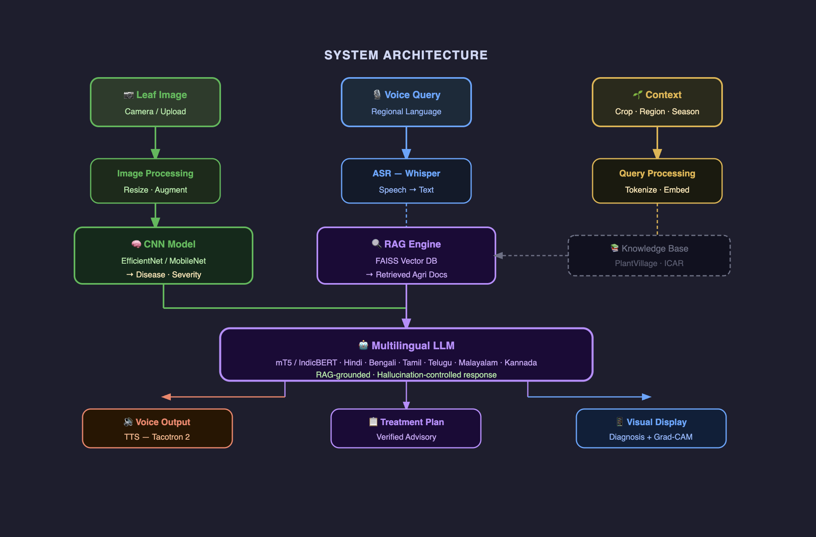
Detailed Architecture

Slide 8
Summary & Next Steps
Dataset curation, CNN baseline training, RAG pipeline setup, initial speech integration
Key deliverable: Vision baseline accuracy benchmark + RAG prototype
Thankyou..

