Slide 1

FINAL PRESENTATION | GROUP 3
E-Commerce
Marketplace
Performance
Indian Institute of Technology Madras
BS Degree Programme · May 2026
DECISION OBJECTIVE
Grow the marketplace without breaking the customer experience.
Orders, delivery reliability,
customer satisfaction and growth
[FULL NAME] · [FULL NAME] · [FULL NAME]
[FULL NAME] · [FULL NAME]

Slide 2
The Decision Story
02
How can the marketplace expand orders, sellers and catalogue breadth while protecting delivery reliability and customer satisfaction?
1
Measure
2
Diagnose
3
Prioritize
4
Act
Order journey
Failure signals
Volume × risk
Guardrailed growth
CORE MESSAGE Delivery reliability is the clearest operational signal associated with customer dissatisfaction.
GROUP 3 | DATA VISUALIZATION DESIGN PROJECT

Slide 3
Data Foundation and Analytical Method
03
A relational view of the full marketplace journey
DATA SCOPE
01
Define grain
Order, item, customer and seller
10
99,441
related source tables
orders
02
Join safely
Explicit keys and cardinality checks
112,650
96,096
03
Derive measures
Delay, lateness, revenue and risk
order-item rows
unique customers
04
Validate
Independent scripts and denominators
3,095
74
sellers
normalized categories
GROUP 3 | DATA VISUALIZATION DESIGN PROJECT

Slide 4
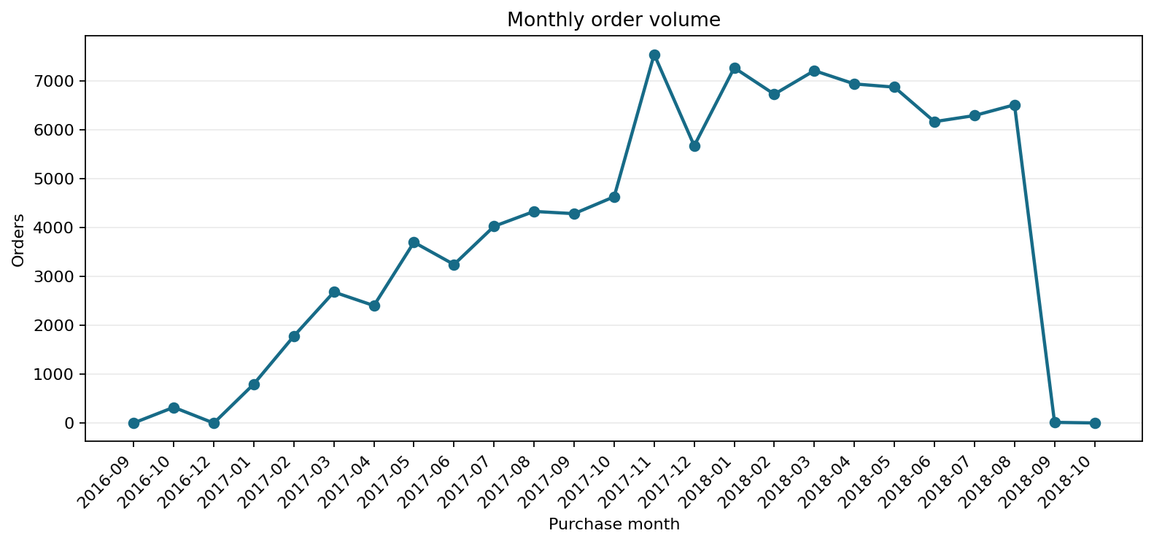
Marketplace Scale and Order Momentum
04
The marketplace achieved meaningful scale, with demand accelerating into late 2017.
Monthly order volume
99,441
orders
32,951
products
3,095
sellers
GROUP 3 | DATA VISUALIZATION DESIGN PROJECT

Slide 5
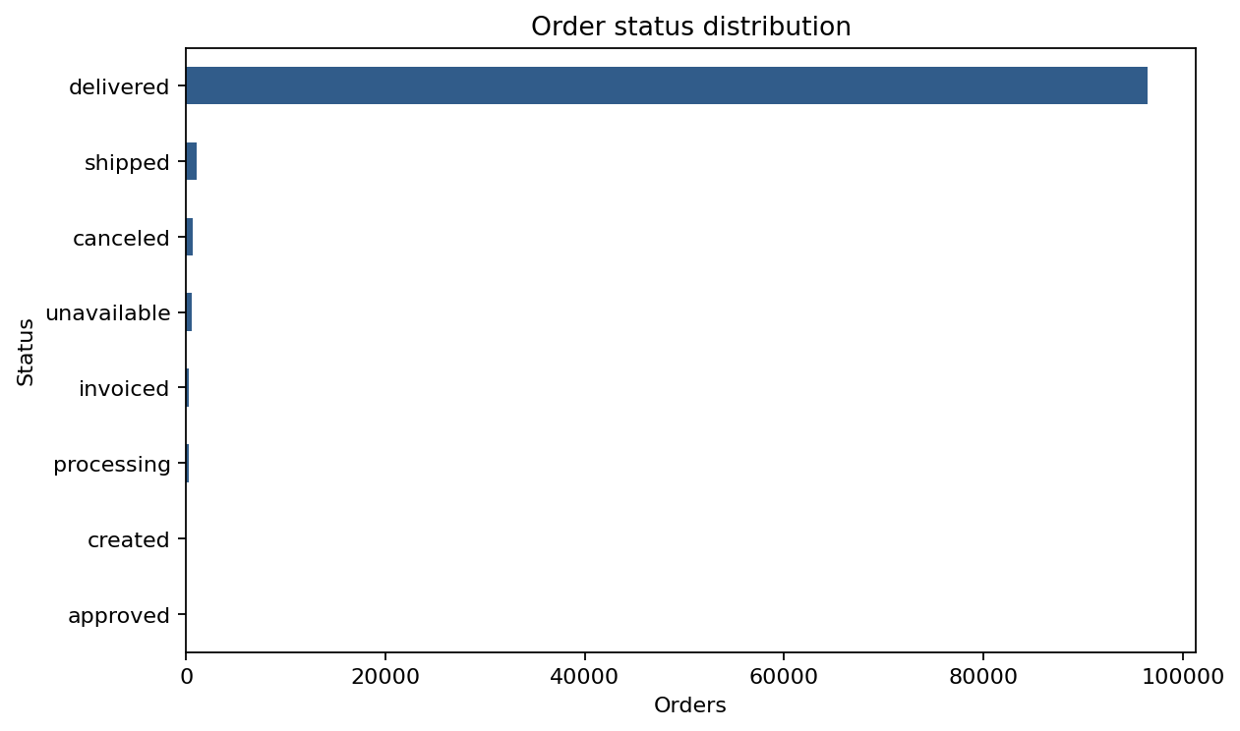
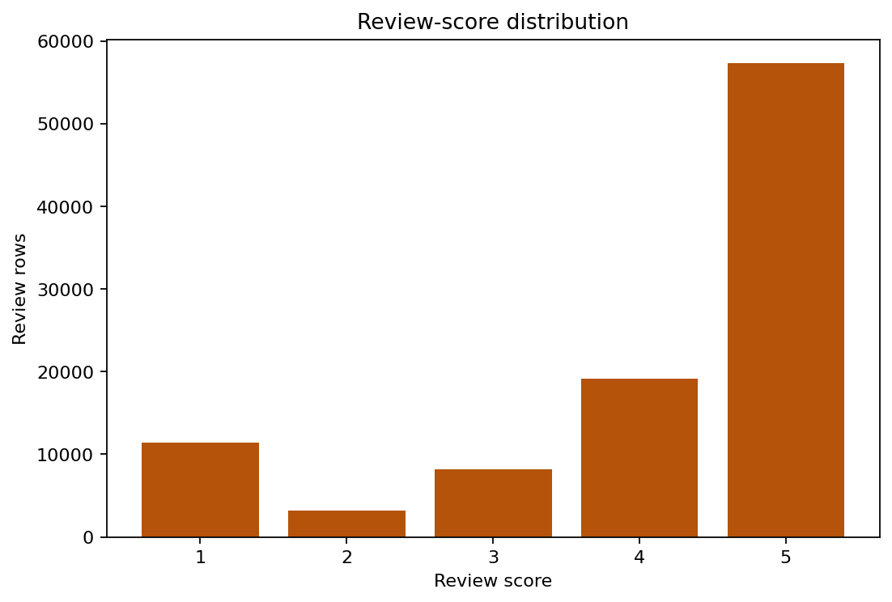
Order Outcomes and Customer Voice
05
Most orders are delivered and most reviews are positive, but aggregate success hides service failures.
Order status distribution
Review score distribution
4.09 average review | 77.1% of reviews are 4–5 stars
GROUP 3 | DATA VISUALIZATION DESIGN PROJECT

Slide 6
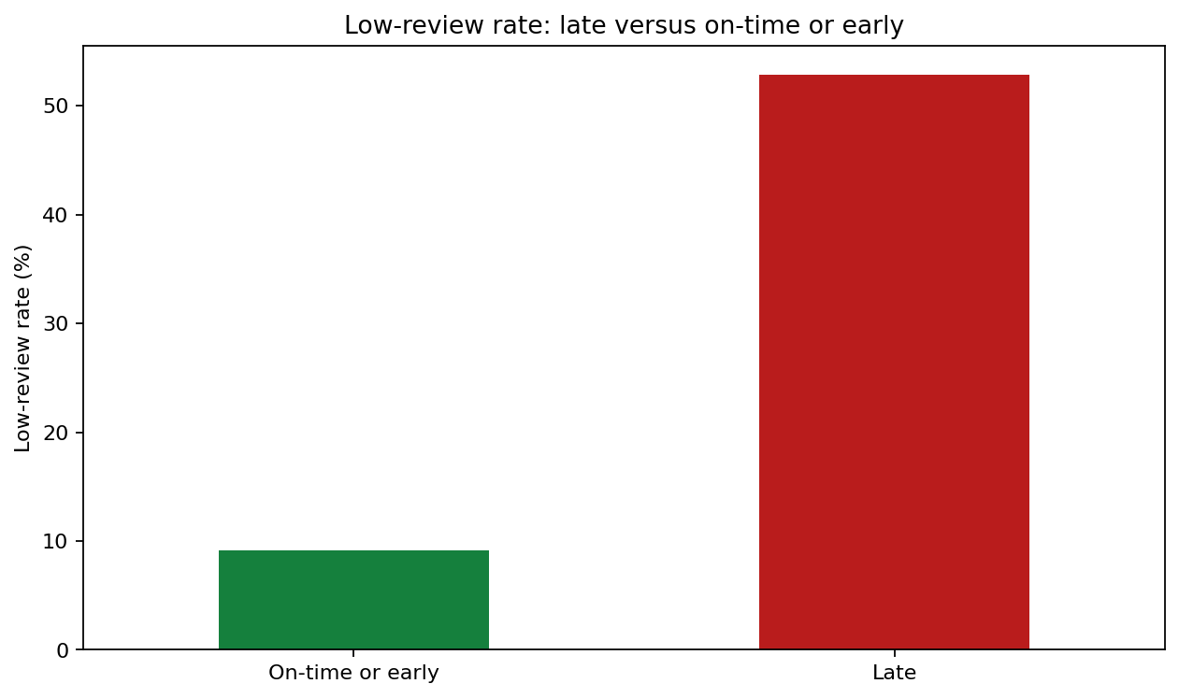
Delivery Reliability Drives Satisfaction
06
Late delivery is the strongest operational warning signal in the analysis.
Review outcome: on-time versus late delivery
12.6 days
average delivered time
8.1%
late-delivery rate
52.8%
low reviews when late
Only 9.1% of on-time delivered orders receive a low review.
GROUP 3 | DATA VISUALIZATION DESIGN PROJECT

Slide 7
Category and Seller Performance
07
Prioritize segments where commercial importance and service risk overlap.
SELLER SEGMENTATION
CATEGORY SCREEN
Use minimum-volume thresholds and compare delivery, lateness and review outcomes before promoting or intervening.
• Rank by demand and revenue
• Overlay review and late-delivery risk
• Separate scale from intervention
• Avoid decisions from small samples
DECISION RULE
Scale proven healthy sellers.
Intervene where volume magnifies service risk.
GROUP 3 | DATA VISUALIZATION DESIGN PROJECT

Slide 8
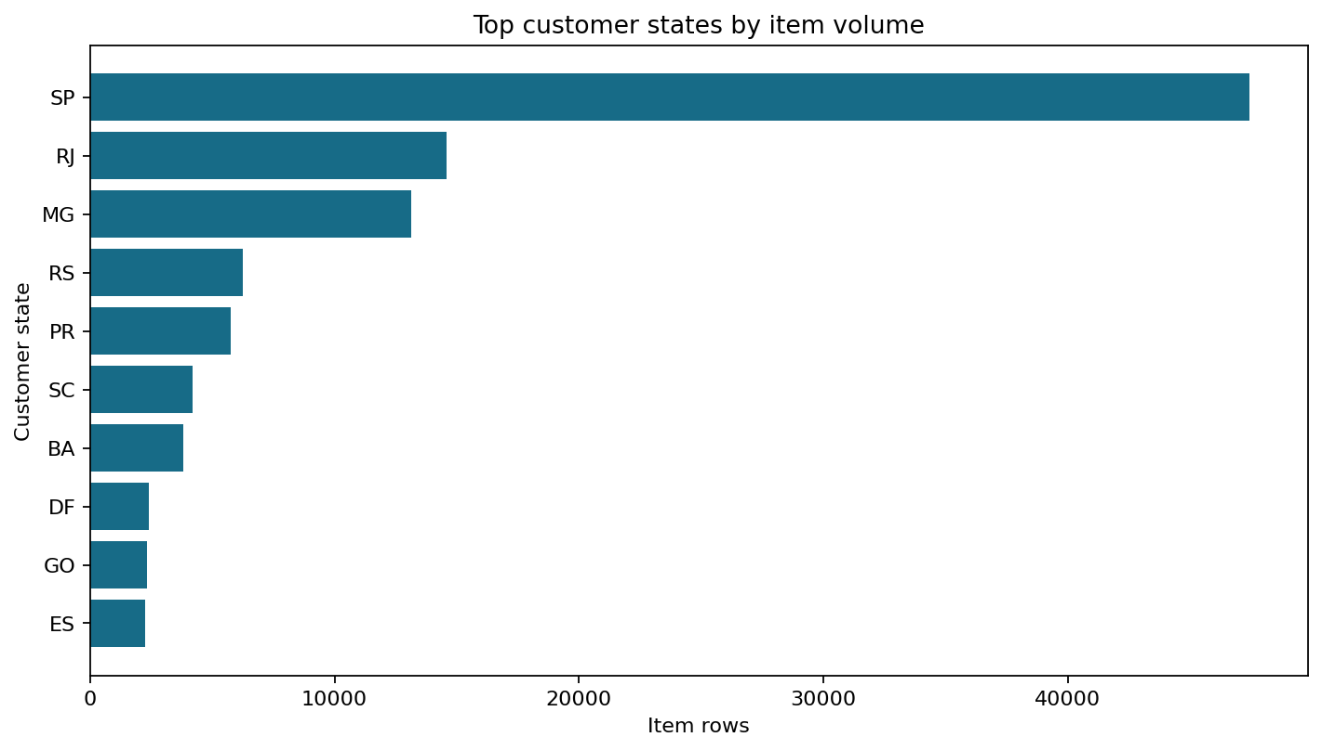
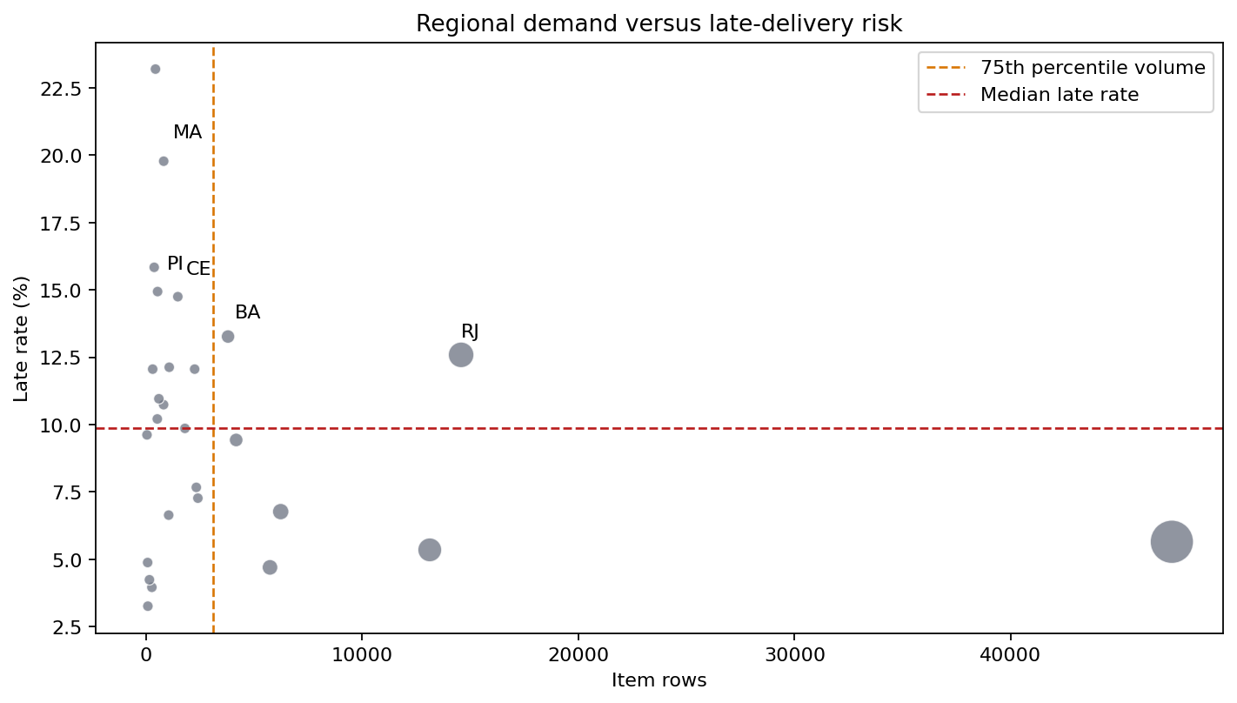
Regional Demand and Operational Risk
08
Demand is concentrated, so risk ranking must account for both volume and delivery performance.
Demand concentration by state
Demand versus service risk
Use a volume × risk screen to distinguish national priorities from noisy low-volume outliers.
GROUP 3 | DATA VISUALIZATION DESIGN PROJECT

Slide 9
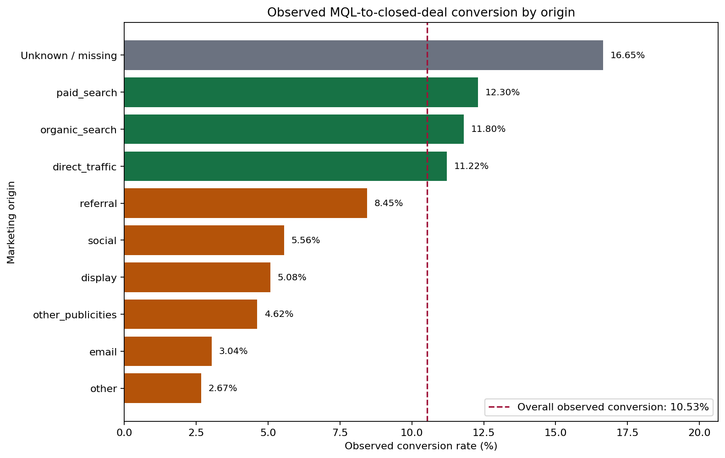
Growth and Marketing Funnel
09
Growth decisions need service guardrails and careful interpretation of acquisition data.
MQL-to-seller conversion by origin
INTERPRETATION
• Compare equal windows
• Separate lead and seller grain
• Flag missing attribution
• Do not infer causality
• Scale only healthy categories
Marketing linkage is directional context, not a complete attribution model.
GROUP 3 | DATA VISUALIZATION DESIGN PROJECT

Slide 10
Recommended Actions
10
1
Protect the promise
Monitor late delivery and review impact weekly
2
Target overlap
Intervene in high-volume, high-risk segments
3
Scale healthy segments
Grow where demand and service quality are proven
4
Improve matching
Shorten fulfilment distance where possible
5
Repair attribution
Strengthen MQL-to-seller linkage before budget shifts
GROUP 3 | DATA VISUALIZATION DESIGN PROJECT

Slide 11
Constraints and Next Improvements
11
WHAT THE DATA CANNOT PROVE
NEXT IMPROVEMENTS
• Relationships are not causal effects
• Reviews are incomplete for some orders
• Some delivery sequences are invalid
• Revenue is not profit
• Marketing linkage is incomplete
• Track complete-attribution cohorts
• Add confidence and sample-size flags
• Model delivery drivers
• Add repeat-customer and profit views
• Operationalize threshold alerts
Use the dashboard as a decision aid, not as proof of causality.
GROUP 3 | DATA VISUALIZATION DESIGN PROJECT

Slide 12
Close: Grow With Service Guardrails
12
Scale is sustainable only when delivery reliability and customer experience improve with it.
Measure the journey → prioritize volume × risk → act with guardrails
LIVE EVIDENCE
Interactive dashboard
Final technical report
[FULL NAME] · [FULL NAME] · [FULL NAME] · [FULL NAME] · [FULL NAME]
GROUP 3 | DATA VISUALIZATION DESIGN PROJECT

