Slide 1
Diabetes Prediction System [DPS]
An End-to-End Machine Learning Web Application for Diabetes Risk Assessment
Mini Project Presentation
Kathan • Aniket • Rudra

Slide 2
Introduction
• DPS is a lightweight, end-to-end Machine Learning project for predicting diabetes risk.
• Built using Python, Scikit-learn, and deployed as a static web application.
• Uses the Pima Indians Diabetes Dataset (768 records, 8 clinical features).
• Trains 4 traditional ML models and selects the best performer automatically.
• Features real-time browser-based inference — no server required after export.
• Includes explainable AI with feature contribution analysis for every prediction.
• Designed for educational and portfolio demonstration purposes.

Slide 3
Technology Stack
ML & Data Science
Python, Scikit-learn, Pandas, NumPy, Imbalanced-learn (SMOTE)
Model Export
m2cgen — converts trained models to pure JavaScript
Frontend
HTML5, CSS3, Vanilla JavaScript, Chart.js
Preprocessing
StandardScaler, Mutual Information, Median Imputation
Deployment
GitHub Pages (static site), no backend needed
Version Control
Git & GitHub

Slide 4
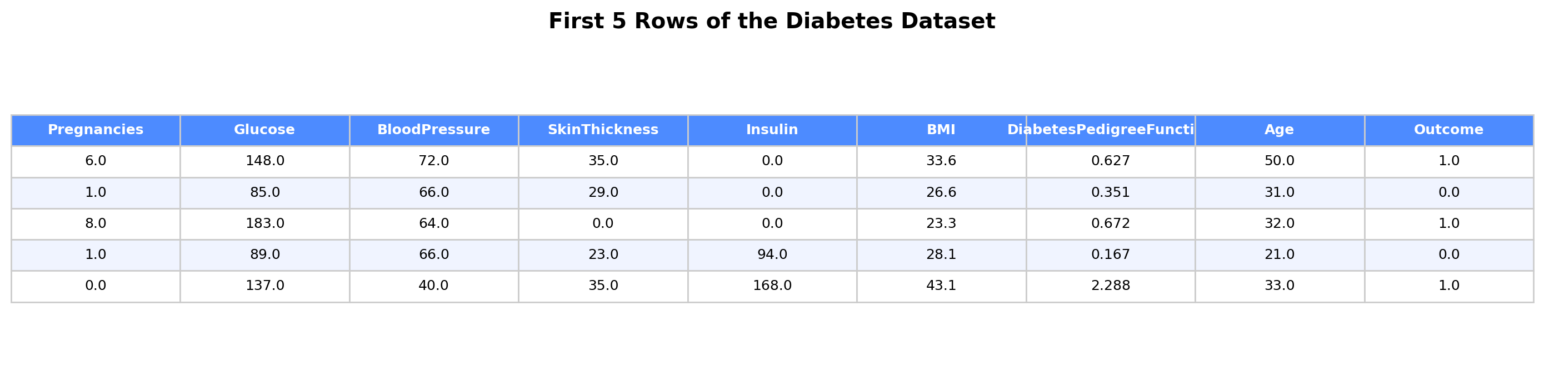
Dataset Preview
The Pima Indians Diabetes Dataset contains 768 samples with 8 clinical features and 1 binary target (Outcome).
Sample of Dataset

Slide 5
Data Preprocessing Pipeline
• Step 1: Data Loading — Read the CSV file with Pandas (768 rows × 9 columns).
• Step 2: Missing Value Imputation — Replace 0s in Glucose, BP, SkinThickness, Insulin, BMI with column medians.
• Step 3: Feature Importance Analysis — Rank features using Mutual Information scores.
• Step 4: Train-Test Split — 80:20 stratified split preserving class distribution.
• Step 5: Feature Scaling — StandardScaler normalizes all features to zero mean and unit variance.
• Step 6: Class Balancing — SMOTE generates synthetic minority samples to fix class imbalance.
• Step 7: Output — Returns balanced training data, scaled test data, scaler, and feature names.

Slide 6
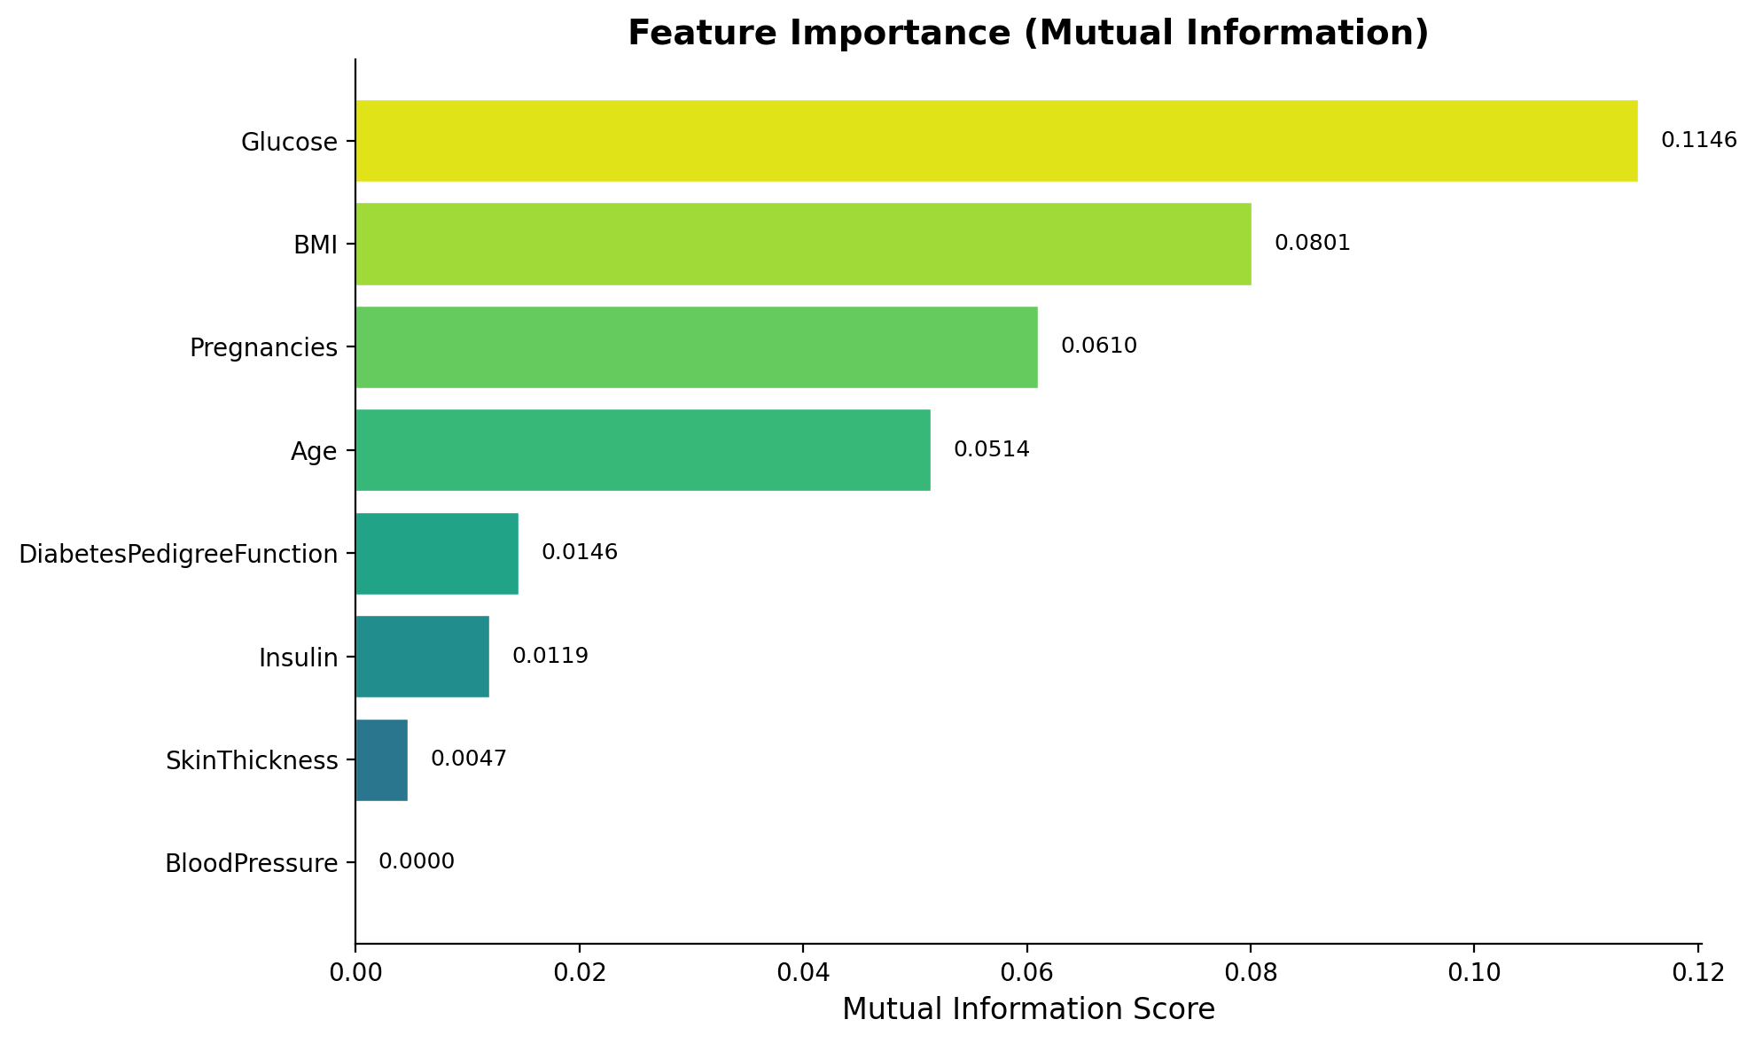
Feature Importance Analysis
Mutual Information scores reveal which clinical features have the strongest predictive power for diabetes.

Slide 7
How the Model Works
• 1. User enters 8 clinical values (Glucose, BMI, Age, etc.) into the web form.
• 2. The preproccesing applies StandardScaler, normalization using saved mean/scale values.
• 3. Scaled features are passed through the exported Random Forest decision tree logic.
• 4. The model outputs a probability score between 0% and 100% for diabetes risk.
• 5. Risk is categorized: Low (<30%), Moderate (30–60%), or High (>60%).
• 6. Feature contributions are computed using z-score deviation analysis.
• 7. Results are displayed with an animated gauge, verdict badge, and explanation bars.

Slide 8
ML Models & Accuracy Scores
Model | Train Acc | Test Acc | Precision | Recall | F1-Score | ROC-AUC
Random Forest | 95.62% | 74.03% | 60.61% | 74.07% | 66.67% | 81.67%
SVM | 90.25% | 70.78% | 57.38% | 64.81% | 60.87% | 79.93%
Naive Bayes | 73.12% | 69.48% | 55.38% | 66.67% | 60.5% | 77.41%
KNN | 100.0% | 68.18% | 53.42% | 72.22% | 61.42% | 77.44%
★ Best Model: Random Forest — 74.03% Test Accuracy

Slide 9
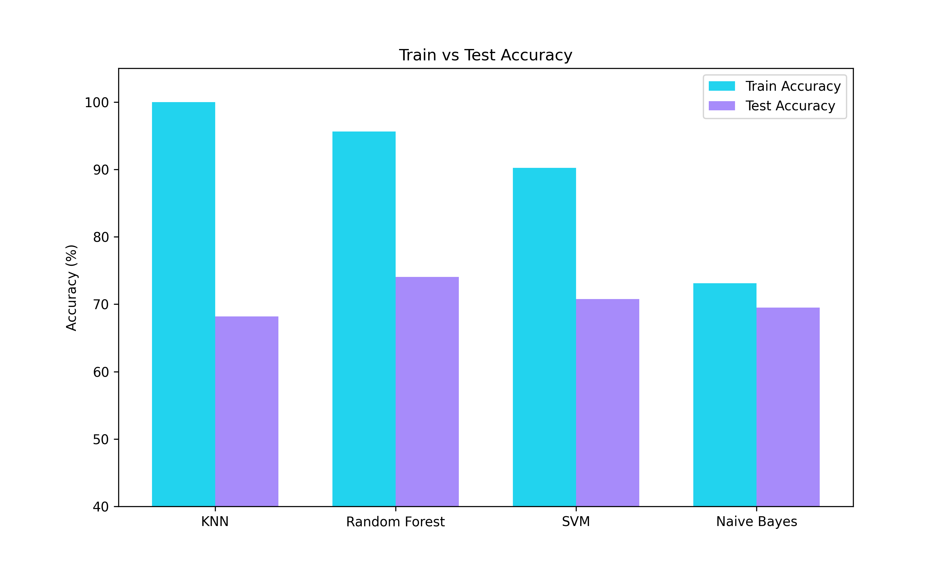
Train vs Test Accuracy

Slide 10
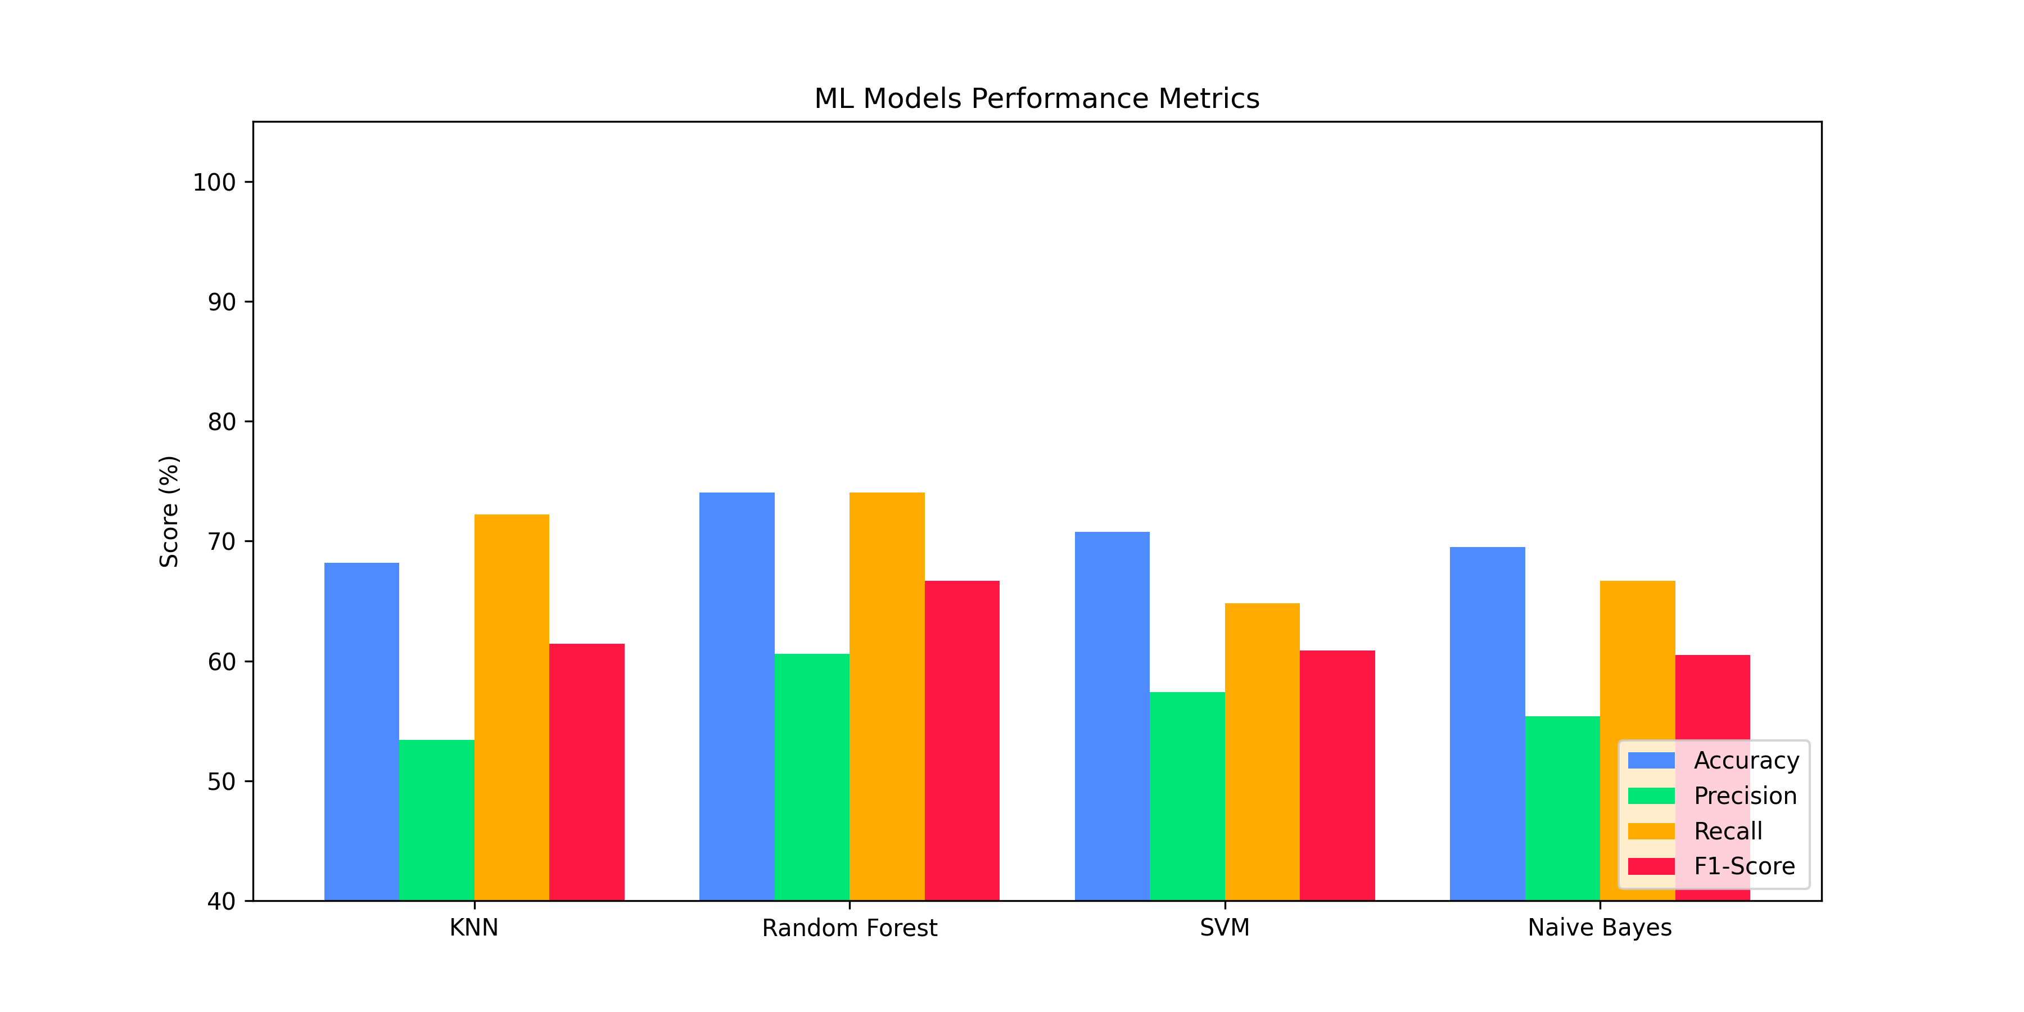
ML Models Performance Metrics

Slide 11
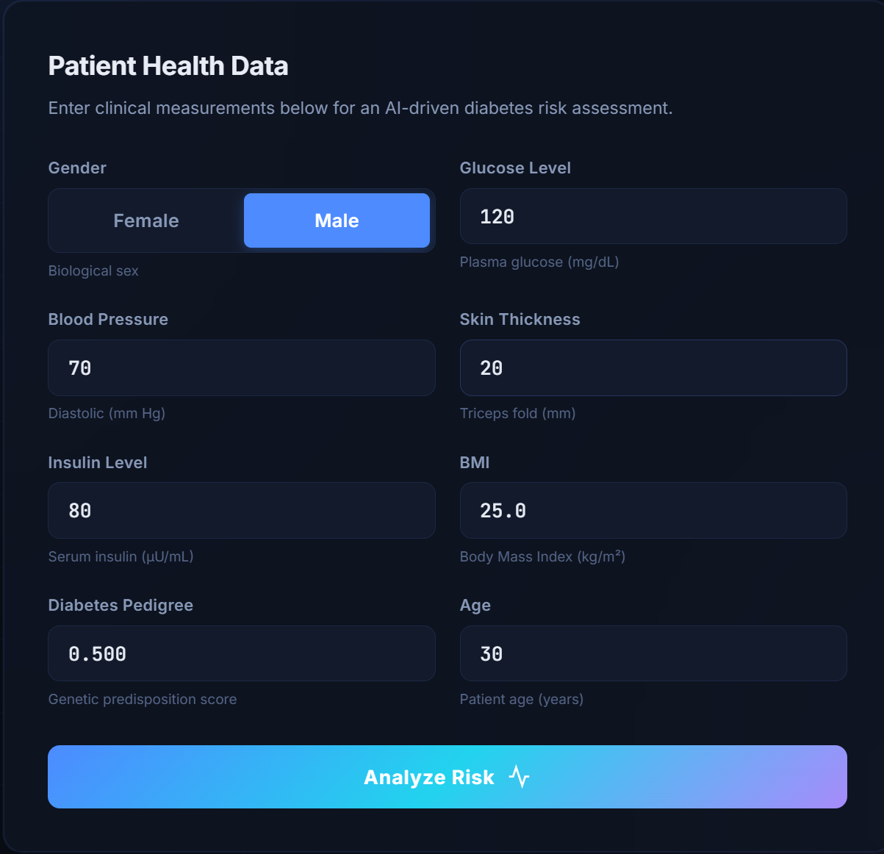
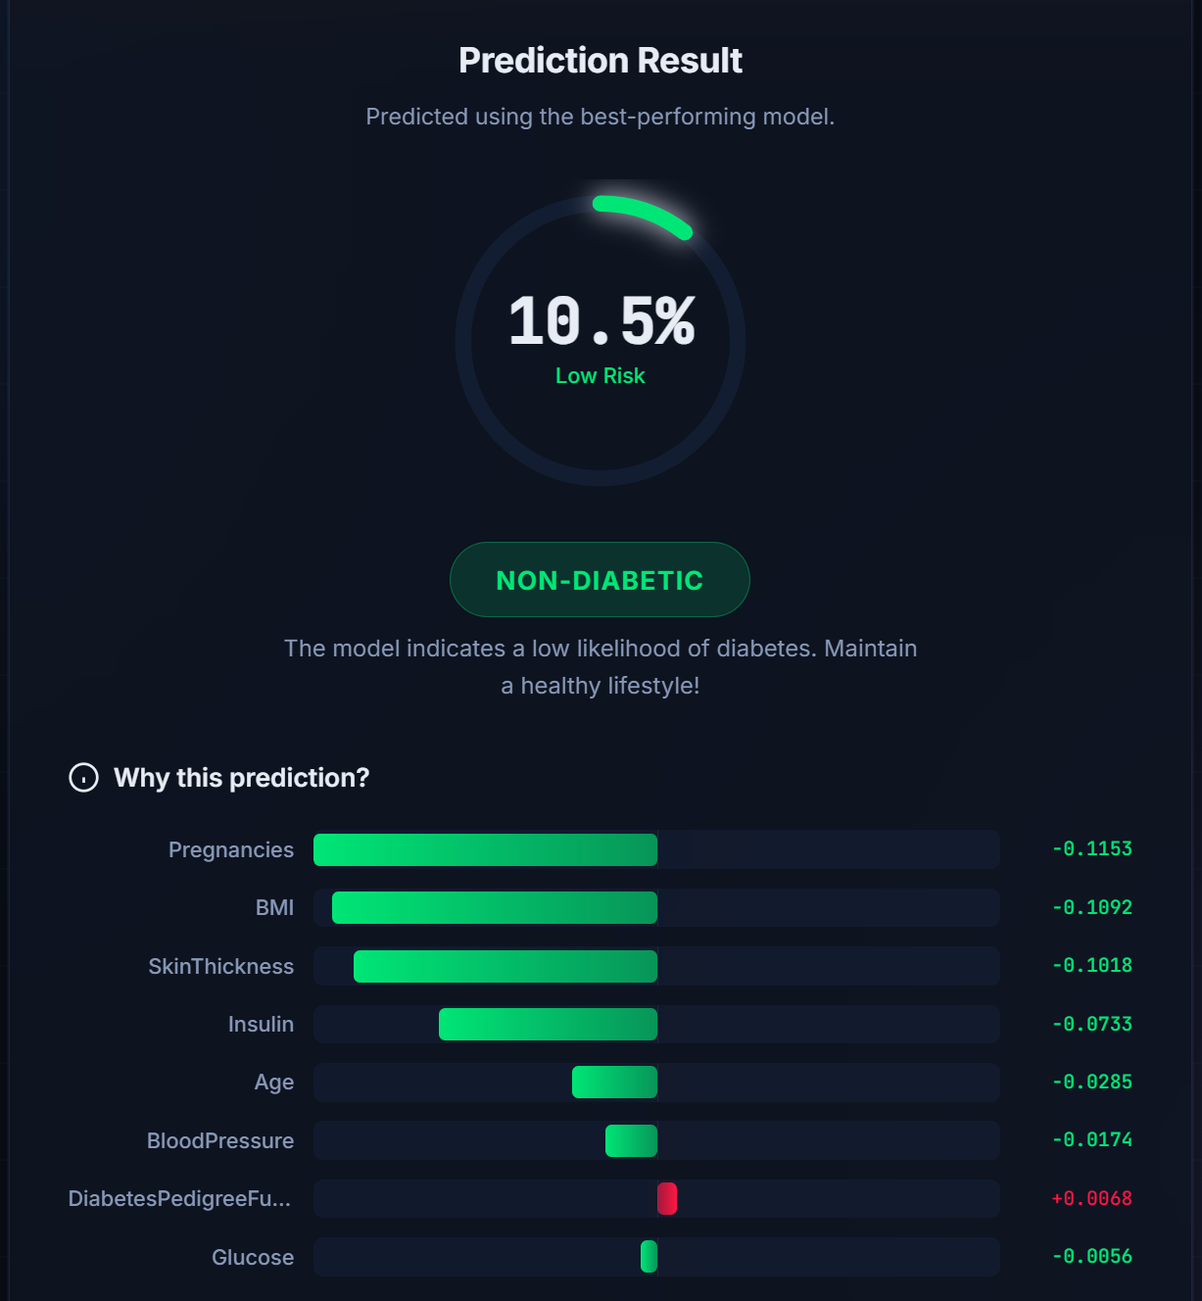
Web Application Interface
The live web app runs entirely in the browser using a JavaScript-exported ML model. No server required.

Slide 12
Thank You!
Diabetes Prediction System [DPS]

