Slide 1
DevOps in M&S
Automation and CICD details for SSI

Slide 2
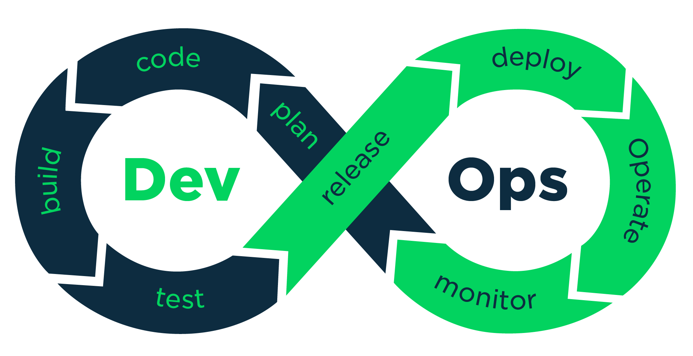
DevOps
DevOps is the practice of operations and development engineers participating together in the entire service lifecycle, from design through the development process to production support.
CI
CD

Slide 3
CI & CD
Continuous integration
Developers practicing continuous integration merge their changes back to the main branch as often as possible. The developer's changes are validated by creating a build and running automated tests against the build. By doing so, you avoid the integration hell that usually happens when people wait for release day to merge their changes into the release branch.
Continuous integration puts a great emphasis on testing automation to check that the application is not broken whenever new commits are integrated into the main branch.
Continued..

Slide 4
Continuous delivery
Continuous delivery is an extension of continuous integration to make sure that you can release new changes to your customers quickly in a sustainable way. This means that on top of having automated your testing, you also have automated your release process and you can deploy your application at any point of time by clicking on a button.
In theory, with continuous delivery, you can decide to release daily, weekly, fortnightly, or whatever suits your business requirements. However, if you truly want to get the benefits of continuous delivery, you should deploy to production as early as possible to make sure that you release small batches, that are easy to troubleshoot in case of a problem.
Continued..

Slide 5
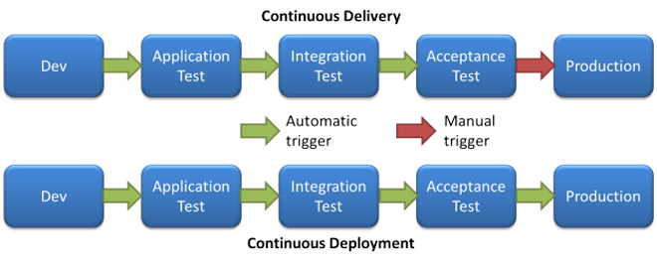
Continuous delivery
vs
Continuous deployment

Slide 6
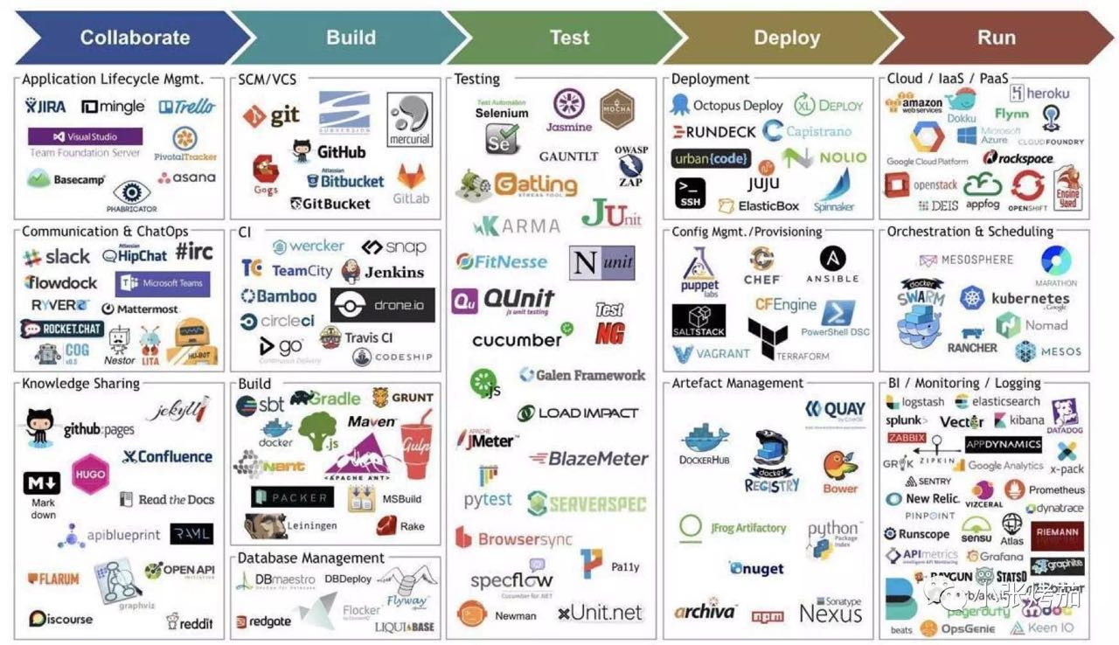
GENERALISED TOOLS

Slide 7
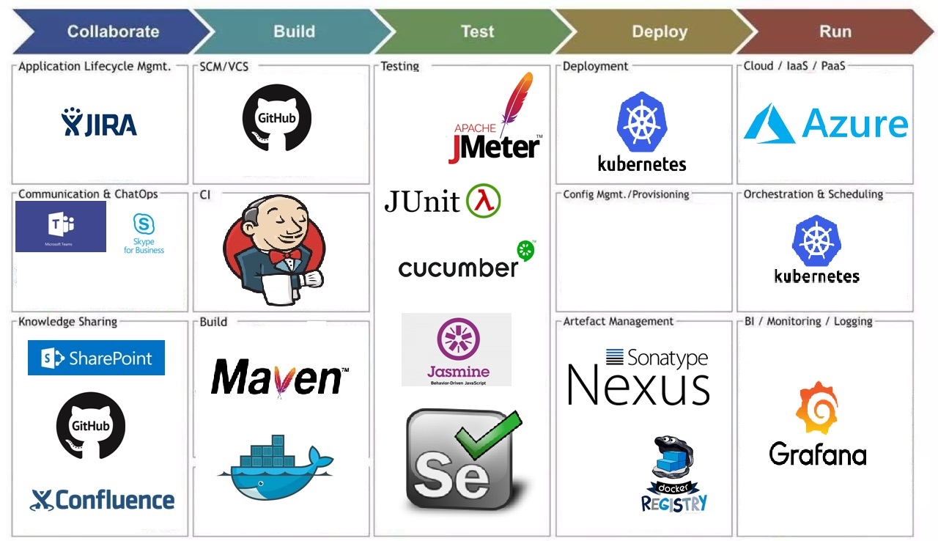
TOOLS USED BY M&S

Slide 8
