Slide 1
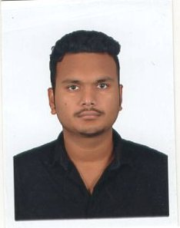
MANAS
+91-9437766389
PATEL
er.manaspatel@gmail.com
www.linkedin.com/in/mp2249
ASSISTANT SYSTEM ENGINEER
Versatile, Flexible, reliable and efficient with 8+ months experience as a developer. Diversified skills include .NET framework , SQl server, AngularJS etc. Open to Any kind of challenging opportunities which will result increase in personal and organizational growth.
Summary
B.Tech Orissa Engineering College
Biju Pattnaik University Of Technology
(2012-2016)
Branch-Electrical Engineering
C.G.P.A-8.2
INTERMIEDIATE Percentage: 72.33% Kalinga Bharati Residential College
(2010-2012)
Education
SSC Percentage: 82.66% Manikeswari High School
(2009-2010)
Tata Consultancy Services
August,2016 - To Present
Trained in DotNET and have a hands on experience in HTML5-CSS3 .Done a retail banking project in my training period.
Experience
Tata Consultancy Services
Tata Consultancy Services

Slide 2


ASP.NET
ADO.NET
MVC
HTML5
Skill
CSS3
ANGULAR JS
SQL Server
SSIS
D.O.B :
22nd of May , 1995
Hobbies :
Cricket, Basketball , Cooking
Personal
Languages :
English:-
Speaking:
Writing:
Details
Hindi:-
Speaking:
Writing:
Oriya:-
Speaking:
Writing:
I do hereby declare that the above given statements are true and correct to the best of my knowledge.
Declaration
Place : Chennai
Signaure
Date :

Slide 3
ASP.NET
ADO.NET
MVC
HTML5
Skill
CSS3
ANGULAR JS
SQL Server
SSIS
D.O.B :
22nd of May , 1995
Hobbies :
Cricket, Basketball , Cooking
Personal
Languages :
English:-
Speaking:
Writing:
Details
Hindi:-
Speaking:
Writing:
Oriya:-
Speaking:
Writing:
I do hereby declare that the above given statements are true and correct to the best of my knowledge.
Declaration
Place : Chennai
Signaure
Date :

