Slide 1
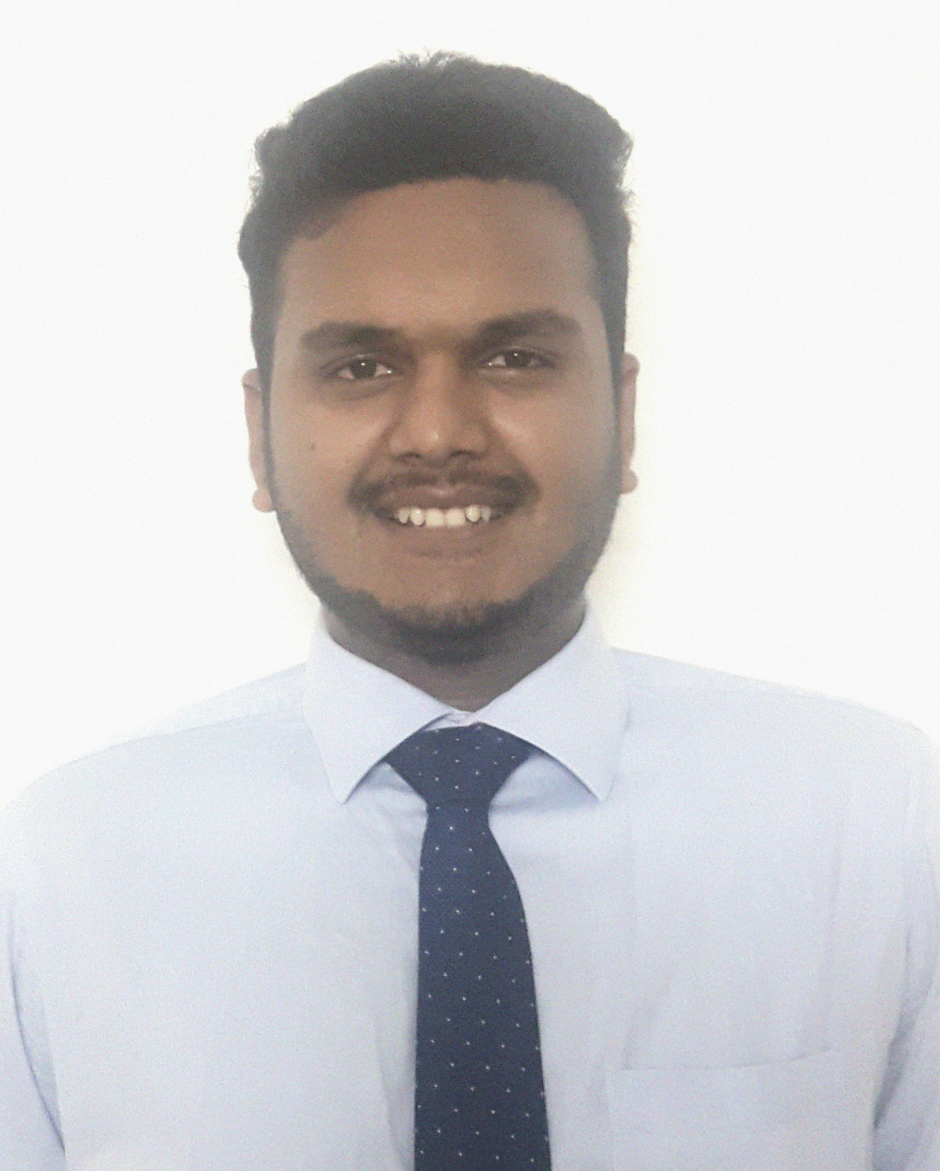
MANAS
+91-9437766389
PATEL
er.manaspatel@gmail.com
www.linkedin.com/in/mp2249
ASSISTANT SYSTEM ENGINEER
Versatile, Flexible, reliable and efficient with 8+ months experience as a developer. Diversified skills include , Angular2/4 ,.NET framework , JAVA Spring Boot, SQl server etc. Open to Any kind of challenging opportunities which will result increase in personal and organizational growth.
Summary
B.Tech Orissa Engineering College
Biju Pattnaik University Of Technology
(2012-2016)
Branch-Electrical Engineering
C.G.P.A-8.2
INTERMIEDIATE Percentage: 72.33% Kalinga Bharati Residential College
(2010-2012)
Education
SSC Percentage: 82.66% Manikeswari High School
(2009-2010)
Tata Consultancy Services
August,2016 - To Present
Working for a UK based giant corporation, basically now working in converting a windows based thick client to cloud based thin client web application using Angular 2 for front and Java SPRINGBOOT for web services.
Experience
I am working on ANGULAR 2 part mainly, mean while have a handful knowledge of JAVA spring framework and spring boot. I have also some hand on experience in DOCKER and KUBERNETES. I have worked with SQL server and handful knowledge on HTML-CSS 3, JAVASCRIPT.
I have some basic knowledge of automation testing(BDD), feature file creation, and capable of writing simple test cases using SELENIUM and CUCUMBER.

Slide 2


ANGULAR 2/4
ASP.NET
ADO.NET
MVC
Skill
HTML5
CSS
SPRINGBOOT
SQL Server
SSIS
D.O.B :
22nd of May , 1995
Hobbies :
Cricket, Basketball , Cooking
Personal
Languages :
English:-
Speaking:
Writing:
Details
Hindi:-
Speaking:
Writing:
Oriya:-
Speaking:
Writing:
I do hereby declare that the above given statements are true and correct to the best of my knowledge.
Declaration
Place : Chennai
Signature
Date :

