Slide 1
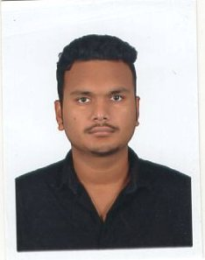
MANAS
+91-9437766389
PATEL
er.manaspatel@gmail.com
www.linkedin.com/in/mp2249
ASSISTANT SYSTEM ENGINEER
Current lly an Assistant System Engineer in TCS. Versatile, Flexible, reliable and efficient with 8+ months experience as a developer and contributing to project. Diversified skills include .NET framework, SQl server, AngularJS etc. Open to any kind of challenging opportunities which will result increase in personal and organizational growth.
Summary
B.Tech Orissa Engineering College
Biju Pattnaik University Of Technology
(2012-2016)
Branch-Electrical Engineering
C.G.P.A-8.2
Education
INTERMIEDIATE Pecentage: 72.33% Kalinga Bharati Residential College
(2010-2012)
SSC Pecentage: 82.66% Manikeswari High School
(2009-2010)
Tata Consultancy Services
August,2016 - To Present
Experience
snchsns

Slide 2


Skill
ASP.NET
ADO.NET
MVC
HTML5
CSS3
ANGULAR JS
SQL Server
SSIS
D.O.B :
22nd of May , 1995
Personal
Hobbies :
Cricket, Basketball , Cooking
Details
Languages :
English:-
Speaking:
Writing:
Hindi:-
Speaking:
Writing:
Oriya:-
Speaking:
Writing:
I do hereby declare that the above given statements are true and correct to the best of my knowledge.
Declaration
Place : Chennai
Signaure

