Slide 1
Realistic Composite Image Generation Using GANs Shivangi Aneja, Soham Mazumder
Team 18: Shivangi and Soham
1

Slide 2
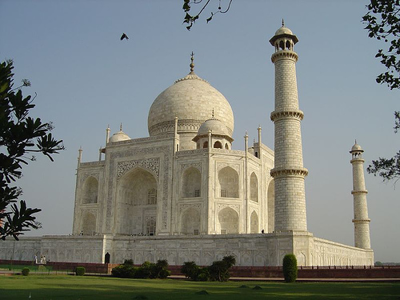

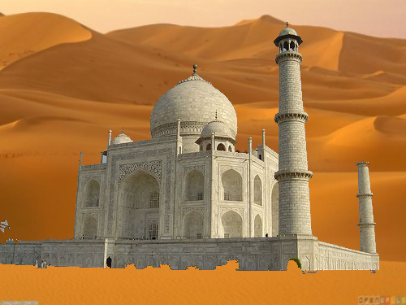
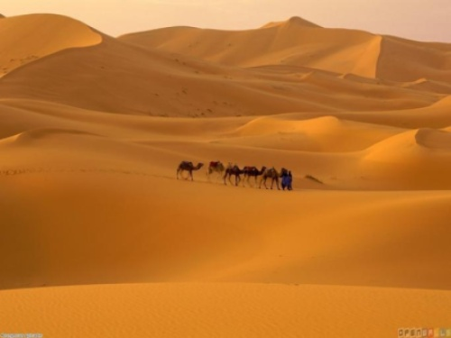
What are Composite Images ?
Input Image
$$I_{comp}={(I}_{fg}∗mask)+(I_{bg}∗(1−mask))$$
Composite Image
Background
Team 18: Shivangi and Soham
2

Slide 3

Introduction
Goal : Produce realistic composite images
Motivation : Need of photoshop experts for image composting
Input: Composite Image
Output: Harmonized Blended Image
Team 18: Shivangi and Soham
3

Slide 4
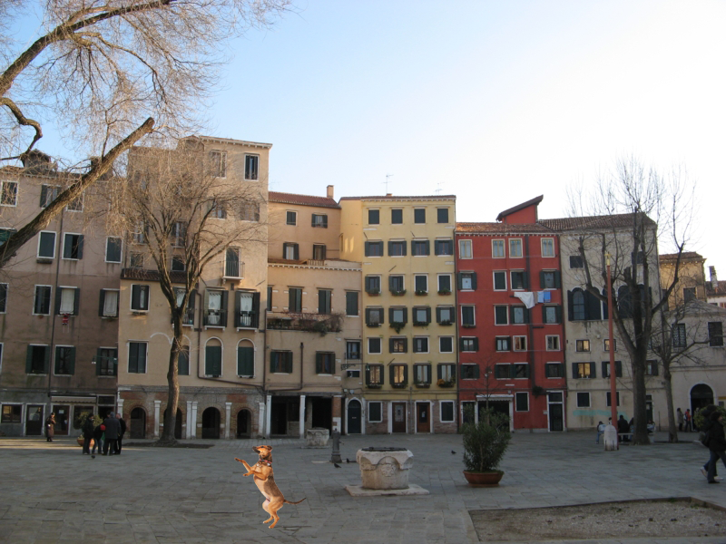
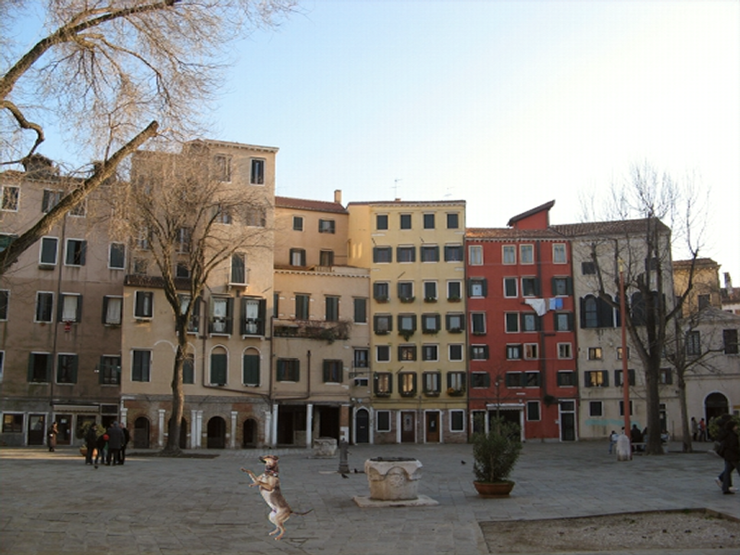
Related Work
J.-Y. Zhu, P. Krahenb ¨ uhl, E. Shechtman, and A. A. Efros. ¨ Learning a discriminative model for the perception of realism in composite images. In ICCV, 2015
Tsai, Y.H., Shen, X., Lin, Z., Sunkavalli, K., Lu, X., Yang, M.H.: Deep image harmonization. In: IEEE Conference on Computer Vision and Pattern Recognition (CVPR). (2017)
Composite Image
Harmonized Image
Team 18: Shivangi and Soham
4

Slide 5
Our Architecture
Conv64
Conv64
FC
Conv128
Conv128
Conv256
Conv256
Generator Architecture
Fake
Discriminator Architecture
Score [0,1]
Conv64
Real
Conv128
FC
Conv256
Team 18: Shivangi and Soham
5

Slide 6
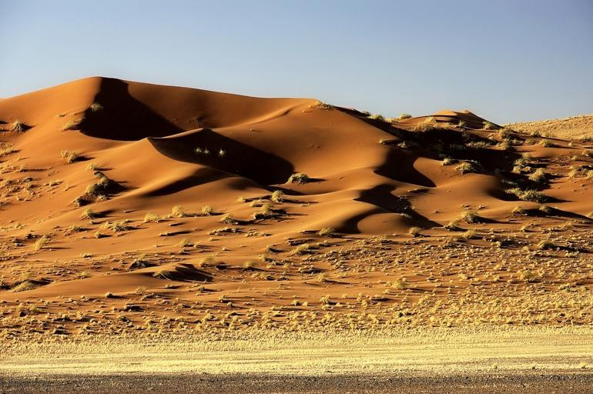
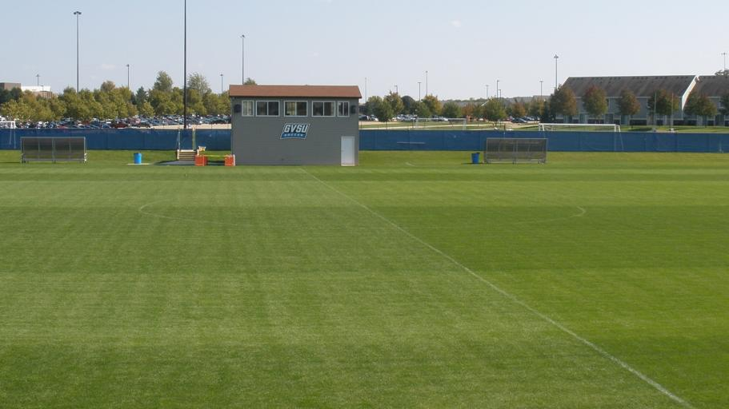

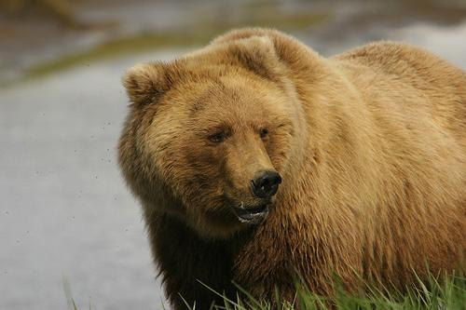

Dataset
Background: Places2 [1]
365 categories with 5000 image per category
Foreground: CMU-Cornell iCoseg dataset [2]
Co-segmentation of 38 groups (643 images)
Handpicked 200 images
Handpicked 250 images
and their corresponding
masks
Team 18: Shivangi and Soham
6

Slide 7
Dataset
Ground Truth Generation
Pre-trained Deep Image Harmonization Model (Caffe)
Composite Image
Laplacian Pyramid
Ground Truth
Team 18: Shivangi and Soham
7

Slide 8
Project plan
Presentation 2
Final
Presentation
Presentation 1
Google Cloud Setup
Dataloaders and Network Pipeline coded
Synthetic Ground Truth Image Generation using Pre-trained network
Overfit the network on single class (32*32 px images)
Train the network with 1000 images (32*32 px)
Overfit the network with bigger image (256*256 px)
Train on bigger images
Try out bigger architectures
For stability : WGAN
Results with skip links (Generator encoder)
Results with additional loss functions : Perceptual Loss
Fine-tune results on final architecture
Hyper-parameter search
Team 18: Shivangi and Soham
8

Slide 9
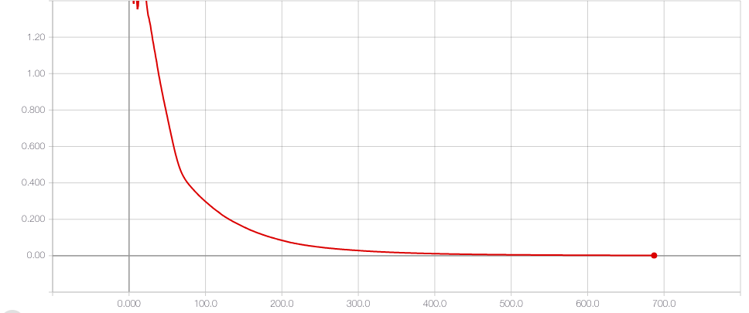
Preliminary Results
Step 1: Overfitting the discriminator network with single image pair
LR : 1e-5
Conv 32 – Conv 64 – Conv 128
Loss
Real : 0.9996
Fake : 0.0003
Less layers : Takes a lot of time (3000 epochs)
More layers: Gives similar result
Epochs
Team 18: Shivangi and Soham
9

Slide 10
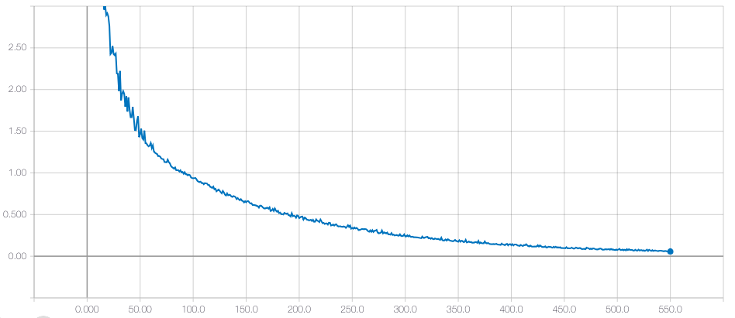
Preliminary Results
Step 2: Overfitting the discriminator with 20 images.
Same foreground and different backgrounds.
LR : 1e-6
Batch Size : 5
Trained on 20 images
Loss
Real: 0.9945
Fake: 0.4416
Epochs
Team 18: Shivangi and Soham
10

Slide 11
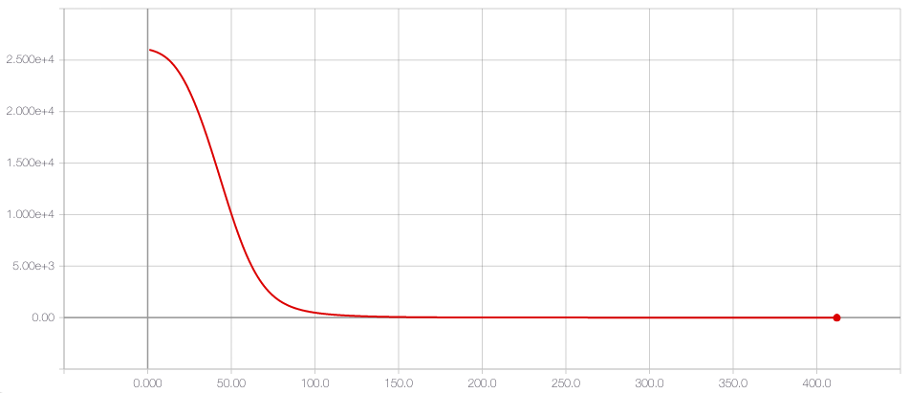
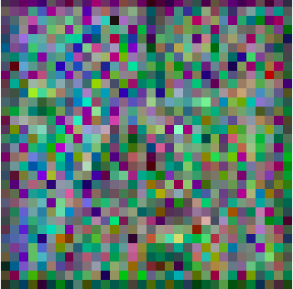
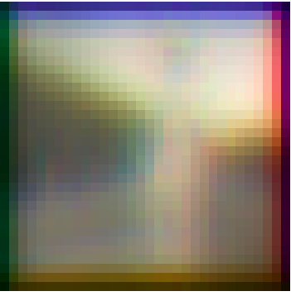

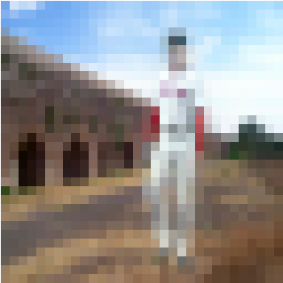
Preliminary Results
Step 3: Overfit the Generator Network with one single image.
LR : 1e-6
Epochs: 420
Loss
25
90
171
420
Epochs
Team 18: Shivangi and Soham
11

Slide 12
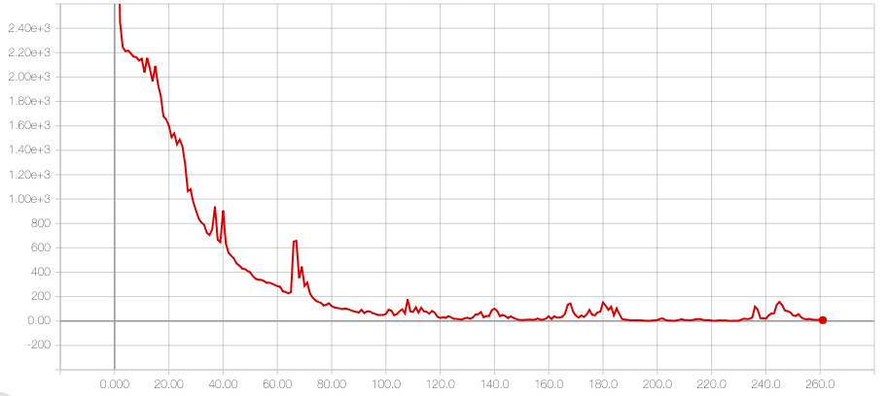
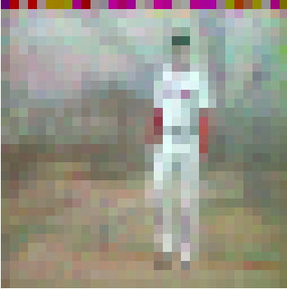
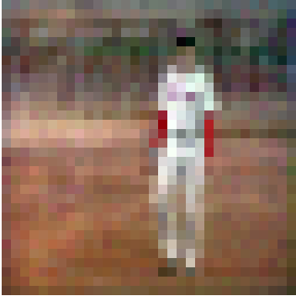
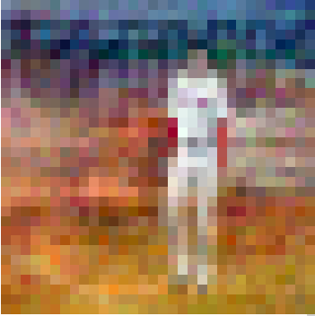

Preliminary Results
Step 4: Overfit the Generator Network with 20 images.
LR : 1e-5
Batch Size: 2
Epochs: 260
Loss
5
70
260
Epochs
Ground Truth
Team 18: Shivangi and Soham
112

Slide 13
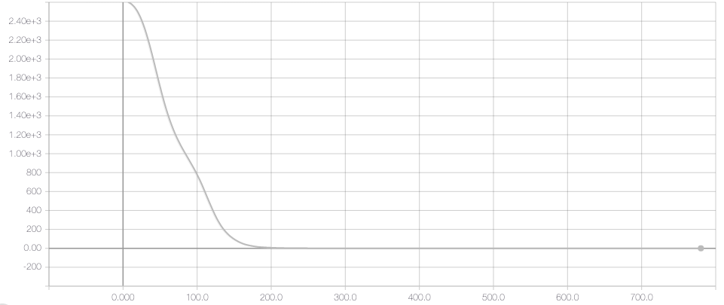
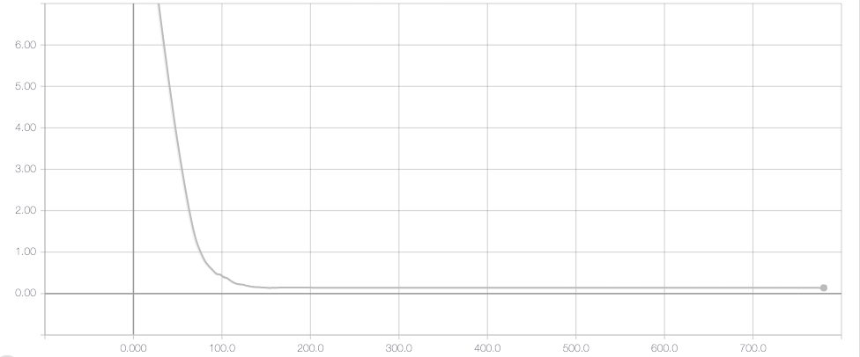
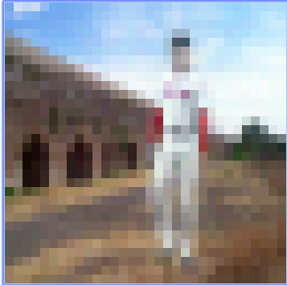

Preliminary Results
Step 5 : Overfit the adversarial network with one image (Composite Image as input).
Loss
Loss
Epochs
Epochs
Generator
Discriminator
Epochs: 780
Generator LR: 1e-6
Discriminator LR: 1e-7
$$L_{Gen}=L_{Adv}+0.1 L_{Reconstruction}$$
Generated Images
13
Team 18: Shivangi and Soham

Slide 14
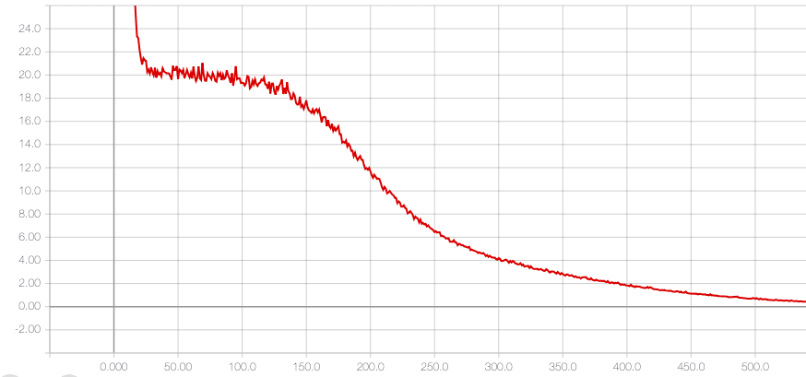
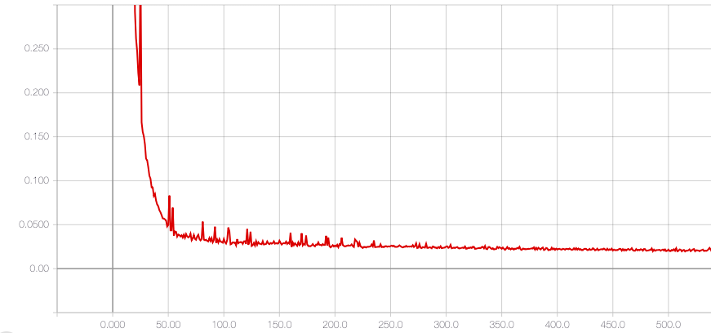
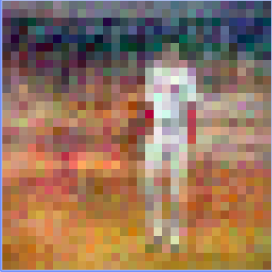
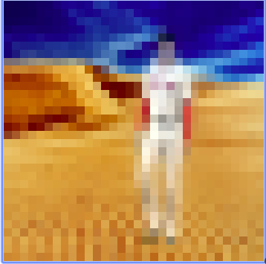
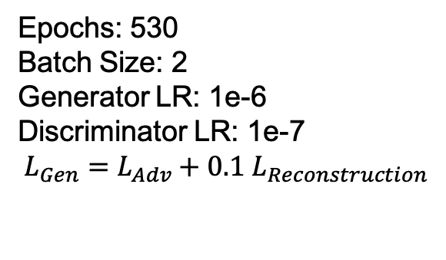
Preliminary Results
Overfit the adversarial network with 20 images.
Loss
Loss
Epochs
Epochs
Generator
Discriminator
Epochs: 530
Batch Size: 2
Generator LR: 1e-6
Discriminator LR: 1e-7
$$L_{Gen}=L_{Adv}+0.1 L_{Reconstruction}$$
Generated Image
Ground Truth
Team 18: Shivangi and Soham
14

Slide 15
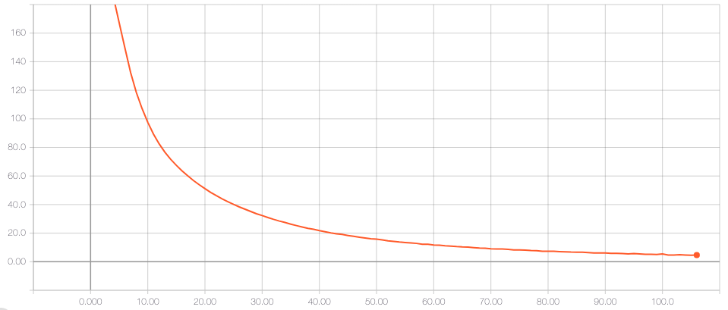
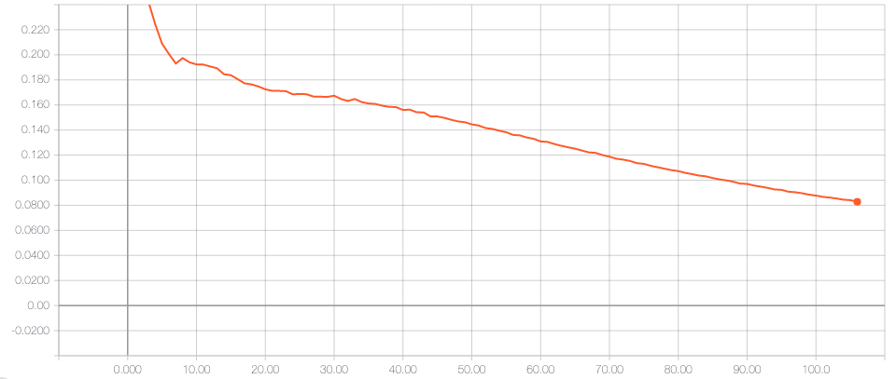
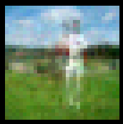
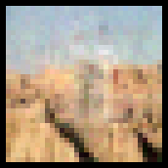
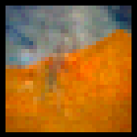
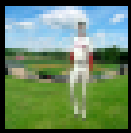
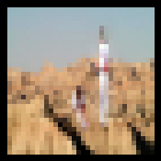
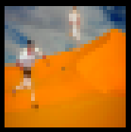
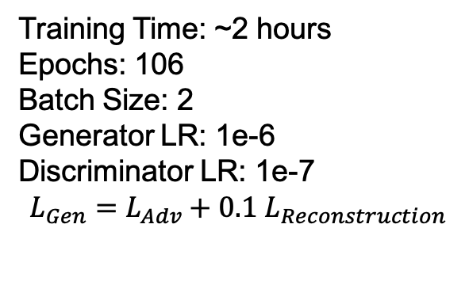
Preliminary Results
Train the network on 1000 images.
Loss
Loss
Epochs
Epochs
Generator
Discriminator
Training Time: ~2 hours
Epochs: 106
Batch Size: 2
Generator LR: 1e-6
Discriminator LR: 1e-7
$$L_{Gen}=L_{Adv}+0.1 L_{Reconstruction}$$
Generated Image
Ground Truth
15

Slide 16
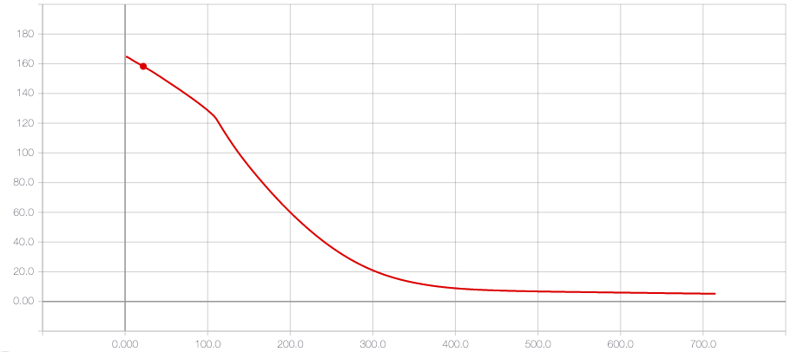
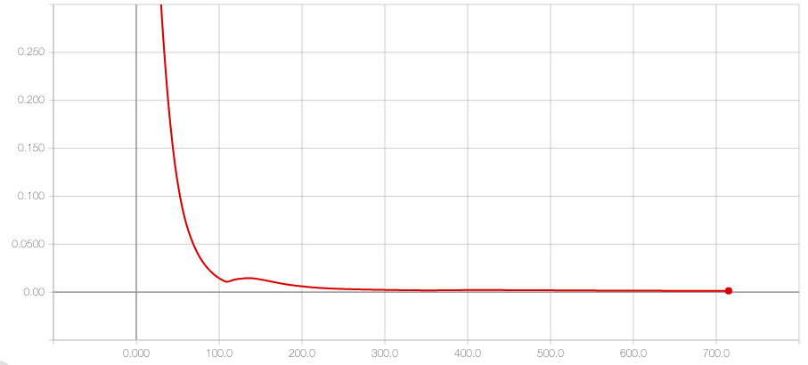
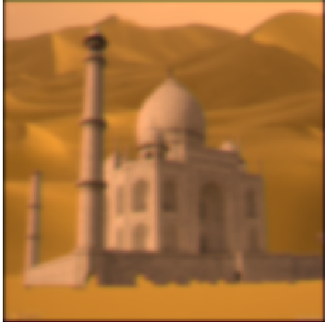
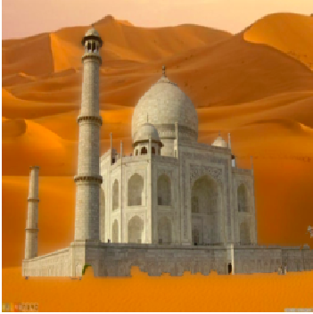
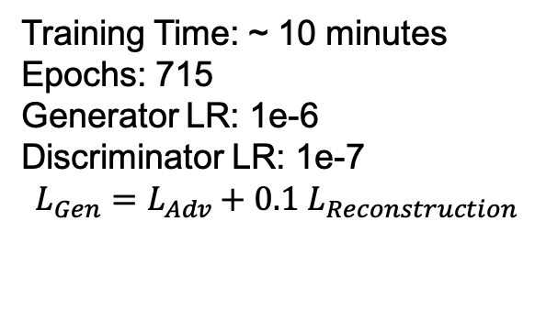
Preliminary Results
Overfit the netwok with big image (256*256 px).
Loss
Loss
Epochs
Epochs
Discriminator
Generator
Training Time: ~ 10 minutes
Epochs: 715
Generator LR: 1e-6
Discriminator LR: 1e-7
$$L_{Gen}=L_{Adv}+0.1 L_{Reconstruction}$$
16
Generated Image
Ground Truth

Slide 17
Challenges
Dataset not available : Constructed composite images and their ground truth.
With just adversarial learning, Generator loss goes to 0. Not learning. Network collapses.
Solution?
Only adversarial loss not enought to learn. Added Reconstruction loss.
Team 18: Shivangi and Soham
17

Slide 18
Next steps
Train on bigger images.
Use W-GAN objective function for stability.
Try out bigger architectures (e.g. VGG-16 for discriminator).
Team 18: Shivangi and Soham
18

Slide 19
Conclusions
Difficult to train Generator Network
Requires a lot of hyper-parameter tuning.
Only adversarial loss is not enough
Adding Reconstruction loss helps the network converge
Team 18: Shivangi and Soham
19

Slide 20
Thank You
Team 18: Shivangi and Soham
20

Slide 21
References
[1] http://places2.csail.mit.edu/
[2] Dhruv Batra, Adarsh Kowdle, Devi Parikh, Jeibo Luo and Tsuhan Chen. "iCoseg: Interactive Co-segmentation with Intelligent Scribble Guidance", Computer Vision and Pattern Recognition, 2010
Team 18: Shivangi and Soham
21

Slide 22
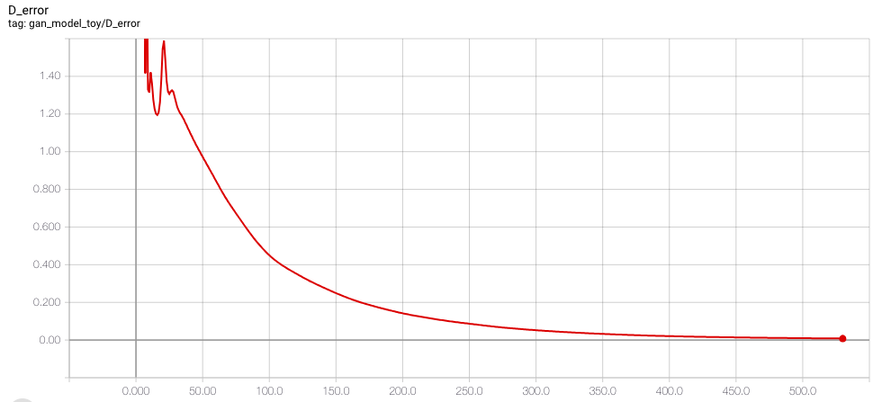
Preliminary Results
Overfitting the discriminator with 5 images pairs.
Same foreground and different background
LR : 1e-5
Batch Size : 5
Trained on 5 images
Loss
Real: 0.635
Fake: 2e-5
Epochs
Team 18: Shivangi and Soham
19

Slide 23
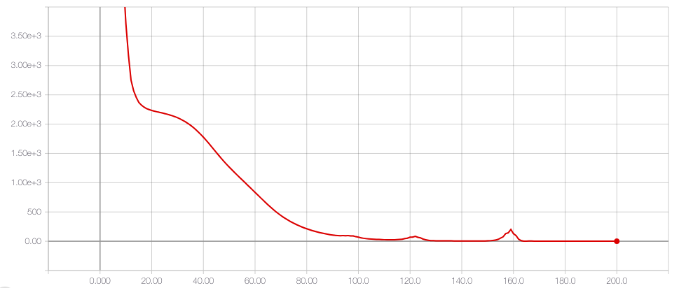
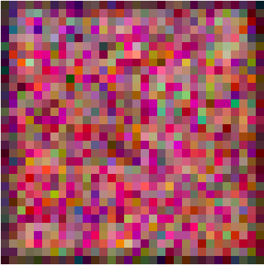
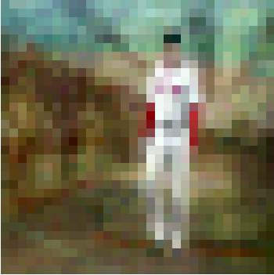
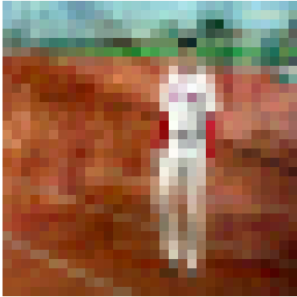
Preliminary Results
Overfit the Generator Network with 5 images.
LR : 1e-5
Batch Size: 5
Epochs: 200
Loss
4
70
200
Epochs
Ground Truth
Team 18: Shivangi and Soham
230

Slide 24
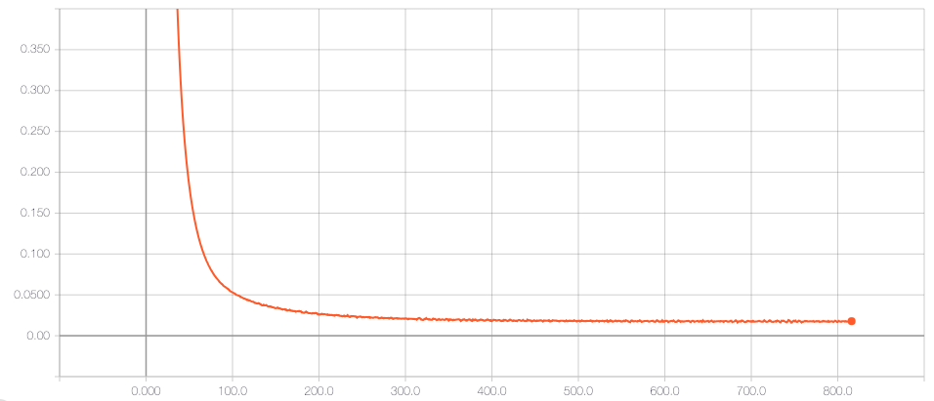
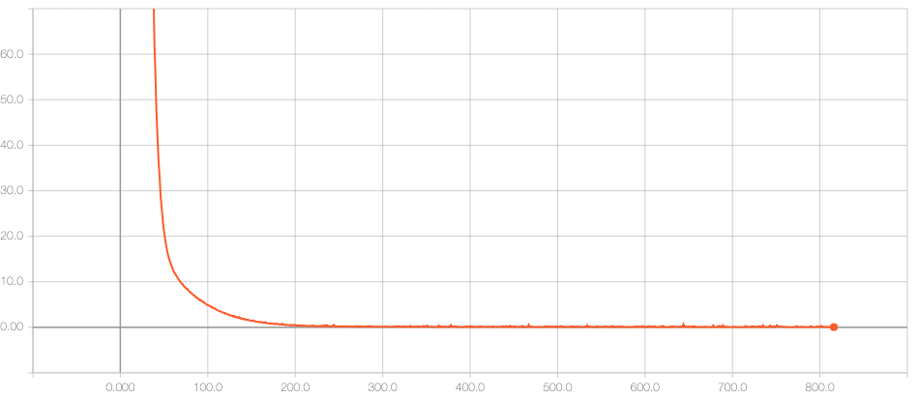

Preliminary Results
Overfit the adversarial network with one image (noise as input).
Loss
Loss
Epochs
Epochs
Discriminator
Generator
Generated Image
Team 18: Shivangi and Soham
241

