Slide 1
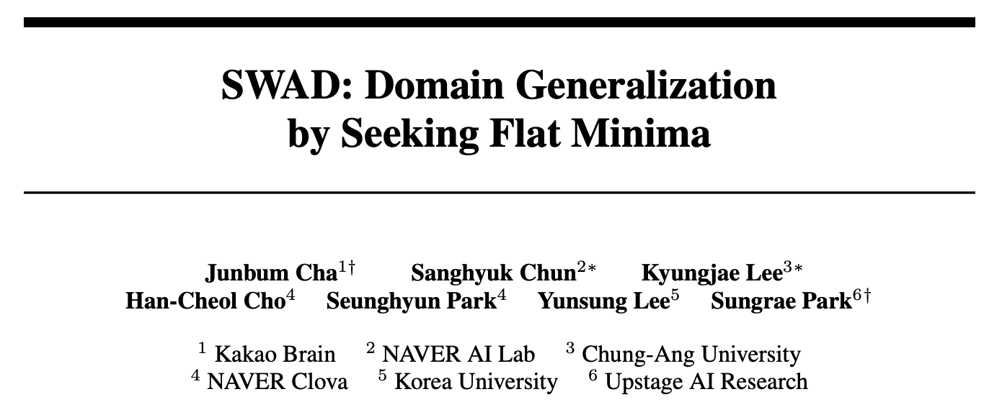
(175 cited. NeurIPS 2021)

Slide 2
주간 보고
Juntang Zhuang et al. (2021). “AdaBelief Optimizer: Adapting Stepsizes by the Belief in Observed Gradients.” NeurIPS.
Peng Mi et al. (2022). “Make Sharpness-Aware Minimization Stronger: A Sparsified Perturbation Approach.” NeurIPS.
Junbum Cha et al. (2021). “SWAD: Domain Generalization by Seeking Flat Minima.” NeurIPS

Slide 3
목차
Abstract
1 Introduction
2 A Theoretical Relationship between Flatness and Domain Generalization
3 SWAD: Domain Generalization by Seeking Minima
4 Experiments
5 Discussion and Limitations
6 Concluding Remarks

Slide 4
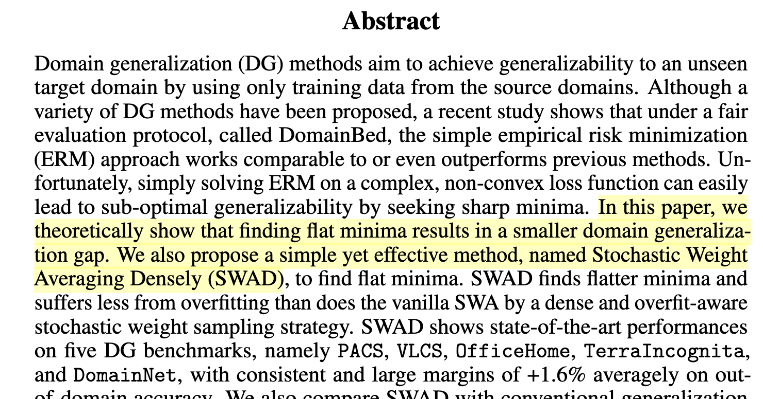
Abstract

Slide 5
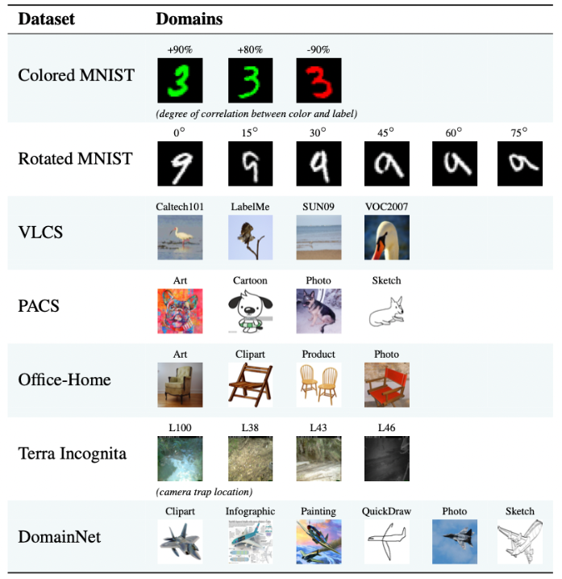

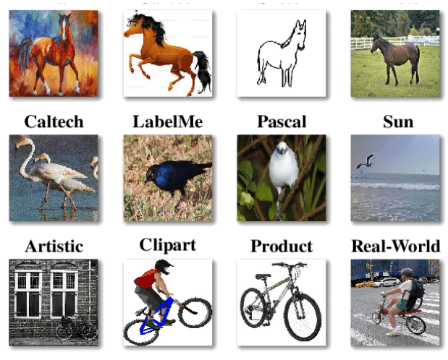
1 Introduction
Domain generalization(DG): aims to address domain shift simulated by training and evaluating on different domains
DomainBed: diverse DG benchmarks under a fair evaluation protocol by Facebook
PACS
VLCS
OfficeHome
PACS
DomainBed

Slide 6
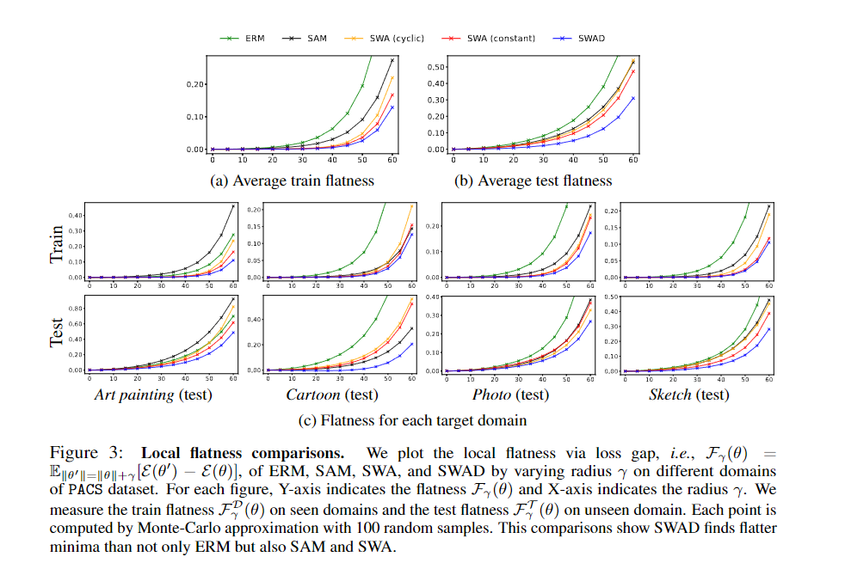
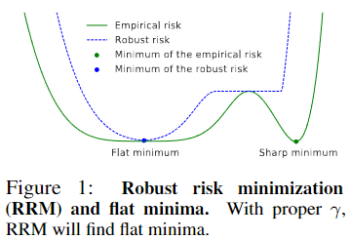
2 A Theoretical Relationship between Flatness and Domain Generalization
Optimizing algorithm with seeking flat minima
RRM, ERM, SWA, SAM, SWAD (proposed)
SWA Finds flat minima by a weight ensemble approach. (finds flatter minima than ERM, SAM)

Slide 7
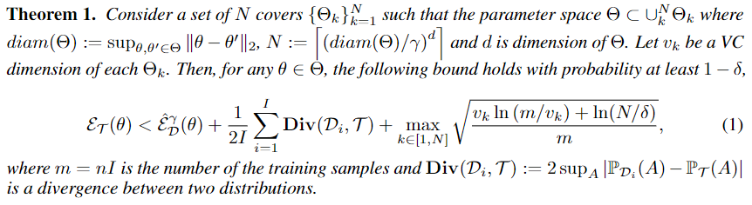
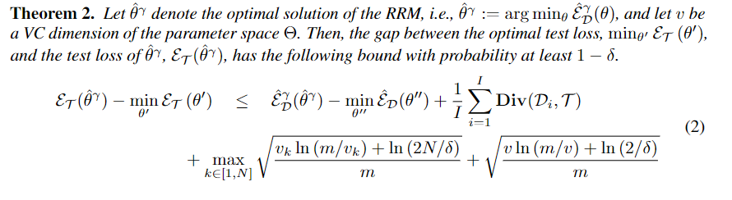
2 A Theoretical Relationship between Flatness and Domain Generalization

Slide 8
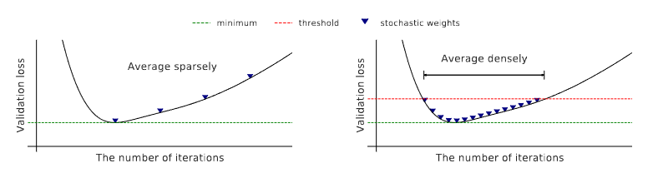
2 A Theoretical Relationship between Flatness and Domain Generalization

Slide 9
3 SWAD: Domain Generalization by Seeking Flat Minima
A baseline method: Stochastic weight averaging
We propose SWAD method with SWA baseline
Dense and overfit-aware stochastic weight sampling strategy
We propose some solutions for the difficulties of SWA toward domain generalization in several ways.
Empirical analysis of SWAD and flatness
(contd)

Slide 10
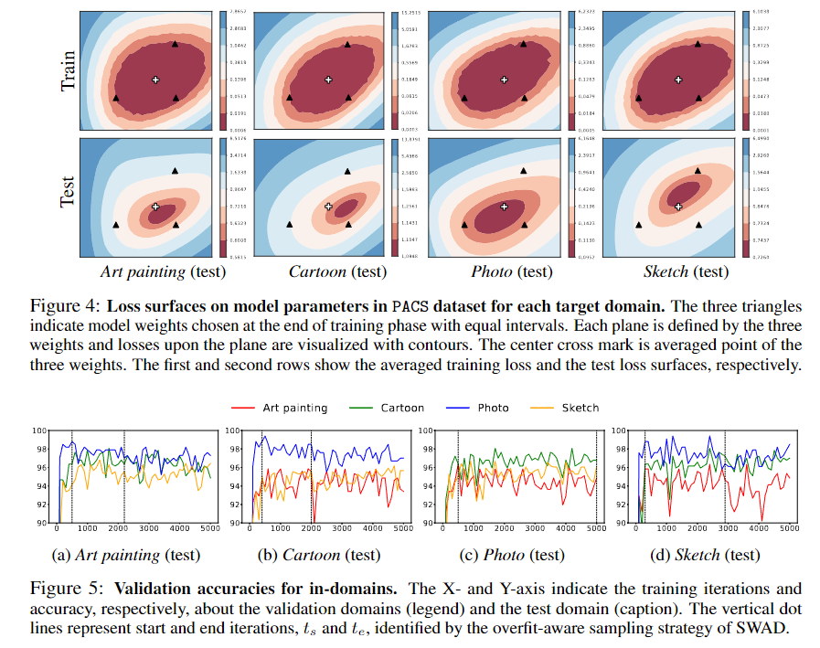
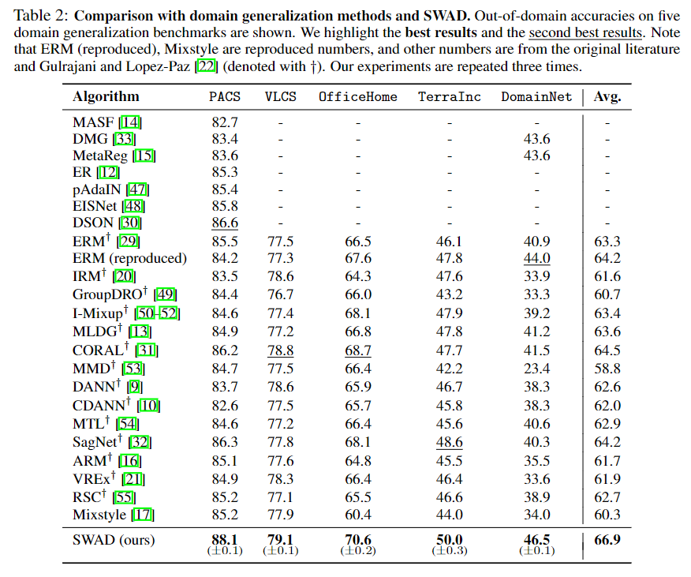
3 SWAD: Domain Generalization by Seeking Flat Minima
Empirical analysis of SWAD and flatness (contd)

Slide 11
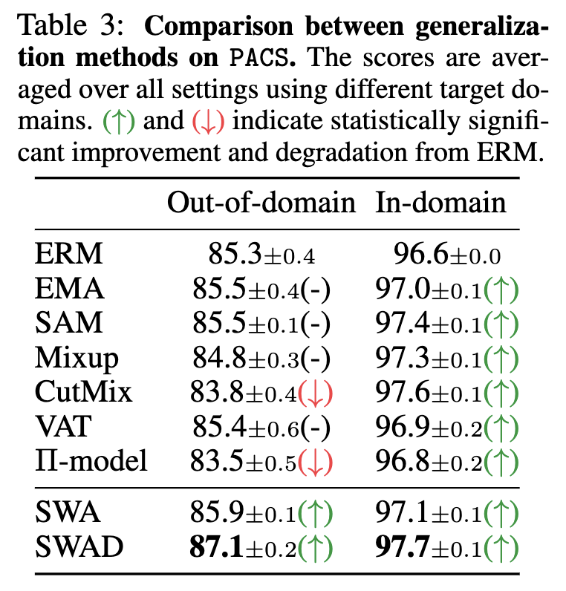
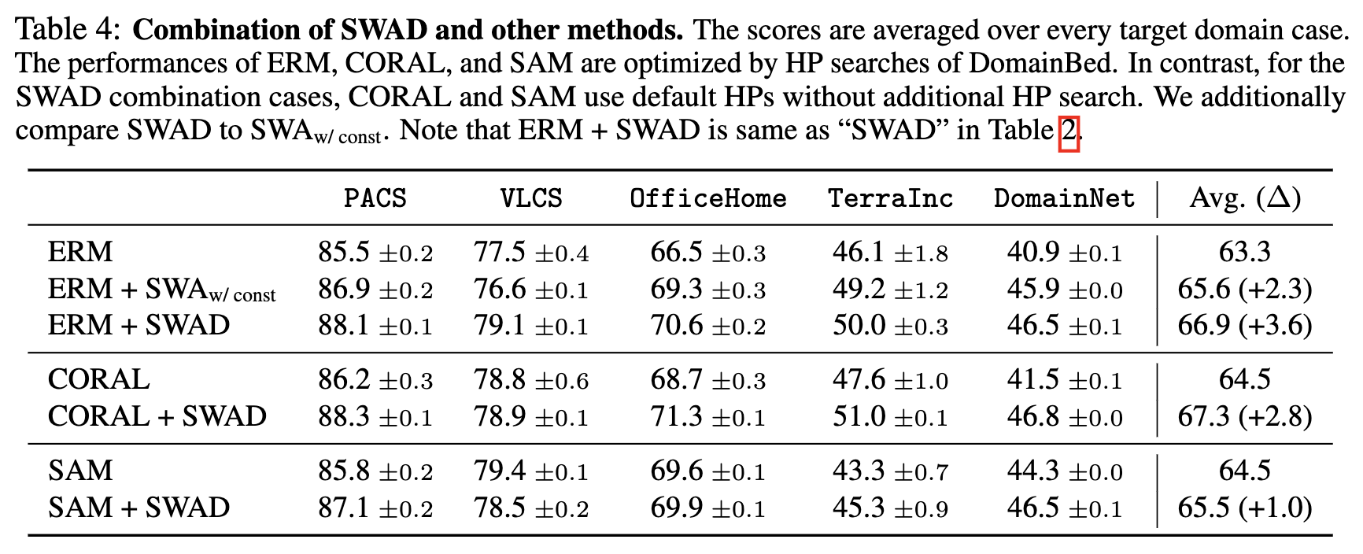
4 Experiments
Main results

Slide 12
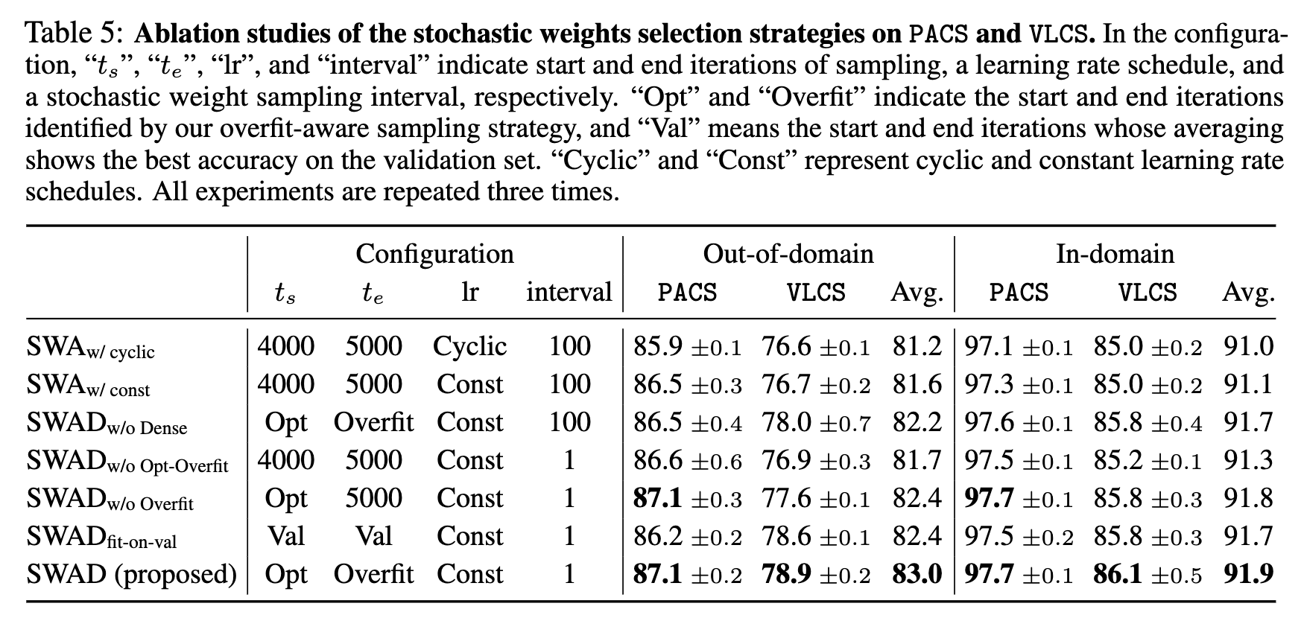
4 Experiments
Ablation study

Slide 13
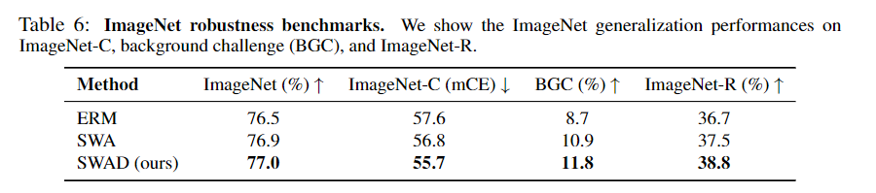
4 Experiments
Exploring the other applications: ImageNet robustness

Slide 14
5 Discussion and Limitations
Algorithm has confidence error bound
Although the idea of SWAD shows the relationship between flat minima and DG, it is not a perfect and theoretically guaranteed solver for flat minima but a heuristic approximation.
SWAD focuses only on the flat minima, not strongly utilize domain=specific information
Personal idea
Domain generalization?

