Slide 1
Bayesian Neural Networks : An Introduction and Survey
Coopt, 이관희

Slide 2
Contents
Introduction
Literature Survey’
Neural Networks
Bayesian Neural Networks
Origin of Bayesian Neural Networks
Early Variational Inference

Slide 3
1. Introduction - Concept of Neural Nets / Frequentist NN
- Neural Nets -> Concept of Biomimicry
- hard to train : computational burden, algorithmic issue, insufficient number of data
=> became feasible with development of technology
- Frequentist Neural networks?
-> hard to interpret the decision of frequentist model
-> failure on industrial applications
-> prone to overfitting (deterministic)
-> decisions are made based on seen data, and NN is blackbox
=> how can we Explain the decision of Neural Nets?
=> how can we handle uncertainty with Neural Nets?

Slide 4
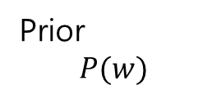
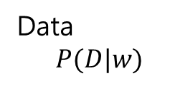
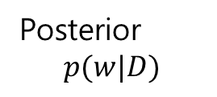
1. Introduction - Bayesian Theory
Bayesian Theory
Data
$$P(D|w)$$
Bayes’ theorem
Posterior
$$p(w|D)$$
Prior
$$P(w)$$

Slide 5
1. Introduction - Bayesian Theory
Bayes’ Theory in context of NN
Given model parameter W,
Data P(D|w),
and probability distribution of W => P(w)
Make prediction(inference) of model parameter W given D => P(w|d)
=>model’s parameter is non-deterministic, thus, it can handle uncertainty

Slide 6
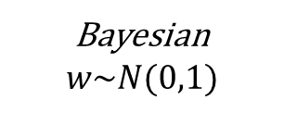
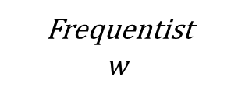
1. Introduction - Bayesian Theory
How can we use Bayes’ Theorem into Neural Networks?
->place a distribution over model parameter
Frequentist
$$w$$
Bayesian
$$w\sim N(0,1)$$
w
Distribution of w

Slide 7
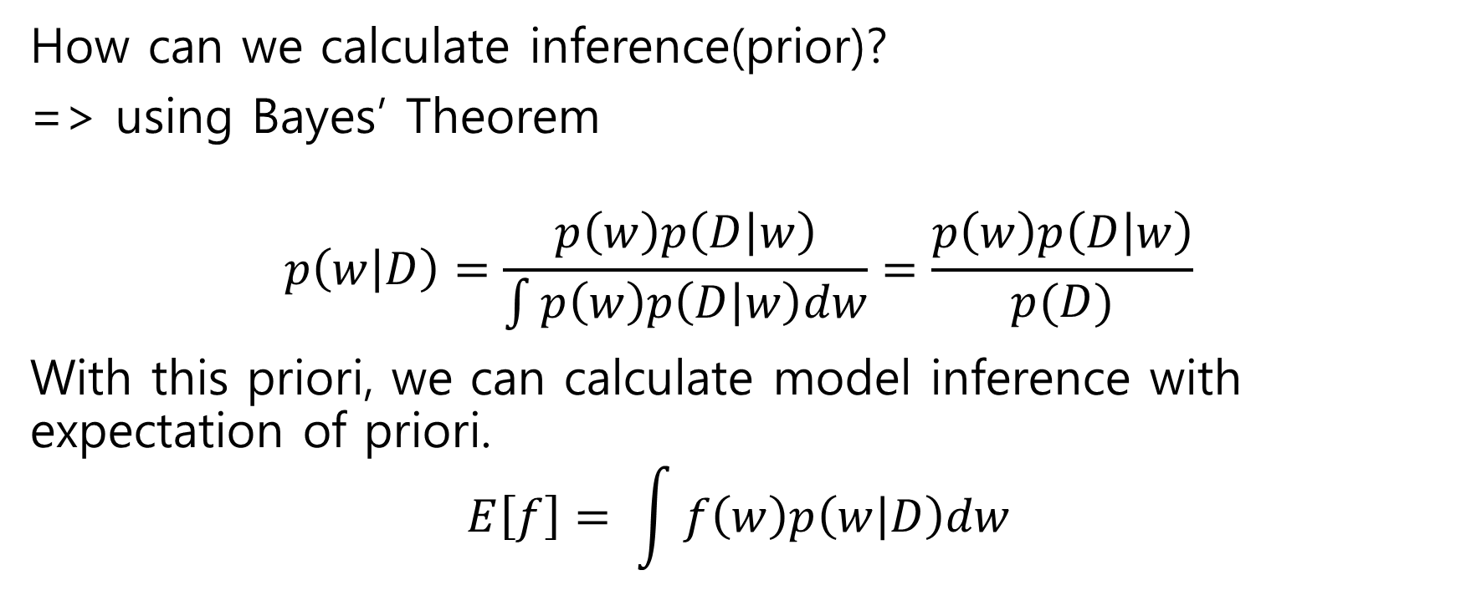
1. Introduction - Bayesian Theory
How can we calculate inference(prior)?
=> using Bayes’ Theorem
$$p\left(w | D\right)=\frac{p\left(w\right)p\left(D | w\right)}{\int{p\left(w\right)p\left(D | w\right)dw}}=\frac{p\left(w\right)p\left(D | w\right)}{p(D)}$$
With this priori, we can calculate model inference with expectation of priori.
$$E\left[f\right]= \int{f\left(w\right)p\left(w | D\right)dw}$$

Slide 8
1. Introduction - Bayesian Theory
Pros and Cons of Bayesian NN?
Pros : high capacity model, can handle uncertainty
Cons : tradeoff on model accuracy, computational burden
Calculating evidence P(d) is hard, so approximate
Using Laplacian Approximation, KL divergence (Variational Inference)

Slide 9
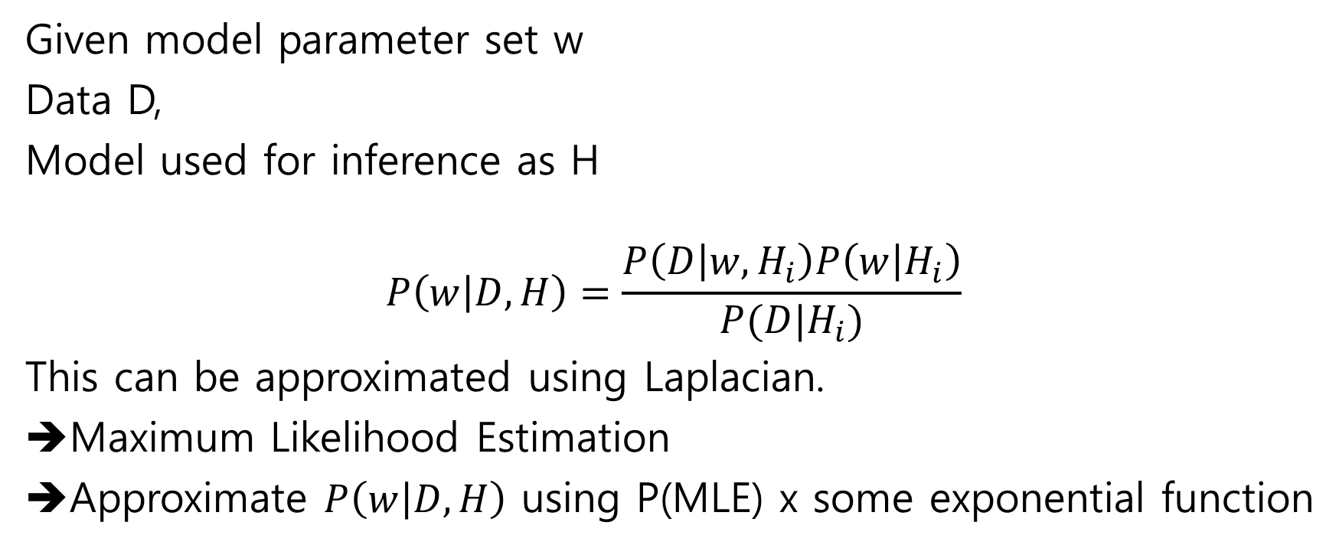
1. Introduction - laplacian approximation
Given model parameter set w
Data D,
Model used for inference as H
$$P\left(w | D,H\right)=\frac{P\left(D | w,H_{i}\right)P\left(w | H_{i}\right)}{P(D|H_{i})}$$
This can be approximated using Laplacian.
Maximum Likelihood Estimation
Approximate $P\left(w | D,H\right)$ using P(MLE) x some exponential function

Slide 10

1. Introduction - Variational Inference
Rather than approximation, make it as optimization problem
Parameterize posterior distribution with $θ$
Minimize KL divergence between posterior and prior

